Slide 1
Living With & Beyond Cancer: SWAG Breast SSG Update
1st March 2019

Slide 2
SWAG LWBC Cancer Transformation Project
In Dec 2017 SWAG CA awarded £2.7m over 2 years for LWBC to support roll out of the Recovery Package and Stratified Follow-Up Pathways
Principle cancer sites = breast, colorectal & prostate
Investment in cancer support worker & AHP workforce, psychological skills training, primary care and project support including evaluation

Slide 3
SWAG LWBC Metrics
Recovery Package component | Year 1 metric | Year 2 metric
HNA (within 31 days of diagnosis) | 40% | 80%
HNA (within 6-12 weeks following end of treatment) | 50% | 95%
Treatment Summary | 40% | 80%
Health & Wellbeing Support | 50% | 75%

Slide 4
Breast Stratified Pathway National Requirements
2018/19 deliverables – drawn from ‘Next Steps on the NHS Five Year Forward View’
100% implementation of clinical protocols and a system for remote monitoring to support stratification of breast cancer patients across the Alliance geography by March 2019

Slide 5
Risk Stratified Pathways
Year 1 | Year 2
By the end of Year 1 all Breast Patients will be on a Risk Stratified Pathway | By the end of Year 2 all Breast, Colorectal and Prostate patients will be on a Risk Stratified Pathway
By the end of Year 1 25% of new breast patients will be on a supported self-management pathway | By the end of Year 2 this will increase to 50% of new breast, colorectal and prostate patients supported on a self-management pathway

Slide 6
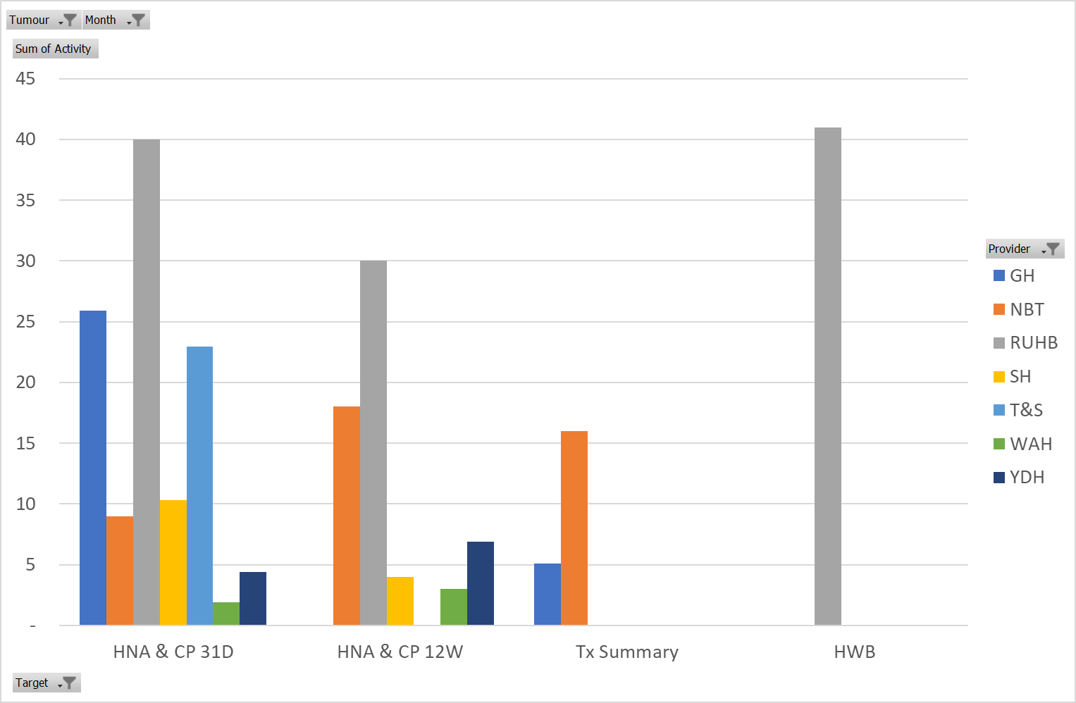
Breast progress against metrics Oct 18
Notes:
Quarterly assurance reporting to NHS E regional team re progress against agreed trajectories and spend

Slide 7
Breast Cancer RSP as per SWAG Policy

Slide 8
Breast RSP progress
SWAG Breast teams largely achieving compliance against the SSG agreed Breast pathway
Treatment summary and ability to safely and robustly deliver remote surveillance are the main issues
However, all Trusts have plans in place to achieve compliance by April 19

Slide 9
Benefits
Positive impact of the cancer support worker role – for patients and MDT
Patients offered more consistent support across the Alliance
Increase in Recovery Package delivery especially HNA and Treatment Summary
Consistent and robust approach to breast risk stratification/ remote surveillance

Slide 10
Challenges
Data collection issues
Impact of training and supporting cancer support workers
Changing culture – new approach for some teams to deliver the Recovery Package & RSP
Short term funding – risk for staff attrition rates
Future commissioning

Slide 11
Personalised care for all patients and transform follow-up care (Jan 2019)
3.64. By 2021, where appropriate every person diagnosed with cancer will have access to personalised care, including needs assessment, a care plan and health and wellbeing information and support. This will be delivered in line with the NHS Comprehensive Model for Personalised Care. This will empower people to manage their care and the impact of their cancer, and maximise the potential of digital and community-based support. Over the next three years every patient with cancer will get a full assessment of their needs, an individual care plan and information and support for their wider health and wellbeing. All patients, including those with secondary cancers, will have access to the right expertise and support, including a Clinical Nurse Specialist or other support worker.
3.65. After treatment, patients will move to a follow-up pathway that suits their needs, and ensures they can get rapid access to clinical support where they are worried that their cancer may have recurred. This stratified follow-up approach will be established in all trusts for breast cancer in 2019, for prostate and colorectal cancers in 2020 and for other cancers where clinically appropriate by 2023. From 2019, we will begin to introduce an innovative quality of life metric – the first on this scale in the world – to track and respond to the long-term impact of cancer.
Notes:
Now referred to as personalised care and support and not Recovery Package

Slide 12
How are we going to achieve this?
Evaluation is a key part of the programme
Louise Worswick is now in post and has established an evaluation steering group who met for the first time 15th October 2018. Membership includes all LWBC project managers, a commissioner, Lead Nurse, Lead LWBC GP, core Alliance team, psychology and 5 patient representatives supported by our PPE Lead Katy.
Evaluation timeframe – draft report of the evaluation to be submitted Oct 2019; final report submitted early 2020 for commissioning consideration
For more information please contact louise.worswick1@nhs.net

Slide 13
Questions
If you have further queries please contact:
Catherine Neck, Macmillan Cancer Rehabilitation/ LWBC Lead
Catherine.neck@nbt.nhs.uk
OR
Patricia McLarnon, SWAG Alliance Programme Manager
Patricia.mclarnon@nhs.net

