Slide 1
National data in surgery: LCCOP 2018(2016)
Doug West Audit Committee Chair, Society for Cardiothoracic Surgery

Slide 2
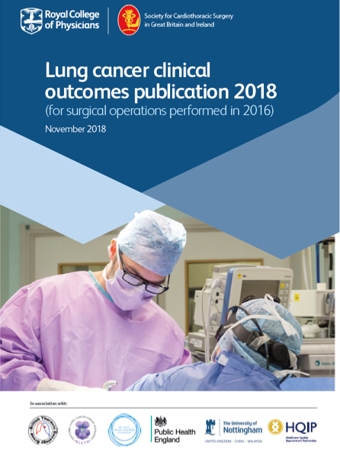

lung cancer
England 2016

Slide 3
Metrics 2018
30 day survival*
90 day survival*
365 day survival*
Median length of stay
Resection rate
90 day all cause all site NHS readmission
Unit and individual surgeon volume
lung cancer
England 2016

Slide 4
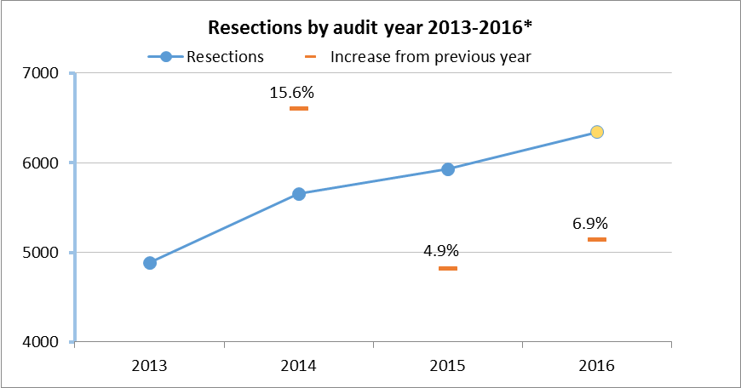
Rising activity

Slide 5
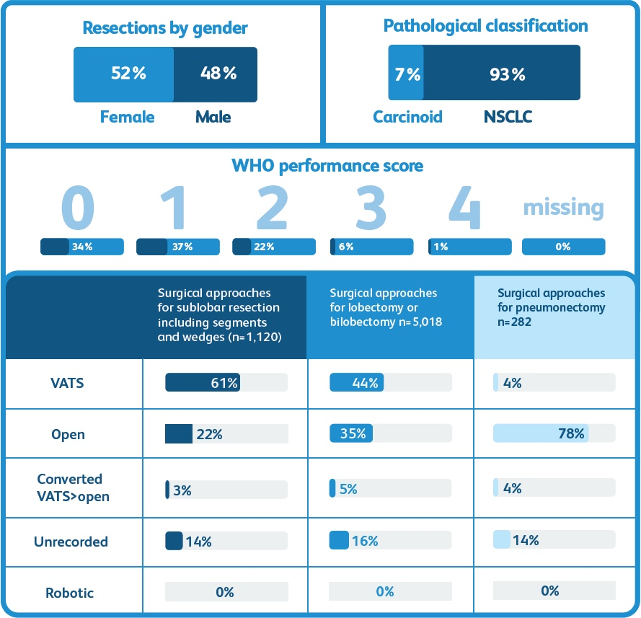

Slide 6
Pneumonectomy and survival

Slide 7
lung cancer
England 2016

Slide 8
lung cancer
England 2016

Slide 9
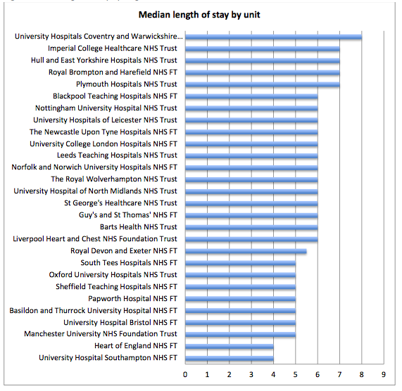

Slide 10
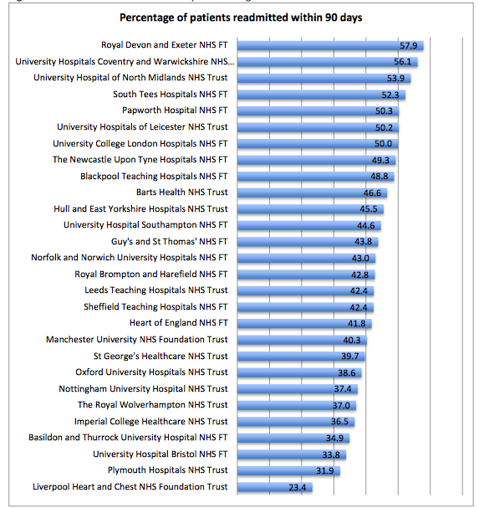

Slide 11
Unadjusted correlation: median LOS and 90 day all cause readmission (HES)
Corr coeff 0.0069

Slide 12
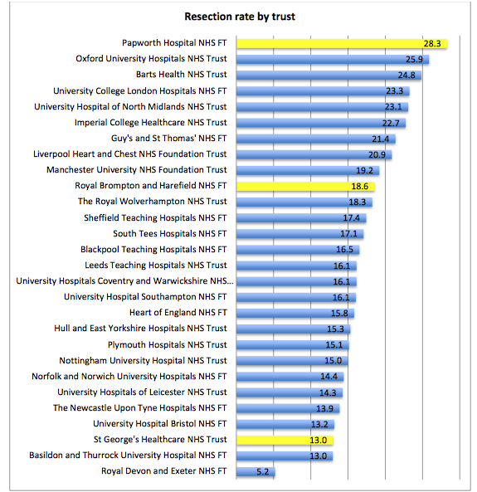

Slide 13
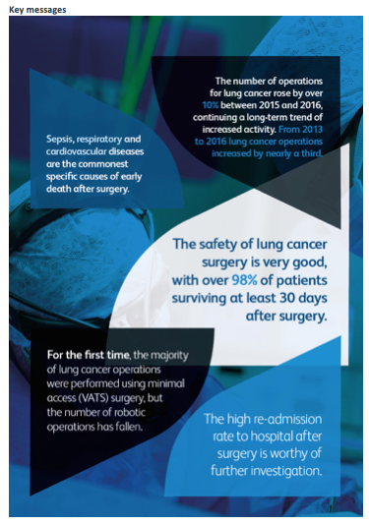
lung cancer
England 2016

