Slide 1
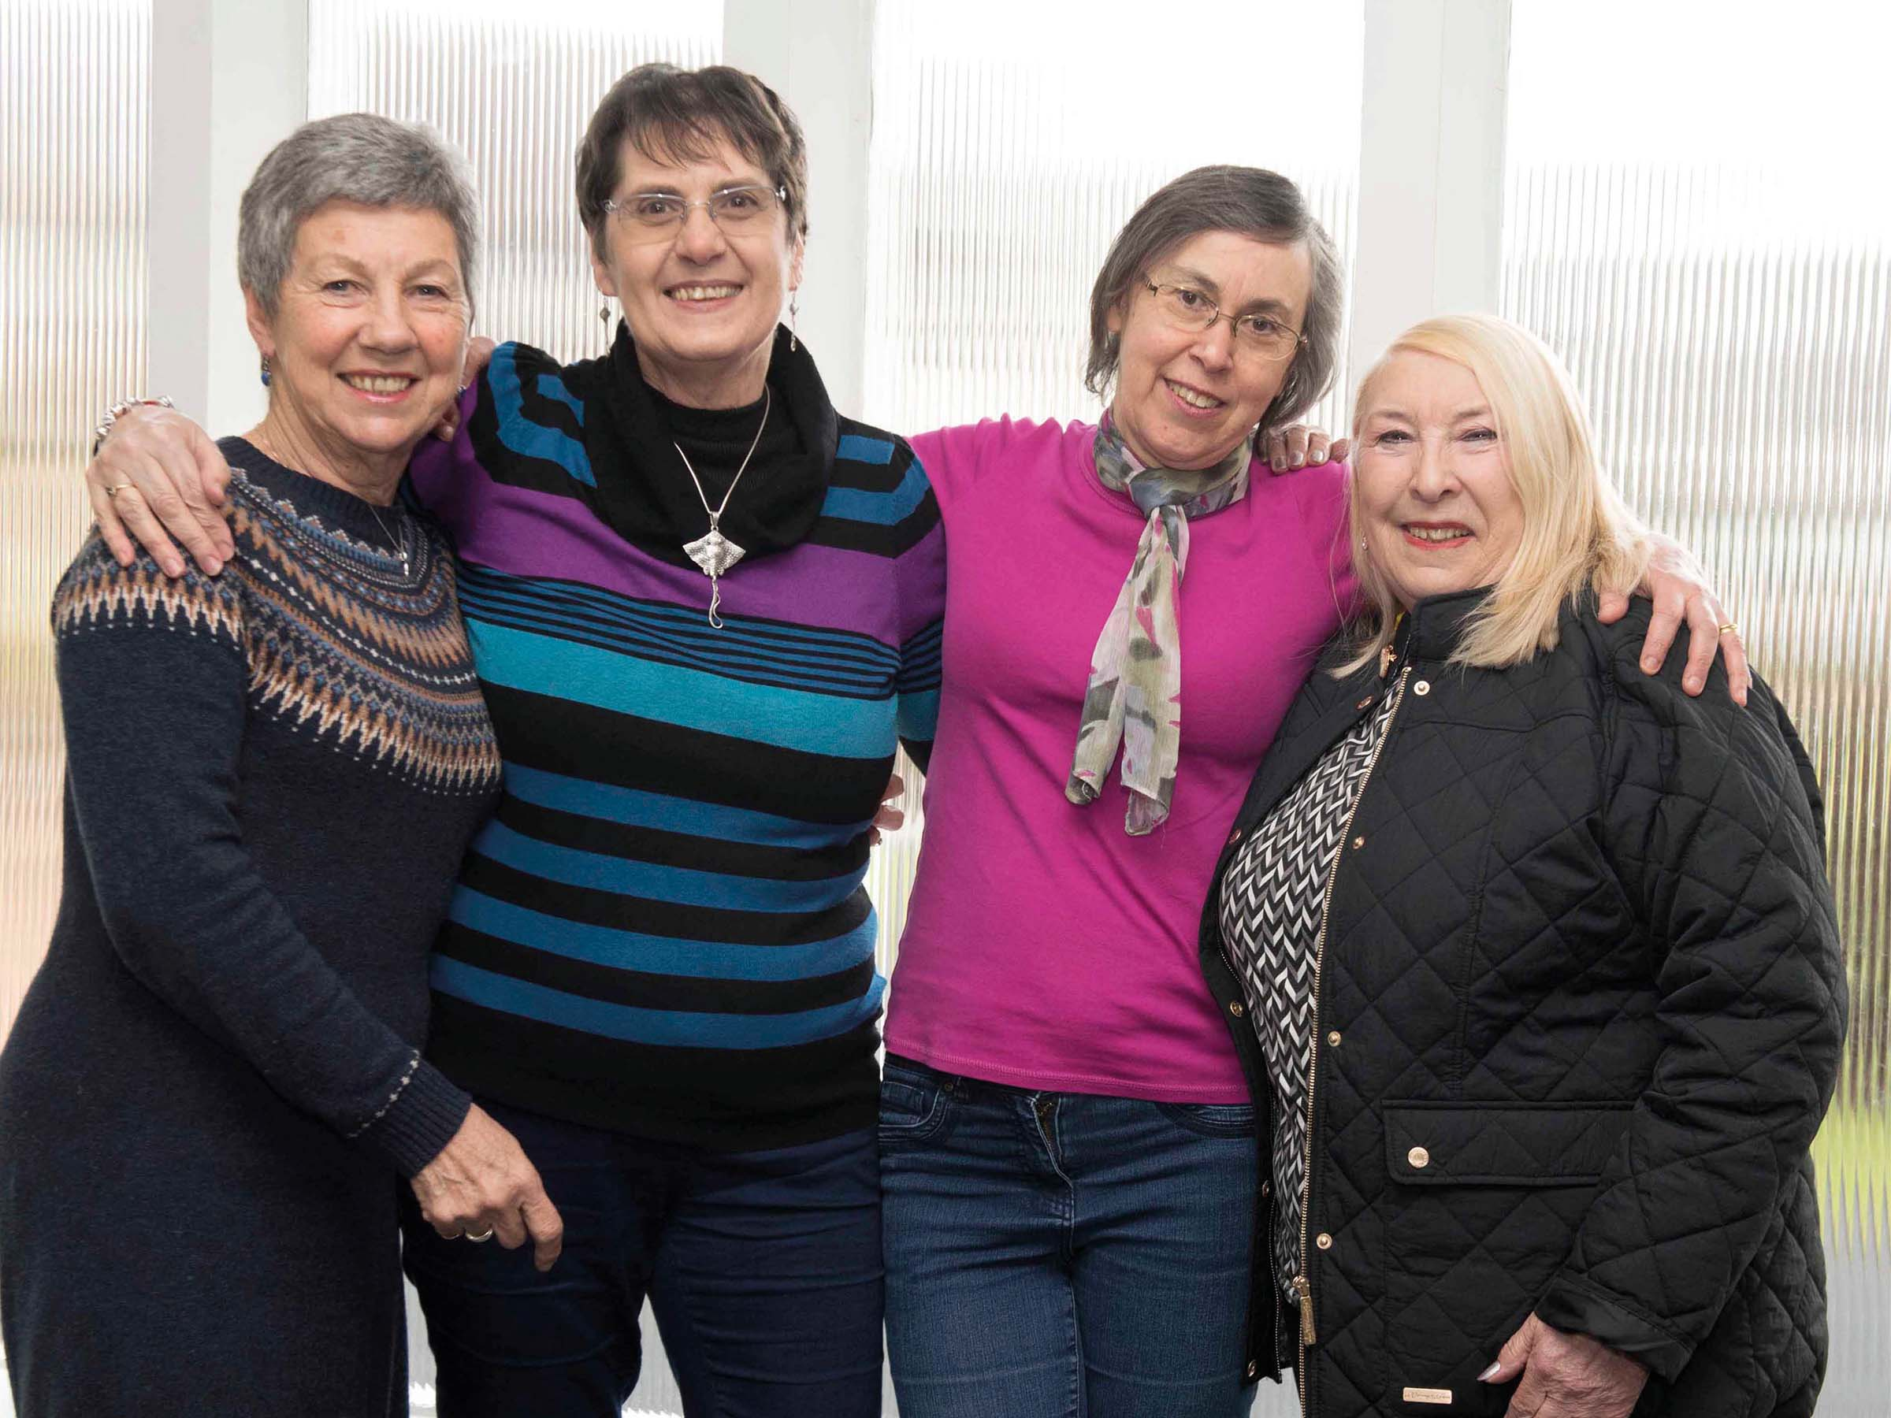

Introducing Lymphoma Action
Sarah Thorn
Community and Partnerships Manager
www.lymphoma-action.org.uk
Notes:
Firstly, thank you very much for having me here today. I know you are all more busy than any human should be, so I really value your time and attention.
I would like to introduce Lymphoma Action– who we are, what we do and why we do it.
Some of you will have known us for years, use our patient information, attend our professional education and training events, etc. but Lymphoma Action might be new to some of you. And, for haematology nurses, you’re covering all the blood cancers and may not have the capacity to be familiar with all the blood cancer charities. The charity has also been through a lot of change in the last year, so this might be an update for those with a long-standing association. I’m also very happy to take your questions and feedback on any aspect of Lymphoma Action’s work.
Just to introduce myself, I’m the Community and Partnerships Manager.
So, introducing Lymphoma Action…. Obviously, patient organisations and charities are needed and do useful work across all disease types. However, we find that people affected by lymphoma experience it a very confusing and complex disease to understand and come to terms with, for several reasons, and this is where I’d like to start, with the need for Lymphoma Action and what we see as our mission.

Slide 2
About lymphoma
Lymphoma is the fifth most common cancer in the UK
There are more than 19,500 new cases diagnosed each year in the UK
Every 27 minutes someone is diagnosed with lymphoma
Around 125,000 people are currently living with the disease
It is the most common cancer among young people aged 15-24
There are over 60 different forms – or subtypes – of lymphoma, each with different treatment options and prognoses
Symptoms include painless lumps, often in the neck, armpit or groin, night sweats, unexplained weight loss, itching, and fatigue
Notes:
I know that you will be familiar with these stats but I thought I’d start with them because they are the reason Lymphoma Action exists. This is the information we use in our presentations, both to people who are affected by lymphoma and when raising awareness among the general public. We always ask at awareness events ‘Who has heard of lymphoma?’ and the answer is usually some but not many – people are invariably surprised to hear that this is the 5th most common cancer in the UK. Therefore, when people are diagnosed, many, many of them tell us that this was the first time they’d heard of lymphoma. They don’t know anything about it and quite a lot don’t know that it is a cancer, including, sometimes, people with a diagnosis.
Not only that but all the things they think they know about cancer from the media or health campaigns – you’ll find a lump, go to your GP, be diagnosed immediately and within days be in hospital having surgery or chemo - often aren’t much help in understanding lymphoma because many of those messages relate to solid tumour cancers.
This makes providing relevant, accurate information about lymphoma essential for those who are directly affected - and for those who might be - and is the starting point for Lymphoma Action’s work. However, that’s not the only difficulty is getting the message about lymphoma across.

Slide 3
Notes:
Lack of awareness of the symptoms, for a start! This is our symptoms poster, which also comes as a postcard that we give out to members of the public at every opportunity.
We hear, as I assume, you hear, that patients may have had symptoms for a long time before going to their GP. They may have a lump but often assume that it’s a ‘swollen gland’ due to an infection, so it’s only when the lump keeps getting bigger or doesn’t go down, that they go their GP, which could be months later.
Of course, they may not have a lump that can be noticed externally. People who have one or more of the B symptoms don’t usually know that they are symptoms of lymphoma or even cancer, and they certainly don’t put them together and add them up to possible lymphoma. Sometimes this lack of awareness and connection of the symptoms means that people don’t necessarily mention all of their symptoms to the GP when they do go. So, raising awareness of the symptoms among the general population becomes a key priority for Lymphoma Action.
But then, of course, they may be completely asymptomatic and only find out they have lymphoma from tests carried out for some other reason.
Awareness is also a key priority for us in our work with GPs because we know that lymphoma is often very difficult to diagnose anyway but we hear a lot of personal stories in which people have struggled, sometimes literally for years, to get their GP to take their symptoms seriously or to include lymphoma in their differential or to refer for diagnostic tests. Quite a high number of people are diagnosed in A&E. And that is why we’ve partnered with the Royal College of GPs to produce an online training module on spotting signs and symptoms of lymphoma, in the hope of improving diagnosis.

Slide 4
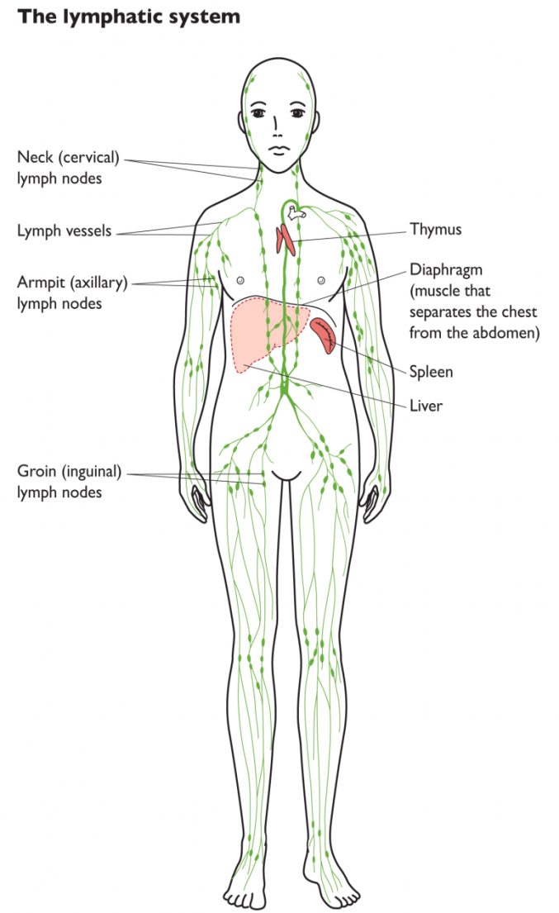
What is lymphoma?
Where is the lymphatic system?
What does the spleen do?
And other questions you never expected to ask…
Notes:
Of course another barrier to awareness and understanding of lymphoma is that most people don’t know where or what the lymphatic system is. A lot of people have heard of the spleen but how many know where it is? And I don’t suppose even 5% know what it does or that it is part of the lymphatic system or the immune system. So, we are dealing with an enigma wrapped in a mystery, which makes explaining lymphoma more difficult both in terms of awareness in the general population and for people who have been diagnosed.
It also doesn’t help that the word ‘cancer’ isn’t in the name of the disease. Normally, in lay terms, people talk about ‘breast cancer’, or ‘lung cancer’. But ‘lymphatic cancer’ is not a term used by the medical profession, so it isn’t one that we use now, either.
Finally, because lymphoma consists of a complex group of about 60 ‘sub-types’ - which have different courses, treatments and outcomes, with increasingly personalised approaches – it is very hard to explain to those affected in a simple way.
So, those are the issues that drive the particular need for Lymphoma Action and the priorities for our work.

Slide 5
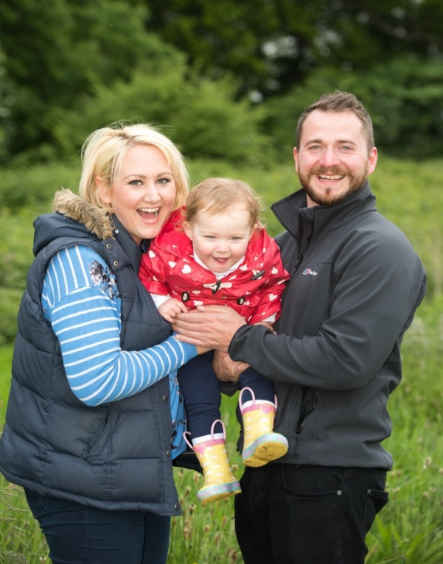
Lymphoma Action
The UK’s only charity dedicated to lymphoma
Providing in-depth information and wide-ranging
support for over 30 years
Supporting people diagnosed with lymphoma, their loved ones, carers, and the health professionals who work with them
Small and friendly – a staff team of around 30
Volunteer-involving organisation, providing peer support and service-user involvement for people affected by lymphoma
Funded almost entirely by charitable donations and grants from charitable trusts and foundations
Notes:
Although there are charities that cover the whole range of blood cancers, as well as some that cover individual types, such as Myeloma UK and Leukaemia Care, and others that cater for particular sub-types, such as CLL or Waldenstrom’s, Lymphoma Action is the only UK charity dedicated solely to lymphoma and to every sub-type.
The charity was founded in 1983 as the ‘Hodgkin’s Disease Association’ by two former patients, Lewis Cash and Richard Franklin, with support of Dr Tony Jelliffe, and has developed steadily over the last 35 years, with the telephone helpline starting in 1986, the first information for patients produced in 1988 and the website launched 10 years later.
We’ve undergone several changes of name in that time, the most recent in April this year, when we changed from the Lymphoma Association to Lymphoma Action, with a new logo, colour scheme and look, though we retained the periwinkle flower, which has been our emblem since 1988. Among the many new things we have this year is a new Chief Executive, Ropinder Gill, to lead us into the next phase of our development.
Lymphoma Action provides information and support to anyone affected by lymphoma, whether they have a diagnosis themselves or are the partner, family member or friend of someone with a diagnosis, who also need information and support, both to help the person they are caring for and for themselves. The only caveat is that we don’t currently provide direct support to children, because of the specialist nature of their needs. However, we do support young adults and the parents and adult family members of children with a lymphoma diagnosis and adults dealing with a diagnosis who need to talk with children about it. And, we have information that is specifically aimed at children with lymphoma and at children with a family member who has lymphoma.
The nature of lymphoma, particularly the indolent non-Hodgkin types, which people live with for long periods, as well as the risk of transformation, different treatments in second or third lines, and the long-term and late effects of treatment, mean that the need for support can extend to decades, with evolving information needs, from the time when someone might be trying to get a diagnosis, through treatment, post-treatment issues, relapse, clinical trials, to end-of-life issues, as well as time on active monitoring programmes – ‘watch and wait ’.
We are grateful for our long-standing relationships with leading consultants and nurse specialists in lymphoma and allied disciplines, who give up their time to speak at our conferences and review our publications. Currently over 30 leading consultants and professors are members of our Medical Advisory Panel, which was formed in 1989 to advise on all aspects of our patient information and education & training, and members of our Nurse Forum also contribute substantially to our information and support.
We are a small charity, having grown to about 30 staff in as many years, though that number includes some part-time colleagues.
Our services are delivered partly by volunteers, frequently people with personal experience of lymphoma, who are able to provide peer-led support that is appreciated by service users. Volunteering is something we want to do better and offer more of, so this year we appointed to a new role, Volunteering Development Manager, to take the charity forward as a modern volunteer-involving organisation, with improved processes for recruitment, training and supervision of volunteers.
We are a registered charity and rely on donations and fundraising by our dedicated supporters, as well as on grants from trusts and foundations and sponsorship from some of the pharmaceutical companies that produce treatments for lymphomas, including Takeda. You can see our statement of ethics around that on our website. We get no NHS or government funding. We strive to keep our overheads low, with 73p in every pound raised going on frontline services, which is at the high end of the scale across the charitable sector.
As well as a new logo this year, we also have a new strapline, Inform | Support | Connect, which we think describes the three key things we do. Let’s have a look at each of those..

Slide 6
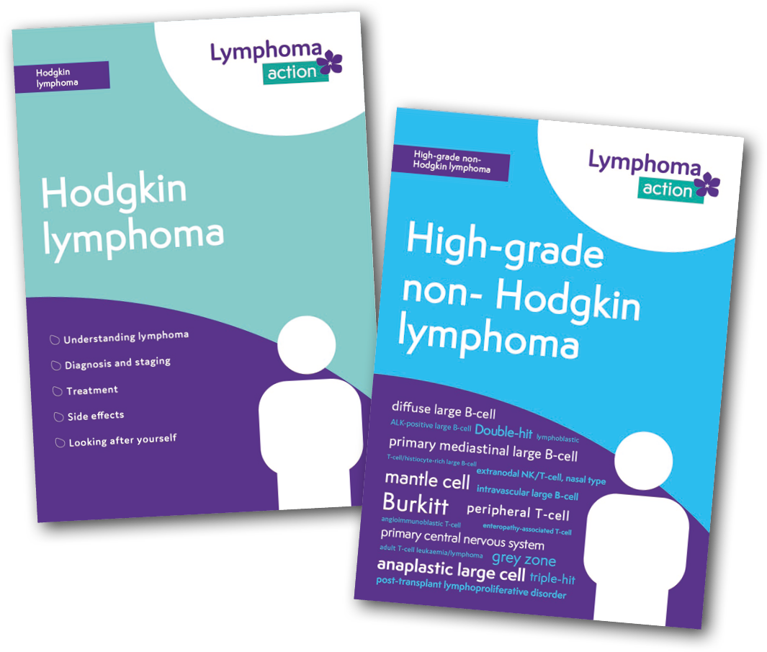
We Inform
Our award-winning, free books and information are endorsed by clinical colleagues and regularly reviewed under the Information Standard
Information on a wide range of topics from diagnosis, treatment and living with lymphoma
Easy online availability or order copies via website Shop, phone or post
Visit our YouTube channel to watch interviews with lymphoma experts and personal experience of people who are affected
Notes:
Lymphoma Action is probably best known for our free patient information - currently 11 books and around 120 information items, all of which can be ordered for delivery or can be read, downloaded and printed from our website for free – and we’ll be having a look at that in my second presentation.
Our aim is always to provide accurate, reliable, clear and up-to- date information, and to that end, Lymphoma Action is an accredited member of The Information Standard, a independent quality assurance scheme, supported by the Department for Health. All our information conforms to nationally recognised standards, including using the DISCERN tool for information about treatments, the NHS Toolkit for producing patient information and the Campaign for Plain English Guidelines. It is written by experienced medical writers, in collaboration with our medical advisers who have the appropriate expertise, and drafts are reviewed by other healthcare professionals and service users who form our volunteer Reader Panel, to ensure that they are clear and accessible to the lay audience and cover the issues of importance to service users. Several of our publications have won awards, such as BMA Patient Information Awards.
The books you can see on screen are in the new branding style. We’ve been re-branding them as we’ve run out of stock, to save resources. Most of these have not been revised for content as part of the re-brand and you can continue to give out the old branded copies, provided they are in date – check this in the back cover, which notes the date that edition was produced and when it is due for revision under The Information Standard.
I’m always willing to come down and have a rummage through your cupboards and help you re-stock with current editions and take away the old ones! And I’ve brought a copy of the current full Publications List for everyone. I know a couple of people weren’t able to make it today, so if anyone will be seeing them, please do take one – and anything else that may be of interest - for them, and if they want to drop me an email, I’d be happy to have a chat with them. We are also hoping to get funding to provide every specialist nurse with a library copy of the new books on Active monitoring and CLL.
The content of our new books and editions have a different look from previous versions, which were quite text-heavy and were experienced as quite a tough read by many service users (Clinical trials). This was inspired by the enthusiastic welcome for our Young Person’s Guide to Lymphoma, which has a very different look and feel and the reaction of both service users and nurses to All about lymphoma, an easyread publication produced in partnership with Scope, for people with learning disabilities and difficulties. Many patients told us they wished they had had a booklet with lots of pictures when they were first diagnosed and trying to take in information about their illness and treatment. And we also had some CNSs who said ‘Actually, I give new patients this book because they can easily absorb the information’.
However, sometimes, however well designed, the written word is too much, especially when someone is fatigued, has chemo-brain or is finding concentration difficult in emotional turmoil. And it doesn’t adequately convey the experience of having lymphoma, so we have an increasing number of videos, which are embedded in information items on the website or can be viewed on our YouTube channel. These cover personal experience of having lymphoma, healthcare professionals explaining different aspects of lymphoma and treatments, and presentations from our conferences, for those who couldn’t be there, as well as those who would like another chance to listen.

Slide 7
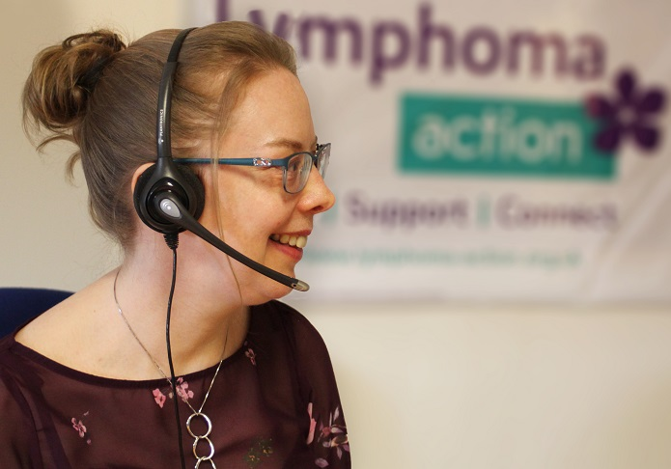
We Support
Our friendly and knowledgeable Information & Support team offer a listening ear
Helpline Monday-Friday 10am to 3pm
Phone, email, and online live chat
Freephone 0808 808 5555
information@lymphoma-action.org.uk
Webchat www.lymphoma-action.org.uk
We offer a busy programme of events
Regional and national events – hear from leading consultants, nurses and researchers and people affected by lymphoma
Live your Life workshops and conferences – for those coming to the end of treatment or on active monitoring (‘watch and wait’)
Notes:
The helpline has been running since 1986 and has held the Telephone Helplines Association (THA) Quality Standard since 2007. It deals with thousands of enquiries each year via the Freephone number, email and live chat through the website, to provide for different levels of access, choice and preference.
This is Sharon, one of our helpline staff, who provide active listening and respond to information needs and can signpost to other of our support services and events, as well as to other organisations for specialist support or information. They have both wide and deep knowledge of lymphoma, treatments and issues around living with lymphoma, as well as of our information - from symptom awareness through diagnosis, treatment and beyond – so they can help people find the right information for their sub-type, treatment and issues.
I should mention at this point that people can only get that sub-type specific information if they know their sub-type and a lot of people still don’t! Even when they have been told, they often don’t remember or can’t pronounce the name. So, we produce these wallet-size cards (What’s my type?) on which patients can ask their medical team to write their sub-type, to help them access the right information and support for them.
Helpline staff can provide details of local support groups and facilitate applications for the Buddy service, which are important forms of peer support.
A new aspect of our support is the Live Your Life survivorship workshops and conferences, which are aimed at people who commonly experience isolation and a dip in emotional health after treatment, which is the common time for reflection and seeking understanding of the ‘new normal’ just as the intense focus on them and the routine of hospital appointments tails off, or after being put on an active monitoring programme, when they go through a cycle of anxiety and relief, as each set of tests comes up, often for years, while trying to get their heads around having cancer but not getting any treatment and dealing with the reactions of others to this situation. We involve local CNSs - and psychologists and counsellors if these are available at the local hospital – and include identifying when you need to contact your CNS, to try to overcome the sense a lot of people – particularly older people – that they don’t want to bother their CNS but also to support a reduction in unnecessary contact with the CNS due more to anxiety and lack of understanding. We know that there is a change to the way lymphoma patients are discharged – and capacity is an issue because of the length of survival – so these workshops are intended to be part of the recovery pathway.
The workshops are for up to 20 attendees, with carers also welcome, and are run as more intimate, participatory days, while the conferences are for about 50 and include more talks by healthcare professionals and opportunities to network.

Slide 8
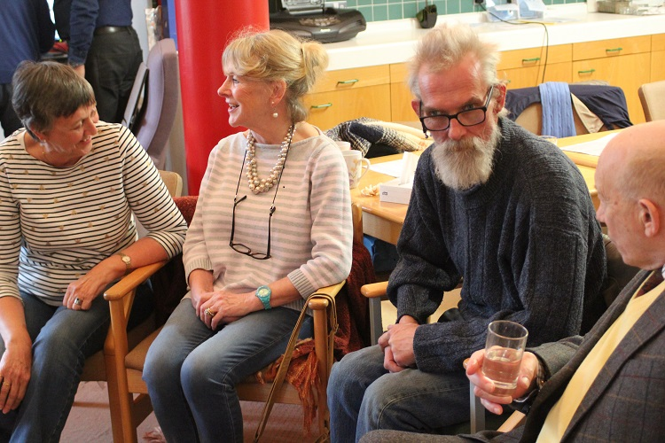
We Connect
We know that sharing concerns, feelings, and experiences can make a real difference – so we make it easy to connect with others
Online community forums, Lymphoma Action Facebook page, and closed regional Facebook groups
50 regional support groups run by staff and volunteers
Our buddies are trained volunteers matched to lymphoma subtype or experience
‘However supportive your friends and family are, sometimes it is a comfort to be able to talk to someone you do not know.’ Kay
Notes:
We put on a range of national and regional events and conferences where people can meet others affected by lymphoma and hear directly from leading healthcare professionals, ask questions and share experiences.
We have around 50 support groups around the UK, and this is increasing all the time. They are run by a mixture of staff and volunteers, and are safe, confidential spaces where anyone affected by lymphoma can share experiences and get mutual support. In this region, I’m planning to launch several new support groups next year, with a focus on Kent, where we have had only the group in Canterbury for some years, since the Ashford group closed and I would really value your input in planning these. We are moving away from having support groups located on hospital sites as many service users tell us that this type of venue can bring back difficult feelings and memories. Hospitals are also increasingly difficult to get to as they move to out-of-town sites, are expensive to park in and are usually only available during the day, when those at work and in education can’t access them. So, all our new support groups will be in community venues.
Our trained volunteer Buddies have personal experience of lymphoma and provide phone or email support to people who have the same type of lymphoma or treatment.

Slide 9
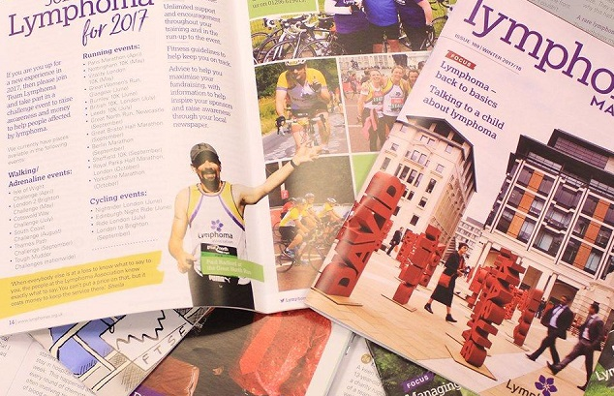
#LymphomaMatters
Stay up-to-date with developments in lymphoma and at Lymphoma Action
www.lymphoma-action.org.uk - new and improved website, with easier navigation to information, Lymphoma TrialsLink, events, support and online forums
Sign up to receive updates - about lymphoma, our work, events and fundraising
Lymphoma Matters magazine - three editions a year, covering personal stories, latest lymphoma news, expert opinion and our work
Notes:
I know some of you are signed up to receive information from us, including Lymphoma Matters magazine and invitations to conferences and training events.
For those who aren’t, please complete a registration form..

Slide 10
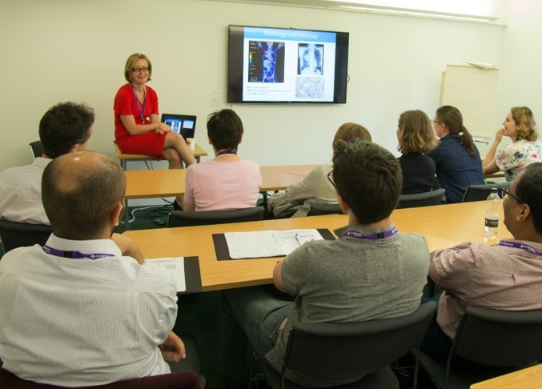
Working with healthcare professionals
We work closely with healthcare professionals to help people affected by
lymphoma get the best treatment and care
Specialist education and training events with expert speakers, the latest updates and developments in lymphoma, networking, and CPD hours
Award-winning patient information,, free to order
Nurse Forum supporting and encouraging best practice and raising awareness of lymphoma
Online GP training module
Expert reviewers for webpages and books
Notes:
We work closely with a number of professional bodies and individual healthcare professionals to put on a range of conferences, masterclasses and forums for medics and nurses..
We welcome nurses to join our Nurse Forum and Health Professionals to join our Medical Advisory Panel and become expert reviewers of our publications and webpages. Do let me know if you are interested and I will put you in touch with our Volunteer Manager

Slide 11
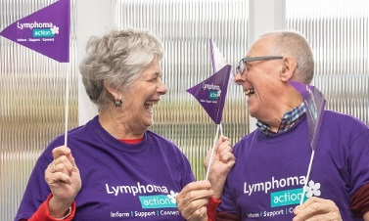
Raising awareness #LymphomaAware
Working to raise awareness of the signs and symptoms of lymphoma, as well as what it’s like to live with a lymphoma diagnosis
Blood Cancer Awareness Month each September – our flagship annual campaign that helps raise awareness of lymphoma
We produce reports, respond to NHS and NICE consultations, giving people affected by lymphoma a voice in the development of the services and treatments they use
Our logo features the periwinkle flower, a derivative of which was used in a lymphoma drug
Notes:
During Awareness Month, we encourage hospitals to have a Lymphoma Action awareness stand in the main entrance and/or an information stand in the department on a lymphoma clinic day. Just get in touch if you like to do this and I can arrange for materials to be sent and sometimes, a volunteer Ambassador or SGO to staff it.
One of the key things we do is provide a voice for people affected by lymphoma by responding to consultations on cancer services, making sure that the particular needs of people with lymphoma are properly included, and on NICE’s draft recommendations on treatments. We do this by giving people opportunities to take part in consultations and feed into our responses.

Slide 12
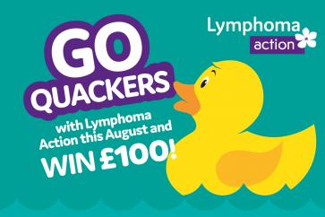

Awareness and Fundraising
Our support and services are almost entirely reliant on the
generous donations and fundraising of our wonderful supporters
Duck Race
Blood Cancer Awareness Month
Put up one of our special posters anywhere you can
Get involved in 27 in 27
Run an awareness stall in a local hospital or shopping centre

Slide 13
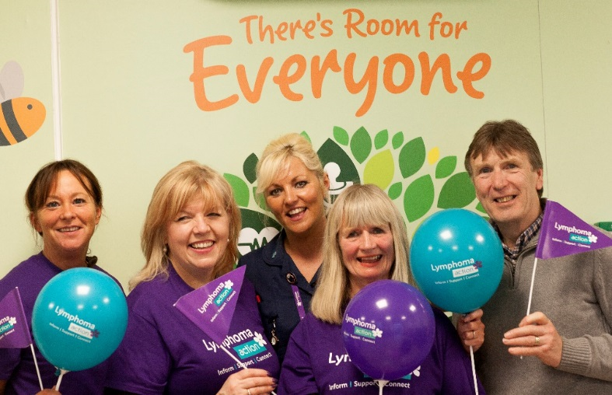
Thank you for listening
Notes:
Any questions?

