Slide 1
Implementing a timed oesophago-gastric pathway
Mr Dip Mukherjee OG Surgeon
National cancer vanguard pathway development member
Pathway director NCELA

Slide 2
WHY ?

Slide 3
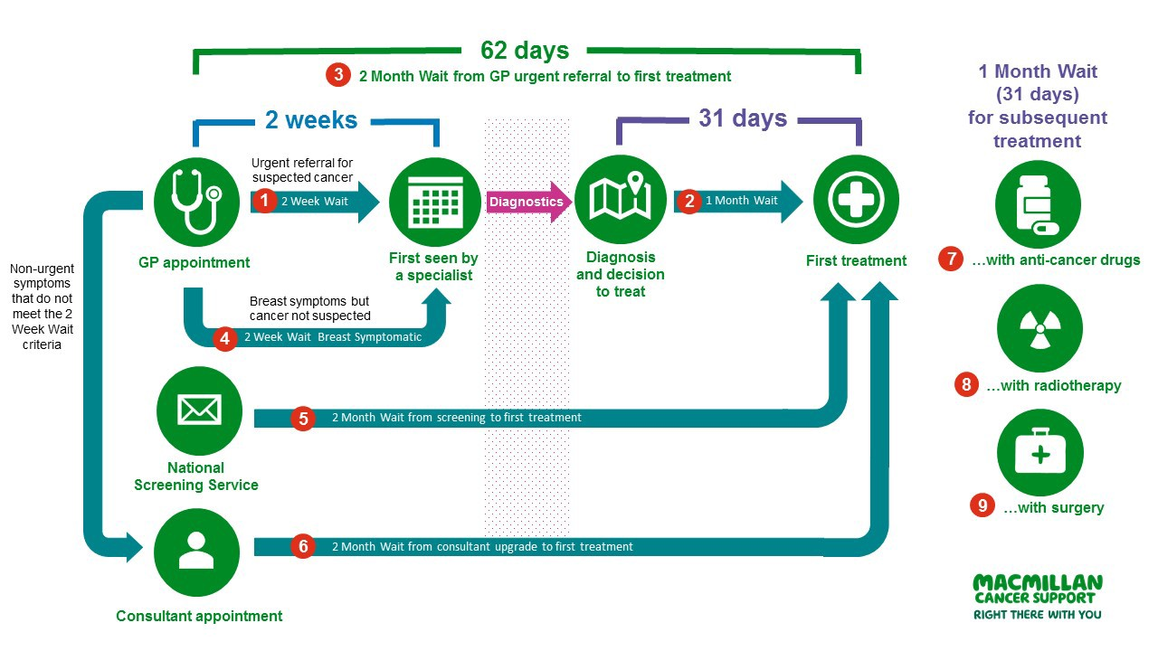
The old world

Slide 4
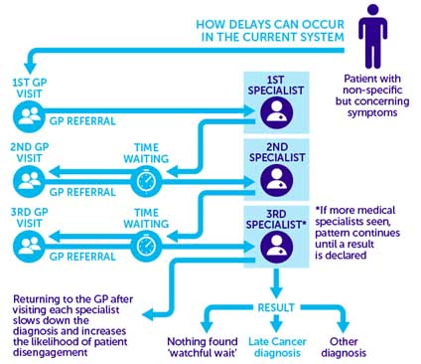
The old world

Slide 5
What ?

Slide 6
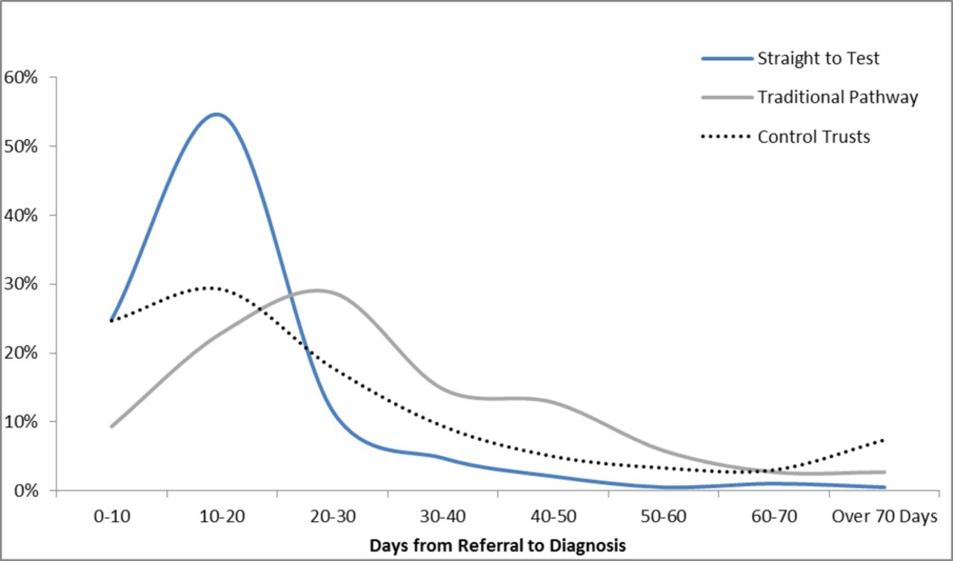

Slide 8
62 day Rule Rules
28 Day FDS
OG Timed pathway
All cancers
April 2020
Whole system
Diagnostic only
All providers
Patient communication is the endpoint at 28 days
OG cancer only
April 2020
OG cancer only
Diagnostic specialist staging and treatment
Diagnostic and specialist MDTs
Endpoint in 42 days similar to 52 days

Slide 10
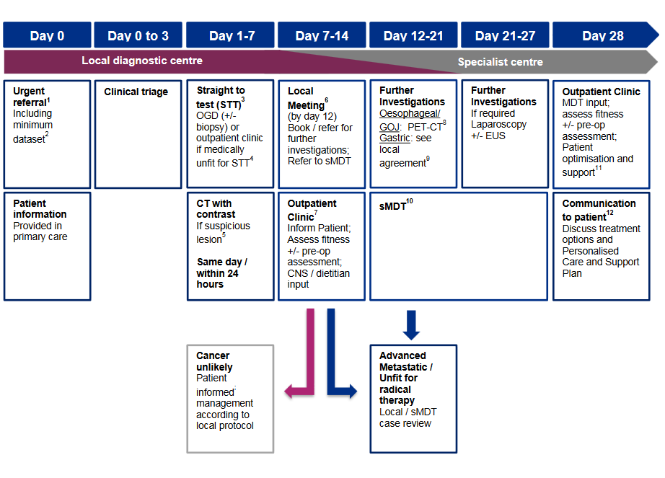
National Timed Pathway

Slide 11
How?

Slide 12
Outline
Form a small coalition
Measure the current state of play
Rapid improvement by marginal gains
Influence rather than line manage
Recognise differences
Encourage innovation: Process, Resource & Workforce
Project management approach crucial

Slide 13
The process
Soft conversations through existing fora
Gap analysis
Engagement event and workshop to develop solutions
Implementation group and an alliance level project
Executive sign off of plans: COO / Trust CEO/Alliance board STP
Shared learning during delivery
service development
innovation
workforce

Slide 14
Aims of the project
Improve the streamlining of the transfer between local units and specialist centres.
Improve patient experience on the diagnostic pathway.
Improve outcomes for patients with OG cancer.
Reduce variation in OG services and outcomes across the NCEL network.
Prepare systems for the introduction of the FDS.

Slide 15
Role of the Cancer Alliance
To provide clinical leadership and project management support.
Facilitate cross-trust working, sharing best practice and learning in NCEL trusts.
Support trusts to develop and implement their action plans for OG diagnostics pathway.
Develop and maintain project management documentation and monitor progress against the national metrics (OP11).
Provide project support, when appropriate, for system-wide changes.
Support stakeholder engagement across the network.

Slide 16
5 pathway steps to deliver
The 5 pathway steps are defined as follows:
There will be organisational agreement to implement the oesophago-gastric pathway by 31st March 2020, with key clinical and operational leaders engaged in the implementation planning process.
Roles and responsibilities of local and specialist teams in the diagnostic and treatment pathway will be specified.
All appropriate organisations delivering the oesophago-gastric pathway will have clinically-led triage in place to facilitate streamlined access to initial diagnostic tests, which will include ‘straight to test’ OGD (STT) for eligible patients and a subsequent CT scan if required. There will also be a clear, standardised pathway for those patients who are unfit for STT.
All appropriate organisations delivering the oesophago-gastric pathway will have standardised protocols and templates in place to ensure streamlined referral both to and from the sMDT.
All appropriate organisations delivering the oesophago-gastric pathway will have clear clinical guidance for further staging investigations to inform and support agreement of treatment options.
https://www.england.nhs.uk/wp-content/uploads/2018/04/implementing-a-timed-oesophago-gastric-cancer-pathway.pdf

Slide 17
What did we do ?
Socialising FDS and timed pathway conversations
Gap analysis
Engagement event
Project Initiation Document
Implementation group formation :13 NHS Trusts
Sharing learning & Innovation
Continuous measurement

Slide 18
January 2019-June 2019
First six months of the year focussed on preparation for implementation.
Gap analysis of current OG services and audit of patients entering the urgent 2ww pathway.
Identified complex issues in the pathway, from referral to definitive diagnosis, which will impact on delivery.
Highlighted priority areas for improvement.
Showed that approximately 41% of patients on an urgent OG cancer pathway were given a diagnosis of cancer/non-cancer within 28 days of referral.
Pathway ‘launch’ event (June 2019).
To ensure that everyone involved with the OG pathway understands the expectations and where they need to focus their resources.
Findings of audit presented back to trusts.
Facilitated workshops aimed at identifying issues in the pathway and possible solutions.
Outputs formed the basis of trust specific implementation plans.

Slide 19
Preliminary data from oesophago-gastric pathway audit
Oesophago-gastric national timed pathway event
4th June 2019

Slide 20
Background and methodology
The National Oesophago-Gastric (OG)Timed Pathway was released in April 2019, with a date for implementation of April 2020.
Trusts in NCEL were asked to undertake a 10 patient audit in order to determine current compliance with the pathway, where bottlenecks occur and highlight issues where the Cancer Alliance can support improvement.
An audit template was created, based on the steps and timings of the national timed pathway, with an additional page of questions requiring a narrative response.
Each trust was requested to complete the audit for the first 10 OG referrals received in January 2019 and the templates were returned to the Cancer Collaborative for analysis.
The data presented can be used to inform the next steps of pathway implementation for individual trusts and also across North Central and East London, where economies of scale may make it more feasible to link as a network.

Slide 21
Data available for analysis
The data presented is for 90 patients from 9 sites, as follows:
Barking, Havering and Redbridge University Hospitals (BHRUT)
Barnet and Chase Farm (BCF)
Homerton University Hospital (HUH)
North Middlesex University Hospital (NMUH)
Royal Free Hospital (RFH)
Royal London Hospital (RLH)
University College London Hospitals (UCLH)
Whittington Health (WH)
Although, not within the area of North Central and East London, data from Princess Alexandra Hospital (PAH) has been included as referrals are made from PAH into the specialist centres.
10 patients per site is small sample size and where there has been insufficient data to analyse, this has been noted.

Slide 22
National Timed Pathway

Slide 23
Pathway overview – referrals (reported by trusts)
OG 2ww referrals received by hospitals in Q3 (Oct - Dec 2018) 2018/19.
NMUH referrals received are for both OG and HPB; BCF and RFH are just OG.
N.B. WH and HUH are omitted as the number of referrals received was not recorded in the audit.

Slide 24
Overview of pathway – diagnostic timeline (median)
The median days to CT scan may be longer than that to histology report as currently CT scans are not performed within 24 hours of endoscopy. It is not clear at what point CT scans are booked.
As only two patients were discussed at MDT, one had staging tests and one was referred to a specialist centre, these data points have been removed.

Slide 25
Referral to diagnosis times
The shortest time to a patient being informed of a cancer/no cancer diagnosis was 4 days (WH) and the longest recorded was 180 days (BHRUT). However, this and two other patients at BHRUT have future dates recorded as the date a diagnosis was given.
The median for all trusts, with the exception of Whittington Health, was greater than 28 days.
The 10 Whittington Health patients were all informed that they did not have a likely diagnosis of cancer at the time of endoscopy and, therefore, within 14 days of referral.
The data is not included for BCF as the date the patients were informed of their diagnosis was not recorded in the audit, although the outcome was.

Slide 26
Direct access to endoscopy and STT pathways
Hospital | Does your Trust have a pathway for direct access endoscopy for OG? | Does your Trust currently have a straight-to-test pathway for OG referrals (i.e. referral is triaged and patient is booked straight into a diagnostic test)? | If yes, approximately what percentage of patients go through the straight-to-test pathway?
BHRUT | No | Yes | 10%
BCF | Yes (but not for all CCGs) | Yes | 50%
HUH | Yes | No | N/A
NMUH | No | No | N/A
PAH | Yes | Yes | 64%
RFH | No | No | N/A
RLH | Yes | Yes | 40%
UCLH | Yes | Yes | 90%
WH | Yes | Yes | >90%

Slide 27
Straight to test pathways
Hospital | Who, within your hospital is responsible for triaging patients onto the straight-to-test pathway? | Does your hospital follow specific protocols for triaging patients onto the STT pathway? | Is choose and book available for the straight-to-test pathway? If so, how does this work?
BHRUT | Gastroenterologists/ Clinical Nurse Specialist | No | No
BCF | All 8 Gastroenterology Consultants | Yes | All appointments are booked via ERS into a 'triage clinic' and triaged either STT or an OPA by the consultant.
HUH | N/A | N/A | N/A
NMUH | MDC pathway has dedicated CNS and Consultant | Yes - on MDC pathway | No
PAH | Gastroenterology Consultant | No specific protocol -Gastroenterologist makes a clinical review based on the information available. | No
RFH | N/A | N/A | N/A
RLH | Gastroenterologists | Yes | Yes - for non cancer patients
UCLH | Nurse Endoscopist | Yes | Yes - via a referral assessment service
WH | Gastroenterology consultants | Yes | Yes - GPs book patients straight into an endoscopy slot. These are triaged daily to ensure that STT endoscopy is appropriate.

Slide 28
Times from referral to endoscopy
Of the 90 patients referred, 90% (81) had an endoscopy. 25% of these were performed within 7 days of referral and 57% within 14 days.
The shortest time from referral to endoscopy was 2 days and the longest was 64.
The audit showed a variation in the speed of access to endoscopy between the hospitals with a DA and/or STT pathway and those without.
None of the patients referred to trusts without DA pathway had an endoscopy within 7 days, and only 1 patient referred to a trust without an STT pathway had an endoscopy in this time (HUH).
1 of 20 patients referred to trusts with either DA or STT pathways had an endoscopy within 7 days while 38% (19 of 50) for those with both had an endoscopy within 7 days.

Slide 29
Constraints to provision of DA or STT
Hospital | If no, what are the main constraints within the trust to providing a pathway for direct access endoscopy? | What are the main constraints to your trust in implementing a straight-to-test pathway for all suitable OG 2ww referrals?
BHRUT | Endoscopy capacity | Endoscopy capacity CNS support
BCF | Not answered | Endoscopy capacity
HUH | N/A | Endoscopy capacity Workforce capacity inability to include additional endoscopy lists. insufficient cover for sickness and annual leave.
NMUH | Endoscopy Capacity Ability to assess suitability of diagnostic based on GP referral | Endoscopy Capacity Ability to assess need based on GP referral Current ERS system direct to 1st outpatient appointment
PAH | N/A | N/A
RFH | Endoscopy capacity CNS capacity and support | Endoscopy capacity CNS capacity and support
RLH | Not answered | Variability of referrals. Currently no STT for 2WW colonoscopies. Weight loss referrals very difficult to deal with outside a clinic environment. HPB referrals come through the same pathway.
UCLH | Not applicable | Dedicated administrative support
WH | Endoscopy capacity - currently insourcing to meet capacity and targets | Endoscopy capacity

Slide 30
CT scans
The national timed pathway requires patients to have a CT scan within 7 days of referral and 24 hours of endoscopy, if a suspicious lesion is seen. Not all patients, therefore, will need a CT scan.
Of the 81 patients who had an endoscopy, 27% (22) went on to have a CT scan.
The shortest time from endoscopy to CT was 3 days (BHRUT) and the longest 54 days (RLH).
5 patients had an OPA followed by a CT and no endoscopy. These patients waited between 8 and 23 days for a CT scan following an OPA and from referral waited between 23 and 66 days for their first diagnostic test.
NMUH has an informal agreement to book same/next day CTs from endoscopy, HUH can do this between Monday and Friday for limited slots (under review) and PAH is currently reviewing this as the trust now has an additional scanner.
The remaining trusts do not have capabilities to book a same/next day CT scan at endoscopy.

Slide 31
Histology – biopsy to reporting
Biopsies were taken for 41 of the 81 patients who had an endoscopy (51%), or 46% of all 90 patients. (a proxy measure was used to obtain the number of biopsies, i.e. date histology reported)
Histology reports were available for 25% of biopsies within 3 days, but there was a marked variation, even within trusts, which needs further investigation.
N.B. NMUH = when report available; RFH = day report received.

Slide 32
Waiting times for a diagnosis
28 patients who had a biopsy also had a recorded date that they were given a definitive diagnosis of cancer/non-cancer.
3 of these were informed at the time of their endoscopy that they did not have cancer, before the histology results were available.
Of the remaining 25, the range of days between histology reporting and patients being given a definitive diagnosis was 3 – 108 days, with a median of 17 days.
63 patients who had an endoscopy also had a recorded date that they were given a definitive diagnosis of cancer/non-cancer.
The range of days between endoscopy and patients being given a definitive diagnosis was 4 – 180 days, with a median of 30 days.
2 of these patients had a cancer diagnosis. The remainder were not given a cancer diagnosis.

Slide 33
Outcomes for patients not diagnosed with cancer
Of the 90 patients audited, two were presumed to have a cancer diagnosis based on one having staging tests and one being referred to a specialist centre..
88 patients were not diagnosed with cancer. A quarter of these were discharged back to their GP and did not need follow-upon and one fifth were discharged with recommended next steps.
11% (n=10) were required to have further diagnostic tests, while 6% (n=5), were referred on to another consultant.

Slide 34
Constraints to delivery of the 28 day FDS
Hospital | Percentage currently meeting 28 day standard, if audited | What are the main issues within your trust with meeting the 28 day faster diagnosis standard for the OG pathway?
BHRUT | UGI baseline in April 15.8% UGI May position is 39.7% | Gastroenterologist vacancies CNS and Cancer Referral Office capacity/workload
BCF | Q4 (Jan - Mar 19): 40% ; Q1 (Apr - May 19): 53.33% | Capacity (endoscopy & radiology)
HUH | Q4 18/19 69% for all Upper GI | Not answered
NMUH | Audit conducted July 18 identified significant delays in patients not referred via the 2ww pathway and other delays associated with multi hospital involvement | Diagnostic capacity Workforce capacity
PAH | 64% | Consultants reviewing diagnostic testing Creating clinic letters to be sent to patients and GPs informing them of outcomes - consultant and typist time.
RFH | Q4 (Jan - Mar 19): 35.34% Q1 (Apr - May 19): 37.29% | Patient attendance. Lack of information given to patients at time of referral. Inappropriate referrals from GP's not meeting 2ww criteria overwhelming the system.
RLH | Not audited | Histopathology – currently 50% vacancy. Access to dedicated radiology slots. Patient choice. The way in which the 2WW patients are followed up means that with annual leave and on-call commitments capacity varies through the year.
UCLH | Not audited | Imaging capacity Outpatient capacity for follow up Discharge process Inter MDT referrals
WH | Currently auditing | Imaging Out-patient clinic availability

Slide 35
Summary
The point at which diagnostic tests were completed varied by hospital, depending upon whether DA or STT pathway was available. Where a hospital had a DA and/or a STT pathway, patients were usually given an endoscopy sooner.
Trusts without a DA and/or STT pathway always waited longer than 7 days for an endoscopy. The range of times from referral to diagnosis at these trusts was 15 – 133, with medians of 74 (RFH) and 31.5 (NMUH).
Not all patients needed a CT following endoscopy (36% had a CT). There is no formal provision to book same/next day scans, which led to delays in imaging with patients waiting between 4 and 32 days for a CT after endoscopy.
48 of the 50 patients were given a non-cancer diagnosis. 50% of these were referred back to their GP.
Where a date of diagnosis was recorded, 56% of patients were given their diagnosis of cancer/non-cancer within 28 days.
All of the WH patients audited were given a diagnosis of likely cancer/non-cancer at their endoscopy appointment.
Endoscopy capacity was reported as the main constraint to delivery of both the DA and STT pathways and the 28 day FDS, although imaging capacity is also an issue for the delivery of the FDS along with outpatient clinic availability.

Slide 36
Recommendations
Use audit findings for whole of NCEL to inform discussions in workshops at the OG timed pathway event in June.
Invite Whittington Health to share feedback on their practice which seems to be already informing patients that they do not have cancer within 14 days of referral.
Consider the practice of telling patients they do not have cancer at endoscopy appointment – who is qualified to do this, how is this done and recorded.
Prioritise review of endoscopy capacity and STT and DA pathways.
Review CT booking processes – inability to book a CT within 24 hours of endoscopy could be a rate limiting step to confirming a cancer diagnosis.
Look into variation in histology reporting.
Work with primary care to develop a minimum dataset for referral and improve referrals on a 2ww pathway.
NMUH – look at possibility of reconfiguring ERS to enable booking directly into an endoscopy slot following triage.
Continue to work with trusts and patient groups to develop pathway specific information to improve patient compliance.

Slide 37
Engagement event
Introduction to the timed pathway including FDS definition – Mr Dip Mukherjee, Consultant Upper GI Surgeon, BHRUT and OG Pathway Board Director and
Andy McMeeking, Deputy Director – Improvement, Transforming Cancer Services Team for London.
Oesophago-gastric national timed pathway audit findings – Caroline Cook, Senior Project Manager, NCELCA.
Lessons learned from previous national pathway implementations – Liz Rippon, Cancer Chief of Operations, UCLH.

Slide 38
Workshop output
Key points arising from this session were:
There is variation in availability of direct access (DA) and straight to test (STT) pathways between trusts, which can impact time to endoscopy.
The quality and completeness of information provided on referral forms varies and sometimes multiple referrals are made on different pathways.
The quality of clinical assessment during endoscopy varies depending on the experience of the endoscopist.
There are long waits for CT scans in all trusts. Commonly, this was due to relevant blood tests not being done at referral.
Turnaround times for pathology are slow but variable between trusts – biopsies from endoscopy are not always treated as urgent and electronic request forms make it harder to flag urgent specimens.
Lack of agreed processes means that delays occur when samples are transferred between labs and reports are sent to clinical teams, not MDT coordinators, leading to delays in adding patients to the MDT list.
Data capture is impacted by workforce capacity, for example, lack of leave cover for triage and PTL tracking. Data entry to the CIS is also manual and some processes are unclear.

Slide 39
Workshop output
Information received from GP varies even with a minimum data set and blood tests are not always done at referral. This can be improved with support from GPs and CCGs/STPs.
Two week wait referrals are not always reviewed by the most appropriate decision maker at the start of the pathway which has implications for the rest of the pathway.
Staffing levels do not provide operational resilience as there is insufficient leave cover for administration, triage, CNS and endoscopy staff.
Capacity in outpatients in particular does not always prioritise the urgent patients and needs review.
In one trust, there are processes in place to prioritise urgent samples on some pathways, but not GI. If OG cancer is suspected, processes should be in place to make sure samples are flagged as urgent at endoscopy.
Processing of samples in external labs may not always be necessary if there is capacity to do these in house with less delay.
It is not always clear from the endoscopy report whether or not patients are still on a cancer pathway following endoscopy as the information given can vary by endoscopist. Compulsory outcome boxes on the reporting template would reduce occurrences of this.
Waiting times to CT scans is variable and delays occur for differing reasons, but could be improved with a set of standardised mandatory blood tests being done by the GP at referral.

Slide 40
Start of the pathway (direct access/ triage /STT) – facilitated by Naser Turabi
RLH has both pathways.
PAH – referrals are fast tracked to endoscopy (gastro) UGI triage/vetting.
OPA given if complicated
Otherwise STT Endoscopy – patients are phoned by bookers with a script and followed up by letter.
Support given by consultant of the week (M-F)
Gastroscopy usually within 10 days.
? RAS
Potential issues raised:
Sometimes there is disparity between the GP referral form and what the patient says.
Limited contextual information on the form, apart from test results.
Multiple referrals made on different pathways.
WH – triage STT rota – requires blood test results from primary care.
What skills are required for a triage role – could this be a registrar or a CNS?
Administrative flows can become complicated.
Possible solutions
Cerner/other EHRS tool can make redirection of patients easier.
Business case for FDS triage nurse to telephone all patients, has helped the endoscopy DNA rate at BCF.
Carve out slots.
Learn from the colorectal pathway.
MDC future plans
Broaden to all Upper GI
Non-clinical/clinical admin/coordinator role is very important.
Issue with people who are found to no longer be 2ww

Slide 41
Diagnostic tests (endoscopy, CT and other tests) – facilitated by Caroline Cook
The role of the CNS was noted to be key from the start of the pathway for liaising with GPs, confirming patients’ understanding and communicating the need to comply with the pathway.
Issues raised:
Endoscopy waiting times need to be reduced to 7 days.
CT scans can have long waiting times and are not booked by the same department as endoscopies.
Delay to CT scan appointments is often because the relevant blood tests have not been done.
The quality of clinical assessment during an endoscopy, including photos taken for MDT discussion, varies with experience of the endoscopist.
Possible solutions:
CTs - a standardised set of blood tests could form part of referral (currently being developed for MDCs).
Patients could be phoned to make an appointment – for speed and convenience.
The potential need for a CT scan can be assessed at referral and the appointment for a scan can be made at that point.
Allocate designated CT slots which can be booked at endoscopy and are linked to clinic and endoscopy slots. There was a query about who would be responsible for booking these as CTs and endoscopies are booked and performed by different departments.

Slide 42
Pathology – facilitated by Holly Norman
Turnaround time (TAT)
Biopsy – if obviously a cancer the sample is marked (PAH) to identify it as urgent. Biopsy urgently taken to histology lab and fast tracked (or couriered).
Clear marking of CWT samples
Not always known that someone is on a cancer pathway.
Move to e-forms is making flagging samples harder and less obvious.
Travel time – HER2 transfers from PAH to UCLH can take a week – small percentages.
PAH have agreed a protocol where younger patients are routinely tested for HER2 (avoiding individual requests). These are sent by pathology.
Transfer between labs (e.g. for specialist opinion). There are no arrangements to smooth this process (a tracker/coordinator helps with this).
Reporting is to the clinical team and there can be delays getting to MDT.
PAH have a flagging system so cancers are always communicated quickly (via MDT coordinators) and pathologists can put people on the MDT list.
Tracking of samples - communication is challenging. Hard to track.
BHRUT get a list of priorities for lung, breast and prostate, but not OG.
PAH have coordinator/tracking roles.
Pathology is hard to understand – poor visibility on why things re taking too long.
Outsourced endoscopy raised queries:
How quickly do they reach the labs?
Who looks at the slides? – not clear to trusts.
What happens to the false negatives?
Resources in labs

Slide 43
Communication with patients (how to communicate a non-cancer diagnosis- face to face/letter/phone - and direction to appropriate next steps) – facilitated by Helen Saunders and Dave Pritchard
The CNS should meet patients early, e.g. at endoscopy, and also to support next steps.
Issues raised:
Content of endoscopy report – varies depending on endoscopist.
Phone after MDT – this can be problematic.
Information sheet needs to emphasise possible rule out of cancer. More to do with awareness from GP.
Delays in diagnostic reviews may delay communications with patients.
What information is given after a suspicious endoscopy?
Possible solutions:
At PAH a letter is sent after endoscopy to confirm a non-cancer diagnosis. This is a template letter, including next steps and the process is agreed by the CCG.
Barnet – continuity of CNS input from triage
Barnet – standard leaflet being signed off
Barnet – letter sent same day (set up for lung)
UGI going digital in the autumn
CPG team
Diagnostic reviews need to be daily and in job plans.
Can try having an allocated time at the end of each list to review.
Wording – “I have informed the patient”. Should also discuss with patient’s escort.

Slide 44
Communication with primary care (referral and discharge) – facilitated by Andy McMeeking and Sophie Morris
Referrals Challenges include:
ERS – triage slots and manual workarounds
Confusion for patients/ sometimes angry patients
GPs not aware of issue
?EMIS workaround
GP comms required
Referral information for triage is not always complete (free text)
GP confidence in upper GI to lower GI referral.
Possible solutions:
Ensuring right referral information is included such as bloods - feedback to CCGs and GPs – name and shame.

Slide 45
Communication with primary care (referral and discharge) – facilitated by Andy McMeeking and Sophie Morris
Discharge
Copy of OGD report at point of assessment/diagnostics → same day discharge.
OGD report not inclusive of discharge and reasons why →clarity of PTL record.
Back up duplication of GP discharge letter reflecting OGD report.
Possible solutions
Protocolisation of discharge requirements.
Constraints on fields to provide clarity of discharge - i.e. endoscopy report cannot be completed until the discharge to GP is defined.
OGD result, drumming down consultant practice of taking off at source – not all consultants remove patients from the pathway following a negative endoscopy.
Cumulative information capture from referral to discharge to streamline information to GP at discharge.
PAH model - tick box story board of what has been done and next steps given to patient and copied to GP. Also, free text for specific actions for discharge without cancer.
MDT coordinator has access to all systems.

Slide 46
Data capture – facilitated by Donna Chung and Emma MacArthur
People
MDT coordinators historically focus on cancer patients, not non-cancer patients
Have the right people got access to Cancer Information System (CIS) (Somerset/InfoFlex) to enter elements of FDS
Leave cover for clinical triage and PTL, both at receipt of referral and for day 28.
Manpower
Data entry into CIS is a manual processes from the tracking list.
Uncertainty about the procedure i.e. who communicates the discharge, enters the data and how the patient is informed of discharge.
Needs a tracker to get the PTL going.

Slide 47
Data capture – facilitated by Donna Chung and Emma MacArthur
Letters
Who is producing/sending/recording these in patient records? Is it the patient navigator or clinicians?
Process
Clinical triage of referral
PTL – reviewed mostly weekly. Should it be reviewed daily?
Multiple systems
There are multiple systems which need to be integrated with workflow.
EHRS
Unisoft/endoscopy.
Appointments
Results (bloods/path)
CIS

Slide 48
June –July 2019
Patient information leaflet
Developed with patient representatives, clinicians, managers, CNSs.
Clearly sets out the pathway so patients know what to expect.
Will improve patient engagement with the pathway.
Added to ERS systems to be provided by GP at point of referral.
Implementation Group
Group established to share learning and best practice across NCEL trusts and provide support.
Membership – clinical and managerial leads for the trusts, alliance project clinical lead and project manager.
Teleconference – reduces impact on clinician time.

Slide 49
Project documentation
Development of project initiation document (PID).
Detailed document setting out reason for change, benefits and aims, metrics, scope.
Includes stakeholder engagement and communications plan.
Live document, which is updated as the project evolves.
Provides a focus for the project team.
Gantt chart
To plan milestones and tasks and to track the progress of the project.
Risk and issues log
Managed by the project manager and reviewed by the implementation group.

Slide 50
Key milestones
 | Milestone | Lead | Estimated target date
1 | Gap analysis of current performance against the pathway completed | Caroline Cook | 31st May 2019
2 | Pathway event for trusts across NCEL held | Dip Mukherjee/ Caroline Cook | 4th June 2019
3 | Gap analysis on implementation of the 5 pathway steps performed by trusts | All trusts in NCEL | 30th June 2019
4 | Updated gap analysis data shared with trusts | Caroline Cook | 19th July 2019
5 | Project implementation steering group established | Dip Mukherjee/ Caroline Cook | 31st July 2019
6 | Trajectory and plan to implement the 5 pathway steps developed by trusts and agreed by STPs | Trust clinical and operational leads | 30th September 2019
7 | Implementation group work plan developed | Implementation group | 30th September 2019
8 | Five pathway steps implemented by trusts | All trusts | 31st March 2020

Slide 51
Stakeholder engagement
Level of influence
High influence, low interest. Keep Satisfied. Meet needs.
Wider community of gastroenterologists/surgeons.
Endoscopy services – interest on impact on services.
Pathology – low staff levels so lower engagement.
High influence, high interest. Key stakeholders. Engage closely.
Trust clinical and managerial leads
STPs
CCGs
Patients
Patient and stakeholder engagement groups
Clinical nurse specialists
Low influence, low interest. Monitor.
Low influence, high interest. Keep informed.
Wider GP networks
MDT coordinators
Level of interest
Adapted from Mendelow’s matrix (1991)

Slide 52
Challenges
Diagnostics
Capacity within endoscopy, CT, histopathology services.
Financial
Lack of funding available to enable necessary system-wide changes.
Lack of funds to invest within trusts to increase CT capacity, employ navigators etc.
Human resources and stakeholder engagement
Engaging all of the correct stakeholders.
Capacity of trust leads to allocate time to focus on the implementation of the pathway alongside FDS readiness.
Informatics
Lack of available robust OG specific data for metrics and monitoring (currently OG and HPB are reported together).
Dependencies:
FDS implementation, pathology improvement projects and MDT improvement programmes/protocolisation.
Perceived lack of influence to implement change.

Slide 53
Possible KPIs
1 | % of Trusts that have performed a gap analysis on implementation of the 5 pathway steps | Gap analysis conducted by cancer alliance. Submissions received by project manager from all trusts in NCEL. | 0% | 100% | Q1 2019/20
2 | % of Trusts that have a trajectory and plan agreed to implement the 5 pathway steps | Trusts reviewed and signed off by NCL or NEL STPs. Number of trust with agreed plans obtained from STP leads. | 0% | 100% | Q2 2019/20
3 | % of Trusts that have implemented the 5 pathway steps | Monitored against trust implementation plans. All objectives/action achieved. | 0% | 100% | Q4 2019/20
4 | 85% of patients on an urgent OG cancer pathway have started treatment within 62 days of referral. | Using the 62 day CWT data submitted to NHS Digital and made available to the Centre for Cancer Outcomes. | TBC | 85%
5 | 85% of patients on an urgent OG cancer pathway have been given a diagnosis of cancer/non-cancer within 28 days of referral | Using the 28 day FDS data submitted to NHS Digital and made available to the Centre for Cancer Outcomes. | TBC | 85% | 2021
6 | Increase in number of patients diagnosed with OG cancer at stage I/II | COSD dataset | TBC | Annual increase on baseline 75% | 2028
7 | Percentage of patients triaged on a STT pathway | Trust data | TBC | TBC | 2021
8 | Patient experience | Patient experience survey | TBC | TBC | Baseline (March 2020), 6 and 12 months

Slide 54
Next steps
Continued support to trusts via the Implementation Group and contact with project manager.
Finalise the implementation monitoring template and begin to track progress of plans.
Repeat a scaled down gap analysis for comparison.
Formal evaluation of the implementation project in the first quarter of 2020/21.
Ongoing monitoring of the impact of the implementation against the agreed metrics through 2020/21.
Review project using a PDSA approach.

Slide 55
NCEL Cancer Alliance OG implementation progress and FDS performance
OG Pathway Implementation Group
3rd December 2019

Slide 56
NHSE metrics
These metrics have been set by NHSE for all Cancer Alliances, who are expected to formally report progress each quarter.
Quarter 1 - 100% of trusts have performed a gap analysis on the implementation of the 5 pathway steps.
Quarter 2 - 100% of trusts have a plan agreed to implement the 5 pathways steps – currently 57% of NCEL trusts have submitted an implementation plan.
Quarters 3 & 4 - 100% of trusts have delivered against their plans to implement the 5 pathway steps – currently overall delivery against plans is at 28%.
Notes:
This slide is carried over from last month. I have updated the final bullet point to highlight the position to date against the outputs required for the 5 pathway steps (these were shared in last month’s update which was shared with trusts)

Slide 57
Delivery of the 5 pathway steps
Output | % complete (all trusts) | % complete (NCEL)
Implementation plan, with Trust ‘buy-in’ and agreed organisational support | 44% | 50%
Access to STT endoscopy | 67% | 63%
Triage protocol | 56% | 63%
CT booking protocol - to book same day/next day scan | 0% | 0%
Pathway for patients unfit for STT endoscopy | 11% | 13%
MDT triage protocols and referral templates. | 11% | 13%
Clear guidance for further staging investigations. | 33% | 38%
Notes:
This is the breakdown of compliance with each output required for the 5 pathway steps. All trusts includes PAH, NCEL doesn’t as technically they are commissioned by West Essex.
Where the problems are at the moment seem to be are in the lack of formalised CT booking protocols, pathways for patients unfit for STT endoscopy and utilisation of MDT triage protocols and standardised referral templates.

Slide 58
FDS data & performance – Sept 2019
 | Patient told they have cancer |  |  | DTT before Diagnosis |  |  | Patient told they do not have cancer |  |  | Total
Trust | Total | Breaches | Performance | Total | Breaches | Performance | Total | Breaches | Performance | Total | Breaches | Performance
BHRUT | 8 | 6 | 25% | 2 | 1 | 50% | 96 | 72 | 25% | 106 | 79 | 25%
Barts Health | 11 | 7 | 36% | 0 | 0 |  | 203 | 84 | 59% | 247 | 91 | 57%
HUH | 1 | 1 | 0% | 0 | 0 |  | 36 | 15 | 58% | 37 | 16 | 57%
NMUH | 1 | 1 | 0% | 1 | 1 | 0% | 54 | 48 | 11% | 56 | 50 | 11%
RFH | 7 | 4 | 43% | 2 | 2 | 0% | 117 | 45 | 62% | 126 | 51 | 60%
UCLH | 0 | 0 |  | 2 | 1 | 50% | 51 | 31 | 39% | 53 | 32 | 40%
Whittington Health | 3 | 1 | 67% | 0 | 0 |  | 46 | 2 | 98% | 49 | 3 | 94%
Notes:
This is just for September 2019 and id broken down by possible outcomes by day 28. Whittington seem to be good at telling patients they do not have cancer, but breached with patients who have cancer, although the numbers are very small.

Slide 59
OG FDS performance – Q3 2019/20
Notes:
This is a FDS compliance across Q3, broken down trust. Whittington is still performing well. Apart from UCLH and NMUH all trusts have improved their performance.

Slide 60
Main reasons given for FDS breach
NEL
Inadequate outpatient capacity (28.6%)
Administration delay (21.1%)
Complex diagnostic pathway - complex tests required (10.3%)
Other – unspecified (16.2%)
NCL
Inadequate elective capacity (20.0%)
Complex diagnostic pathway - complex tests required (12.6%)
Field left blank (59.3%)
Notes:
This is the main reasons given by trusts across each STP for breaching. They are the same as last month, but the green arrows indicate that the percentage has gone down (and improvement) and the red arrows show the percentage has gone up (a deterioration).

Slide 61
Lessons
Needs whole system approach and all staff group
Tight timeline delivery needs radical changes
MDT need to evolve
Sharing learning is key
This is only possible by engagement
Innovation is often alliance specific & trust specific
Project management approach is useful for alliance
Unless we measure it we can not improve it
Beware of unintended consequences. CNS and patient partners are crucial safeguard

