Slide 1
Audit of Head and neck angiosarcoma referred to Bristol 2009 - 2018
Gareth Ayre
SSG 12th Feb, 2019

Slide 2
Audit design
Search of pathology database for all diagnoses of angiosarcoma 1st Jan 2009 – 2018 (9 years)
New diagnoses of head and neck angiosarcoma extracted
12 cases found (1.25 / year)
Median follow up 2.6 years (Range 1.2 – 7.3)

Slide 3
Patient and disease factors
 |  | Median | Range or %
Age at diagnosis |  | 80 | 62-90
Gender | Male | 10 | 83%
 | Female | 2 | 17%
Site | Scalp | 11 | 91%
 | Thyroid | 1 | 9%
Stage | IIA | 6 | 50%
 | IIB | 5 | 41%
 | IV | 1 | 9%
Size (mm) |  | 25 | 10 - 120
High grade |  | 12 | 100%

Slide 4
Surgical management
11 of 12 resected 1 case metastatic at presentation
Reconstruction 2 x SSG, 1 x transposition flap
Re-excision 6 of 11 (55%)
Final margin | R0 | 5 | 45%
 | R1 (close) | 1 | 9%
 | R1 (involved) | 3 | 27%
 | R2 | 2 | 18%
Which margin | Deep | 1 | 17%
 | Peripheral | 2 | 33%
 | Both | 3 | 50%

Slide 5
Adjuvant treatment
Radiotherapy R0 2 of 5 40%
R1/2 2 of 6 33%
RT dose 60Gy in 30 fractions
ECT 1 case
Chemo none

Slide 6
Reason why RT not given – 7 cases
Inappropriate – 3 cases:
Poor PS + dementia
Planned marginal excision + ECT
RT would necessitate flap reconstruction – not fit
Not referred to sarcoma MDT – 1 case:
3 excisions under dermatology. Involved margins
MDT outcome suggested Post-op RT but not given – 2 cases:
Notes not pulled so reason unclear
MDT outcome – surveillance – 1 case

Slide 7
Recurrence
6 cases recurred (55%) at average 11m follow up
Site of recurrence | Local | 3 | 27%
 | Nodal | 1 | 9%
 | Distant | 2 | 18%
Local Recurrence | R0 - RT | 0 | 0%
 | R0 – no RT | 1 | 33%
 | R1/2 - RT | 0 | 0%
 | R1/2 – no RT | 2 | 50%

Slide 8
Treatment for recurrence
Local 2 had re-excision (1 x R0, 1 x R1)
Neither received adjuvant RT
1 had palliative RT (30Gy in 10)
Why no RT? 1 case – incomplete resection and non-
healing SSG wound
1 case – MDT outcome – surgical FU

Slide 9
Survival
No recurrence 1 of 5 dead Unrelated
Recurrence 4 0f 6 dead Disease
1 alive with mets
1 – further local recurrence requiring re-excision and adjuvant RT

Slide 10
Case illustration 1
82yo presented with 10cm region of AS
Feb 2018 - WLE and SSG with microscopic radial margin
May 2018 – further WLE for recurrent disease
margin again involved
June 2018 – assessed for adjuvant RT but non-healing
wound and clear evidence of recurrence at margins and probably in tumour bed
Jan 2019 Liver mets

Slide 11
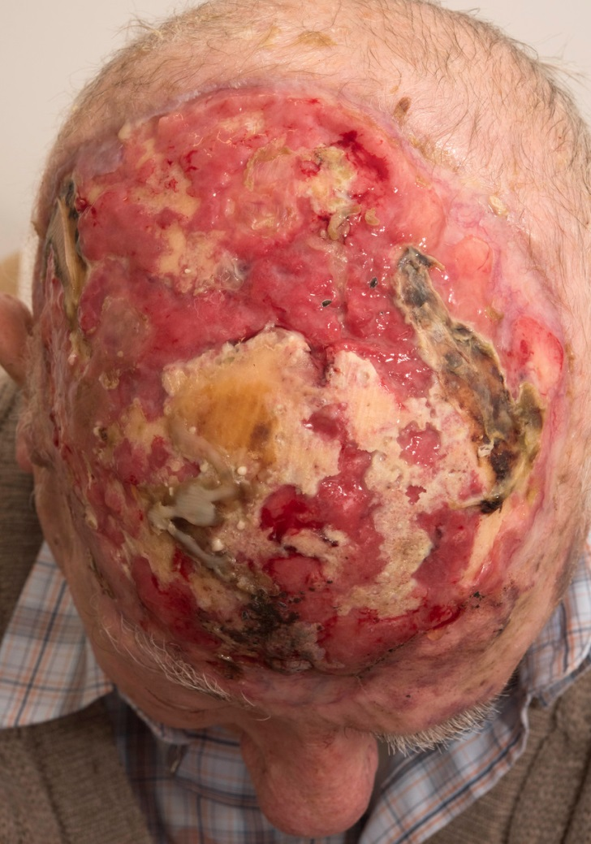

Slide 12
Case illustration 2
Fit 62 year old underwent excision biospy June 2016 under derm for 20mm AS – margins involved
Sept 2016 WLE under plastics – residual disease
Margins clear – 3mm deep
No RT given
Aug 2017 Local recurrence requiring 2 attempts to clear
Margins clear – no RT given
May 2018 Local recurrence – 2 operations to clear
Pedicled flap
Involved margins adjacent to orbit and ear

Slide 13
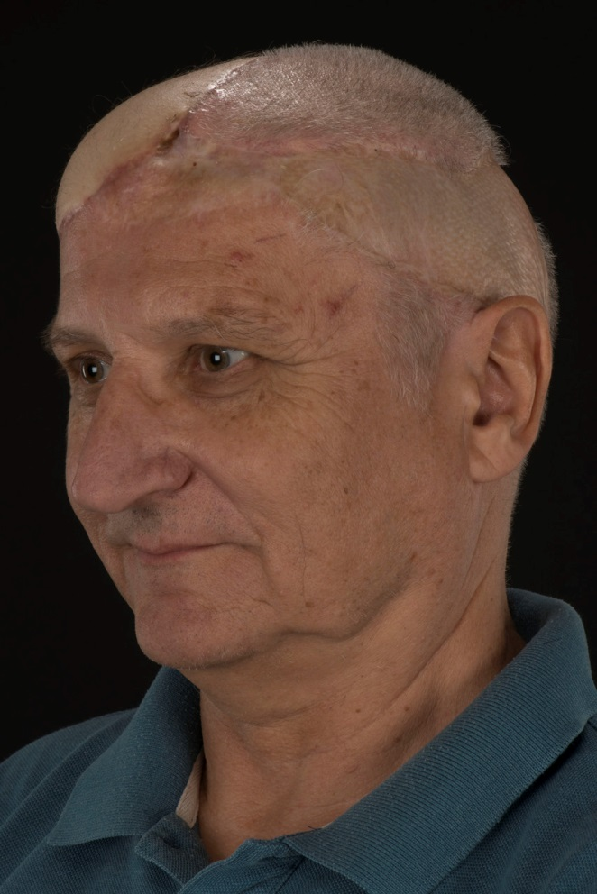
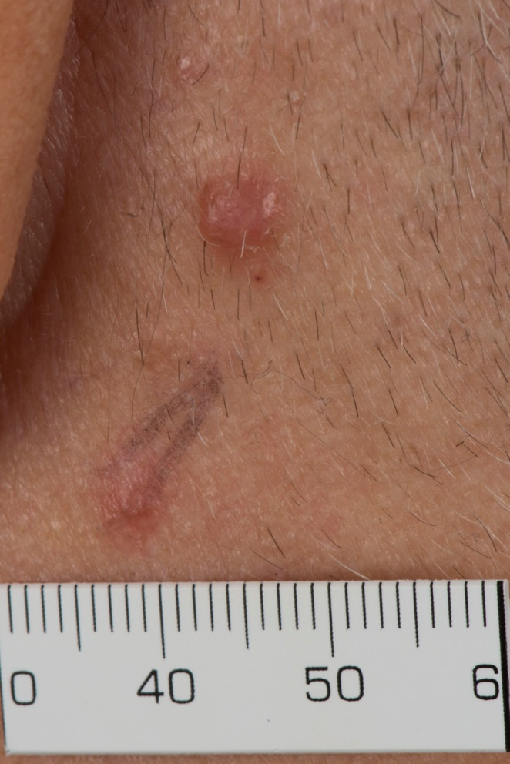
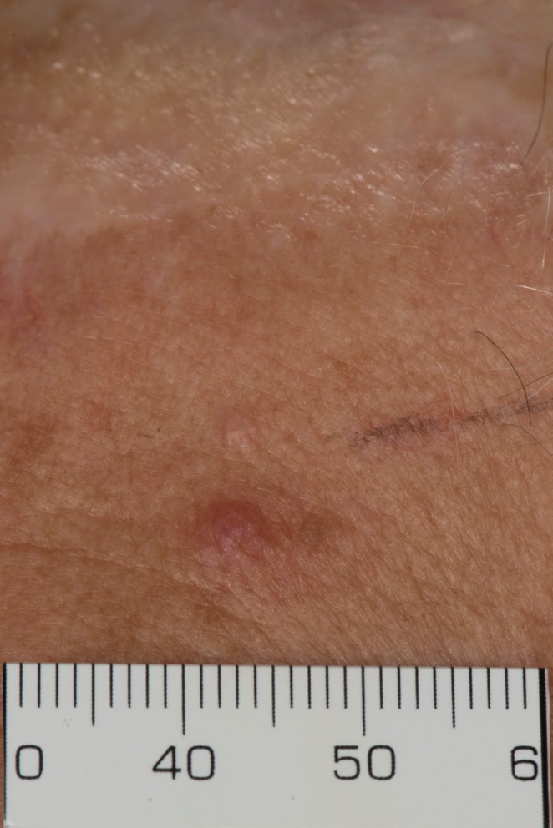

Slide 14
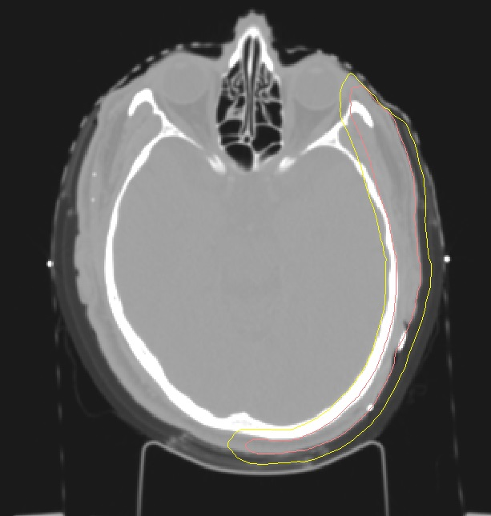
Radiotherapy technique (SCUBA)

Slide 16
What do we know about CAS?
15% of all head and neck sarcoma
62% of CAS affects the scalp
Typically affects older men
Diffuse, clinically undetectable intra-dermal spread
Indistinct borders and multi-centric tumour
Poor prognosis – 5-year survival 34%

Slide 17
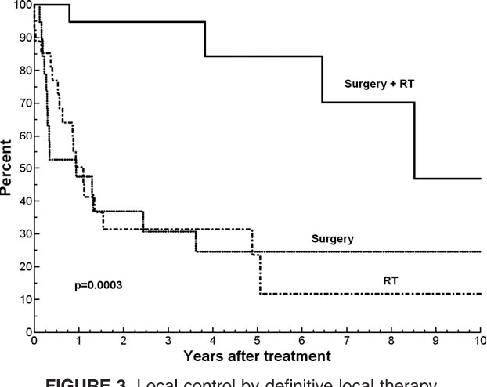
Factors associated with poor outcome:
Size > 5cm
Incomplete resection
Age > 70
Lack of RT
70 pts treated at MDA
5-year disease-specific survival
76% with surgery + RT
33% with single modality
Guadagnolo et al. Outcomes after definitive treatment for cutaneous angiosarcoma of the face and scalp.
Head & neck 33 5 (2011): 661-7 .

Slide 18
VMAT Radiotherapy

Slide 19
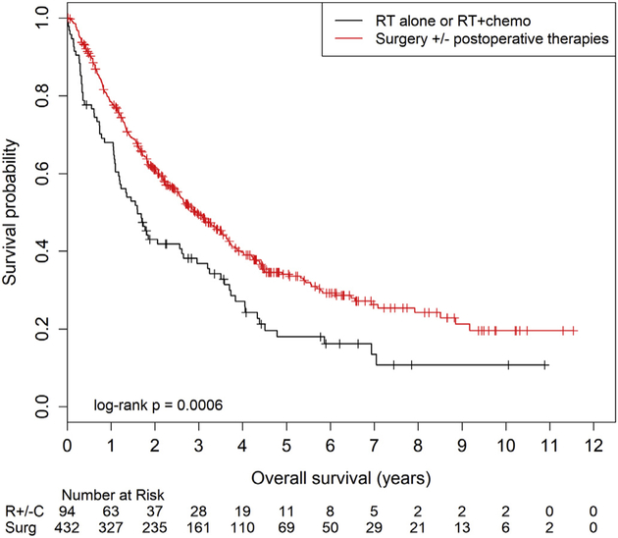
Do we need surgeons?

Slide 20
Treatment recommendations
Complete resection aiming for 1cm peripheral margin
If fascia uninvolved, then this is an acceptable deep margin
If fascia involved then periosteum should be taken
Pre or post-op RT for almost all patients
Definitive RT +/- concurrent taxane for patients who are unresectable or medically inoperable

