Slide 1


Update on 100,000 Genomes Project and look ahead to Genomic Medicine Service
Chris Wragg, Lead Cancer Scientist, SWGLH
Notes:
One of the most common neonatal diabetes syndromes is Wolcott Rallison caused by biallelic mutations in the EIF2AK3 gene. The common features are neonatal diabetes skeletal dysplasia and liver dysfunction.
Each intercurrent illness can potentially be complicated by acute liver and/or renal dysfunction and is responsible for the poor outcome of some patients. Early diagnosis of WRS is important because it allows the anticipation of potential complications during acute illness, trauma or major surgery.
IPEX syndrome is another common neonatal diabetes syndrome with patients presenting with diabetes, severe enteropathy and hypothyridism. IPEX can be fatal in infancy if not recognised and current therapeutic options are limited. The only known effective cure for IPEX syndrome is a bone marrow transplant

Slide 2

Contents
100,000 Genomes Project
  National update
Update on the future genomic medicine service

Slide 3
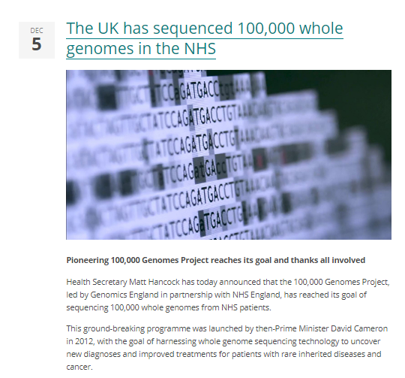

A remarkable achievement

Slide 4
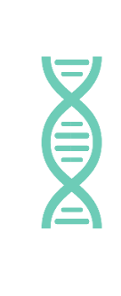

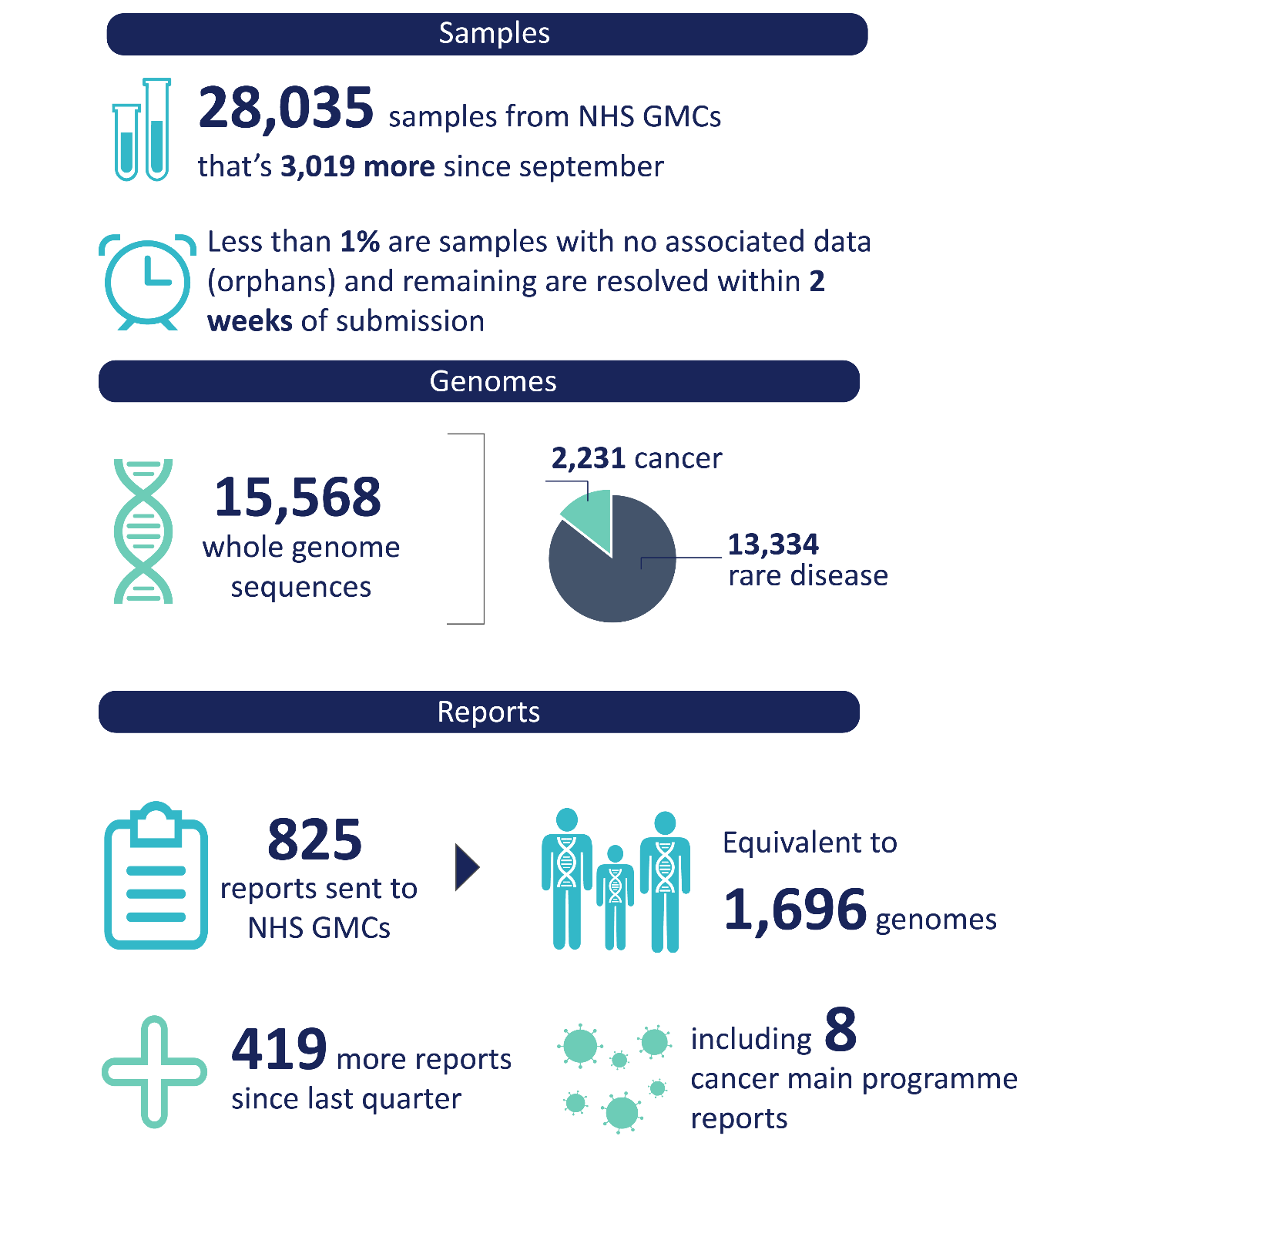
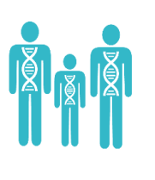


100,000 Genomes Project: WE GMC Summary
Samples
Genomes
Analysis and Reports
>3,550
Total 333
RD 166 Cancer 167
3,249
Patient Results received
Samples collected across WE GMC
Samples sent to national biorepository
Samples collected from all provider organisations in both rare disease and cancer
- 18 cancer pathways actively consenting patients
First reports being issued to families across the region
Identifying actionable findings
Human Phenotypic Ontology Data completed in
of cases – deadline November
Developing processes to speed up consent to sample dispatch
~85%
All RD samples
sent by 31st Oct
Cancer diagnosis data being submitted
S

Slide 5
GMC update
The recruitment of participants and the submission of samples to the project is now complete
Activity will need to continue throughout 2019 to finish the validation and return of results to participants, and to support continued development of the NHS genomic medicine service
In recognition of the continued role of the NHS GMCs, it is NHS England’s intention to:
  extend the existing NHS GMC contracts for a further 12 months; and
  complete a provider selection process to identify the future GMC infrastructure from 2020 onwards (aligned with the geographies of the seven Genomic Laboratory Hubs)
Anticipated that the extension will only be taken forward by a smaller number of existing NHS GMCs

Slide 6
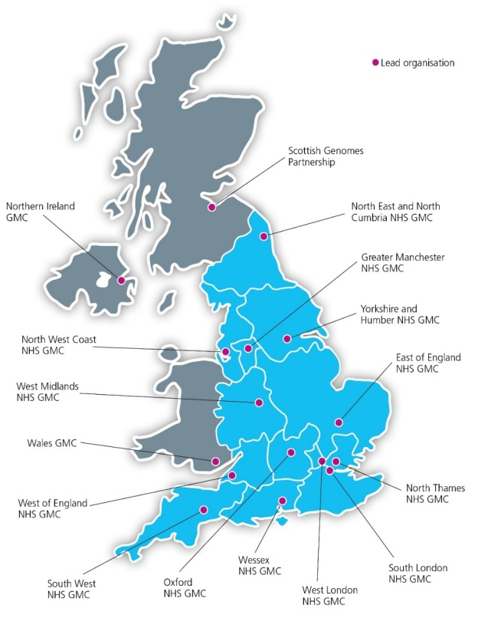
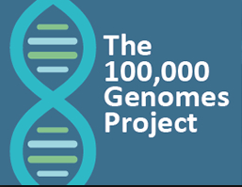





National delivery of 100,000 Genomes Project

Slide 7
GMC update
Return of results from the 100,000 Genomes Project
Patient engagement and involvement
Support introduction of the Genomic Medicine Service and whole genome sequencing (WGS)
Co-ordination and implementation of future genomics projects

Slide 8
Mainstreaming genomic medicine - Beyond 1st October 2018
Genomic Medicine Service
Genetics Laboratory Hubs:
7 nationally commissioned laboratory hubs
National Directory for all genetic & genomic testing
Genomic Laboratory Hubs
Clinical Genetics Services
Genomic Medicine Centres
Cancer Services
Genomic Medicine Centres:
Support transition from project to clinical practice
Clinical Genetics Services:
- Review of services to ensure support and equity
Cancer Services:
- Supporting 100,000 Genomes patients and future genomics pathways
Notes:
As of 1st October there are:
7 Genomic Laboratory Hubs
A national directory of tests dictating which tests will be funded nationally
GMCs will exist with a transformation, governance and potential project based remit
To support this there is a review of clinical genetics services as potential impact on their work will be critical

Slide 9
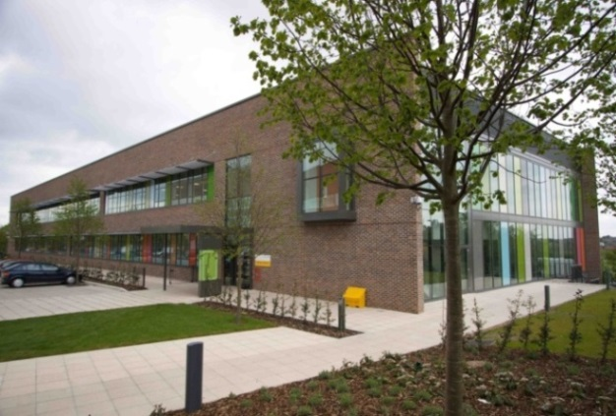
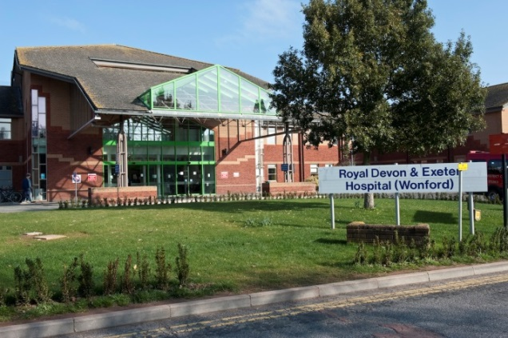
South West Genomic Laboratory Hub
Partnership
  North Bristol NHS Trust
  Royal Devon and Exeter NHS Foundation Trust
Core genomic tests ( all 7 GLH)
  Rare disease Test Directory (review 1/4/19)
  Cancer Test Directory (Draft)
Specialist genomic tests delivered by GLH appointed as a National Specialist Test Provider (NSTP)
  17 clinical specialisms ( 2 or 4 providers)
GLH will forward samples to the designated NSTP lab
Cardiology
Renal
Neurology
Respiratory/Metabolic
Endocrinology

Slide 10
The National Test Directory
Technology | Est prop’n of reports
Targeted mutation testing | 20-25%
Microarray | 10-20%
WGS | 10-25%
Small panel | 10-15%
STR testing | 10-15%
WES or large panel | 2-14%
MLPA or equivalent | 5-7%
Common aneuploidy testing | 5-7%
Karyotype | 3-5%
Single gene sequencing | 3-5%
FISH; DNA repair defect testing; Methylation testing; UPD testing; X-inactivation; Identity testing; Microsatellite instability; NIPT; NIPD; PGD | each <2%
Other | 2-5%
500,000
tests per year
300
RD indications
across 14 groups
covering ~ 3000 RDs
180
cancer indications
26
Indications
for WGS
22
test technologies – single gene to WGS
Defines all the genetic and genomic tests available through the NHS in England – specifying the appropriate test for each clinical indication
Developed through national & international scientific review built upon UKGTN approach
Updated annually - led by expert panel to keep pace with scientific advance

Slide 11
What the future holds…
Increased, more equitable access to genomic testing (centrally funded by NHS England)
On-line ordering of genomic tests from national test directory according to defined clinical eligibility criteria
New “patient choice” materials with opt-in for research
Standardised methodology across laboratories and improved reporting times
Increasing number of tests performed by genome sequencing (500,000 funded over next 5 years, aspiration of 5 million genomic tests!)

Slide 12
What the future holds…
Developing, validating and implementing a rapid whole genome sequencing in the NHS
Developing IT infrastructure
Developing consent/patient choice materials
Maintaining existing fresh frozen sample pathways
Building on 100K genomes sample pathways to enable rapid enrolment of appropriate patients alongside sample and clinical data
Developing robust and timely return of results pathways linking into MDTs
Expanding interim standard of care genomic testing in the SWGLH
NHSE Sarcoma T&F Group -19th February

Slide 13


Thank you!
Notes:
One of the most common neonatal diabetes syndromes is Wolcott Rallison caused by biallelic mutations in the EIF2AK3 gene. The common features are neonatal diabetes skeletal dysplasia and liver dysfunction.
Each intercurrent illness can potentially be complicated by acute liver and/or renal dysfunction and is responsible for the poor outcome of some patients. Early diagnosis of WRS is important because it allows the anticipation of potential complications during acute illness, trauma or major surgery.
IPEX syndrome is another common neonatal diabetes syndrome with patients presenting with diabetes, severe enteropathy and hypothyridism. IPEX can be fatal in infancy if not recognised and current therapeutic options are limited. The only known effective cure for IPEX syndrome is a bone marrow transplant

