Slide 1
Looking ahead: Genomic Laboratory Hub
Rachel Butler, Head of Bristol Genetics Laboratory

Slide 2
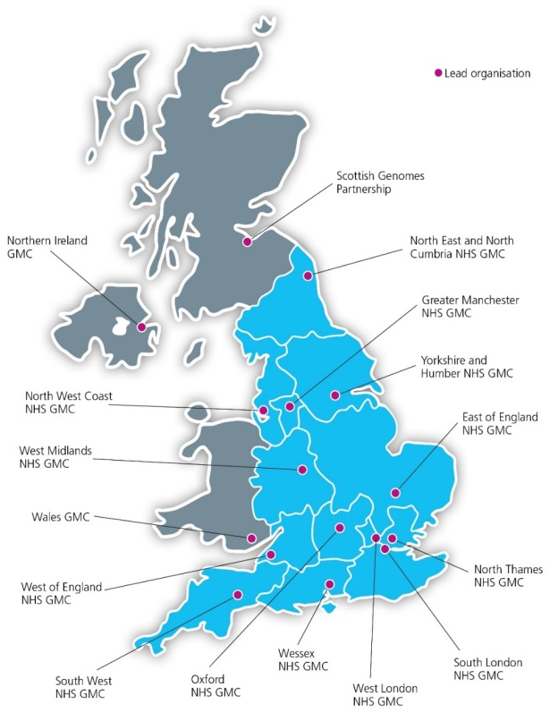
National delivery of 100,000 Genomes Project

Slide 3
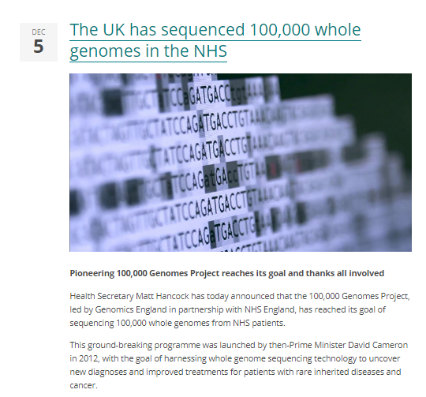
A remarkable achievement

Slide 4
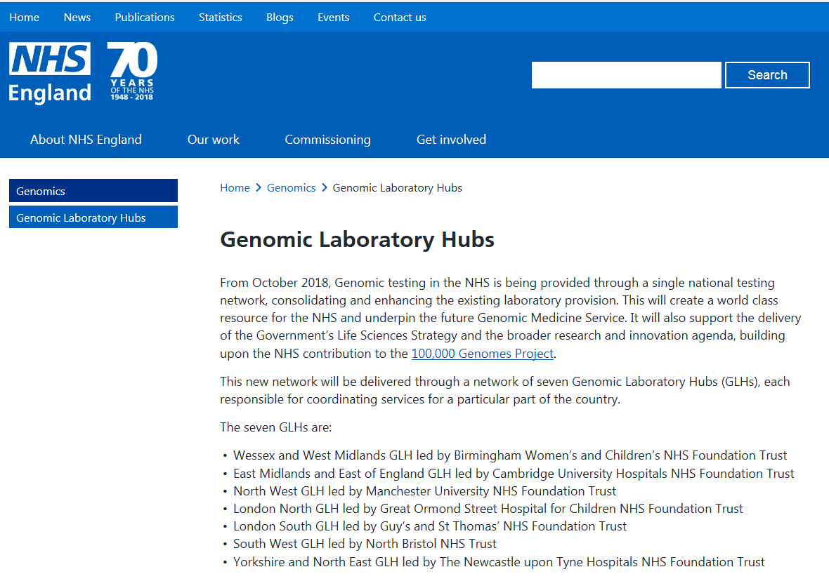
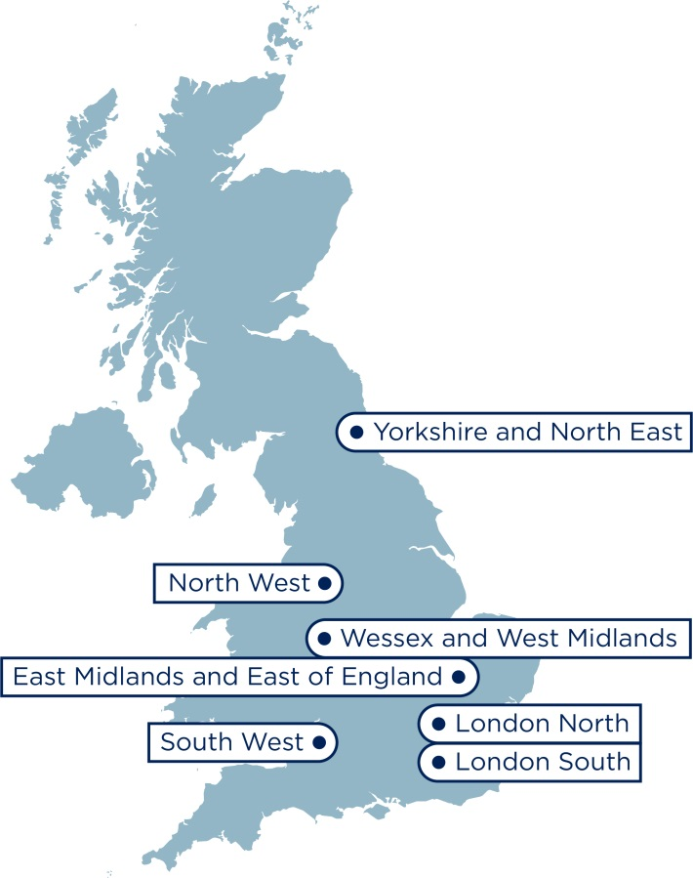
Genomic Laboratory Hubs
Notes:
Dear colleagues
As you may be aware at the Conservative Party Conference today, 2 October, the Health and Social Care Secretary Matt Hancock made reference to the Government’s plans for genomics across the UK. During his speech he referenced the development of the genomic medicine service and highlighted that mobilisation of the Genomic Laboratory Hubs is beginning. SofS also set out the Government’s ambition for 5 million genomic analyses to be performed in the UK over the next 5 years, of which the NHS will contribute 500k.
We have provided some key points about the speech this afternoon that you may want to share locally. These can be used in conjunction with the broader lines that we shared yesterday. If you do receive any queries regarding the genomics announcement or the genomic medicine service, please do not hesitate to contact NHS England press office on nhsengland.media@nhs.net<mailto:nhsengland.media@nhs.net> or 011382 50958, who can provide support.
Key points
· The Health and Social Care Secretary Matt Hancock has announced that the NHS will sequence up to 500,000 whole genomes as part of routine clinical care over the next five year period.
· Implementation of whole genome sequencing will be coordinated through the Genomic Laboratory Hubs, which from October will begin to mobilise to the new service.
· Access to whole genome sequencing will begin to be planned from October 2018 and is expected to be operational from early 2019.
· The National Genomic Test Directory 2018/19 sets that from early 2019, whole genome sequencing will be available to:
o Seriously ill children with a suspected genetic disorder, including those with cancer.
o People with 21 rare and inherited conditions.
o People with specific types of cancer which have been identified as having clear benefits to patients.
· The NHS will introduce and expand whole genome sequencing for some cancers and rare diseases, extending to other conditions as the evidence improves.
Please do not hesitate to get in touch if you have any questions or require any additional information.

Slide 5
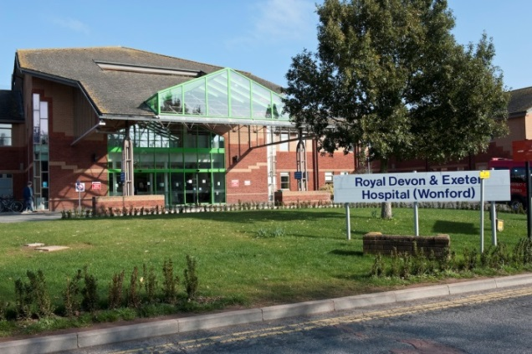
South West Genomic Laboratory Hub (SWGLH)
Partnership
North Bristol NHS Trust
Royal Devon and Exeter NHS Foundation Trust
Core genomic tests ( all 7 GLH)
Rare disease Test Directory
Cancer Test Directory
Specialist genomic tests delivered by GLH appointed as a National Specialist Test Provider (NSTP)
17 clinical specialisms ( 2 or 4 providers)
GLH will forward samples to the designated NSTP lab
Cancer (somatic/inherited)
Cardiology
Renal
Neurology
Respiratory/Metabolic
Endocrinology

Slide 6
The National Genomic Test Directory
500,000
tests per year
Technology | Est prop’n of reports
Targeted mutation testing | 20-25%
Microarray | 10-20%
WGS | 10-25%
Small panel | 10-15%
STR testing | 10-15%
WES or large panel | 2-14%
MLPA or equivalent | 5-7%
Common aneuploidy testing | 5-7%
Karyotype | 3-5%
Single gene sequencing | 3-5%
FISH; DNA repair defect testing; Methylation testing; UPD testing; X-inactivation; Identity testing; Microsatellite instability; NIPT; NIPD; PGD | each <2%
Other | 2-5%
300
RD indications
across 14 groups
covering ~ 3000 RDs
180
cancer indications
26
Indications for WGS
22
test technologies – single gene to WGS
Defines all the genetic and genomic tests available through the NHS in England – specifying the appropriate test for each clinical indication
Requesting via central IT system (NGIS)
Developed through national & international scientific review
Updated annually - led by expert panel to keep pace with scientific advance

Slide 7
The National Genomic Test Directory
https://www.england.nhs.uk/publication/national-genomic-test-directories/
Solid Tumours (Adult) | Core | M2 | Ovarian Carcinoma | M2.1 | Multi-target NGS panel - small variant (BRCA1, BRCA2) | BRCA1, BRCA2 | Small variant detection | Panel
 |  |  |  | M2.2 | Multi-target NGS panel - small variant (SMARCA4) | SMARCA4 | Small variant detection | Panel
Sarcomas | Core | M53 | Endometrial Stromal Sarcoma | M53.1 | EPC1-PHF1 rearrangement FISH | EPC1-PHF1 | Structural variant detection | FISH
 |  |  |  | M53.2 | JAZF1-PHF1 rearrangement FISH | JAZF1-PHF1 | Structural variant detection | FISH
 |  |  |  | M53.3 | JAZF1-SUZ12 rearrangement FISH | JAZF1-SUZ12 | Structural variant detection | FISH
 |  |  |  | M53.4 | WGS Germline and Tumour | All including burden / signature | All variant types | WGS
Sarcomas | Core | M203 | Uterine Sarcomas (Inc Endometrial) | M203.1 | EPC1-PHF1 rearrangement FISH | EPC1-PHF1 | Structural variant detection | FISH
 |  |  |  | M203.2 | JAZF1-PHF1 rearrangement FISH | JAZF1-PHF1 | Structural variant detection | FISH
 |  |  |  | M203.3 | JAZF1-SUZ12 rearrangement FISH | JAZF1-SUZ12 | Structural variant detection | FISH
 |  |  |  | M203.4 | NUTM2B-YWHAE FISH/RT-PCR | NUTM2B-YWHAE | Structural variant detection | FISH/Simple targeted mutation testing
 |  |  |  | M203.5 | WGS Germline and Tumour | All including burden / signature | All variant types | WGS

Slide 8
Mainstreaming genomic medicine
Genomic Medicine Service
Genetics Laboratory Hubs:
7 nationally commissioned laboratory hubs
National Directory for all genetic & genomic testing
Genomic Laboratory Hubs
Clinical Genetics Services
Genomic Medicine Centres
Cancer Services
Genomic Medicine Centres:
Support transition from project to clinical practice
Clinical Genetics Services:
- Review of services to ensure support and equity
Cancer Services:
- Supporting 100,000 Genomes patients and future genomics pathways

Slide 9
BRCA analysis for ovarian cancer

Slide 10
BrCa pedigree
I:1
I:2
I:3
I:4
II:1
II:2
II:3
II:4
II:5
III:1
III:2
III:3
III:4
III:5
IV:1
IV:2

Slide 11
BrCa pedigree
I:1
I:2
I:3
I:4
II:1
II:2
II:3
II:4
II:5
III:1
III:2
III:3
III:4
III:5
Mutation
Predictive / confirmatory testing available
IV:1
IV:2

Slide 12
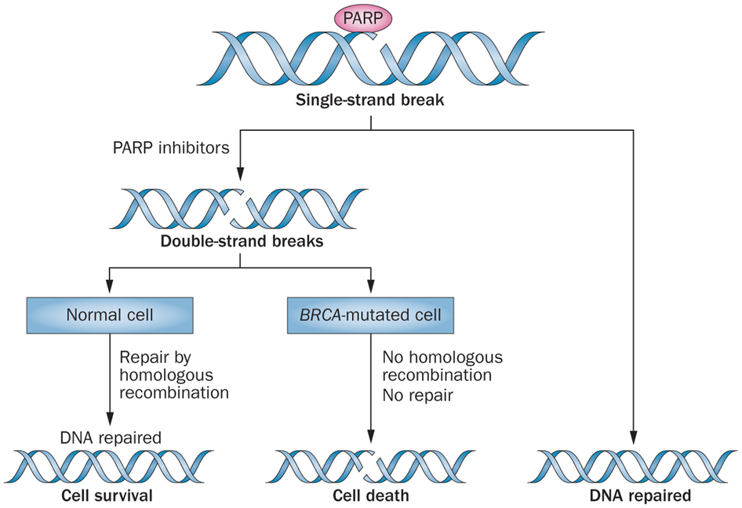
PARPi and synthetic lethality

Slide 13
Third line treatment: BRCA mutation patients
Lederman et al 2012

Slide 14
SOLO-1
1st Line
Moore, 2018

Slide 15
BrCa pedigree
I:1
I:2
I:3
I:4
II:1
II:2
II:3
II:4
II:5
Treatment with PARPi
III:1
III:2
III:3
III:4
III:5
Mutation
Predictive / confirmatory testing available
IV:1
IV:2

Slide 16
Isolated high grade serous ovarian cancer
NICE guidance is to test patients at >10% risk
Analysis for BRCA
Treatment with PARPi

Slide 17
High grade serous ovarian cancer
~15% have a BRCA1 or 2 mutation
2/3 are germline
1/3 somatic (tumour only)
High response rate to PARP inhibitors (much better than chemo)
Eligibility: Patients who are sensitive to platinum therapy and BRCA-positive (third line, but anticipated to extend to 1st line)

Slide 18
What to test?
Germline (blood)
Somatic (tumour)
Detects 2/3 of mutations
Test performs better, and detects dels / dups (10% of mutations)
Assay available in local labs
Knowledge that mutation is inherited
Detects all mutations (in theory)
Requires FFPE tissue (integration with pathology)
New NGS assay specifically for BRCA-FFPE
Can struggle to detect dels / dups
Requires confirmation of inheritance

Slide 19
If you were a patient, what would you choose?
Proportion of patients with mutation detected

Slide 20
Proposed pathway
Patient identification and consent for test
(oncology clinic)
FFPE sample* sent to GLH for tBRCA analysis
NGS
(2 weeks)
NGS poor quality / fails*
BRCA1/2 mutation detected
BRCA1/2 normal
Report to Oncology and request blood for gBRCA analysis
Report to Oncology AND
Report to Oncology
Refer to Clin Genetics
Request blood sample for germline confirmation
Targeted BRCA1/2 mutation analysis
(2 weeks)
* Low neoplastic cell content sample could trigger request for blood

Slide 21
Current services
We can offer this now
Germline BRCA analysis at GLH (Bristol Genetics)
Or, tBRCA analysis at Cardiff Genetics (for free – funded by AZ)
tBRCA analysis currently being set up at Bristol Genetics Lab
For 1st line treatment, will need clear pathways and rapid turnaround

Slide 22
Laboratory contacts
Laura Yarram-Smith - Lead for solid tumours and BRCA (laura.yarram-smith@nbt.nhs.uk)
Chris Wragg – Oncology Lead (christopher.wragg@nbt.nhs.uk)
Rachel Butler – Laboratory Head (rachel.butler@nbt.nhs.uk)

