Slide 1
gynaecological cancer genomics
Dr Daniel Nelmes
Cancer Genomics Lead – SW genomic lab hub
Dr tracie miles (Jonathan Frost)

Slide 2
Gynaecological Cancer Genomics
Genomics in England and Genomic Lab Hub
Genomic Test Directory
Testing Pathways
Somatic
Germline

Slide 3
Genomics – What is it?
3 Billion base pairs in the human genome

Slide 4
The systematic application of genomic technologies has the potential to transform patient’s lives by:
enabling a quicker diagnosis for patients with a rare disease, rather than years of uncertainty, often referred to in rare disease as the ‘diagnostic odyssey’
matching people to the most effective medications and interventions, reducing the likelihood of an adverse drug reaction
increasing the number of people surviving cancer each year because of more accurate and early diagnosis and more effective use of therapies
There are also significant benefits for research and development that can be leveraged on behalf of the NHS, taxpayers and the wider economy.
https://www.england.nhs.uk/genomics/nhs-genomic-med-service/

Slide 5
The UK is recognised worldwide as a leader in genomics and the unique structure of the NHS is allowing us to deliver these advances at scale and pace for patient benefit.
In March 2017, the NHS England Board set out its strategic approach to build a commissioned National Genomic Medicine Service, building on the NHS contribution to the 100,000 Genomes Project. This comprises five key elements:
A national genomic laboratory service through a network of Genomic Laboratory Hubs
A new National Genomic Test Directory to underpin the genomic laboratory network
A national Whole Genomic Sequencing provision and supporting informatics infrastructure developed in partnership with Genomics England
A clinical genomics medicine services and an evolved Genomic Medicine Centre service
A national co-ordinating and oversight function within NHS England (Genomics Unit)

Slide 6
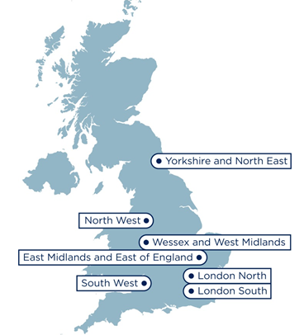
Mainstreaming genomic medicine
7 Genomic Laboratory Hubs
South West Genomic Laboratory Hub region
H
H
L
13 Hospital Sites [H]
H
H*
H
2 Central laboratories [L]
Bristol Genetics Laboratory
Exeter Genetics Laboratory
H
H
H
H
L
2 Clinical genetics services
Bristol Genetics Service
SWP Genetics Service
H*
H
H
Population: >5,000,000
Span: >200 miles
GMCs: 2
H
Notes:
Check map for locations and add Torbay

Slide 7
Genomic Test Directory – Somatic and Inherited
https://www.england.nhs.uk/publication/national-genomic-test-directories/
Genomic Test Directory
Cancer
Rare and Inherited Diseases (RID)
Last updated March 2019
Go-live WGS – November 2019
Go-live with non-WGS genomic testing – April 2020
Until then – current pathways
Germline – via clinical genetics
1st and 3rd line systemic therapy, BRCA funded via AZ

Slide 8
Genomic Test Directory – Cancer
Cancer | Gene | Test | Indication
High Grade Serous Ovarian Cancer | BRCA1/2 | Gene panel (NGS) | All
Small cell carcinoma of ovary | SMARCA4 | Gene panel (NGS) | Cases of diagnostic uncertainty
Uterine Sarcoma (incl. endometrial) | EPC1-PHF1 | Rearrangement (FISH) | Aid diagnosis
 | JAZF1-PHF1 | Rearrangement (FISH) | Aid diagnosis
 | JAZF1-SUZ12 | Rearrangement (FISH) | Aid diagnosis
 | NUTN2B-YWHAE | FISH/RT-PCR | Aid diagnosis
 | WGS | Germline and Tumour | Pathologists discretion

Slide 9
Genomic Test Directory - RID
R207 – Inherited Ovarian Cancer (without breast cancer)
EOC AND >/= 1 1st degree relative with EOC, or
EOC AND >/= 1 second degree relative with EOC (intervening relative is male, OR female with BSO, or deceased female <60)
EOC and >/= 2 second/third degree relatives with EOC
Panel Testing/MLPA (to capture Exon level changes and CNVs)
BRCA1, BRCA2, MLH1, MSH2, MSH6, PMS2

Slide 10
Genomic Test Directory - RID
R208 Inherited breast and(or) ovarian cancer
Non mucinous ovarian cancer (any age)
Pathology adjusted Manchester score > 15 or BOADICEA score > 10%
Fallopian Tube and Primary Peritoneal cancers can be included
BRCA1, BRCA2
R210 Lynch – Endometrial cancer any age with another Lynch cancer or Lynch related cancer under 50yrs old or Lynch cancer with family history
Lynch 'tumours' include endometrial, ovarian, and endocervical
Screen for MMR (MSI or IHC), then if present, decide if acquired (BRAFV600E or MLH1 Hypermethylation) or inherited (all on tumour tissue)

Slide 11
BRCA Somatic versus germline analysis
Germline (blood)
Detects 2/3 of mutations
Test performs better and detects dels/dups (10% of pathogenic variants)
Knowledge that variant is inherited
Available in Bristol laboratory
Currently departmentally funded, central funding anticipated from April 2020
Somatic (tumour)
Detects all mutations (in theory)
Requires tumour tissue (integration with pathology)
Requires confirmation of inheritance
New assay specifically for BRCA-FFPE – can struggle to detect dels / dups
Testing for 3rd line ovarian cancer patients funded by AstraZeneca in Cardiff and Manchester
Testing for 1st line patients funded by AZ in Manchester and to start in Bristol Autumn 2019
Slide courtesy of Rachel Butler
Notes:
Department = Trust
Turn around time within a month but is responsive to clinical need.
Southmead will take AZ service soon

Slide 12
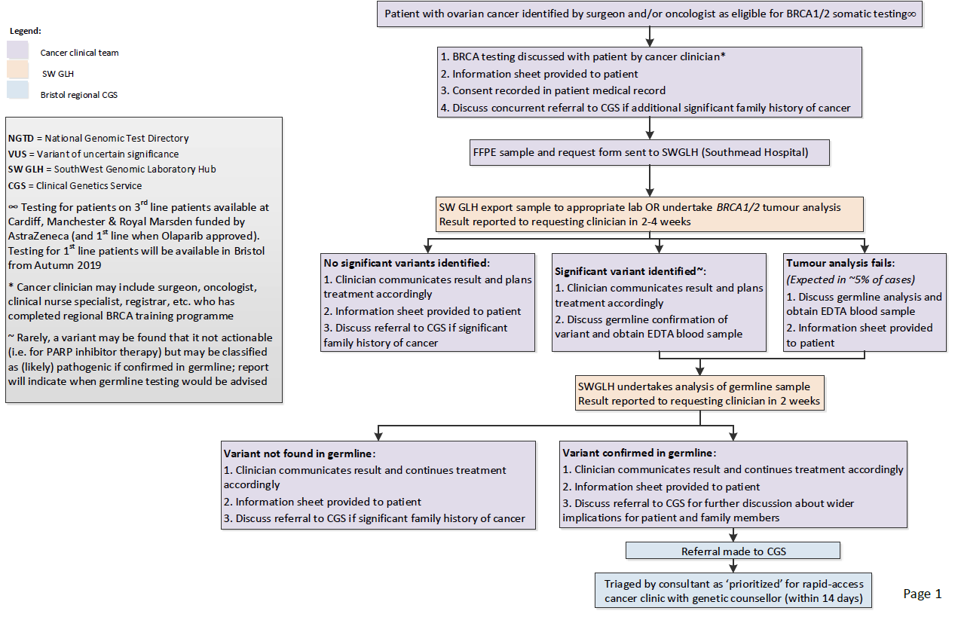
Somatic testing pathway
Notes:
Teaching day on 21st May this year in Bristol well evaluated ; GLH and HEE collaborating to role out trust specific teaching requirements.
Pathway developed in SW by Amanda Pichini, Rachel and Tracie.
Information sheet is currently being developed to support the pathway
Hospitals currently paying for germline testing

Slide 13
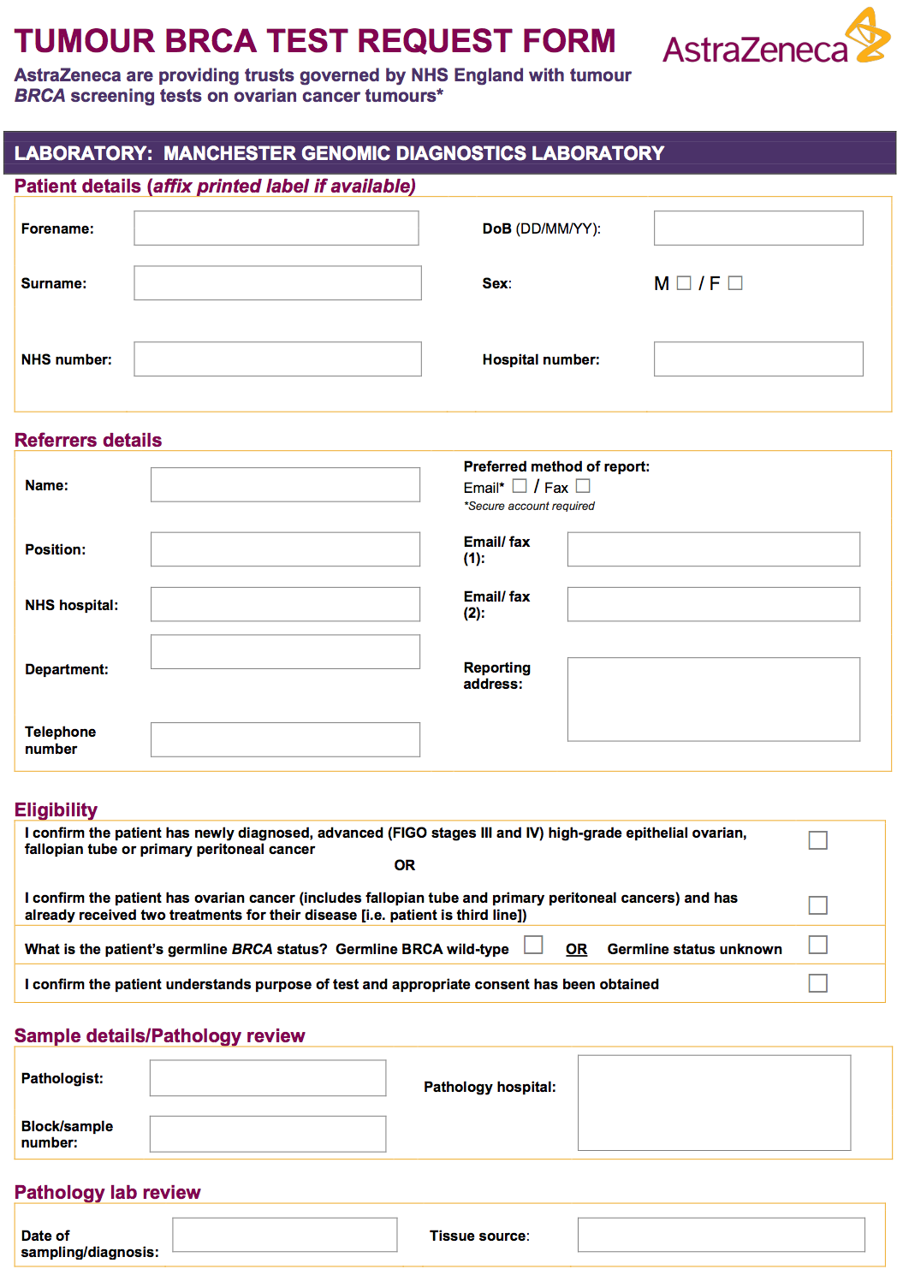
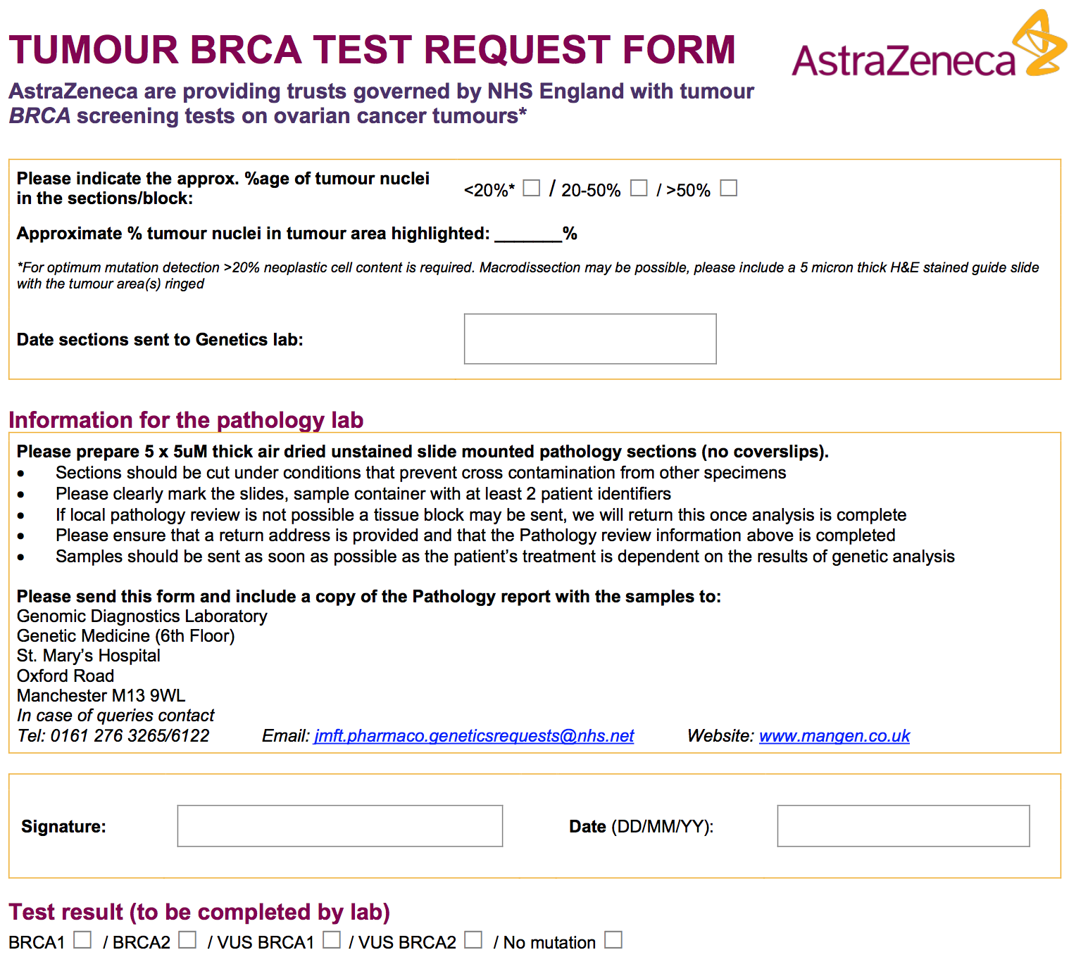
Notes:
Hopefully you are all familiar with this free service ?
Show of hands ?!
Results are being returned usually within a month.

Slide 14
Histopathology Guidelines (Tumour Tissue)
Make sure NHS number on form and all other identifiers.
Think about a failsafe for receiving and recording the results.
CT/ other biopsy to be formalin fixed. Ideally 2 decent core biopsies (not fragments) to be taken if clinically feasible one for diagnosis, one for molecular testing.
Pathologist assesses tumour in core biopsy and requests tissue sections to send away to genetics lab - preferable if only one core. If 2 good cores submitted, one whole block with second core can be sent to genetics lab. (>20 % tumour nuclei required for optimum mutation detection.)
Post neo–adjuvant biopsies with excellent chemo response may not have adequate tissue for somatic testing
Currently not spinning down cytology to make cell blocks …. But maybe in the future ?
Notes:
Top tips from histopathology:
Time in Formalin is important and if you have questions about this please contact Sarah Valenti-Smith AZ rep here today who can put you in touch with Lee Welch Biomedical Chemist.
Make sure NHS number on form and all other identifiers.
Think about a failsafe for receiving and recording the results. (In Bath path secretaries act as a failsafe to make sure results get onto the electronic patient record.)
CT biopsy to be formalin fixed. Ideally 2 decent core biopsies (not fragments) to be taken if clinically feasible one for diagnosis, one for molecular testing.
One core with sufficient tumour ok though.
Pathologist assess tumour in core biopsy and requests tissue sections to send away to genetics lab (currently Manchester) using form filled in by consenter (CNS / surgeon/ oncologist), - preferable if only one core.
If 2 good cores submitted, one whole block with second core can be sent to genetics lab.
>20 % tumour nuclei required for optimum mutation detection.
Post neo–adjuvant biopsies with excellent chemo response may not have adequate tissue for somatic testing – consider taking pre – chemo tissue biopsies in all cases ? ( just a thought from our histopathologist and myself as the BRCA girls respond better than others !)
Currently not spinning down cytology to make cell blocks …. But maybe in the future ?

Slide 15
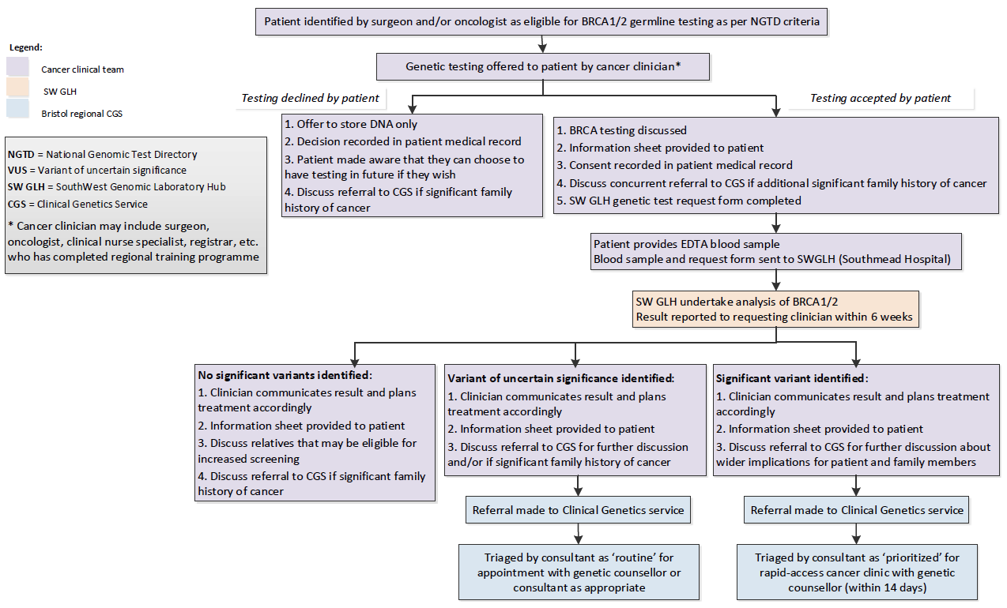
Germline testing pathway
Notes:
Currently suggested pathway is Somatic first followed by Germline if needed.
These pathway form guidance for trusts and clinicians.
The team would like feedback which can be sent to Tracie Miles.

Slide 16
Patient choice (and research offer)
A model of consent that covers both the clinical implications of a test, as well as an offer within the clinical pathway to participate in the National Genomic Research Library
Expected to involve one or more conversations depending on the clinical context, supported by information for patients to make informed choices
Choices captured by nationally standardised Record of Discussion forms
Note: documentation of clinical consent is good clinical practice; however, a signature is not sufficient!
Aims:
Set a clear and informed choice about having genomic testing in the NHS Genomic Medicine Service.
Clear and distinct choice to be part of a national database.
Ensure that the choice to undergo genomic testing is discussed in a safe and effective manner across specialties.
Notes:
A model of consent that covers both the clinical implications of a test, as well as an offer to participate in the National Genomic Research Library
Consent materials based on experience in existing clinical care pathways and from the 100,000 genome project and will covers key points to discuss with patients when undergoing whole genome sequencing, including data and samples that may be shared nationally as part of clinical interpretation AND separate opt-in choice to have de-identified data and samples stored in database (research library)
Expected to involve one or more conversations depending on the clinical context, supported by information for patients to make informed choices
Choices captured by nationally standardized Record of Discussion forms
The conversation(s) are most important; record of discussion form is meant to be used as an ‘anchor point’ to the discussion(s).
Clinician and patient supporting information will be available (from the GEP – Genomic Education Practitioners, NHSE, GeL – Genomic Laboratory Services used for 100,00 genome)
WITH BRCA , TRACIE DEVELOPING SOMATIC AND GERMLINE PATIENT INFO DOCS WITH ANGELA GEORGE ONCOGENTISIST FROM MARSDEN (ANGELA WILL SPEAK AT BGCS CONFERENCE IN CHELTENHAM)
SOMATIC AND GERMLINE PATIENT INFO DOCS WITH ANGELA GEORGE FROM MARSDEN ( ANGELA WILL SPEAK AT BGCS CONFERENCE IN CHELTENHAM )

Slide 17
National Genomic Research Library (NGRL)
A similar offer to the 100,000 Genomes Project, but patients have a distinct choice from having clinical testing in the NHS Genomic Medicine Service and can withdraw at any time.
Aims to provide equity of access to research opportunities, and to accelerate diagnosis, discovery, development of new biomarkers, diagnostics and therapeutic agents.
Not an individual research study, but a single, national secure resource of de-identified patient data that can be viewed in one environment by approved researchers:
genomic sequence data; and
health records, including hospital and community records, NHS digital information, disease registries.
May not directly help each individual patient; however, provides greater likelihood of finding a diagnosis or a rare disease or eligibility for a clinical trial
Protocol and materials approved by a Research Ethics Committee governed by the Health Research Authority.
Notes:
If a patient chooses to have whole genome sequencing and contribute to the National Genomic Research Library, some of their DNA will be sent to Genomics England.
Clinical information is also collected via records held in NHS Digital and sent by healthcare professionals involved in their care, and sent through a protected NHS network and stored securely by Genomics England. They can also choose to have whole genome sequencing as part of clinical care but not take part in the National Genomic Research Library, or can choose to withdraw at any time.
Aims to provide equity of access to research opportunities and establishes a unique data resource, with appropriate consent, will maximise the potential for scientific discovery, and the benefits of this will feed back into the NHS. Appropriate partnerships will increase the possibility of finding a diagnosis for patients, as well as developing new treatments, diagnostics and tools for discovery.
Does not need to go through local R&D approval processes.
Not part of the National Institute for Health Research Clinical Research Network (NIHR CRN) portfolio of studies.
May or may not directly help individual patients: Greater likelihood of finding a diagnosis of a patient’s rare disease, or identifying a clinical trial or other treatment that may be accessible now or in the future.
May help others in the future as researchers use the data to learn more about health conditions, develop drugs or diagnostic tools, and advance personalised medicine for society as a whole.
Patients may be contacted in the future with requests for additional data or samples, if information is found from research that might be relevant to them, or to inform them of other research opportunities.

Slide 18
Support
Buddy system ; Bristol = Taunton, Yeovil, Bath, Bristol, Cheltenham. Exeter = Peninsula south of Taunton to Cornwall.
Somatic and germline patient information documents in development – Tracie Miles and Angela George (Oncogenetisist Royal Marsden)
BGCS Conference – Cheltenham July 2020
GLH genomics engagement event – Jan 2020
GLH presence at CAGs
GLH/Clinical Genetics training/education on patient choice etc. (local trust level)
Notes:
Bristol clinical genetics are working out a buddy – system to assign 2-3 genetic counsellors to support MDT’s across the region (will be sharing plans /ideas with Exeter colleagues) .
The idea is to support mainstreaming education, to include communication streams etc.
WITH BRCA , TRACIE DEVELOPING SOMATIC AND GERMLINE PATIENT INFO DOCS WITH ANGELA GEORGE ONCOGENTISIST FROM MARSDEN (ANGELA WILL SPEAK AT BGCS CONFERENCE IN CHELTENHAM)

Slide 19
Thank you
Queries and feedback about pathway to Tracie Miles tracie.miles@nhs.net
Thanks to:
Prof Rachel Butler
Amanda Pichini
Tracie Miles

