Slide 1
Lung cancer genomics
Dr Daniel Nelmes
Cancer Genomics Lead – SW genomic lab hub

Slide 2
Lung Cancer Genomics
Genomics in England and Genomic Lab Hub
Genomic Test Directory
Tests in lung cancers

Slide 3
Genomics – What is it?
3 Billion base pairs in the human genome

Slide 4
The systematic application of genomic technologies has the potential to transform patient’s lives by:
enabling a quicker diagnosis for patients with a rare disease, rather than years of uncertainty, often referred to in rare disease as the ‘diagnostic odyssey’
matching people to the most effective medications and interventions, reducing the likelihood of an adverse drug reaction
increasing the number of people surviving cancer each year because of more accurate and early diagnosis and more effective use of therapies
There are also significant benefits for research and development that can be leveraged on behalf of the NHS, taxpayers and the wider economy.
https://www.england.nhs.uk/genomics/nhs-genomic-med-service/

Slide 5
The UK is recognised worldwide as a leader in genomics and the unique structure of the NHS is allowing us to deliver these advances at scale and pace for patient benefit.
In March 2017, the NHS England Board set out its strategic approach to build a commissioned National Genomic Medicine Service, building on the NHS contribution to the 100,000 Genomes Project. This comprises five key elements:
A national genomic laboratory service through a network of Genomic Laboratory Hubs
A new National Genomic Test Directory to underpin the genomic laboratory network
A national Whole Genomic Sequencing provision and supporting informatics infrastructure developed in partnership with Genomics England
A clinical genomics medicine services and an evolved Genomic Medicine Centre service
A national co-ordinating and oversight function within NHS England (Genomics Unit)

Slide 6
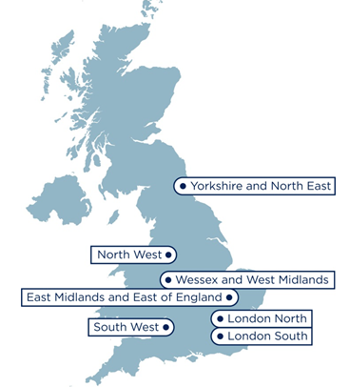
Mainstreaming genomic medicine
7 Genomic Laboratory Hubs
South West Genomic Laboratory Hub region
H
H
L
13 Hospital Sites [H]
H
H*
H
2 Central laboratories [L]
Bristol Genetics Laboratory
Exeter Genetics Laboratory
H
H
H
H
L
2 Clinical genetics services
Bristol Genetics Service
SWP Genetics Service
H*
H
H
Population: >5,000,000
Span: >200 miles
GMCs: 2
H
Notes:
Check map for locations and add Torbay

Slide 7
Genomic Test Directory – Somatic and Inherited
https://www.england.nhs.uk/publication/national-genomic-test-directories/
Genomic Test Directory
Cancer
Rare and Inherited Diseases (RID)
March 2019

Slide 8
Genomic Test Directory – Cancer - Adult
M4.1 | Multi-target NGS panel - small variant (EGFR) | EGFR | Small variant detection | Panel
M4.2 | Multi-target NGS panel - structural variant (ROS1, RET, ELM4-ALK) | ROS1, RET, ELM4-ALK | Structural variant detection | Panel
M4.3 | Multi-target NGS panel - copy number variant (MET) | MET | Copy number variant detection to exon level resolution | Panel
M4.4 | EGFR hotspot tumour | EGFR | Small variant detection | Simple targeted mutation testing
M4.5 | EGFR hotspot ctDNA | EGFR | Small variant detection | Simple targeted mutation testing
M4.6 | ROS1 rearrangement FISH/RT-PCR | ROS1 | Structural variant detection | FISH/Simple targeted mutation testing
M4.7 | RET rearrangement FISH/RT-PC | RET | Structural variant detection | FISH
M4.8 | MET copy number FISH | MET | Copy number variant detection to genomewide resolution | FISH
M4.9 | Multi-target NGS panel - structural variant (ELM4-ALK) | ELM4-ALK | Structural variant detection | Panel
M4.10 | EML4-ALK FISH/RT-PCR | ELM4-ALK | Structural variant detection | FISH/Simple targeted mutation testing

Slide 9
Summary
Genomic Lab Hub
Genomic Test Directory
Gene Panel Testing for NSCLC Cancer
Thank you
Questions?
Save the Date!
Genomic Medicine Service – Cancer Education Programme – Wednesday 29th Jan 2020

