Slide 1


Update on 100,000 Genomes Project and look ahead to Genomic Medicine Service
Laura Yarram-Smith, North Bristol Trust
& Catherine Carpenter-Clawson, Programme Manager WE GMC
18th June 2019

Slide 2

Project Objectives:
100,000 whole genome sequences
  Discovery of pathogenic variants leading to new treatments, devices and diagnostics
  Accelerate uptake of genomic medicine practice integrated into the NHS
  Increase public understanding for genomic medicine
  Advance UK life sciences industry and commercial activity in genomics
Notes:
Change to insert logo

Slide 3
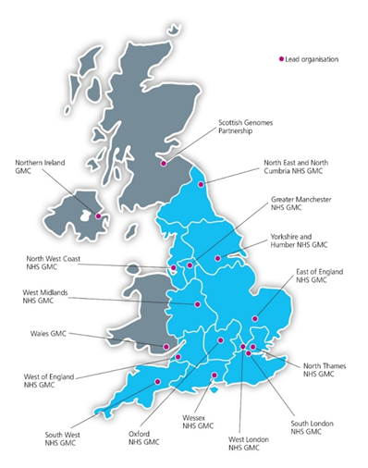
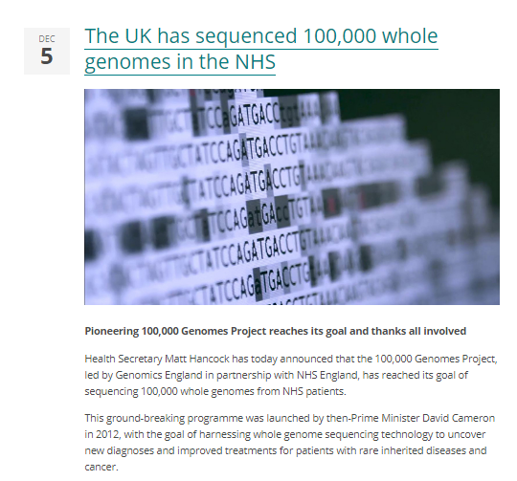

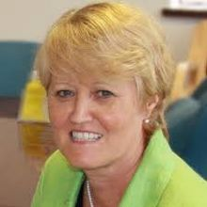
Role of Genomic Medicine Centres
in delivering 100,000 Genomes Project:
13 Genomic medicine centres
Rare disease or cancer recruitment
Working across organisations across a large geographical area
Increase access to genomic testing
2015-2019
Sue Hill OBE Chief Scientific Officer for England

Slide 4
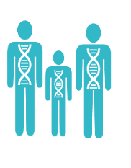

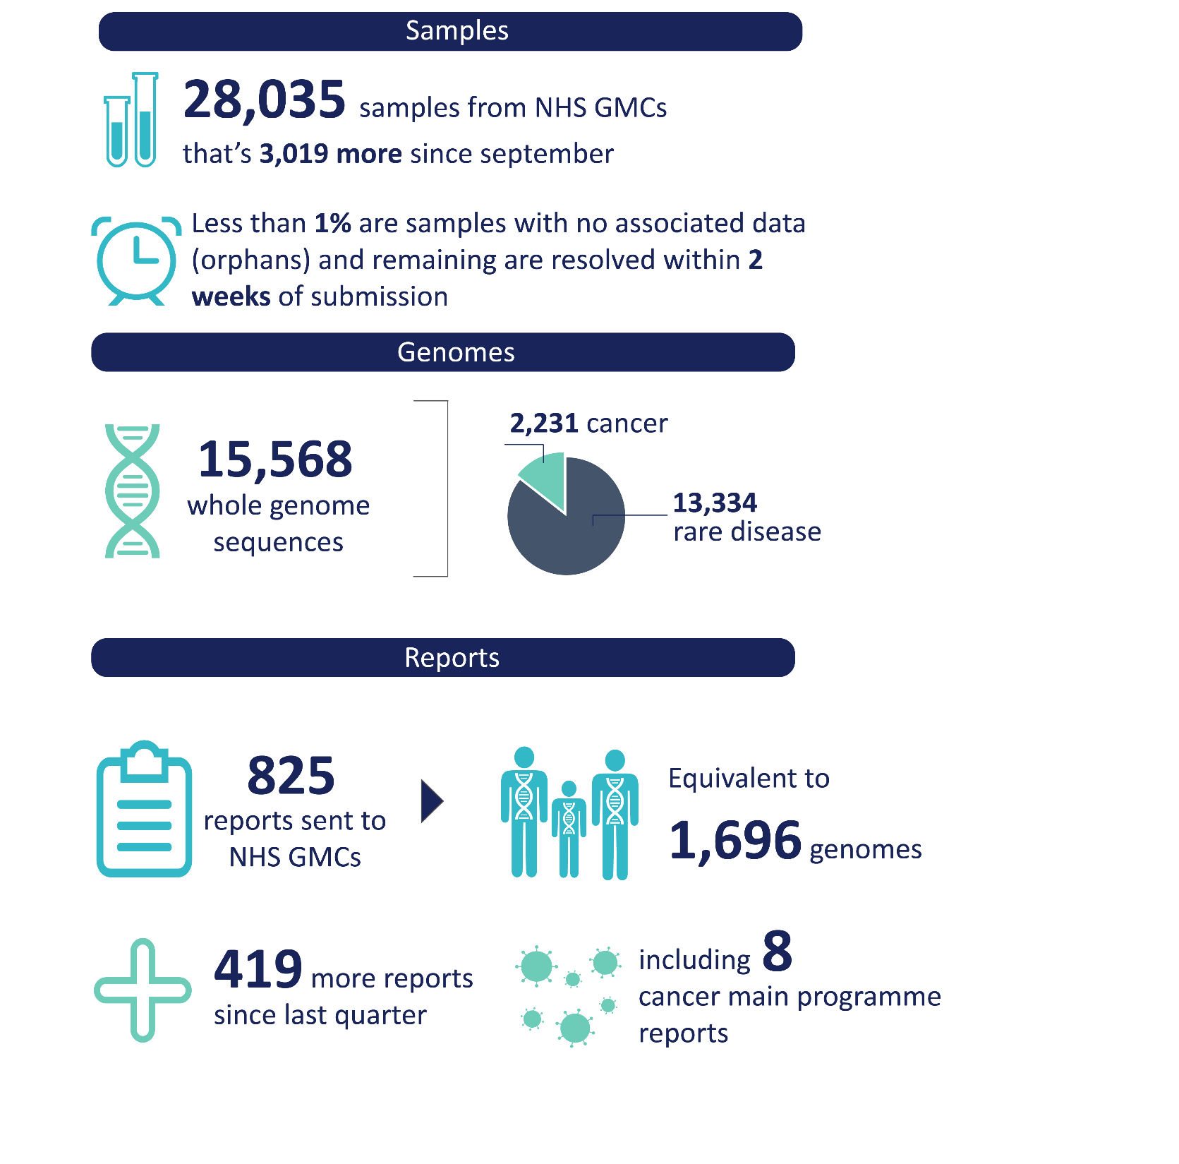




WE GMC
Progress Update May 2019
Taking part
Samples
Analysis and Reports
3,335
~3,750
1,654
Reports anticipated for WE GMC patients
Individuals consented to participate across
WE GMC
Samples sent to national biorepository
~50%
including blood, tumour, saliva, resubmissions and omics samples
Currently available for analysis with the GMC laboratory team
Participants were consented from all provider organisations in both rare disease and cancer
1,077 – Cancer samples
~25%
Reported by laboratory to clinical team
2,655 –
Rare Disease samples
18 cancer pathways actively participated in the project
Results being returned to patients by appropriate clinician
S
Notes:
11,000 cancer samples processed and further 5,000 collected

Slide 5
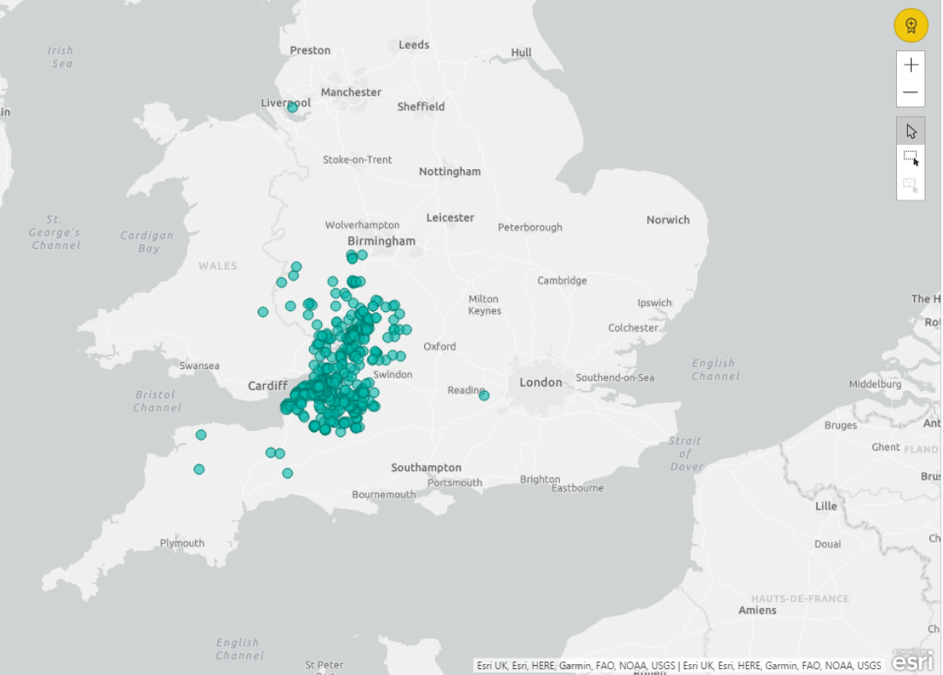
Cancer Achievement:
4 providers
18 open pathways
680 patients consented
537 paired samples passed QC
1074 samples sent germline & tumour samples
11 tumour types participated
Transformation:
Fresh Frozen pathways
Identify patients through MDT
CNS-led consent
Retrospective consent
Theatre scheduling
Regional specimen transport infrastructure
Cross-specialty communication
Genomic Tumour Advisory Boards GTAB
Support across regional cancer groups
Post codes of consented cancer patients across WE GMC
Notes:
Add local team pictures as required

Slide 6



Cancer Achievement:
Pathways opened across region:
Patients consented across region:
North Bristol Trust Breast Colorectal Haem Onc Skin Brain Sarcoma | 231 118 74 15 9 8 7
Gloucestershire Hospitals Breast Gynaecology Urology Head & Neck | 207 87 69 47 3
Royal United Hospitals Gynaecology Breast Renal Colorectal | 160 83 45 16 16
University Hospitals Bristol Colorectal Paediatric Haem Onc Head & Neck | 81 47 16 15 3
Breast
2
Colorectal
1
2
Brain
Endometrium
2
2
Ovarian
Haematological
2
Renal
2
Head & Neck
1
Melanoma
1
1
Paediatric
Sarcoma
2 = number of provider with pathway open by end of project in WE GMN region
Notes:
Add local team pictures as required

Slide 7



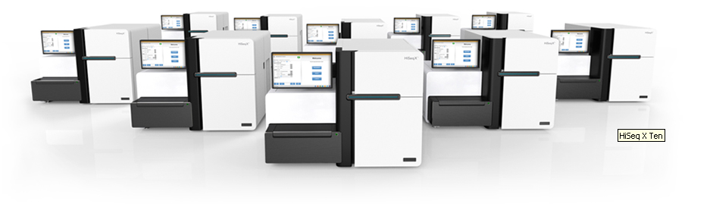

Getting a result: Simplified overview
Recruit patients, extract DNA, send DNA to Biorepository and submit clinical data
Genome sequencing by Illumina (Hinxton, Cambridge)
Bioinformatic analysis of genome sequence data
(gene panel analysis → tiered variants)
Analysis of genomic variants, GTABs where required, confirmatory testing, issue of clinical diagnostic report and communication of result to patient

Slide 8
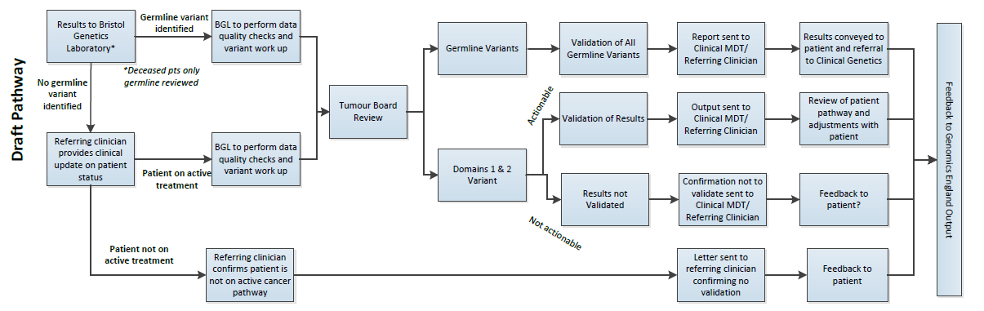
100,000 Genomes Project
Cancer Return of Results Processes
However: proposal to analyse all the results for the sarcoma patients and have a dedicated Genomics Tumour Advisory Board to review the analysis

Slide 9
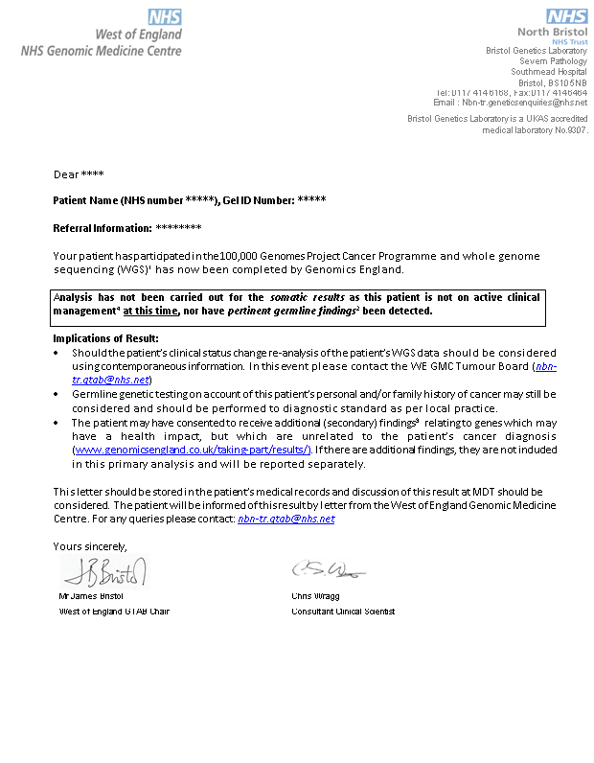
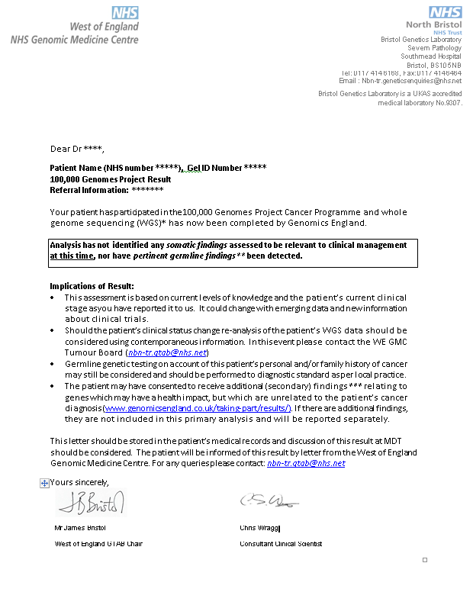
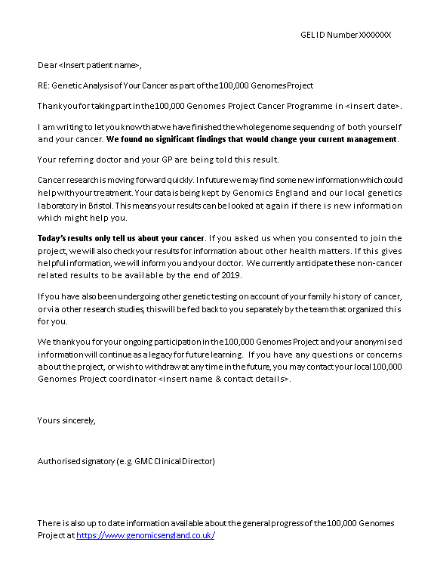
Cancer Results Management
Notes:
Note difference in letter templates between WE & SW GMC so need to update

Slide 10
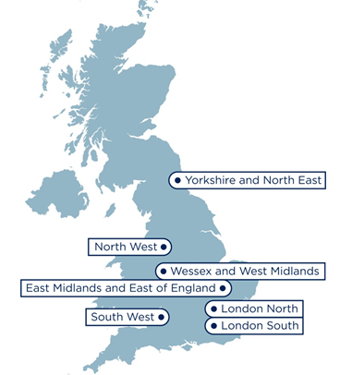

Mainstreaming genomic medicine
7 Genomic Laboratory Hubs
H
South West Genomic Laboratory Hub region
H
H
L
H*
13 Hospital Sites [H]
H
H
2 Central laboratories [L]
Bristol Genetics Laboratory
Exeter Genetics Laboratory
H
H
H
L
H*
2 Clinical genetics services
Bristol Genetics Service
SWP Genetics Service
H
H
Population: >5,000,000
Span: >200 miles
GMCs: 2
H
Notes:
Check map for locations and add Torbay

Slide 11
National Test Directory
Defines all the genetic and genomic tests available through the NHS in England – specifying the appropriate test for each clinical indication
Developed through national & international scientific review built upon UKGTN approach
Updated annually - led by expert panel to keep pace with scientific advance
Directory specifies the technology:
Directory split by clinical indications:
Technology | Est prop’n
Targeted mutation testing | 20-25%
Microarray | 10-20%
WGS | 10-25%
Small panel | 10-15%
STR testing | 10-15%
WES or large panel | 2-14%
MLPA or equivalent | 5-7%
Common aneuploidy testing | 5-7%
Karyotype | 3-5%
Single gene sequencing | 3-5%
FISH; DNA repair defect testing; Methylation testing; UPD testing; X-inactivation; Identity testing; Microsatellite instability; NIPT; NIPD; PGD | each <2%
Other | 2-5%
300
RD indications
across 14 groups
covering ~ 3000 RDs
RD Clinical Indication Groups - all genomic testing
Cardiology
Deafness
Endocrinology
Eyes
Gastrohepatology
Haematology
Immunology
Inherited cancer
Metabolic
Musculoskeletal
Neurology
Renal
Respiratory
Skin
180
cancer indications
22 technologies – single gene to WGS
Notes:
National Directory defines all future genetic testing – outlines type of test that should be carried out based on the clinical indication of the patient

Slide 12
National Test directory- whole genome sequencing
26
Indications
for WGS in Directory commencing in 2019
22 Rare Disease clinical indications identified for WGS include:
Acutely unwell infants (NICU & PICU)
Congenital malformation
Moderate, severe or profound intellectual disability
Neonatal diabetes
Cerebral malformation
Rare neuromuscular disorders
Cystic renal disease
4 cancer conditions identified for WGS include:
Sarcoma
Paediatric Tumours
Acute Leukaemias
Clinical teams, Genomic Laboratory Hub and Genomic Medicine Centres working together to establish pathways and processes to facilitate this service development in mainstream clinical practice

Slide 13
Evolution of genetic testing:
Test Directory launched October 2018
7 Laboratory Hubs working to develop the core testing service
  Development of specialised panels
Services are being rolled out over the next 12 months
New informatics system being developed to support ordering of tests
Standardised record of discussion being developed nationally
Improved equity of access
Genomic Medicine Service
Genomic Laboratory Hubs
Cancer Services
Clinical Genetics Services
Genomic Medicine Centres
Notes:
Key message is GLHs, Clinical services & GMCs

Slide 14
High Level Sarcoma Pathway from NHS England
Fresh Tissue Sample taken
(as per sample handling guidance)
SOC testing pathway continues as normal
Cancer Diagnosis confirmed
WGS sample sent to Genomic Laboratory Hub DNA extraction lab at North Bristol Trust
Informed Patient consent taken and Record of Discussion Form completed and sent to GLH
Germline sample taken at appropriate point and sent to GLH for DNA extraction
DNA extracted from tumour and germline sample and both sent to GLH Plating Hub.
Both Tumour and Germline samples must be sent together from GLH t GLH Plating Hub
Plating GLH plates samples and sends to Illumina
WGS at Illumina
WGS Data analysed by Genomics England
WGA result made available on Interpretation portal
GTAB/MDT takes place
GLH access WGA result and validate as required
Histopathology produces (integrated) report from WGA report
Genomics report returned to referring clinician

Slide 15
High Level Sarcoma Pathway from NHS England
- What do we
need to discuss?
Fresh Tissue Sample taken
(as per sample handling guidance)
How, when and where could samples be taken?
National paperwork provided:
What clinical discussions need to take place to ensure informed consent?
When, how, who complete forms?
SOC testing pathway continues as normal
Cancer Diagnosis confirmed
WGS sample sent to Genomic Laboratory Hub DNA extraction lab at North Bristol Trust
What is needed to ensure smooth sample transport and receipt?
Informed Patient consent taken and Record of Discussion Form completed and sent to GLH
Germline sample taken at appropriate point and sent to GLH for DNA extraction
When, who and how might the germline sample be taken? What opportunities exist along existing clinical pathway?
DNA extracted from tumour and germline sample and both sent to GLH Plating Hub.
How to manage this? How to escalate issues?
Plating GLH plates samples and sends to Illumina
Both Tumour and Germline samples must be sent together from GLH t GLH Plating Hub
What processes and SOP do we need to set up?
What are the education and training needs of all staff to support this?
WGS at Illumina
Does a national GTAB approach seem appropriate? What level of input do we want locally?
WGS Data analysed by Genomics England
WGA result made available on Interpretation portal
GTAB/MDT takes place
Straight forward reports versus complex discussions?
What support required?
GLH access WGA result and validate as required
Will this be national or locally agreed?
Histopathology produces (integrated) report from WGA report
Genomics report returned to referring clinician

Slide 16
Next steps
SW Genomic Laboratory Hub has appointed Clinical Leads
  Dr Dan Nelmes is Cancer Clinical Lead and leading the development of the SW sarcoma pathways
Currently liaising with NHS England team to get as many answers to national questions as we can
Arrange meeting with key representatives from 3 sarcoma pathways in the South West in next 4 weeks to consider local options
  Please nominate/volunteer to be involved
Start to consider what a local pathway means in practice and what support would be required
Building on national materials to support local education
  Case studies and example reports

Slide 17
What is the role of the GMC?
Ensure successful results return to all participants
Answer questions from patients and clinicians on the results pathway
Support the re-consenting of participants who are now 16+
Work closely with partner Trusts, the GLH and genetics services to help embed a new model of ‘consent’
Update teams on the changes taking place across the Genomic Medicine Service.
Deliver national and local programs of education and training utilising clinical and scientific expertise in the region
Work with the GLH to create pathways for whole genome sequencing
Continued support from patient involvement working with patient forum and patient groups

Slide 18

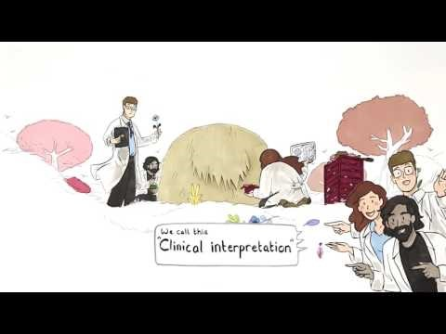
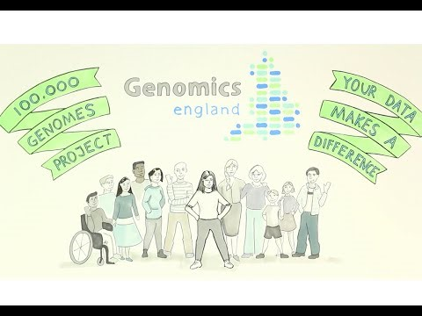


Resources:
https://www.youtube.com/watch?v=m1k91ynqFIU
https://youtu.be/nneWFaJ6Hfc
www.genomicsengland.co.uk/
www.genomicseducation.hee.nhs.uk/
https://portal.e-lfh.org.uk/Component/Details/540918
Notes:
But not through the headers!

Slide 19







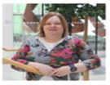

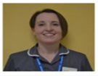

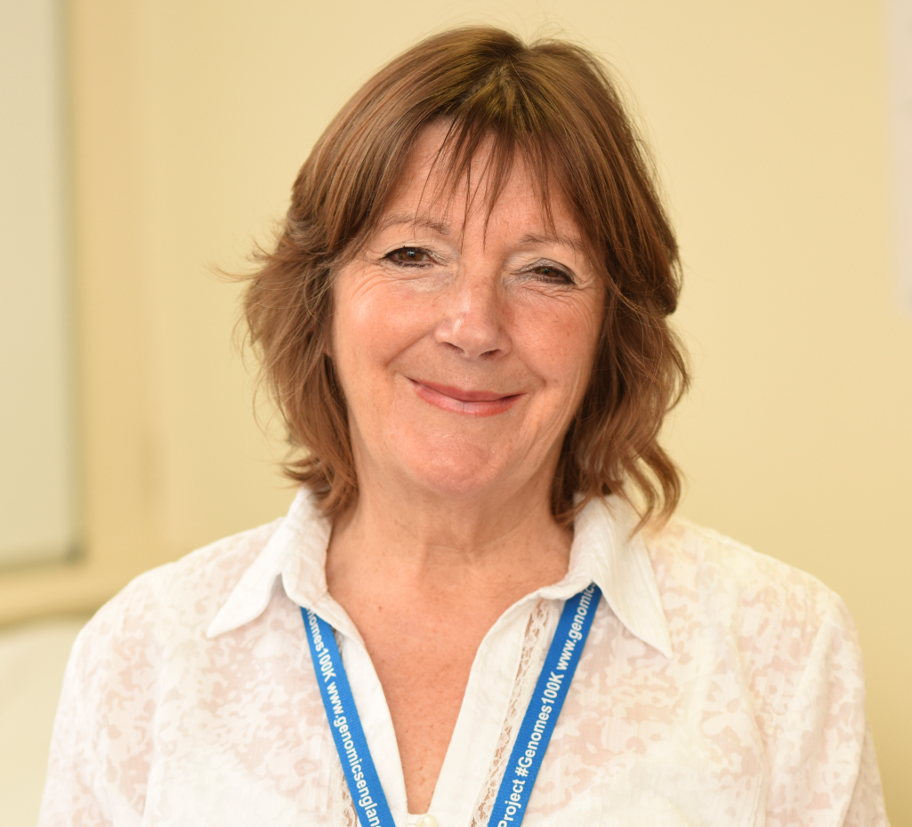
West of England Medicine Centre
Core team members:
Funded Genomic Practitioners:
Prof Sarah Smithson
North Bristol Trust
Weston Area Health Trust
Royal United Hospitals Bath
Gloucestershire Hospitals
Mr James Bristol
Lead Organisation:
University Hospitals Bristol
SRO: Dr William Oldfield
Director: Prof Sarah Smithson
Cancer Lead: Mr James Bristol
Programme manager:
Catherine Carpenter-Clawson
Genomics Practitioner Lead: Amanda Pichini
Leah Buckley & Janice Bailey, UHBristol
Amanda Pichini
E-mail the team: ubh-tr.wegmc@nhs.net
Suriya Kirkpatrick, North Bristol
Catherine Carpenter-Clawson
Mel Watson,
Education & Training Lead SW GLH
Tracie Miles & Faye Price, RUH
John Kirk, Communication Lead UHBristol
Gill Hopkins, GHNFT

Slide 20

Thank you!

