Slide 1
100,000 Genomes Project & mainstreaming genomic medicine
Skin SSG
May 2018
Catherine Carpenter-Clawson, Programme Manager, WE GMC

Slide 3
From Genetics to Genomics
Genetic testing = single gene(s) or panels
Exome sequencing = coding DNA
Genomic sequencing = all coding and non-coding DNA
Single gene
Small panel (5-10)
Larger panel (50-100)
Clinical exome
Whole exome
Whole genome
Courtesy of HEE E&T Group

Slide 4
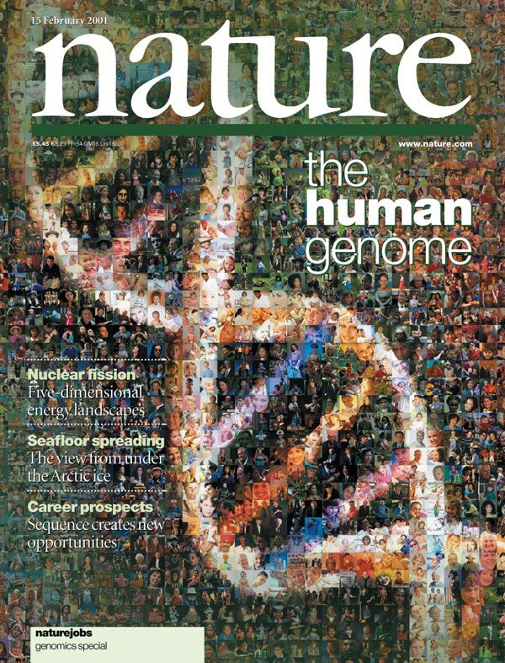
The Human Genome Project
Commenced in 1990 - completed in April 2001/2003
First genome cost $2.7 billion in total
First time the human genetic blueprint had been completely ‘read’
Enabled the discovery of genes which cause disease
Allowed genetic diagnostics to progress
Paved the way for large-scale diagnostic sequencing programmes
Courtesy of HEE E&T Group
Notes:
Reference genome created…..version 38 now causing issues!

Slide 5
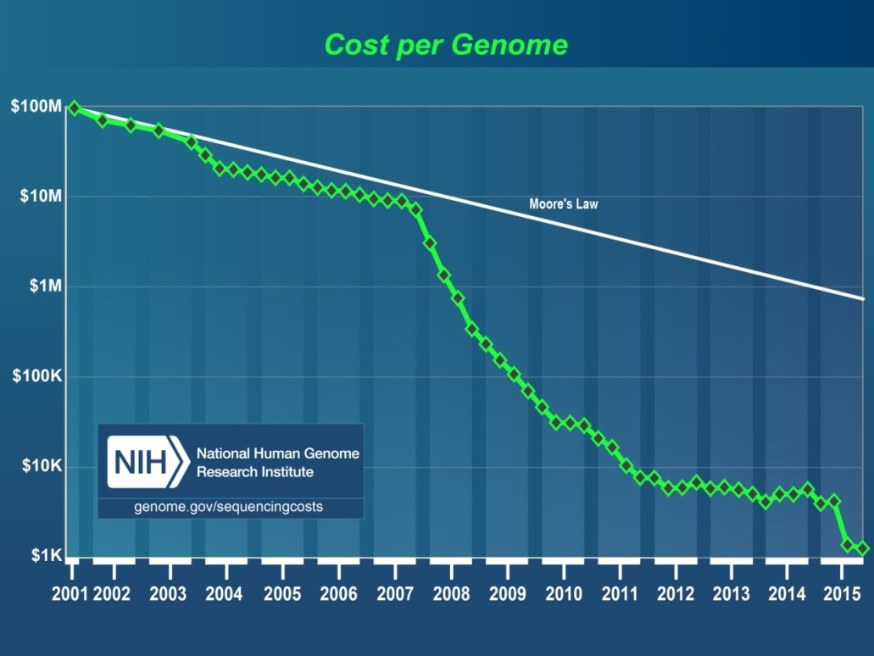
100,000 Genomes Project: How did we get here?
1. Human Genome Project generates reference sequence at an estimated cost of $2.7 billion
2. Development of new technologies drives down the cost of Whole Genome Sequencing – the $1000 genome is now a reality
Graph from NHGRI
3. Potential to bring real benefits to patients, drive research and drug development, and develop personalised medicine for the NHS, in the NHS, by the NHS
Courtesy of HEE E&T Group
Notes:
The $1000 genome was talked about as the holy grail of genomics – the point at which it became possible to offer WGS at a parallel cost to standard diagnostics.
These two things made it possible, but the biggest drive for the 100K programme was the potential to bring benefits to current and future patients in the form of personalised medicine – a one size does not fit all model. Recognising that we are not identical, that tumours are not identical, some drugs work better in some than others (especially so in cancer) and that targeting therapies to individuals is a possibility – that no one alive is youer that you.

Slide 6
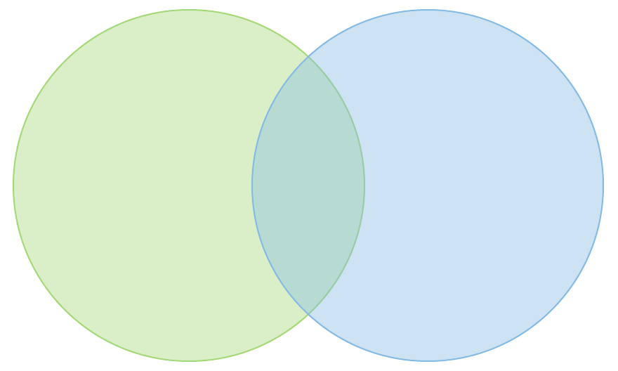
100,000 Genomes Project: Objectives
NHS
Transformation
Research
Clinical
100,000 Whole Genome Sequences with linked data set by end 2018
Increased discovery of pathogenic variants leading to new treatments, devices and diagnostics
Accelerate uptake with advanced genomic medicine practice integrated into the NHS
*Mainstreaming*
Increase public understanding and support for genomic medicine
Stimulate and advance UK life sciences industry and commercial activity in genomics
Courtesy of HEE E&T Group
Notes:
Programme legacy will see:
Improving outcomes for patients and reducing variation in clinical care
High quality sample preparation and use of high throughput and novel genomic technologies
Reduction in variation of quality in laboratory processes and access to genomic testing
Richer phenotypic data linked to genetic abnormalities and markers
A robust informatics infrastructure and interoperability
Stronger link between clinical practice and applied genomics
New genomic multidisciplinary teams – bringing together many more clinical scientists and clinicians Improved clinical leadership and delivery of the clinical change model

Slide 7
100,000 Genomes Project: NHS Genomic Medicine Centres
NHS Genomic Medicine Centres (NHS GMCs) :
NHS GMCs work in partnership with academia, patients and industry in collaboration with Academic Health Science Networks

Slide 8
100,000 Genomes Project: what is a Genomic Medicine Centre?
A group of NHS providers (and other key local organisations) who have come together to support delivery of the 100,000 Genomes Project
We are ordinary NHS staff seconded to work on the project and set it up alongside existing clinical practice
We are not building a big new centre or working outside of existing NHS structures

Slide 9
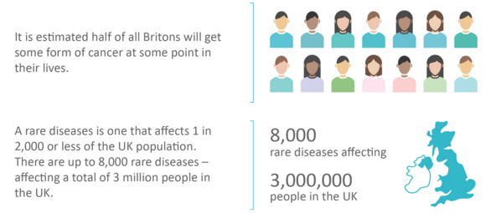
100,000 Genomes Project: who is eligible?
Cancer: 17 cancer groups with tumour size and type requirements
Rare diseases: >250 different conditions
Minimal diagnostic criteria and prior genetic testing
No causal variant identified

Slide 10
100,000 Genomes Project: Summary of clinical pathway
Clinician identifies eligible patient
Typically through clinical referral or via MDT
Findings & recommendations reported back to referring clinician
Patient approached regarding project
First approach through existing clinical contacts
Separate consent appointment
Dedicated clinicians trained in consent process
Samples obtained
Validation of findings at regional at genetics lab
During consent or at appropriate time point in pathway
DNA extraction at genetics lab
Samples follow standard transport flows to regional genetics laboratory
Findings returned to GMCs
DNA sequenced in Genomics England national centre
Samples sent to Sanger Institute, Cambridge for whole genome sequencing

Slide 11
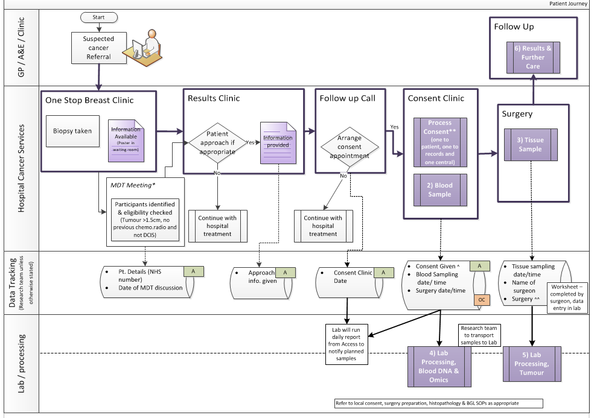
How do you develop a pathway?
Patient
Pathology
GPs
Imaging
Consultants
Surgeons
Nursing staff
Specialists
Breast Care Nurses
Research team
Theatre team
Clinic management
MDT co-ordinators
Specimen transport team
IT experts
How do you develop a pathway? – the key is engagement at every step of the pathway…..
Blood laboratory
Tumour laboratory
Managers
Reception
Processing

Slide 12
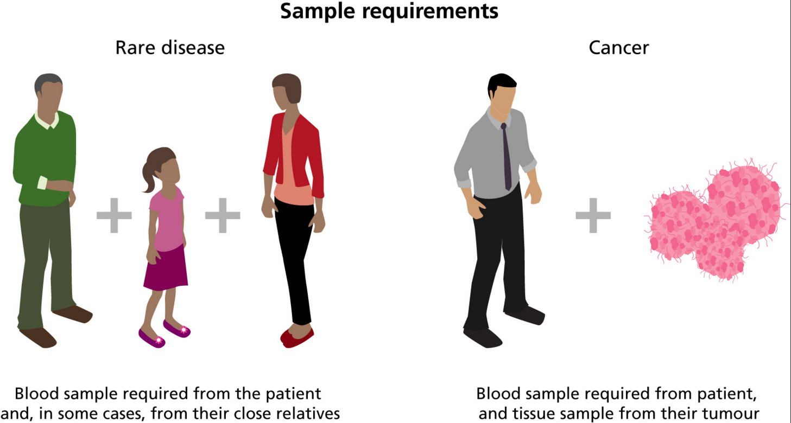
100,000 Genomes Project: what samples are taken?

Slide 13
Cancer: pathway status summary
Summary:
>300 patients consented across the region
Consented across 18 pathways
Final pathway to open Paediatric Oncology at UHBristol (plan to go live by April 2018)
Focus to shift to return of results and biopsy piloting
Conclusion: At continued levels WE GMC will consent approximately 500 patients by September 2018 (just below agreed target)

Slide 14
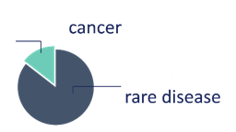
100,000 Genomes Project: National Update – March 2018
Samples
Genomes
Analysis and Reports
79,742
52,881
Reports for
8,918
families sent to GMCs
Samples collected from NHS GMCs
genomes
Equivalent to
17,083
18,346
genomes
8,705
62,659
20-25% actionable findings
48,870
Over 1000 cancers
Fast Turnaround Time
Research
Clinical data on 53,150 People
33,025 Genomes
Scaling up
759
12.9
+12,151 genomes
since meeting
847
As of 09/03/2018
Courtesy of NHS England
Notes:
Mark to cover this – we would like to keep the pilot numbers in there as we’ve reported the total programme numbers all along

Slide 15
Future of genomic medicine: Infrastructure beyond September 2018
Genomic Medicine Service
Genetics Laboratory Hubs:
7 nationally commissioned laboratory hubs by October 2018
National Directory for all genetic & genomic testing
Genomic Laboratory Hubs
Cancer Services
Clinical Genetics Services
Genomic Medicine Centres
Genomic Medicine Centres:
Support results return & transition from project to clinical practice
Clinical Genetics Services & Cancer Services:
- Review of services to ensure support and equity

Slide 16
Future of genomic medicine: Providing actionable information
Courtesy of Genomics England
Prognosis
Diagnosis
Clinical Trials opening up eligibility
Molecular Markers
WGS provides extra diagnostic reach (structural variants, copy no. variants etc)
Global patterns of mutation (‘signatures’) proving informative
Defining causal drivers from benign ‘passengers’ is critical
Therapy selection
Cancer susceptibility
Notes:
Early analysis shows 65% of reports identify actionable genes
Tumour disposition genes also found in germline analysis
Findings have opened up eligibility for patients to enter further clinical trials

Slide 17
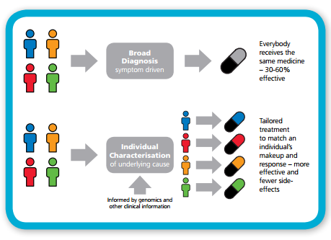
Future of genomic medicine: Providing personalised medicine
NHSE: Improving Outcomes through Personalised Medicine, September 2016
Notes:
Currently drugs are developed for a particular condition and there is the assumption that everyone will respond in the same manner. All patients with the same condition are given the same first line treatment however it is thought this is only effective for between 30 and 60% of patients.
Looking and the genomic and diagnostic characterisation different subtypes of patients within a condition can be identified, and a treatment can be tailored to the underlying cause.
For cancer this is an approach which is more commonly in place. Offering a genomic or molecular diagnosis - we can better understand the genetic basis and select the most appropriate treatment – improving survival chances.
It means that cancer patients can be stratified according to what is the most effective for their condition. May also mean that patients with different types of cancer may on the genomic diagnosis receive similar treatments.

Slide 18
Future of genomic medicine: Providing access to target clinical trials

Slide 19
Future of genomic medicine: Genomics in Mainstream Healthcare
Diagnoses
Genomics
Personalised Medicine
Prognoses
Treatments
The NHS workforce needs to understand, discuss and convey this complex area to colleagues and patients
How do we support clinical teams to deliver genomic medicine in the future, training, support, piloting and education
Notes:
The introduction of genomics into mainstream healthcare is set to provide new diagnoses, prognoses and treatments, forming the foundations of personalised medicine.
The genomic revolution is critical to the personalisation of healthcare, to the prediction of disease, and the prevention of disease.

Slide 20
Thanks and any questions
Catherine Carpenter-Clawson
Programme Manager, West of England GMC
Catherine.Carpenter-Clawson@nbt.nhs.uk

