Slide 1
South West Genomic Laboratory Hub (SWGLH) Update
Laura Yarram-Smith
SWGLH Solid Tumour Laboratory Lead
20/09/2019

Slide 2
Breast Cancer Genomics
Genomics in England and Genomic Lab Hub
Genomic Test Directory
Genomic Biomarkers in Breast Cancer
Future technologies eg ctDNA

Slide 3
Genomics – What is it?
3 Billion base pairs in the human genome

Slide 4
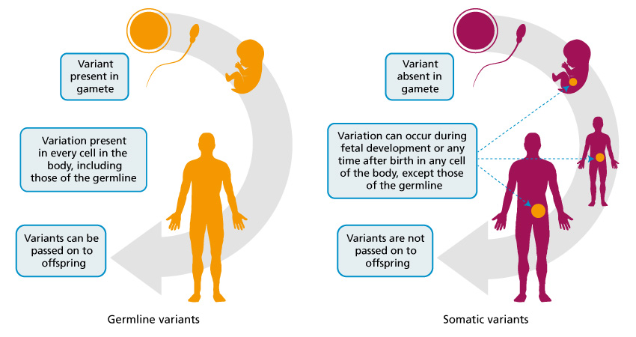
Germline/Somatic Variants
Professor Clare Turnbull of Genomics England - somatic and germline genomes in Cancer

Slide 5
The last 10-20 years has seen advances of ‘genomic technologies’
Next Generation Sequencing (NGS)
Whole Genomes
Whole Exomes (WES)
Targeted Gene panel
Whole Genome Sequencing (WGS)
Decrease in size of technology
Improvement in IT and bioinformatics
Decrease in genomic technology costs
Clinically Applicable within NHS

Slide 6
The UK is recognised worldwide as a leader in genomics and the unique structure of the NHS is allowing us to deliver these advances at scale and pace for patient benefit.
In March 2017, the NHS England Board set out its strategic approach to build a commissioned National Genomic Medicine Service, building on the NHS contribution to the 100,000 Genomes Project. This comprises five key elements:
A national genomic laboratory service through a network of Genomic Laboratory Hubs
A new National Genomic Test Directory to underpin the genomic laboratory network
A national Whole Genomic Sequencing provision and supporting informatics infrastructure developed in partnership with Genomics England
A clinical genomics medicine services and an evolved Genomic Medicine Centre service
A national co-ordinating and oversight function within NHS England (Genomics Unit)

Slide 7
The systematic application of genomic technologies has the potential to transform patient’s lives by:
enabling a quicker diagnosis for patients with a rare disease, rather than years of uncertainty, often referred to in rare disease as the ‘diagnostic odyssey’
matching people to the most effective medications and interventions, reducing the likelihood of an adverse drug reaction
increasing the number of people surviving cancer each year because of more accurate and early diagnosis and more effective use of therapies
There are also significant benefits for research and development that can be leveraged on behalf of the NHS, taxpayers and the wider economy.
https://www.england.nhs.uk/genomics/nhs-genomic-med-service/

Slide 8
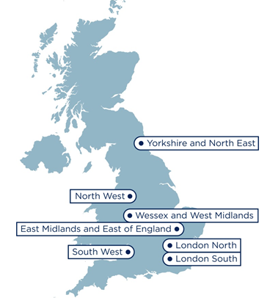
Mainstreaming genomic medicine
7 Regional Genomic Laboratory Hubs
South West Genomic Laboratory Hub region:
H
13 Hospital Sites [H]
H
H
2 Central laboratories [L]
Bristol Genetics Laboratory
Exeter Genetics Laboratory
L
H*
H
H
H
H
H
2 Clinical genetics services*
Bristol Genetics Service
SWP Genetics Service
L
H*
H
2 Genomic Medicine Centers
West of England
South West Peninsula
H
Population: >5,000,000
Span: >200 miles
GMCs: 2
H

Slide 9
Genomic Test Directory – Somatic
https://www.england.nhs.uk/publication/national-genomic-test-directories/
3 somatic indications for genomic testing in breast cancer
Latest version March 2019
Breast Cancer (M3) – testing continued by existing providers
Oncotype Dx (M3.2)
Endopredict (M3.3)
Prosignia (M3.4)
As per NICE recommendations in ER positive, Her2 negative, lymph node negative early breast cancer

Slide 10
Genomic Test Directory –Inherited
https://www.england.nhs.uk/publication/national-genomic-test-directories/
Genomic Test Directory for inherited rare diseases
Germline BRCA1 & BRCA2 indications for breast and ovarian cancers (R208)
Triple Negative Breast Cancer < 60 years
Multiple or bilateral breast cancers, first diagnosed < 50 years
Any breast cancer < 30 years
Any male breast cancer
Others
Consent by ‘non-genetics’ staff, impact on patient care

Slide 11
Possible Somatic genetic biomarkers
Laboratory developments – 500+ gene panel
Gene |  | Treatment | Status
PIK3CA | 37% | Alpelisib & Fulvestrant | FDA approved
AKT1 (E17K) | 5% | Capivasertib & Fulvestrant | Clinical trial
ESR1 | 8% | Fulvestrant & Lasofexifene (SERM) & LSZ102 (oral SERD) | Clinical trial
BRCA1, BRCA2 (somatic) | 3%, 4.5% | Olaparib & talazoparib | Approved
 |  | Olaparib, talazoparib and carboplatin | Clinical trial

Slide 12
Somatic Gene Panel Testing
BRCA1/2
AKT1 (E17K)
ESR1
PIK3CA
Is this what you expect from candidate somatic genes in breast cancer?
Are there any other genes you think should be included?
Nb. Only tests included on the test directory will be commissioned

Slide 13
ctDNA in breast cancer
ctDNA = circulating tumour DNA
Largely relies on detecting a somatic mutation in the tumour DNA, to subsequently look for that mutation in ctDNA
Where no tumour DNA not available, or no mutations discovered (eg tumour hetereogeneity) NGS can ‘screen’ for various somatic mutations in ctDNA
PlasmaMATCH – umbrella trial
Detection of ctDNA during follow-up associated with significantly higher risk of relapse
Detection of ctDNA occurred a median of 10.7 months before identification of clinical relapse.

Slide 14
Summary
Genomic Lab Hub
Genomic Test Directory
Potential Gene Panel Testing for Breast Cancer
Future developments in clinical practice e.g. ctDNA

Slide 15
Thank you!

