Slide 1
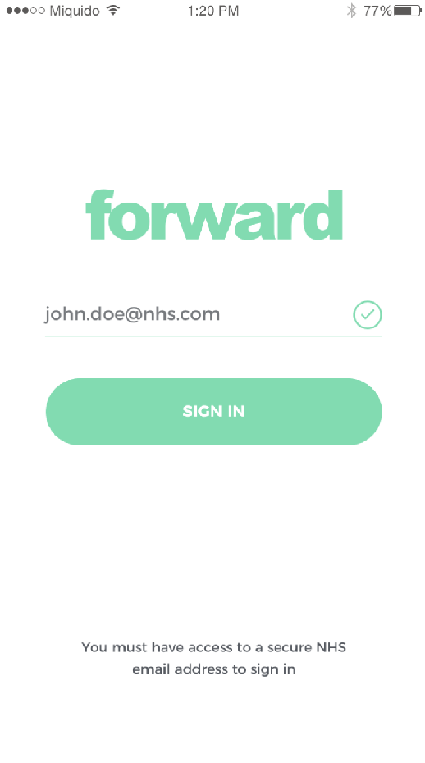
forward
Skin Cancer Network
aneurin.bevan@forward.com
fwd

Slide 2
Get GDPR ready!
Clinical networks are difficult to maintain without the right communication tools.
fwd

Slide 3
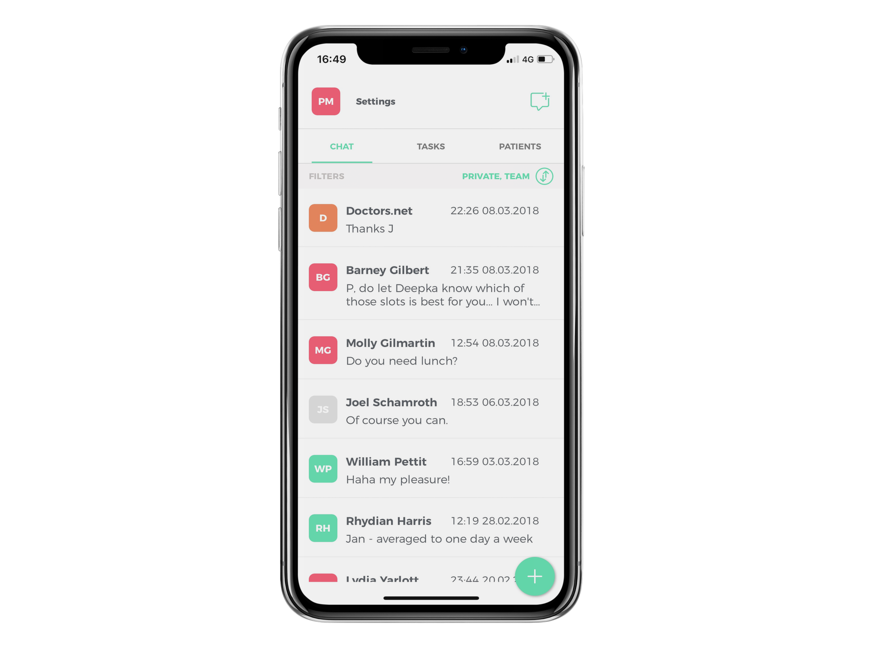
Secure messaging for
clinical networks & teams
Ability to share patient identifiable data safely & securely
Capture of key clinical decision quickly

Slide 4
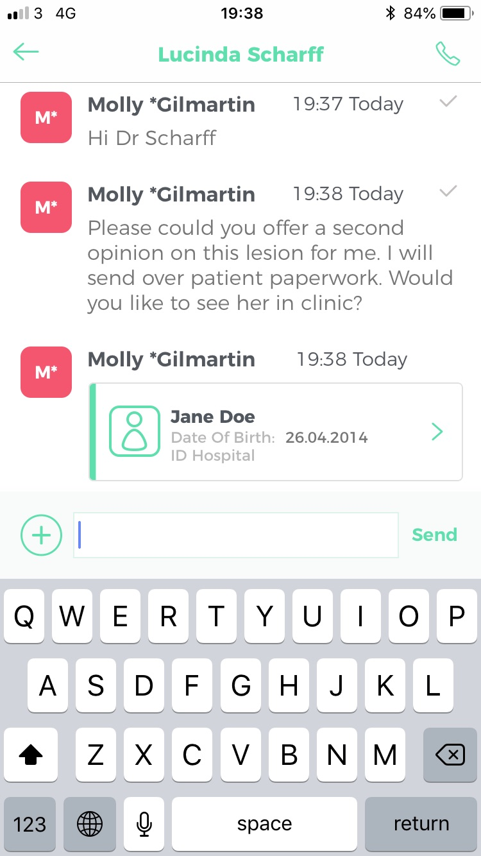
Built for clinical networks
Find colleagues on Forward using ‘Full Directory’
Shared patient profiles to transmit photos & patient details together
fwd

Slide 5
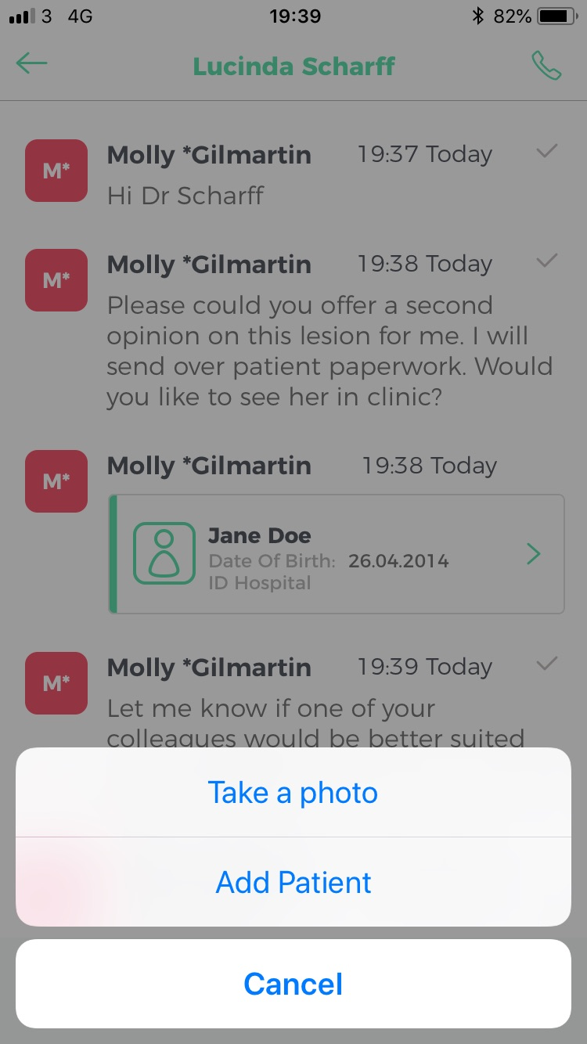
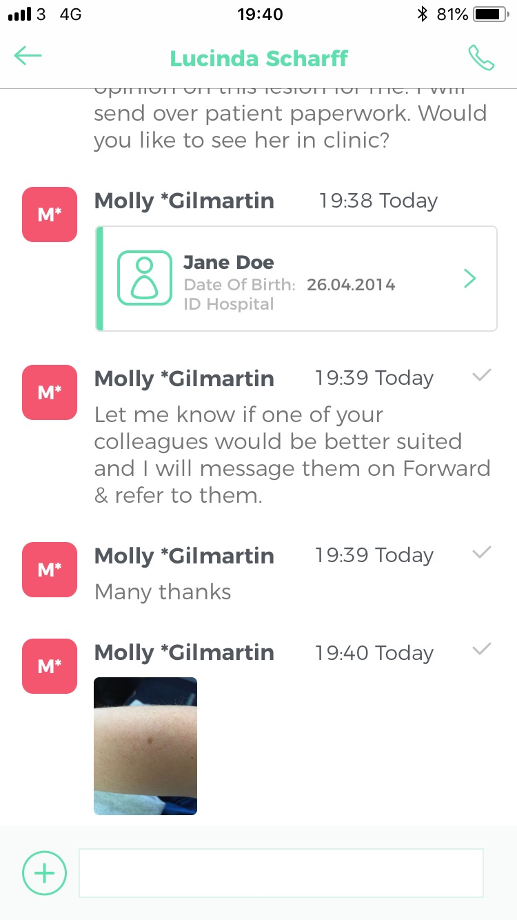
Share photos as patient profiles or directly in message threads
From the end of this week you will be able to transmit photographs directly within the messaging stream
Zoom available on photos

Slide 6
Keeping your patient data secure
NHS Information Governance Toolkit certified
All data stored on secure UK based servers
All data encrypted in transit & at rest
Ready for GDPR
fwd

Slide 7
Formally endorsed:
High User Count at:

Slide 8
"Forward has really changed how we work at Medway and we are proud to be the first Trust using the app. It is another great example of how we can use innovation to improve the patient experience." - Lesley Dwyer, CEO Medway Maritime NHS Trust
"I have tried all the apps on the market, and FWD is the most intuitive, the most thought through and definitely the one I would pick.” Consultant at Oxford University Hospital

Slide 9
Forward User Support 24/7
Contact the team at any time of day via their website: www.forwardhealth.co
Call 07702246407 [03300970165]
Email: molly@forwardhealth.co

