Slide 1
CADEAS Early Diagnosis Data 2017
Breast Cancer Clinical Advisory Group
20th September 2019

Slide 2
SWAG Data 2017: lowest early diagnosis rate in the country

Slide 3
Further detail from CADEAS

Slide 4
Investigation of potential reasons
Data completeness? Not significant: <4% incomplete data (majority of incomplete data is Performance Status)
Screening uptake?
SWAG uptake: 72.6%
England uptake: 70.5%
Diagnostic pathway? Cancer Waiting Times for Breast Cancer are consistently above the national standard over this time period.

Slide 5
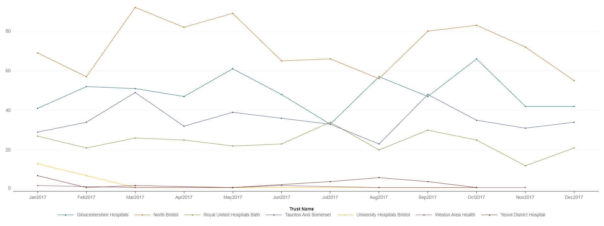
Other considerations: Incidence 2017 Summer holidays?

Slide 6
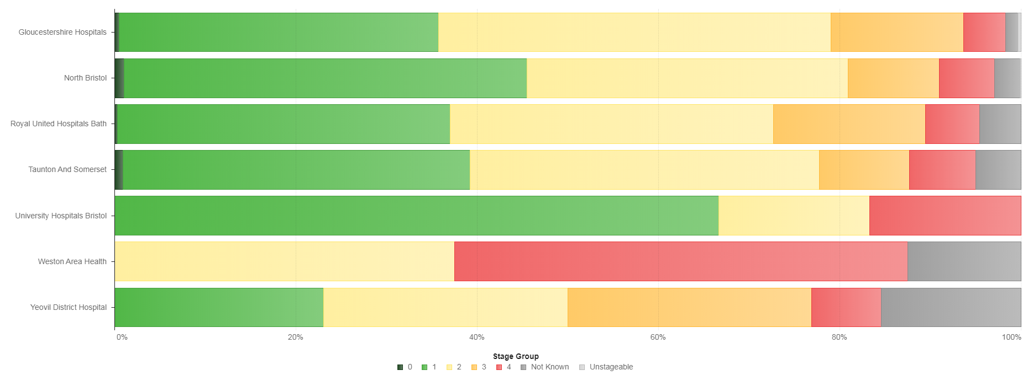
Stage 2017

Slide 7
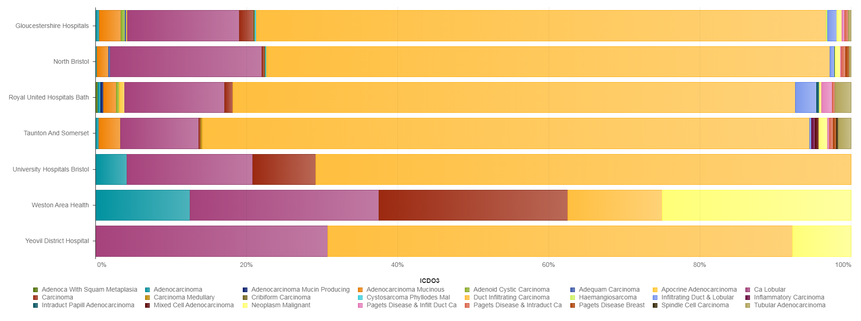
Morphology

Slide 8
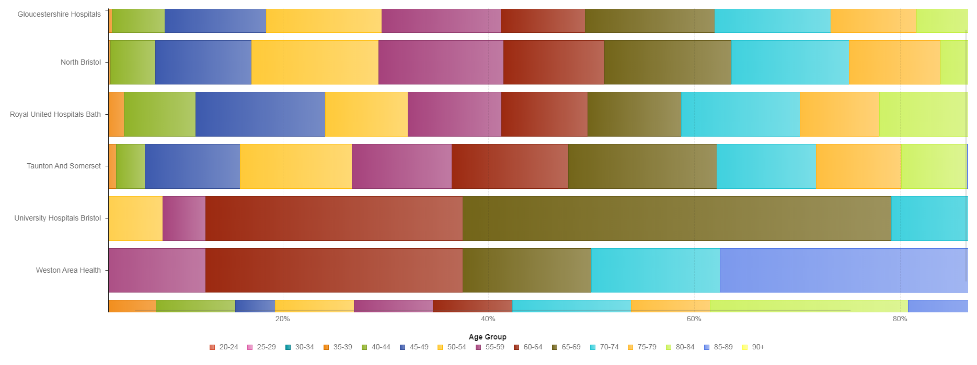
Age

Slide 9
Treatment 2017
Surgery
Radiotherapy
Chemotherapy

Slide 10
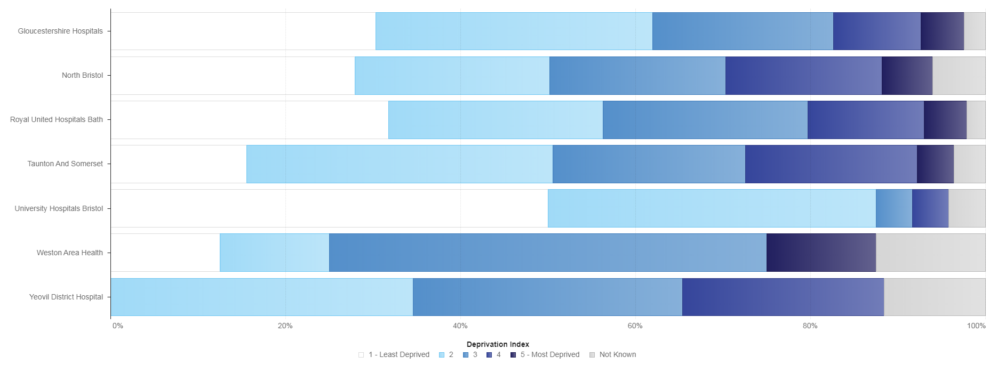
Deprivation 2017

Slide 11
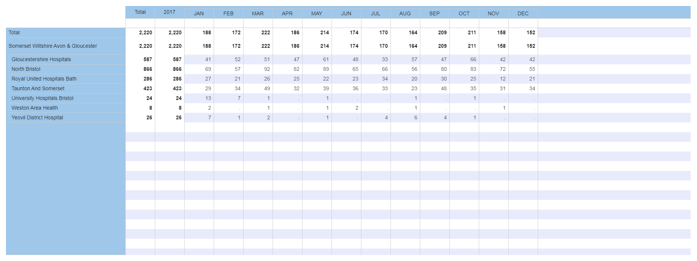
Data Table 2017

