Slide 1
Enhanced Recovery after Maxillofacial Surgery Bristol Royal Infirmary
Rory Spanton
Enhanced Recovery Nurse Practitioner
Bristol Royal Infirmary
July 2019

Slide 2
Attenuate perioperative stress
Maintain physiological function
Minimise post-op complications
Reduce length of stay
Improve clinical outcomes

Slide 3
BRI enhanced recovery timeline
2012 – Colorectal (all), thoracic (all) and oesophagectomy
2013 – Major free-flap
2015 – Whipple’s procedure, gastrectomy (total, subtotal), ENT (over 48 hours stay), all elective inpatient max fax procedures
2016 – Open liver resection
2018 – ERAS Lead, lap liver, bypass, distal panc, emergency laparotomy pathway,

Slide 4
Rory Spanton - ERAS Nurse Practitioner
Natasha Joshi - ERAS Clinical Lead
Lesley Wood – Data collection
Sandy Johnson – Data collection
Ceri Hughes – Max Fax surgical Lead
Patient and family
Pain Specialist Nurse
Ward Nurse
ICU
Anaesthetist
Physio
Surgeon
Dietician

Slide 5
Pre op Visit
Patient fit for surgery
Explanation of ERP verbal and written
Admitted on day of surgery
Carbohydrate drinks given pre-op
Avoided long acting sedative pre-med
Appropriate antibiotics given prior to KTS
Individualised goal directed fluid therapy
Hypothermia Prevention
Avoid post-op crystalloid overload
Avoid systemic opiates post-op
Early post-op nutrition
Targeted individual nausea and vomiting control
Mobilisation within 24 hours
Preoperative
Intraoperative
Postoperative

Slide 7
MDT buy-in
Overall component compliance
70-80%
“…to improve outcomes…”
Gotlib et al (2015)

Slide 9
What data do we collect?
ALL elective inpatients (over 24 hour stay)
ERAS compliance
Length of stay
Readmissions
Reoperations

Slide 11
Recommendations for free flap surgery
Consensus review
Core principles the same across specialties

Slide 12
Bristol Royal Infirmary 2016

Slide 13
Free Flap ERAS compliance (%)

Slide 14
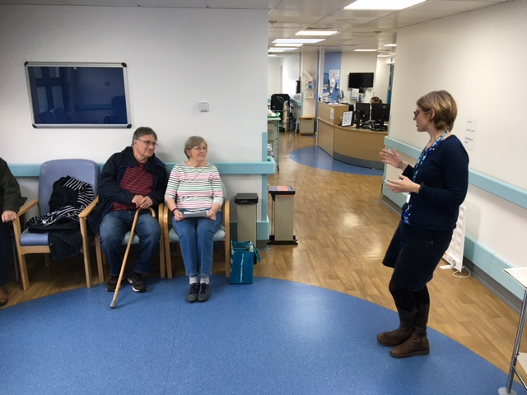
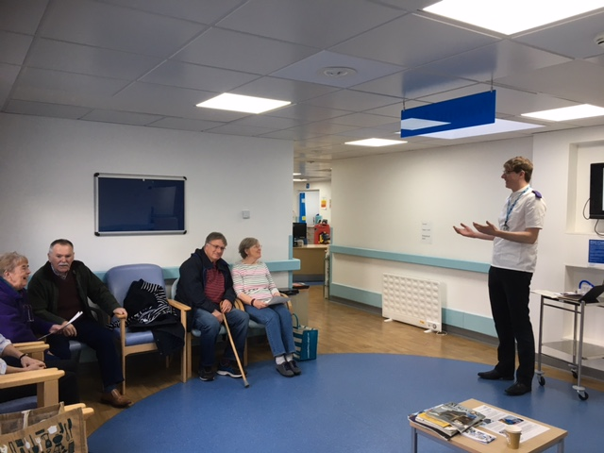
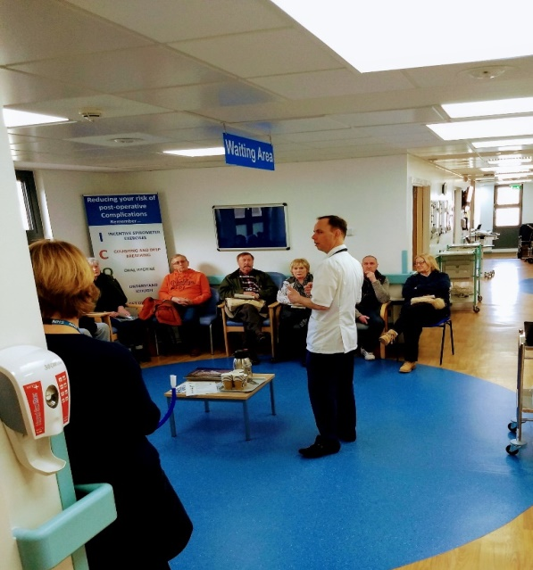
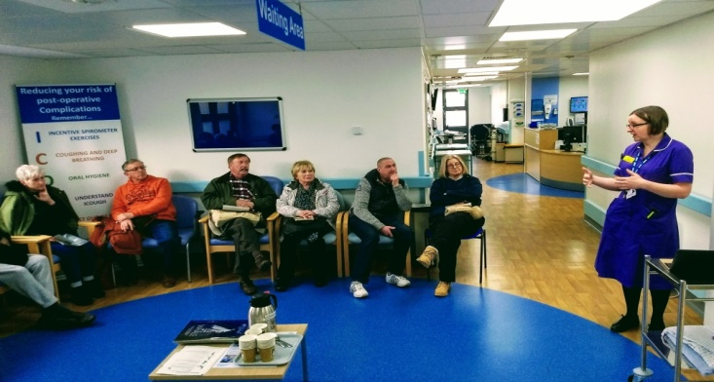
Prepare 4 Surgery
Every Monday, 2pm - POAC

Slide 15
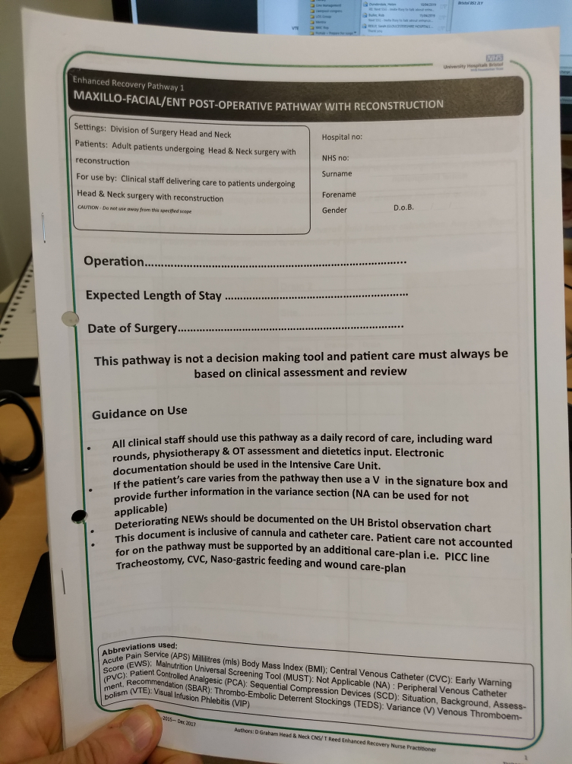
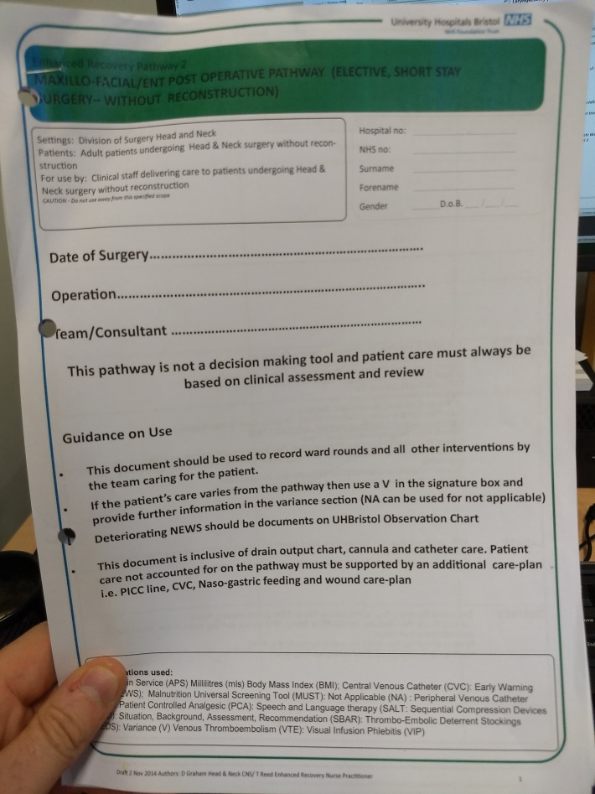
Areas for improvement
1. Pathway usage

Slide 16
2. POAC and ward staff engagement
 | 2014 (%) | 2018 (%)
Pre-op visit compliance | 100 | 100
Assessed as fit | 100 | 100
Carb drink consumption | 74 | 47
Written and verbal ERAS information | 55 | 52
Target nausea control | 97 | 95
Goal directed fluid therapy | 10 | 52
Mobilising within 24 hours | 7 | 38
Nutrition within 24 hours | 90 | 86

Slide 17
3. Data collection
 | MEDIAN LENGTH OF STAY
Month | Excision sub-mandibular gland | Major - Flap/ Reconstruction | Major - Free Flap | Maxillectomy | Neck dissection | Osteotomy | Other | Parotidectomy | Thyroidectomy | Comb maxill & neck diss'n | Comb neck diss'n & parotid | Comb thyroid & neck diss'n | Overall Median LOS
Jan-17 |  |  | 15.5 | 3.0 | 8.0 | 1.0 | 1.0 |  |  |  |  |  | 1.0
Feb-17 |  |  | 19.0 | 1.0 | 4.0 | 1.0 | 1.0 | 1.0 | 1.0 |  |  |  | 1.0
Mar-17 |  |  | 11.0 | 1.0 | 5.0 | 1.0 | 1.0 |  | 1.0 |  |  |  | 1.0
Apr-17 | 1.0 |  |  |  | 6.5 | 1.0 | 1.0 |  | 1.0 | 4.0 |  |  | 1.5
May-17 |  |  | 17.0 | 6.0 | 8.0 | 1.5 | 1.0 | 3.0 | 1.0 |  |  |  | 1.0
Jun-17 |  | 15.0 | 11.0 |  | 9.0 | 1.0 | 1.0 | 1.0 | 1.0 |  |  |  | 1.0
Jul-17 | 1.0 | 17.0 | 19.0 |  | 3.0 | 1.0 | 1.0 | 1.0 | 1.0 |  |  |  | 1.0
Aug-17 | 1.0 |  | 16.5 | 16.0 | 8.0 | 1.0 | 1.0 |  | 1.0 |  |  |  | 1.0
Sep-17 | 1.0 |  | 69.0 | 1.0 | 9.0 | 1.0 | 1.0 | 1.0 | 1.0 |  |  |  | 1.0
Oct-17 | 1.0 |  | 25.5 | 1.0 |  | 1.0 | 1.0 |  | 1.0 |  |  |  | 1.0
Nov-17 | 1.0 |  | 14.0 |  | 5.0 | 1.0 | 1.0 | 1.0 | 1.5 |  |  |  | 1.0
Dec-17 |  |  | 11.0 |  | 8.0 | 1.0 | 1.0 |  |  |  |  |  | 1.0
Jan-18 |  |  | 10.5 | 4.0 | 15.0 | 1.0 | 3.0 | 1.0 | 1.0 |  |  |  | 3.0
Feb-18 |  |  | 8.0 |  | 8.0 | 1.0 | 1.0 |  | 1.0 |  |  |  | 2.9
Mar-18 | 1.0 |  | 36.0 |  |  | 1.5 | 1.0 |  | 1.5 |  |  | 4.0 | 1.0
Apr-18 |  |  |  |  | 4.5 | 1.0 | 1.0 | 1.0 | 1.0 |  |  |  | 1.0
May-18 |  |  | 12.0 | 3.0 | 5.0 | 1.0 | 1.0 |  | 1.0 |  |  |  | 1.0
Jun-18 |  |  | 17.0 | 1.5 | 2.0 | 1.0 | 1.0 |  | 2.0 |  |  |  | 1.0
Jul-18 | 1.0 |  | 16.0 |  |  | 1.0 | 1.0 | 1.0 | 1.0 |  |  |  | 1.0
Aug-18 | 1.0 | 25.0 | 16.5 |  | 7.0 | 2.0 | 1.0 | 1.0 |  |  |  |  | 1.0
Sep-18 |  |  | 20.0 | 1.0 |  | 1.0 | 1.0 |  | 1.0 |  |  |  | 1.0
Oct-18 | 1.0 |  | 21.0 | 3.0 | 5.0 | 1.0 | 1.0 | 1.0 | 1.0 |  |  |  | 1.0
Nov-18 | 1.0 | 20.0 | 5.0 | 3.0 | 1.0 | 1.0 | 1.0 | 1.0 | 1.0 |  |  |  | 1.0
Dec-18 |  |  |  | 2.0 | 9.0 | 2.0 | 1.0 | 1.5 | 1.0 |  |  |  | 1.0
Current issues
Retrospective collection
Ambiguous categories (‘other’)
Is the data actually being used?

Slide 18
Questions and discussion?
rory.spanton@uhbristol.nhs.uk
Reading:
1.Gotlib Conn L, McKenzie M, Persall EA, McLeod RS. Successful implementation of an enhanced recovery after surgery programme for elective colorectal surgery: a process evaluation of champions’ experiences. Implement sci. 2015;10:99.
2.Ljungvist O, Scott M, Fearon KC. Enhanced Recovery After Surgery; a Review. JAMA Surg. 2017;152(3):292-298.
3. Nicholson A, Lowe MC, Parker J, Lewis SR, Alderson P, Smith AF. Systematic review and meta-analysis of enhanced recovery programmes in surgical patients. Br J Surg 2014;101:172–88.
4. Gustafsson UO, Scott MJ, Hubner M, Nygren J, Demartines N, Francis N, Rockall TA, Young-Fadok TM, Hill AG, Soop M, de Boer HD, Urnam RD, Chnag GJ, Fichera A, Kessler H, Grass F, Whang EE, Fawcett WJ, Carli F, Lobo DN, Rollins KE, Balfour A, Baldini G, Riedel B, Ljungqvist O. Guidelines for Perioperative Care in Elective Colorectal Surgery: Enhanced Recovery After Surgery (ERAS) Society Recommendations: 2018 et al colorectal guidelines. World J Surg. 2018; doi.org/10.1007/s00268-018-4844-y
5. Wynter-Blyth V, Moorthy K. Prehabilitation: Preparing patients for surgery. BMJ. 2017;358:j3702.
6. Weiser TG, Haynes AB, Molina G, et al. Estimate of the global volume of surgery in 2012: an assessment supporting improved health outcomes. Lancet 2015; 385(Suppl ):S11
7. Scheede-Bergdahl C,Minnella EM, Carli F. Multi-modal prehabilitation: addressing the why, when,what, how, who and where next? Anaesthesia 2019, 74 (Suppl. 1), 20–26
8. Neville A. Leel L, Antonescu I, Mayo NE, Vassioiou MC, Fried GM, Feldman LS. Systematic review of outcomes used to evaluate enhanced recovery after surgery. BJS. 2014;101(3):159-171.
9. Laudicella, M., Walsh, B., Munasinghe, A. and Faiz, O. (2016) Impact of laparoscopic versus open surgery on hospital costs for colon cancer: a population-based retrospective cohort study. BMJ Open [online]. 6 (11), pp. e012977. Available from: http://bmjopen.bmj.com/lookup/doi/10.1136/bmjopen-2016-012977doi:10.1136/bmjopen-2016-012977.

