Slide 1
Dermatology in Somerset
Carmen Chadwick-Cox
Deputy Director of Commissioning Planned Care
6th November 2019

Slide 2
Background
Secondary Care
Historically 2 acute providers in Somerset – YDH & TST
2017 – TST stopped providing a service for new patients
Activity redistributed between Yeovil, Bristol and Exeter
2WW - UHB provide 40 slots per week
Routine – mainly to RD&E, with some to YDH & RUH
Community Dermatology (GPwSI)
Historically service available across Somerset
Now only provided by 4 GPwSI in 2 Practices in Taunton
Service in Tiverton that can be accessed by Somerset patients (run by RD&E Consultants)

Slide 3
Current Service Issues
2WW Capacity
Extra capacity provided by UHB & RD&E
No extra capacity available this year
Created a backlog of referrals held back

Slide 4
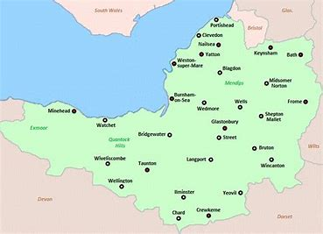
Current Service Issues
Inequitable service provision
Patients having to travel to Bristol, from Taunton area, for 1st appointment
Secondary Care
Only available in Yeovil
Community Dermatology Service
Only available in Taunton
(2 x Practices 4 x GPwSI)

Slide 5
Plan
Dermatology agreed as a workstream for the Planned Care Transformation Programme
Identify gaps in current model and develop future model
Stakeholder Workshop18th Oct
New Dermatology Model to STPB for Agreement at the beginning of Q4

Slide 6
Plan
Key deliverables:
Reduction in 2WW demand
Increase in Telederm referrals/number of GP’s using Telederm
GP confidence to manage patients within Primary Care
Equitable provision of Community Dermatology across the county
Robust provision in place for training, accrediting and supporting GPwER
Rolling Programme of Primary Care education on recognition of skin lesions and pathway management
Patient feedback on confidence to self manage

Slide 7
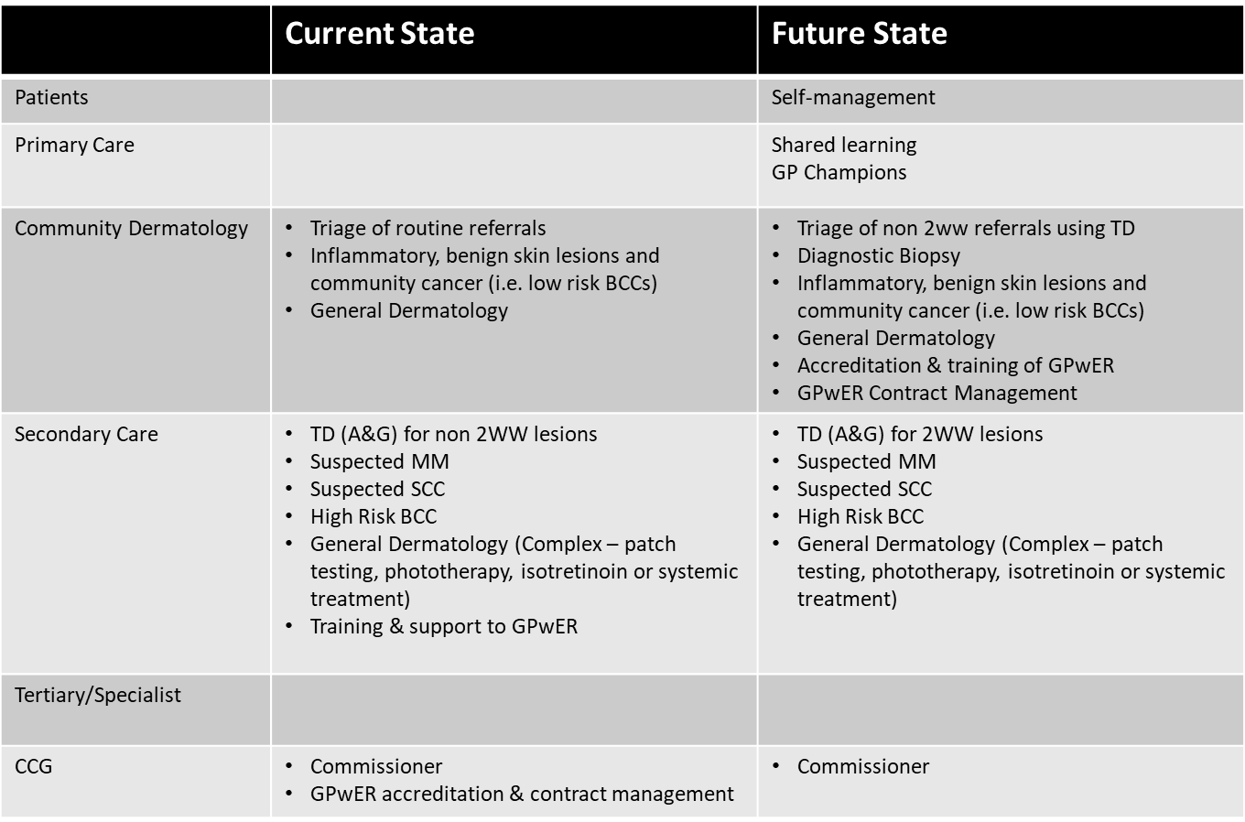
Current State v Future State

