Slide 1
SWAG Cancer Alliance: Cancer Transformation Programme
Catherine Neck
Macmillan Cancer Rehabilitation/ Recovery Package Project Lead
Catherine.neck@nbt.nhs.uk

Slide 2
Cancer Transformation Funding
SWAG Alliance CT Funding:
Revenue £2.8m in 2017/18; £2.7m in 2018/19 Capital £0.4m in 2017/18 only
Principle cancer sites = Breast, colorectal & prostate
Increase roll out of the Recovery Package:
2 x Holistic Needs Assessment: by 31 days post diagnosis; within 6 weeks of end of treatment
Health & Wellbeing events
Treatment summaries
GP Cancer Care Review
Implement Risk Stratified Pathways:
By end of Yr 1 – Breast
By end of Yr 2 – Colorectal & Prostate

Slide 3
SWAG Cancer Alliance CT Project
Recruitment of Cancer Support Workers to enable increased delivery of HNA and H&WB activity
Development of Digital Patient Portal
Development of SCR/ Infoflex to support data collection and support implementation
Psychological training programme
Quality improvements for primary care support
Cancer Rehabilitation services

Slide 4
Alliance Programme Governance
Clinical Leadership is provided by Dr Dorothy Goddard as Alliance LWBC Clinical Lead and Chair of the Alliance LWBC group.
There will be a pan –Alliance programme management team made up of the Alliance Programme manager, Macmillan resourced senior project managers and cancer transformation funded (CTF) STP and provider project managers.
The CTF project managers will work in a consistent way and be professionally accountable to the Alliance programme manager and clinical lead in addition to their employing organisation. This will enable the team to work across the alliance and with system wide developments across each STP including primary care and the community to ensure delivery of the Alliance agreed ambitions.
This structure crucial to achieve change at pace both within Trusts but also achieve an equitable and sustainable service across SWAG.

Slide 5
Jon Miller South West Cancer Programme Lead
Peninsula Cancer Alliance
SWAG Cancer Alliance
Dr Alison Diamond Executive Lead
Mr John Renninson Clinical Lead
Lynne Kilner Programme Manager
Patricia Mclarnon Programme Manager
Dr Amelia Randle Clinical Lead
James Rimmer Executive Lead
Dr Joe Mays P&ED Clinical Lead
LWBC Clinical Lead
Pathways Clinical Lead – Prostate Mr Nick Burns-Cox
Dr Sadaf Haque P&ED Clinical Lead
Dr Dorothy Goddard LWBC Clinical Lead
Pathways Clinical Lead – Prostate Prof. Raj Persad
Lung – vacant
Nina Kamalarajan SSG Manager
Macmillan Patient and Public Involvement Lead
Sarah-Jane Davies P&ED Project Manager
Nicola Gowen
P&ED Project Manager
Macmillan PPE – Katy Horton-Fawkes
Helen Dunderdale SSG Manager
Asha Sahni SSG Administrator
Emma Derrick Network Assistant
Admin Assistant - vacant

Slide 6
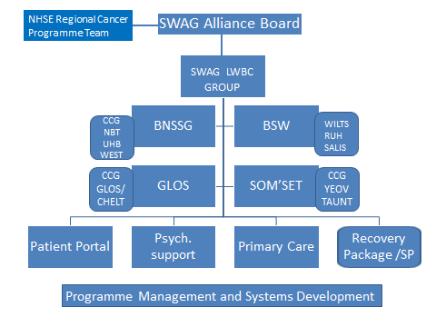

Slide 7
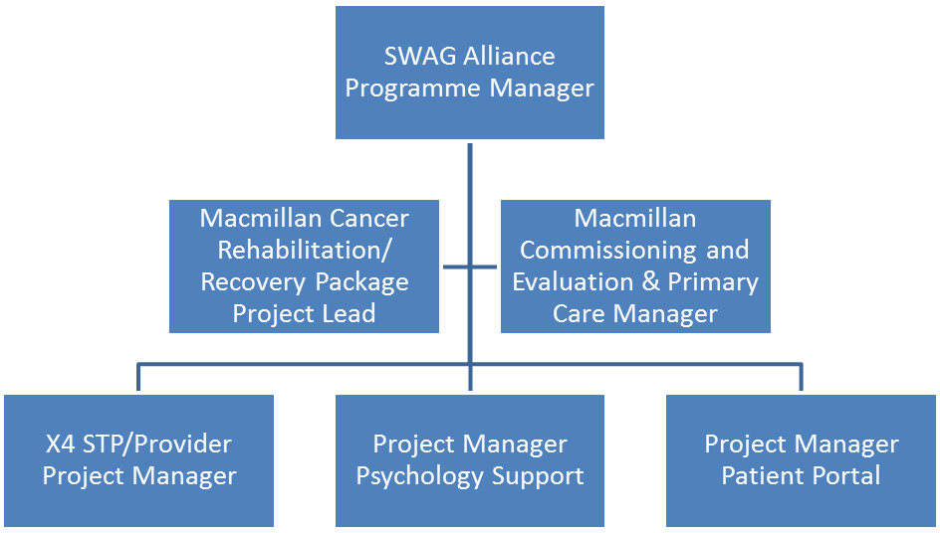
Success in achieving SWAG’s aspirations for cancer services is dependent on a collaborative approach which is built on the ability of organisations to develop a joint approach, where each organisation accepts the collective responsibility for achieving mutually agreed objectives and a shared approach to risk

Slide 8
Implications for Head & Neck Cancer teams
Cancer support workers to enable delivery of the Recovery Package
Greater access for patients to Health & Wellbeing events
Continue work on developing Risk Stratification Pathways
Improvements to SCR/ Infoflex
Digital Patient Portal development
Greater access to rehabilitation services

