Slide 1
Cancer Stats Website
Breast Cancer SSG
14th November 2018
https://cancerstats.ndrs.nhs.uk

Slide 2
Cancer Outcomes and Services Dataset – Level 2
This portal has been designed to give providers of COSD cancer data rapid feedback on the quality of their submissions.
It allows users to look at the completeness of key data items and to conduct comparisons with local, regional and national averages to calculate relative performance
Notes:
The Cancer Outcomes and Services Dataset (COSD) entered into the Somerset Cancer Register within the MDT and submitted to the National Cancer Registration and Analysis Team on a monthly basis, is available to view on NHS computers by registering on the Cancer Stats website
Data completeness sent from Trusts can be viewed by selecting ‘Level 2’ from the COSD drop down menu. The dataset can then be filtered by tumour group, Trust and year to look at the monthly submissions in detail.

Slide 3
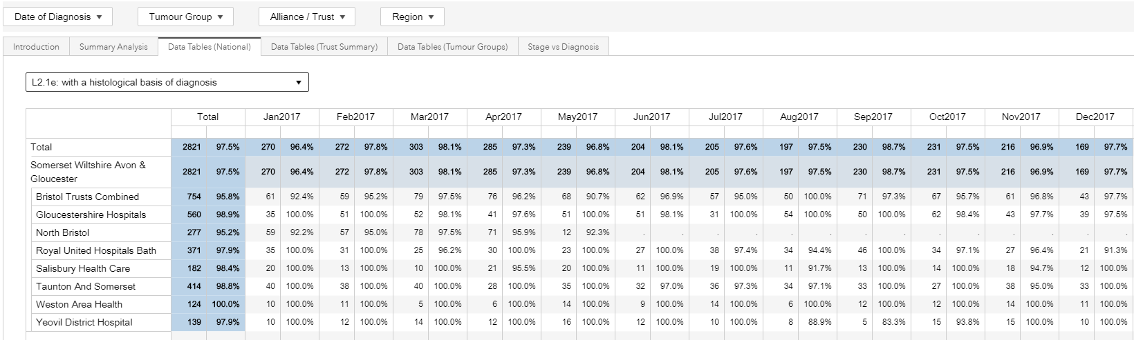
Data Tables – Trust Summary
Notes:
For example, breast cases with a histological basis of diagnosis in 2017

Slide 4
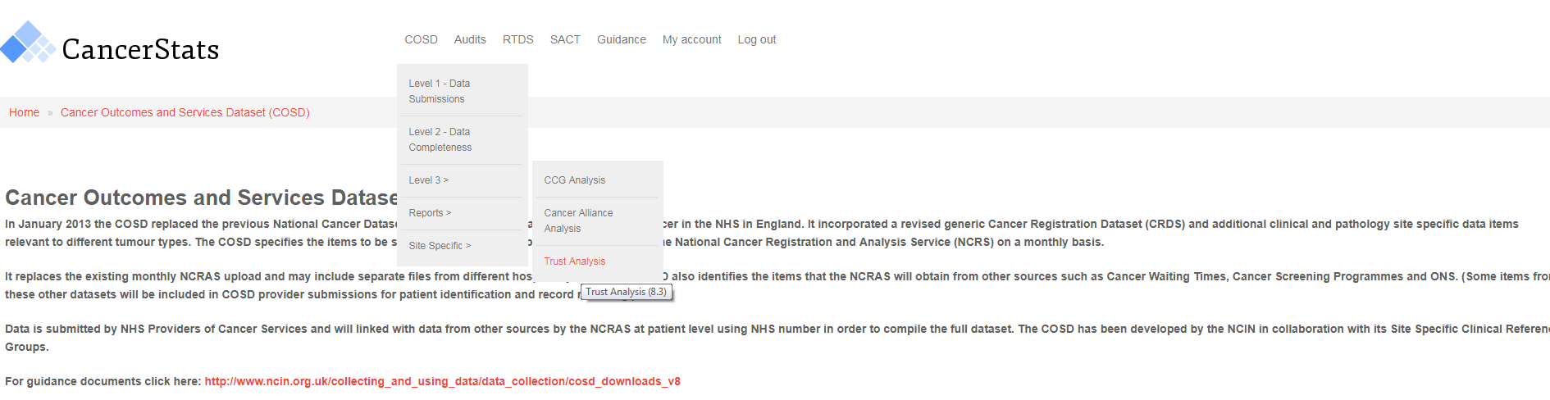
Level 3 Data
Notes:
The registration team add missing information to the dataset by accessing a variety of information systems, including pathology, radiology, systemic anti-cancer therapy, cancer waiting times etc. Ideally the dataset would be completed in full prior to submission. This more complete dataset can be viewed by selecting ‘Level 3’ from the COSD drop down menu, filtered as above, and compared with other Trusts.

Slide 5
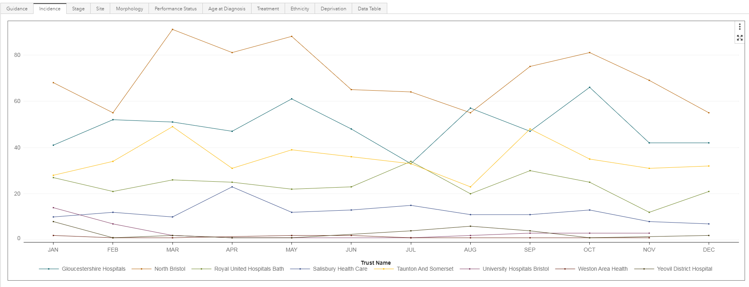
Incidence

Slide 6
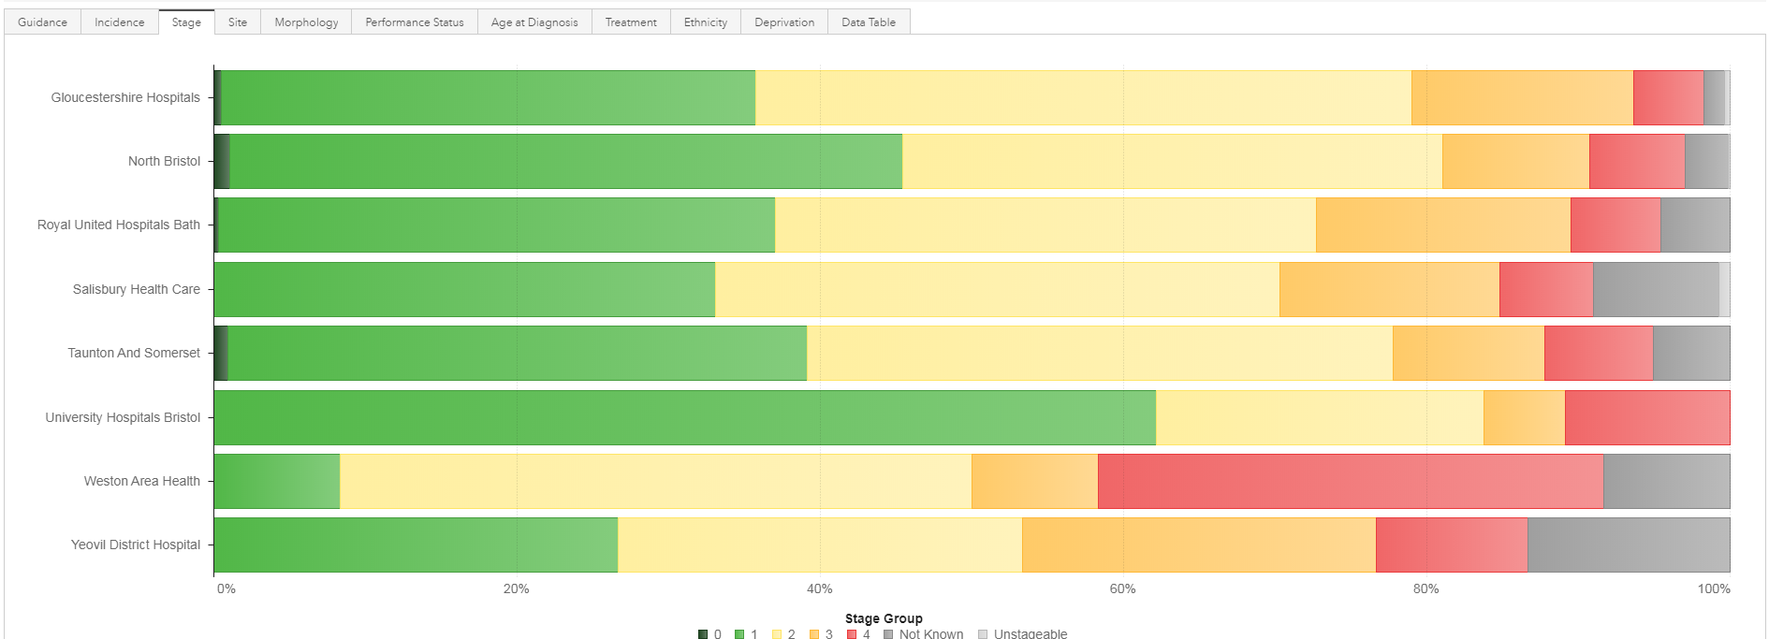
Stage

Slide 7
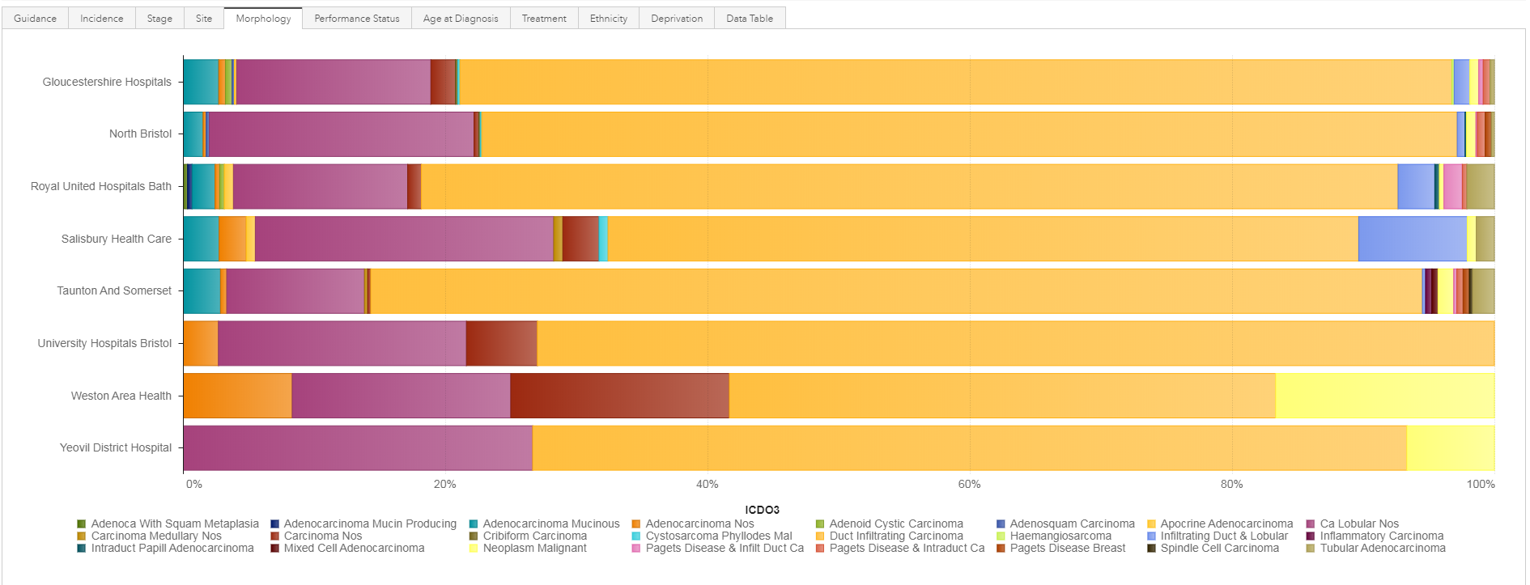
Morphology

Slide 8
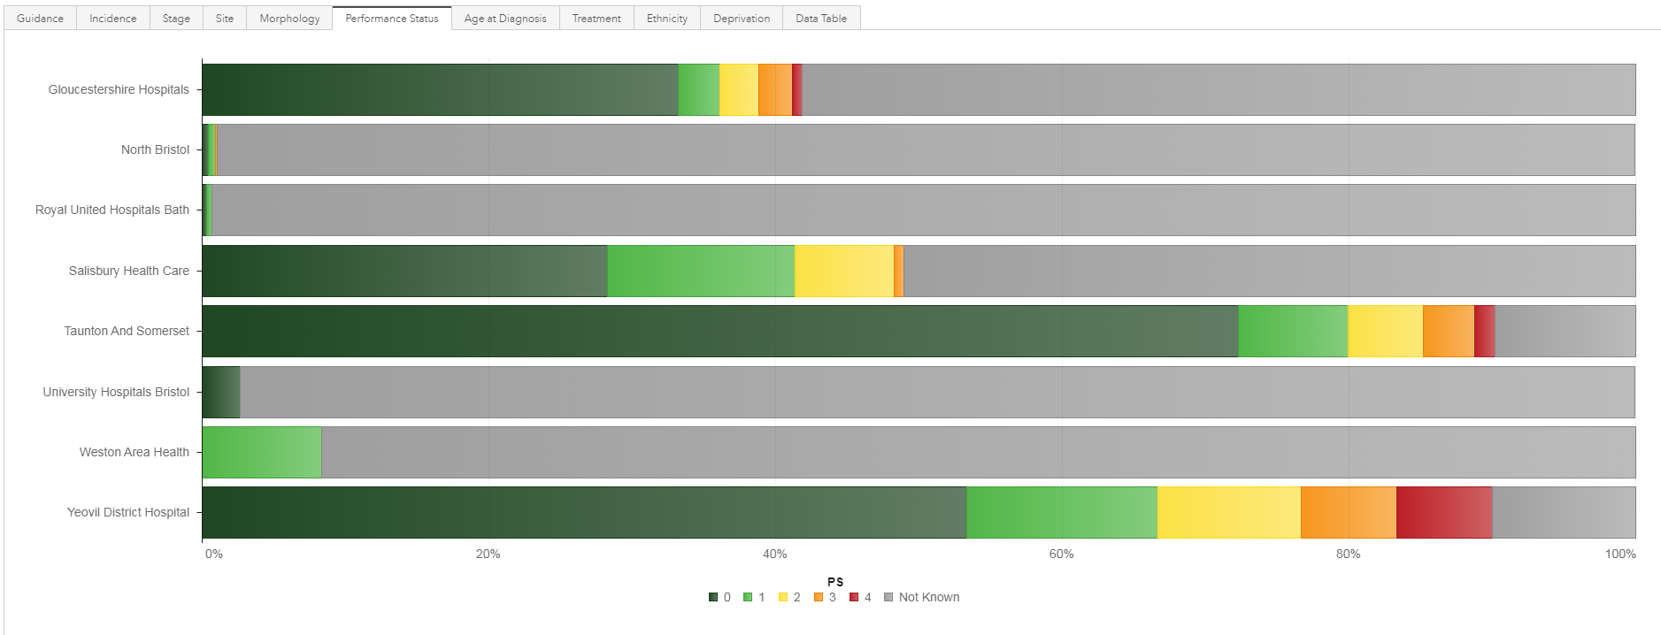
Performance Status

Slide 9
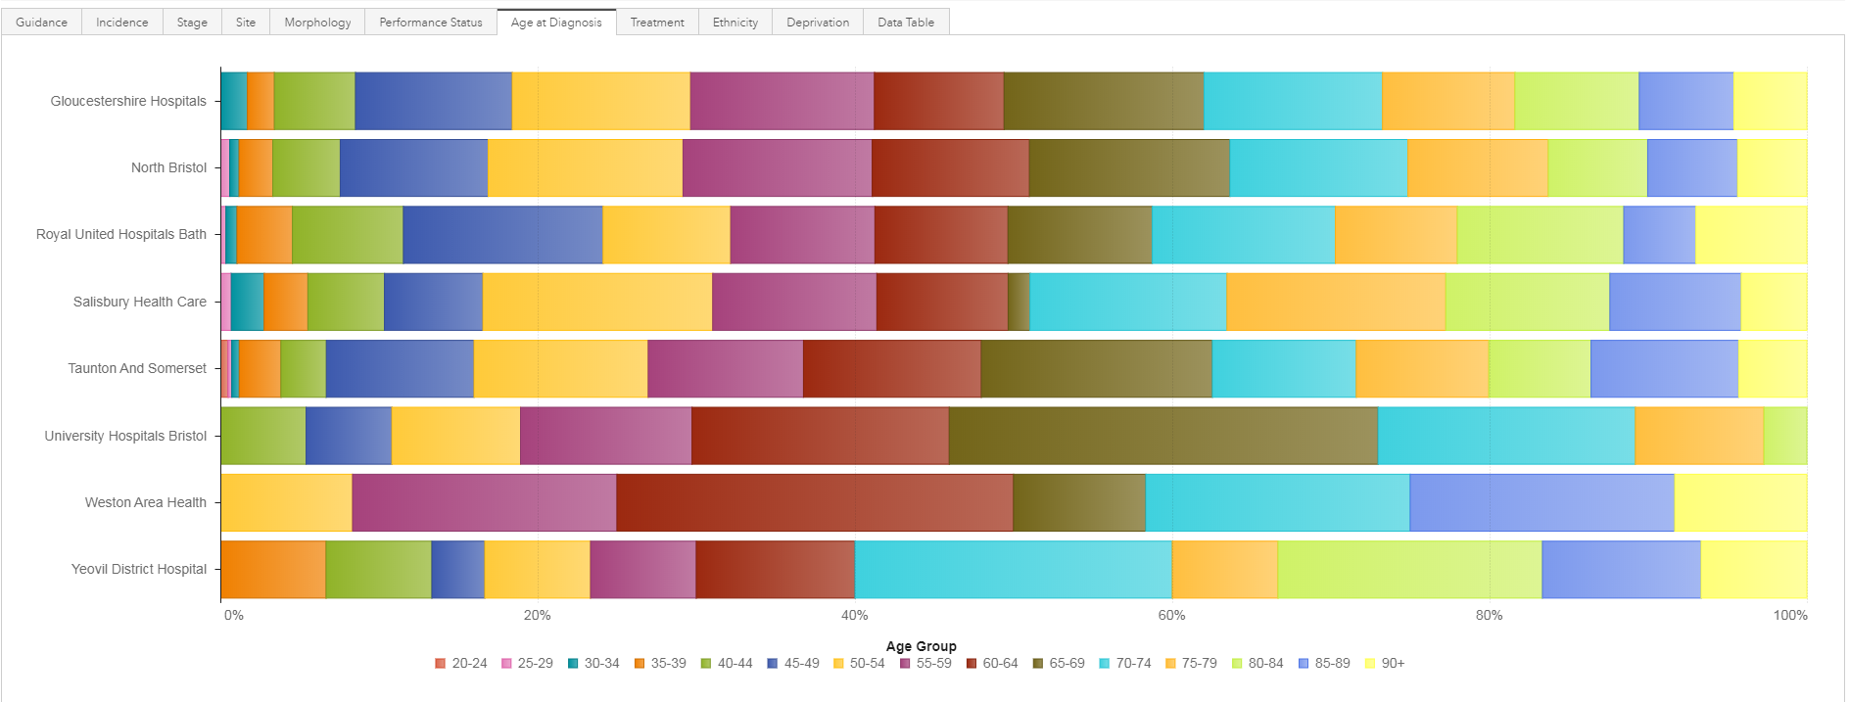
Age at diagnosis

Slide 10
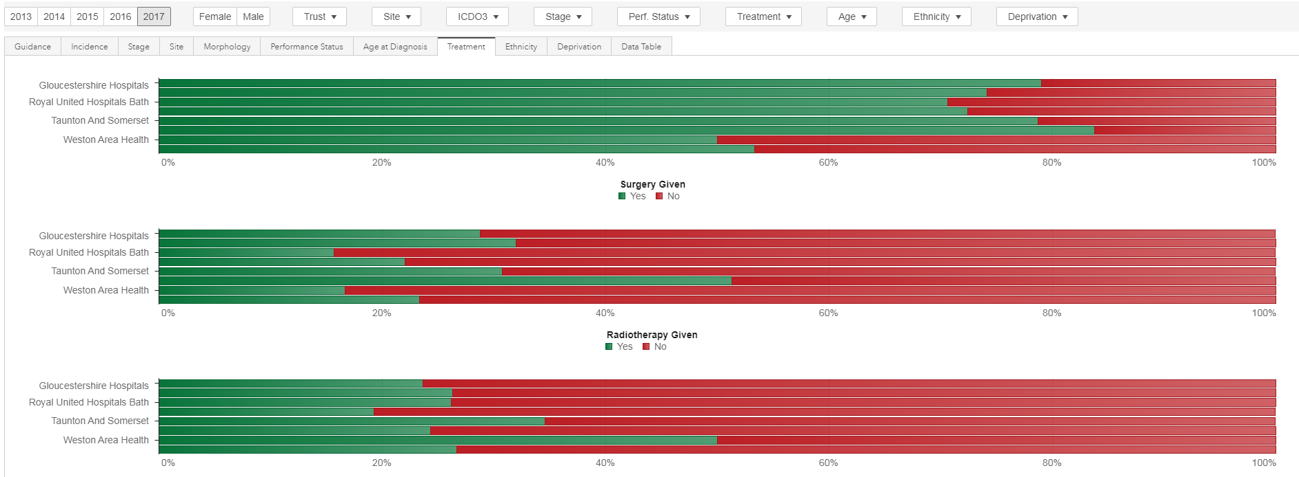
Treatment

Slide 11
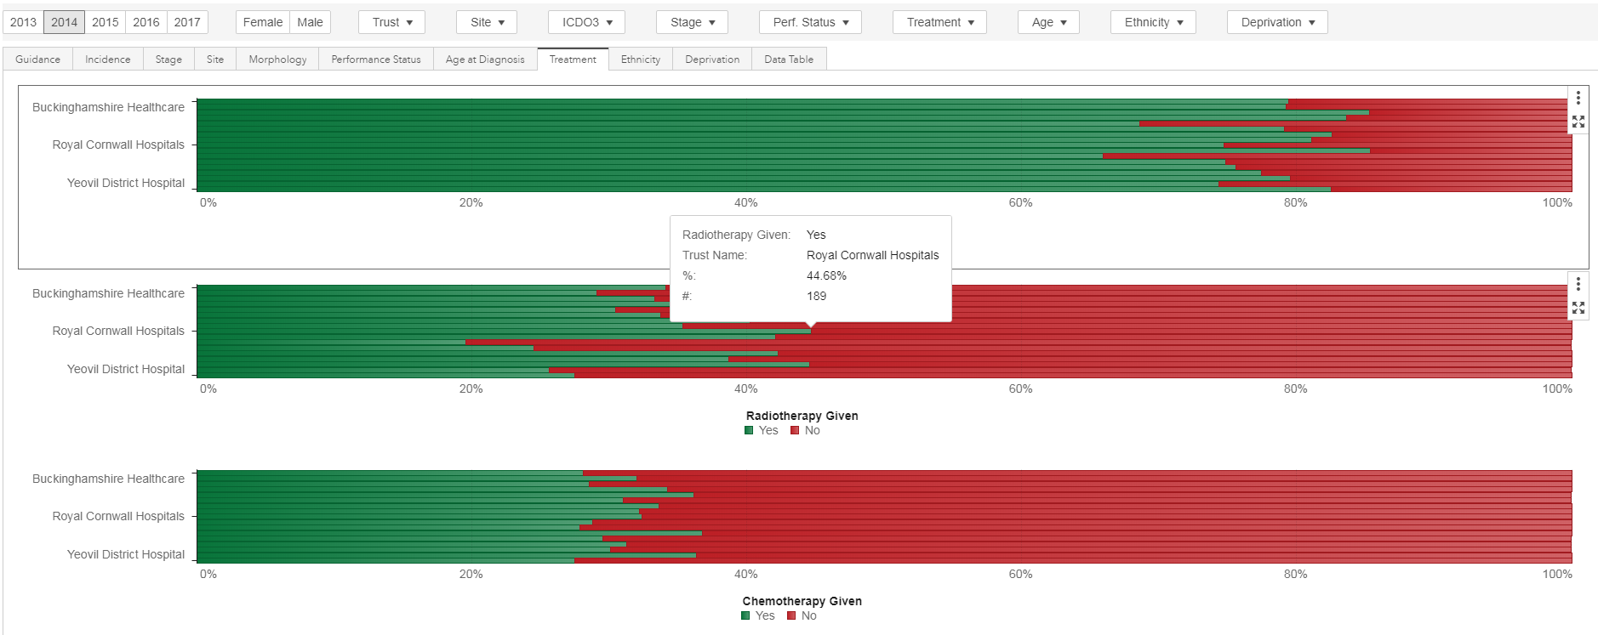
Comparison with other Alliances

Slide 12
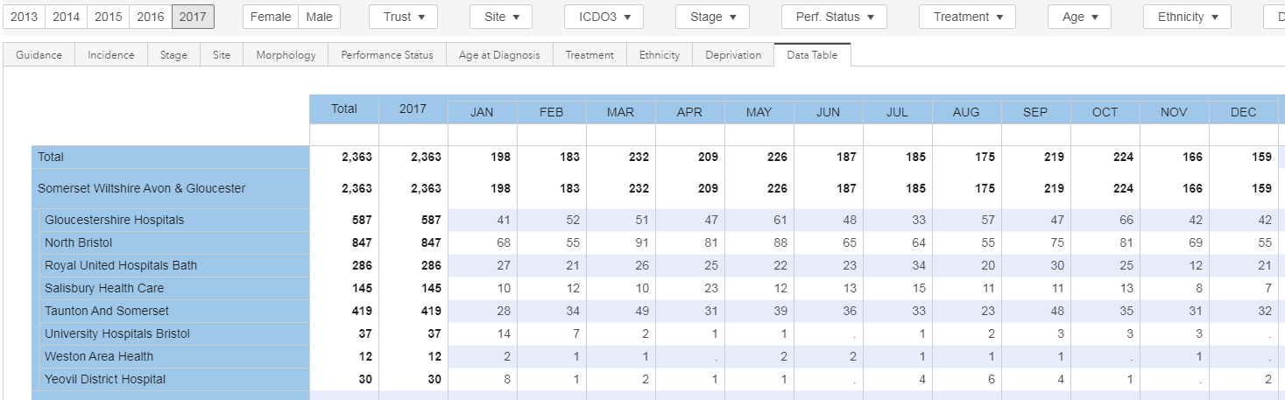
Data Table

Slide 13
NBT Diagnoses
2013: 601
2014: 715
2015: 803
2016: 805
2017: 847
Incidences appear to fall in Summer

Slide 14
Register
http://cancerstats.ndrs.nhs.uk/
Queries about analysis:
NCRASenquiries@phe.gov.uk.

