Slide 1
SW Cancer Alliances Colorectal Pathway Plan
Michael Thomas SWAG Clinical Lead
Melanie Feldman PCA Clinical Lead

Slide 2
The SW CRC Pathway Case for Change – Mike to add to slides as appropriate
CRC is the 4th most common cancer in the UK, 42000 are diagnosed each year.
More than doubling referrals into cancer diagnostic pathways since 2015, a gap in capacity for endoscopy and radiology provision, surgical and oncology services, and a financially limited environment
2WW pathways have become seen as a reliable means of ensuring a patient is investigated promptly
The pathways consume huge volumes of resource for those without cancer, people often being referred into the pathways year after year after year.
limited diagnostic capacity means that patients in routine pathways have extended waits yet 20% of cancer patients start in routine pathways and 20% don’t present at all until an emergency develops – these people having more advanced disease
Notes:
Text

Slide 3
The SW CRC Pathway Case for Change – Mike to add to slides as appropriate
SW Clinical Senate Sept 2018
To what extent are providers in the South West able to deliver the national commissioning pathways for colorectal cancer patients?
What are the key areas for pathway redesign and provision of service that will improve the quality of experience & timeliness of treatment for patients across the region?
One model of care will not suit all yet the drive to constantly find local solutions to local problems leads to duplication of work, paralysis in the face of huge challenge and inequitable provision of services which leads to compromised patient outcomes.

Slide 4
National Drivers
The national cancer strategy - ambitious aim to make significant progress in reducing preventable cancers, increasing cancer survival and improving patient experience and quality of life.
Survival rates for cancer have never been higher, and overall patients report a very good experience of care. However, earlier and quicker diagnosis will have a major impact on survival. Variation in access to care also needs to be addressed.
Early diagnosis, fast diagnosis, and equity of access to treatment and care are central to the National Cancer Programme and the transformation of services we want to achieve.
Cancer and the NHS Long Term Plan - Diagnose 75% of cancers at stage 1 or 2 by 2028
Rapid Diagnostic Pathway - improved number of cancers diagnosed within 28 days by March 2020
Notes:
Cancer alliances are leading their local commissioners and providers to drive earlier and faster diagnosis. The rapid diagnosis and assessment interventions they are putting in place now will help to ensure the Faster Diagnosis Standard is met for patients when fully introduced from April 2020.

Slide 5
Illustrates a simplified portrayal of a very complex system
As CRC, and its precursor ( polyps) are more prevalent with age many patients have additional health problems which can be exacerbated by diagnostic tests, treatments can be life threatening or life changing. Though the volume of referrals has led to streamlined and automated pathways there will always be moments for complex shared decision making and these can occur at multiple steps in the pathway. Plus, limited IT abilities may mean that apparently simple administrative steps involve multiple organisational and human factor aspects with inbuilt and unrecognised delay.
Staging tests may be contraindicated – MRI with some metal devices within the body, inconclusive biopsies needing repeat, or lead to additional tests when significant incidental findings are present.
Arranging appointments can involve several steps in series over several days, dependent on individuals being present at work and not switched to doing different urgent work.

Slide 6
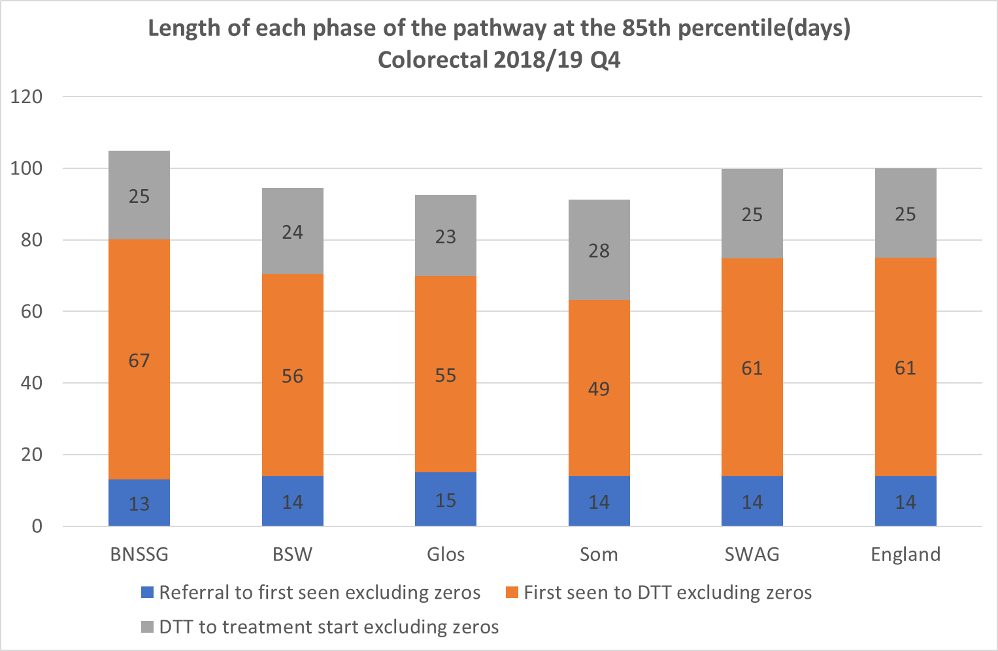

Slide 7
Project Approach & Outcomes
Peer review visits with two outputs: 1. A report for each Trust outlining areas of strength, weakness, challenge and good practice.
2. A handbook of the good practice and practical solutions in use throughout the region which can be used as a resource for change elsewhere.
The peer review need not be onerous, mixing collection of established data sets with site visits where decision making can be discussed and patient views sought.
Site visits are the key time when clinicians can learn about each others’ practice and build networks across the region.
Mike Thomas Clinical Lead SWAG
Ousaima Alhamouieh Transformation Project Manager
SW Pathway Group
Melanie Feldman Clinical Lead PCA
Site Visits Potential dates
Timetable will be shared once finalized
Notes:
As education is driven by assessment, change can be driven by scrutiny. Change is difficult and the major advantage of peer review programmes conducted in a formative atmosphere is the ability to create networks, share ideas and adopt good practice that has already been shown to work elsewhere. Good peer review can stimulate optimism, shared learning and team working.
A review process that culminates only in a report with recommendations to the managers of an organisation risks being side-lined by other priorities. To make change happen it is important to engage the people who deliver services and to help them delver change, avoiding simply adding to the pressures they already have.

Slide 8
Deconstructing the Pathway (How is currently care provided?)
Case 4: 89 years woman, active, works 1 day a week on a voluntary basis, no comorbidities. Distal sigmoid tumour found. No metastasis.
Case 5: 72 man, PMH, MI a month ago, started duel antiplatelet therapy, diarrhea & bleeding since. Impassable tumour, narrow lumen
Case 6:56 woman, upper abdominal pain & back pain. qFIT positive.
Case 1: 52 years old woman, anal lump, biopsy = SCC+AIN
Case 2: 39 years old man, recently married, rectal cancer 1cm above top of anal sphincter + tethered anteriorly
Case 3: 65 years man, weight loss, right sided abdominal mass & anaemia. Vomiting most meals.
Notes:
The aim of this excel sheet is to gather information to support you better. We need to understand the current situation and all the possible drawbacks & challenges that you are confronted to and preventing you from delivering optimal outcomes to CRC patients. With your help and support this will allow us to design process maps of your current pathways so future changes are based on specific requirements that may fit your hospital rather than focusing on implementing best practice standards which may not work for you. I have always believed that healthcare practitioners and care givers are the process owners, their feedback is what matter the most.
In short, the first thing that needs to be done is to standardize how things are performed at each hospital (What pathway is followed for CRC patients) to ensure that everything is captured, drawbacks identified in order to ensure that potential change ideas will be fit for future and result in sustained improved performance in your hospitals.
We came up with 6 patients scenarios that need to be entered in the excel. Enter any information related to the patient pathway by date (As day 1 in Patient Journey, what happens? Please try to be as detailed & accurate as possible, consider all potential treatment options. If you do not have an exact date try to enter it in the date you find the most accurate).
For each step of the patient pathway, identify all inputs in the process (manpower, equipment).

Slide 9
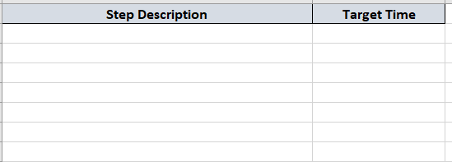
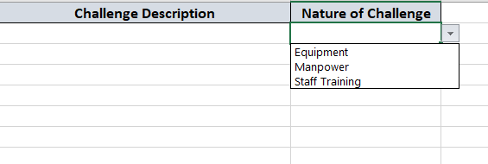
Benchmarks in Place & Current Challenges
Deconstructing the Pathway (How is currently care provided?)
Notes:
“TARGET TIMES”
If you already have set benchmarks for target times between each step, kindly specify it.
“MAIN CHALLENGES”
List the challenges ( Major to minor importance) that you believe are the main reason for the drawbacks in your performance.

Slide 10
Data Reports to support identifying gaps
Importance of data to identify gaps in the current care models – How are diagnosis communicated to patients?. Working to get a snapshot of the current practice to identify where can improvement be made, where can variation be reduced in a standardized and timed approach to shorten pathway. This will allow us to assess if the future change ideas work and are fit for the future!
Time 1
Referral
Time 2
First seen
Time 4
Test results
Time 5
Time 3
Time 6
Tests ordered
MDT
Diagnosis
Time 7
Decision to treat
Mean and Median Times for each step
Notes:
The data with the built process maps from the 6 scenarios will enable us to generate customized reports and support each provider based on their drawbacks, resources, processes capabilities and fit for their population needs.

Slide 11
Project Plan Detail May 2019 – March 2020
CA collate data from the cancer dashboard on waiting times, volumes of work, from NBOCAP (reports have a lag time of 18-24 months) on a variety of indicators related to quality and process, the NCES, PHE on BCSP uptake and follow on work, HES data on admissions elective / emergency
CA request additional data from providers to illustrate additional areas of practice (e.g. local 2WW referral forms, protocols for straight to test, MDT referral / outcome forms) cancellations due to lack of HDU provision, availability of perioperative medicine / CPET), median time to histology reports, waiting time for start of chemotherapy, and diagnostic waits
Clinical teams to receive introductory information about the review, explanation of the principle of analysing decision making and processes. Examples provided of deconstructed pathways and a request that teams consider carefully how their pathways work and where the inefficiencies remain
Site visit – clinician to present the means of making decisions and the challenges in processes. Visiting team to include both CNS and consultant member as a minimum. Afternoon group discussion with a patient group and clinicians from the MDT
CA to provide a written report to each Trust MST/ exec team shared with local commissioners
CA to construct a ‘Toolkit’ summarising good practice approaches to major areas of (1) decision making and (2) process constructed at the end of the review, offered to all Trusts and commissioners in the South West and publicly available. This would be short descriptions of each challenge, how the team approached the problem, stakeholders involved, practical steps needed to implement change
Preliminary report to executive team at the end of the day
Notes:
Based on the experience of the emergency service reviews
Does the SSG believe this approach to be practical, of relevance and are we applying the right level of challenge?

Slide 12
The Metrics
Increased numbers of colorectal cancer patients being diagnosed within 28 days
Delivery of 8 wait times standards
a. Increased capacity
b. effective cross-organizational working
c. supply and demand management
% Patients diagnosed at stage 1 or 2
Improved Patient experience
Saved £

Slide 13
The project will begin in May 2019 with a first milestone report expected Sep,19.
CHART OF POTENTIAL 12 MONTH ROADMAP FOR 19/20
Actions |  | 1 | 2 | 3 | 4 | 5 | 6 | 7 | 8 | 9 | 10 | 11 | 12
 |  | Apr 19 | May 19 | Jun 19 | Jul 19 | Aug 19 | Sep 19 | Oct 19 | Nov 19 | Dec 19 | Jan 20 | Feb 20 | Mar 20
A | Discover - Benchmark
B | Define – Standards agreed by SW pathway group
C | Develop – Self Assessment, peer visits and report
D | Deliver – Quality Standards Framework
E | Evaluation -
F | Milestone report
Notes:
There should be an ambition to conduct previsit data collection during the summer so that peer review site visits can occur between September and February when staff holidays are less prevalent with the review completed by the end of March 2020.

Slide 14
Next Steps
First SW Colorectal Cancer Pathway Delivery Group 25th July, Exeter.
Members will represent their professional group in pathway improvement work programme activities, as well as action responsibilities as agreed.
SWAG Proposed Names
Eric Thomas (radiologist) Hannah Madder (Cancer Service Manager) Jasmine King (CNS) Ben Colleypriest (Gastroenterologist representative) Jackie Mifflin (Patient representative) Harker Nicola (GP representative) Emma Fynn (Cancer service improvement lead)
Clinical Leads will be in touch to arrange peer visits.
Volunteers who are willing to support the steering group please ! ☺

