Slide 1






Effect of a lower-intensity PSA-based screening intervention on prostate cancer mortality: the CAP randomized clinical trial
SWAG Urology SSG
11th October 2018

Slide 2
Context of PSA based screening
ERSPC and PLCO highlighted that the balance of benefits and harms in men remains close
Small mortality benefit with 2-4 yearly repeated screening, 5 instead of 6 deaths in 1000
Overdiagnosis between 20-50%, increasing with the intensity of screening
Men receiving surgery or radiotherapy experience serious impacts on sexual, urinary & bowel function - clearly quantified in ProtecT

Slide 3
Objectives
Estimate the effect of an invitation to a single PSA-screen (vs standard practice) on median 10-yr:
PCa-specific mortality (1ary outcome)
All-cause mortality (2ary outcome)
PCa detection, stage & grade (2ary outcomes)
Other 2ary outcomes not reported here: PCa & all-cause mortality at 15 yrs, HRQoL, cost-effectiveness

Slide 4



CAP (2001-2009, Zelen design)
UK General Practices (N=573/785; 73%)
Invited to PSA testing intervention
(ProtecT study) N=189,386
Comparison arm
N=219,439
Notes:
CAP is a primary-care based cluster-randomized trial of population-based PSA testing, within which the ProtecT trial of treatments for localized prostate cancer was embedded. Between 2001 and 2009, 785 eligible general practices in 8 hospital centers in England and Wales were randomized before their recruitment (‘Zelen’ design) to intervention- or control-groups and approached for consent to participate. Randomization was blocked and stratified within geographical groups of neighboring practices, using a computerized random number generator. In total, 573 (73%) practices agreed to participate
no important between-group differences in measured baseline characteristics at practice- or individual-levels
Cumulative contamination in the control group was estimated at ≈10-15% over 10-years in UK general practice

Slide 5
CAP (2001-2009, Zelen design)
UK General Practices (N=573/785; 73%)
Invited to PSA testing intervention
(ProtecT study) N=189,386
Comparison arm
N=219,439
Attended 75,707(40%)
(PSA>3ng/ml: 10-core biopsy
DNA 113,679
ProtecT randomization
to 3 treatments
Standard NHS
management
Notes:
CAP is a primary-care based cluster-randomized trial of population-based PSA testing, within which the ProtecT trial of treatments for localized prostate cancer was embedded. Between 2001 and 2009, 785 eligible general practices in 8 hospital centers in England and Wales were randomized before their recruitment (‘Zelen’ design) to intervention- or control-groups and approached for consent to participate. Randomization was blocked and stratified within geographical groups of neighboring practices, using a computerized random number generator. In total, 573 (73%) practices agreed to participate
no important between-group differences in measured baseline characteristics at practice- or individual-levels
Cumulative contamination in the control group was estimated at ≈10-15% over 10-years in UK general practice

Slide 6
CAP (2001-2009, Zelen design)
UK General Practices (N=573/785; 73%)
All
eligible
men
flagged
Invited to PSA testing intervention
(ProtecT study) N=189,386
Comparison arm
N=219,439
Attended 75,707(40%)
(PSA>3ng/ml: 10-core biopsy
DNA 113,679
ProtecT randomization
to 3 treatments
Standard NHS
management
Standard NHS
management
Primary outcome prostate cancer mortality 10 years
(reached March 2016) analysed by intention-to-screen
Power to detect an overall PCa mortality rate ratio (ORR) of 0.84, 80% power (5% alpha)
Notes:
CAP is a primary-care based cluster-randomized trial of population-based PSA testing, within which the ProtecT trial of treatments for localized prostate cancer was embedded. Between 2001 and 2009, 785 eligible general practices in 8 hospital centers in England and Wales were randomized before their recruitment (‘Zelen’ design) to intervention- or control-groups and approached for consent to participate. Randomization was blocked and stratified within geographical groups of neighboring practices, using a computerized random number generator. In total, 573 (73%) practices agreed to participate
no important between-group differences in measured baseline characteristics at practice- or individual-levels
Cumulative contamination in the control group was estimated at ≈10-15% over 10-years in UK general practice

Slide 7
Post-randomization exclusions did not introduce selection bias
No important differences in:
Characteristics of randomised practices that did vs did not agree to participate
Characteristics of intervention vs control-group practices or men
The distribution of non PCa deaths between intervention vs control-group

Slide 8
Adherence
Of 189,386 intervention group men:
  75,707 (40%) attended for PSA-testing
  67,313 (36%) had a blood sample taken
  64,436 had a ‘valid’ test result
Of these 64,436 men:
  6,857 (11%) - PSA 3-19.9ng/ml (ProtecT eligible )
  Of whom 5,850 (85%) had a prostate biopsy
Cumulative PSA testing in controls indirectly estimated at ≈10-15% over 10-years

Slide 9
Primary analysis

Slide 10
Effect of CAP PSA invitation intervention on 10 yr median PCa mortality
PCa deaths
  Intervention arm: n = 549 (0.30/1000 pyrs)
  Control arm: n = 647 (0.31/1000 pyrs)
Rate ratio, ITT
  0.96 (95% CI: 0.85, 1.08); p=0.50
Rate difference per 1000 person years
  - 0.013 (95% CI: - 0.047, 0.022)

Slide 11
Kaplan Meier cumulative PCa mortality
Median (IQR) follow-up:
Int: 10.03 (8.80, 11.50)
Control: 9.92 (8.74, 10.93)
Non-proportional hazards: p=0.38

Slide 12
secondary analysis

Slide 13
Effect of the CAP PSA invitation intervention on cumulative PCa risk
Incident PCa
  Intervention: n=8,054 (4.3%)
  Control: n = 7,853 (3.6%)
Detection per 1000 pyrs:
  4.45 (95% CI: 4.36, 4.55) vs. 3.80 (3.72, 3.89)
Difference per 1000 pyrs
  0.65 (0.52, 0.78; p<0.001)
During screening phase
  10.42 v 2.18 (p<0.001)
Notes:
During the first 18 months following recruitment (the screening phase), the rate of prostate cancer detection was 10.42 per 1000 person-years (95% CI, 10.05 to 10.81) in the
intervention group compared with 2.18 per 1000 personyears (95% CI, 2.02 to 2.34) in the control group (rate difference, 8.25 [95% CI, 7.83 to 8.66], P < .001).

Slide 14
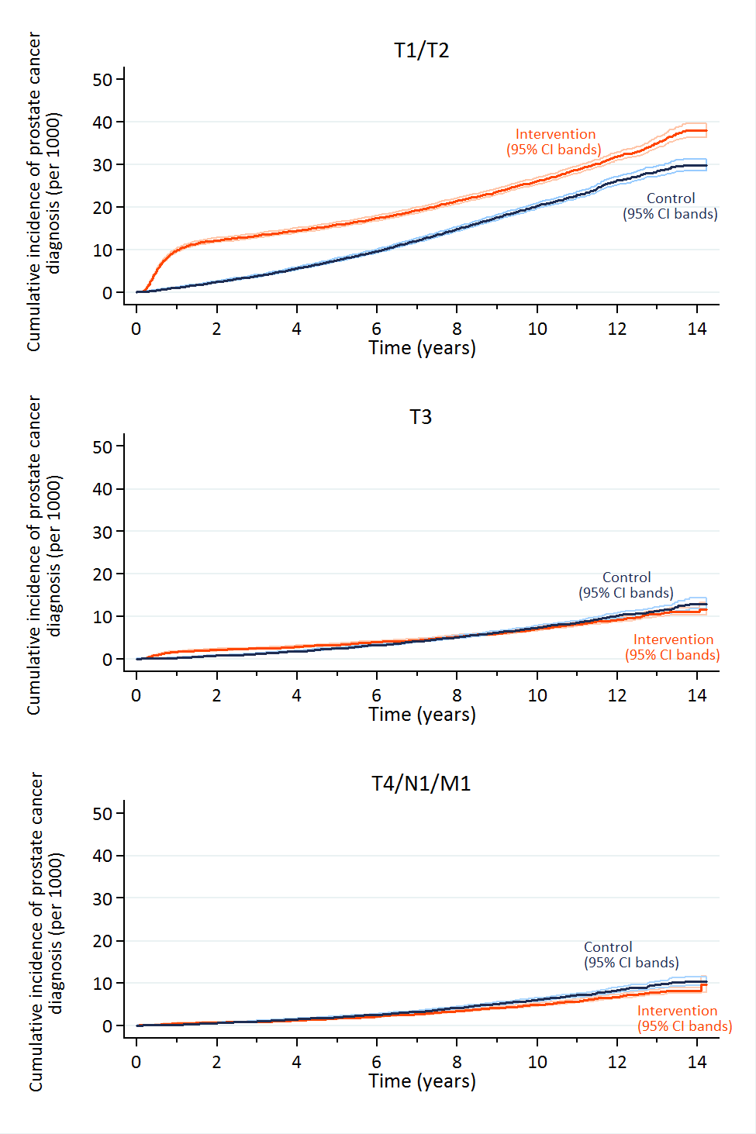
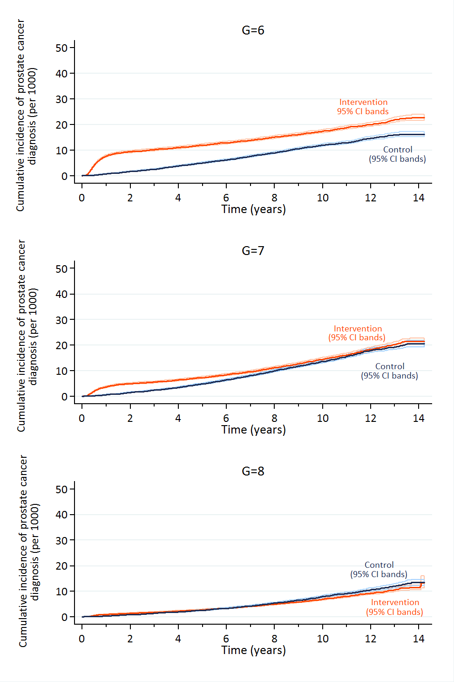
Cumulative incidence by stage & grade
PCa in the intervention-group more likely to be low-grade & early-stage (p<0.001)

Slide 15
Other secondary/subgroup analysis
IV analysis (causal effect amongst attenders)
  0.93 (95% CI 0.67, 1.29); p=0.66
All cause mortality:
  Intervention arm: n = 25,459 (13.7/1000 pyrs)
  Control arm: n = 28,306 (13.5/1000 pyrs)
  RR: 0.99: 95% CI 0.94, 1.03; p=0.49
No differences in effect by age or SES
Intervention-related deaths
  8 in the intervention-group, 7 in controls

Slide 16
Missed lethal cancers in the intervention-group
Of 549 men who died in the intervention-group
  Attended a screening appointment: 188 (34%)
Of the 188 attendees who died, 129 (69%) had not been identified by a PSA test:
  Not received a PSA test: n = 42
  Eligible men not receiving a biopsy: n = 15
  PSA level < 3ng/ml: n = 68
  Benign prostate biopsy result: n = 4

Slide 17
Limitations
Single screen - multiple rounds in ERSPC & PLCO
  But over-detection with repeat screens
Lower-intensity strategy under-detected lethal cases
  High intensity wrt TRUS biopsy: 85% adherence; 10-core
  Identification of this is a design strength
40% adherence vs 59-69% in ERSPC
  IV analysis (effect of attendance) found similar results
mpMRI will improve diagnostic pathway
Median 10-yr follow-up may be too short
  In ProtecT, PCa mortality was 1% across treatments
  If lower-intensity strategy with TRUS biopsy has a long-term effect, would still be informative for mpMRI

Slide 18
At a median 10 yrs, a lower-intensity screening intervention (a single PSA test):
Had no discernible effect on PCa-specific mortality
Increased detection of early-stage, low-grade PCa
Did not detect some lethal cancers
Long-term follow-up will ascertain if lower-intensity screening reduces over-detection while achieving mortality gains
The current findings do not support single PSA-testing for population-based screening

Slide 19
Dissemination
www.youtube.com/channel/UCc0AUjDL7q89p3IGyIigB0g
https://discover.dc.nihr.ac.uk/content/signal-000602/single-routine-offer-of-a-blood-test-for-prostate-cancer-did-not-save-lives
CLAHRCBite

Slide 20
Further funded work
Effect on 15-year PCa-specific & all-cause mortality
Age-specific lead time & over-diagnosis rates
Projected lifetime effectiveness & cost-effectiveness of alternative, UK-focused PCa screening options
  UK-specific decision analytic (Markov) model
  Incorporate parameters computed from CAP & ProtecT
  MPES to enable assessment of risk stratified screening & use of mpMRI

Slide 21

Acknowledgements
International Trial Steering Committee (TSC): Michael Baum (chair), Peter Albertsen, Tracy Roberts, Mary Robinson, Jan Adolfsson, David Dearnley, Anthony Zeitman, Fritz Schroder, Tim Peters, Peter Holding, Teresa Lennon, Sue Bonnington, Malcolm Mason, Jon Oxley.
Data Monitoring Committee (DMC): Lars Holmberg (chair), Rob Pickard, Simon Thompson, Usha Menon.
Cause of Death Evaluation (CoDE) committee: Peter Albertsen (chair), Colette Reid, Jon McFarlane, Jon Oxley, Mary Robinson, Jan Adolfsson, Michael Baum, Anthony Zeitman, Amit Bahl, Anthony Koupparis.
Trial Management Group (TMG): Lead PI (Prof Martin) and co-PIs (Profs Donovan, Hamdy and Neal). Dr Turner trial co-ordinator. Dr Lane, ProtecT trial co-ordinator, Prof Sterne and Dr Metcalfe statistical input. Dr Noble health economic analyses. Drs Mohiuddin and Sanghera decision-analytical model-based economic evaluation. Prof Ben-Shlomo (epidemiology); Dr Oliver (public health), Dr Brindle (public health), Simon Evans (urologist)
Research Staff (past & present): Fieldworkers: Lindsey Bell, Leah Bowen, Vicky Brookes, Charlotte Davies, Sean Harrison, Liz Hill, Laura Hughes, Mari-Anne Rowlands, Liz Salter, Jainnee Mauree, Siaw Yein Ng, Naomi Williams; Kerry Avery (recruitment)
Data Management: Liz Down, Eleanor Walsh; Michael Davies; Database development: Pete Shiarly;
Statistician: Grace Young; Health Economics: Joanna Thorn; Research support: Marta Tazewell, Jessica Toole;
Administrators: Genevieve Hatton-Brown, Chris Pawsey, Tom Steuart-Feilding;
Mr Luke Hounsome (National Cancer Registration & Analysis Service, Public Health England).
ProtecT Research, Nursing & Administrative staff

Slide 22
Comparison of RCTs
 | CAP | ERSPC | PLCO
Mean age (yrs) | 59.0 | 61.5 | NA
N controls | 219,439 | 89,353 | 38,350
% PSA-tested, intervention | 36% | 64% | 85%
Biopsy rate | 85% | 86% | 41%⁸
PSA testing in controls | ≈10% over 10 yrs | ≈15% | ≈50%
PCa risk, intervention | 4% over 10 yrs | 5% over 9 yrs⁶ | 8% over 10 yrs
PCa’s in controls
Gleason grade ≤6 | 35% | 55% | 62%
Gleason grade 7 | 41% | 29% | 27%
Gleason grade ≥8 | 24% | 16% | 12%
Stage T1/2 | 60% | 79% | 95%
PCa’s in intervention grp
Gleason grade ≤6 | 45% | 72% | 67%
Gleason grade 7 | 37% | 20% | 24%
Gleason grade ≥8 | 18% | 7% | 9%
Stage T1/2 | 69% | 90% | 97%
Mean age at diagnosis (yrs) | 67 | 61 | NK

