Slide 2
Rapid Diagnostic Service
NHSE Specification (TBC)
15% of Alliance Funds for 2019/20 to be spent on development of rapid diagnostic service for patients with serious but non-specific symptoms
= £900,000 for SWAG.
Co-ordinated and rapid series of tests.
Not necessarily same day but a reduced number of appointments
Holistic Diagnostic Assessment – Not a rule in- rule out service but get a diagnosis
Single point of access
Participation in minimum dataset

Slide 3
SWAG Specification
Service to be delivered within PCNs
Money to be spent on clinical time and networking.
NHSE Spec estimates 80 patients / 100,000 per year
Consider broadening scope to include 2ww referrals of limited clinical value
Don’t want to add additional unnecessary steps where further investigations clearly defined.
Notes:
= 24-40 per PCN

Slide 4
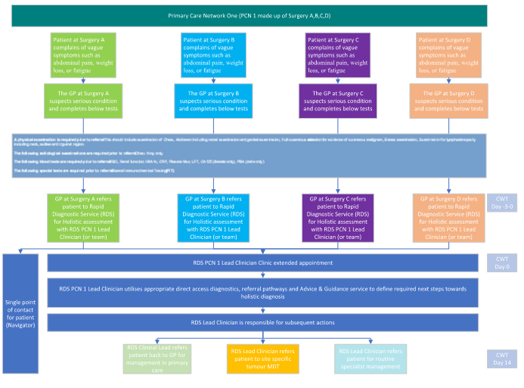

Slide 5
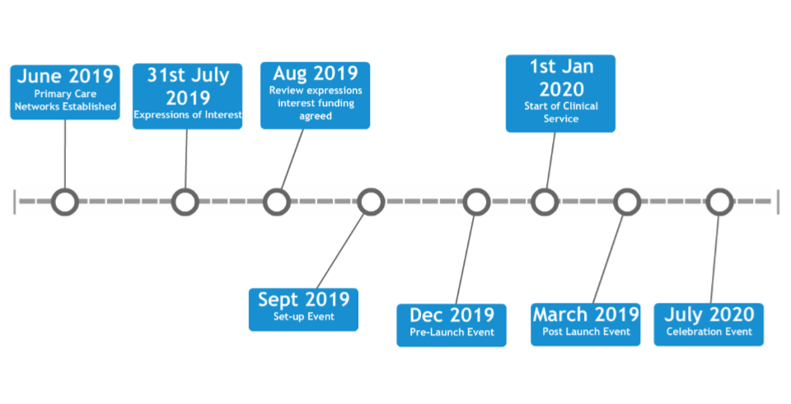
Timeline

Slide 6
Expression of Interest
To be submitted by 31st July 2019
STP Lead
Secondary care lead
PCN Lead
Lead clinician (Can be Secondary care lead or PCN Lead)
Geographical area and population to be served.
Providers involved in project
£10,000 budget to support project planning and business case.

Slide 7
Outcomes: NHSE will specify
ACE programme reported on:
Patient Characteristics – demographics / co-morbidities
Cancer Diagnoses
Non-cancer diagnoses
Stage of Cancer diagnosis
Interval times of pathway
Patient Experience

Slide 8


Benefits
NHS
Patient

Slide 9
Equality

Slide 10
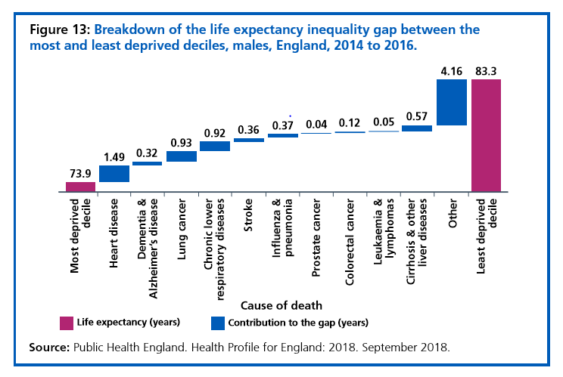
NHS long term plan focus on reducing inequalities.
Substantial improvement in early diagnosis over past 30 years but one-size-fits-all services have often failed to engage with the people most in need, leading to inequalities in access and outcome

Slide 11
Learning from LeDeR Programme
Key Themes – Diagnostic masking and access to investigations
Valuing people definition of LD – needs based rather than IQ threshold – will apply to much broader population.
Learning will apply to all vulnerable groups not just those with LD – an opportunity to reduce inequalities in Cancer outcomes across the whole population.
‘Tim told the staff in hospital he was losing weight. His sister felt that no one had listened to him. ‘

Slide 12

Person Centered Care

Slide 13
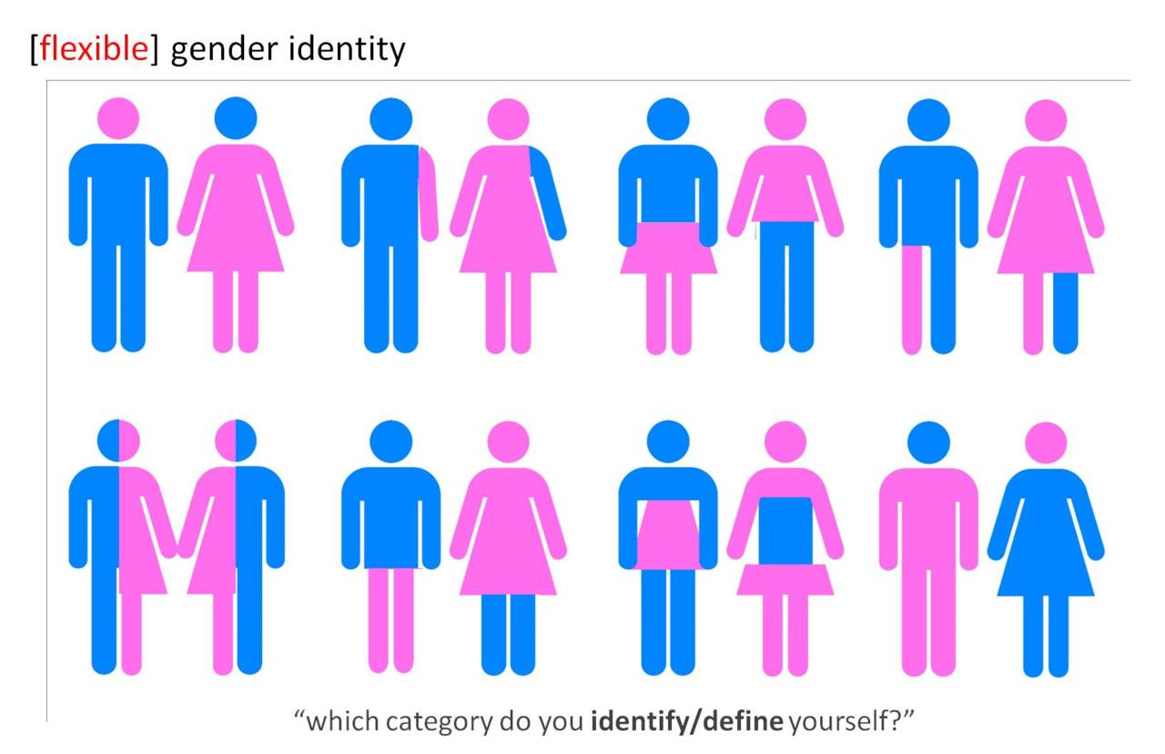
Person Centered Care

Slide 14
20/20 work
Patients with mental health conditions have:
poorer access to cancer services
poorer experience once they are on cancer pathways
similar incidence rates for cancer as the general population but significantly higher mortality rates.
Poor early experiences influencing their perception of healthcare
Inadequate support for their additional needs from clinical staff

Slide 15
We will use a ‘double diamond’ methodology to understand patient experience, define the problem and prioritise solutions
3. Delivery plan
Double diamond methodology
In the first phase, we aim to expand our focus, gathering patient input from different sources and using different methodologies to gain a nuanced understanding
of mental health
patients’
experience
In the second phase, we aim to narrow our focus, presenting back key themes to the alliance to agree on which problems to prioritise
In the third phase, we aim to expand our focus, gathering best practice and running co-design workshops with patients and clinicians
to understand the
range of ways
we can
improve
In the fourth and final phase, we aim to narrow our focus, prioritising the interventions that will have the greatest impact and moving to delivery
Talk to patients, interviews, engagement
Focus on themes and define problem
Prioritise delivery planning for most impact
Best practice, co-design
Notes:
Hypthesise

Slide 16
Clinical Advisory Groups
Standing Agenda item - inequalities work
Discuss emerging pateitnexperience data
Support small programmes at work testing new approaches.
Collaborative evolution of services

