Slide 1
C-POST – ADJUVANT Immunotherapy post Surgery and RT

Slide 2
Principles of the C-POST Adjuvant study
Proof of Concept: Cemiplimab is highly active therapy for advanced CSCC, but the best time to help patients with CSCC is prior to disease recurrence
  The concept that anti-PD1/PD-L1 can prevent recurrence in the adjuvant setting has been established in other tumor types (lung, melanoma)
Define a High-Risk Population: POST, the first phase 3 adjuvant study in CSCC, identified extracapsular extension (ECE) as the key high-risk feature in sub-group analyses
  Lesson from POST: If a study that enrolls mostly low risk patients, it will be incapable of showing a meaningful treatment effect
Enrollment will be a challenge: Patients may be uninterested in C-POST if the first time they hear about it is at the completion of RT
  C-POST needs multidisciplinary skin cancer teams to identify high-risk patients shortly after surgery
“Cross-over”: Because this is a placebo-controlled study, it is important to have a ”Part 2 option” for patients to receive subsequent cemiplimab after disease recurrence

Slide 3
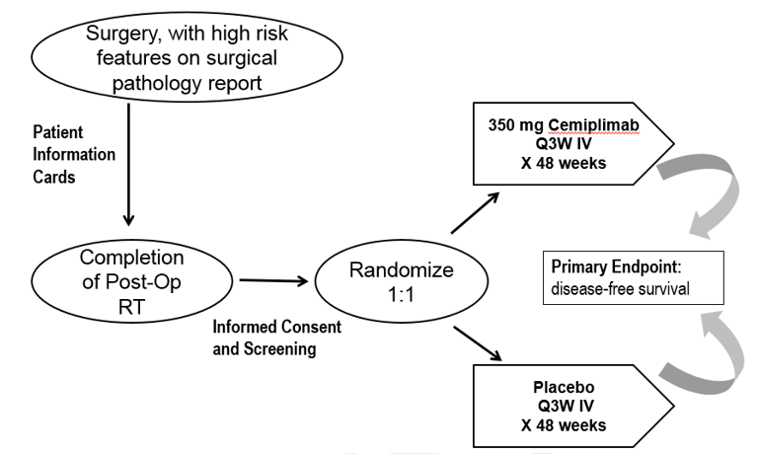
C-POST Schematic: Primary endpoint is Disease-Free Survival (Part 1)
Part 1
Part 2
Optional Cemiplimab for
patients who have recurrence on placebo arm (or who completed cemiplimab treatment in Part 1, and recurred >= 3 months later).
Part 2 is designed to mirror routine clinical practice, with less intense schedule
N = 412
Completion of RT within 2- 6 weeks

Slide 4
High risk CSCC features for inclusion in C-POST
High risk features associated with recurrent CSCC for this study are defined:
Nodal disease with extracapsular extension (ECE) and at least one node > 20mm on the surgical pathology report.
In-transit metastases (ITM) defined as skin or subcutaneous metastases that are > 2cm from the primary lesion but are not beyond the regional nodal basin
T4 lesions
Perineural invasion (PNI), defined as clinical and/or radiologic involvement of named nerves
Recurrent CSCC, defined as CSCC that arises within the area of the previously resected tumor, plus at least one of the following additional features:
  ≥ N2b disease associated with the recurrent lesion
  Nominal ≥ T3 (recurrent lesion ≥ 4cm in diameter or minor bone erosion or deep invasion > 6mm measured from the granular layer of normal adjacent epithelium)
  Poorly differentiated histology and ≥ 20mm diameter of recurrent lesion. The recurrent lesion must be documented to be within the area of the previously resected CSCC by radial measurement of the greatest radius of the final defect, measured from the estimated center of the original surgical wound.

