Slide 1
Breast Cancer Clinical Advisory Group
Research Report
20/09/2019
David Rea
Mark Beresford

Slide 2
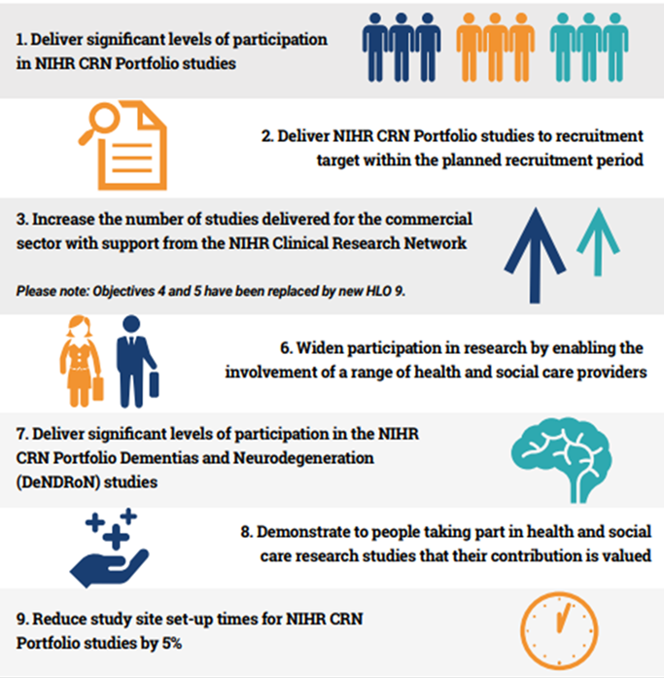
NIHR CRN High Level Objectives 2019-20
HLO 1
Target - 28,883 recruits
HLO 2 Commercial – 80%
Non Commercial – 80%
HLO 9
Commercial – 80 days
Non-commercial – 62 days

Slide 3
Harmonised speciality objectives 2019-20
Harmonised speciality objectives have been introduced
30 individual speciality objectives replaced by 5 harmonised objectives
Increasing early career researchers involvement in NIHR portfolio research.
Specific areas within cancer, currently under represented.
Cancer Surgery
Radiotherapy
Rare Cancers
Teenage and Young Adults

Slide 4
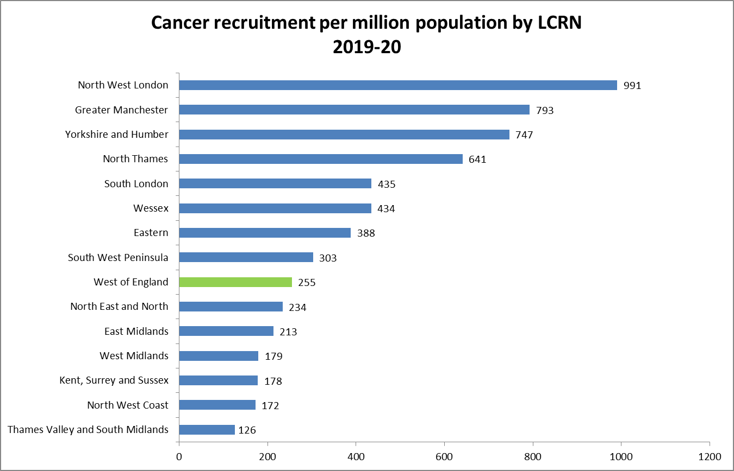
Cancer recruitment per million population 2019-20

Slide 5
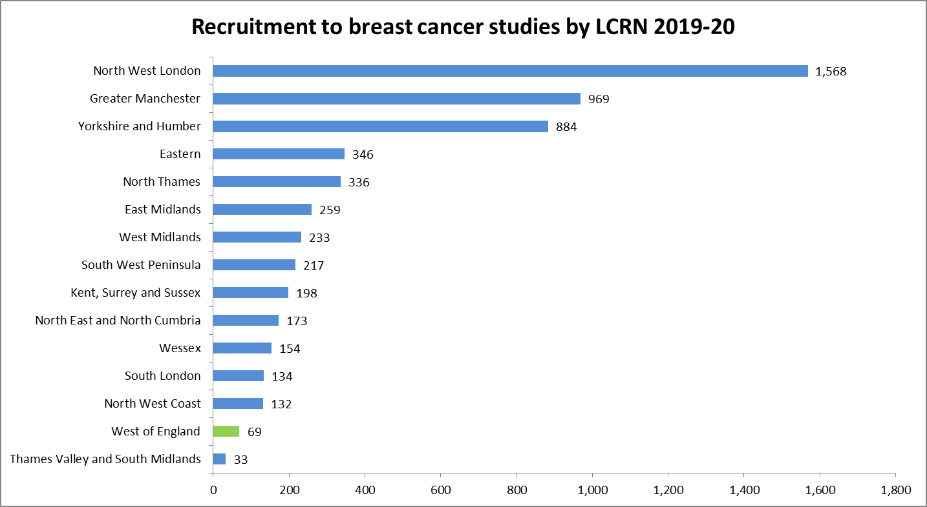
Breast cancer recruitment by LCRN 2019-20

Slide 6
Useful links
https://www.crn.nihr.ac.uk/
National and local network information including training programmes templates, tools, contacts, videos etc.
https://odp.nihr.ac.uk/
Open data platform. Look at performance across whole CRN including all specialty areas
http://csg.ncri.org.uk/portfolio/portfolio-maps/
View current national portfolio of open, closed and ‘in set up’ cancer studies
https://www.ukctg.nihr.ac.uk/
See which studies are open across the country (will soon be Be Part of Research)
http://public-odp.nihr.ac.uk/
Search for a study to fit criteria. Good for horizon scanning, eligibility criteria

Slide 7
Contacts
Research Delivery Manager – David.Rea@nihr.ac.uk
Research Portfolio Facilitator – Jessica.Bartlett@nihr.ac.uk
Breast cancer Sub-specialty Lead - mark.beresford@nhs.net; zenon.rayter@nbt.nhs.uk

