Slide 1
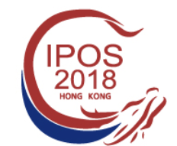
Body Image Issues and Attitudes Toward Exercise in Men Diagnosed with Prostate Cancer Undergoing Androgen Deprivation Therapy
Presentation by
Caterina Gentili, PhD candidate
27th September 2018 – CAR weekly

Slide 2
Background

Slide 3
Background
growing population
of PCa survivors

Slide 4
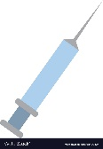
Background
growing population
of PCa survivors
Androgen Deprivation Therapy (ADT)

Slide 5
Background
growing population
of PCa survivors
Androgen Deprivation Therapy (ADT)
Gold standard treatment
Received by 50% of PCa patients
(Chen et al., 2014; Ferlay et al., 2018)

Slide 6
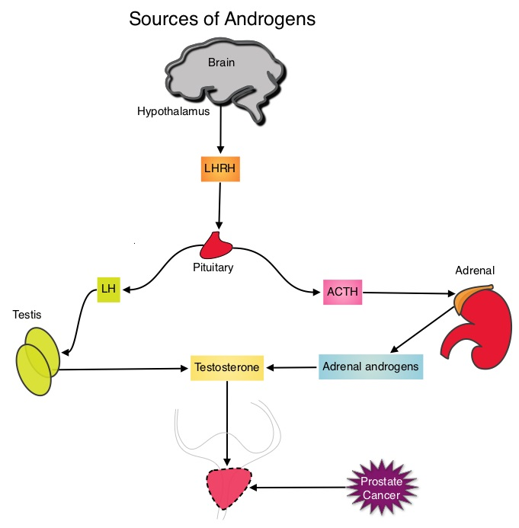
Androgen Deprivation Therapy

Slide 7
Androgen Deprivation Therapy

Slide 8
Androgen Deprivation Therapy
Slowing cancer growth

Slide 9
Androgen Deprivation Therapy
Slowing cancer growth
Side effects:
Weight gain
Loss of muscle mass
Breast enlargement
Penile and testicular shrinkage
Lack of libido
Impotence
Incontinence
Hot flushes
Fatigue
Etc.

Slide 10
Androgen Deprivation Therapy
Slowing cancer growth
Side effects:
Weight gain
Loss of muscle mass
Breast enlargement
Penile and testicular shrinkage
Lack of libido
Impotence
Incontinence
Hot flushes
Fatigue
Etc.
Quality of life
Sexuality
Body Image
(Harrington, Jones, E. G., & Badger, T., 2009)

Slide 11
What can patients do about it?

Slide 12
What can patients do about it?
Seek psychological help?

Slide 13
What can patients do about it?
Awareness?
Access?
Acceptability?
Seek psychological help?

Slide 14
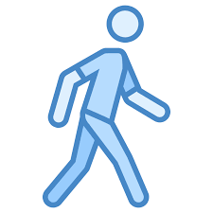
What can patients do about it?
Awareness?
Access?
Acceptability?
Seek psychological help?
Practical coping strategy: exercise?

Slide 15
What can patients do about it?
Awareness?
Access?
Acceptability?
Seek psychological help?
Practical coping strategy: exercise?
Physical health
survival
muscular and skeletal strength
cardiorespiratory outcomes
sexual functioning
cancer progression
fatigue
cholesterol

Slide 16
What can patients do about it?
Awareness?
Access?
Acceptability?
Seek psychological help?
Practical coping strategy: exercise?
Physical health
survival
muscular and skeletal strength
cardiorespiratory outcomes
sexual functioning
cancer progression
fatigue
cholesterol
Psychological health
quality of life
masculine identity
control over ADT side effects
body satisfaction
appearance satisfaction
physical self efficacy
stress management

Slide 17
What can patients do about it?
Awareness?
Access?
Acceptability?
Seek psychological help?
Practical coping strategy: exercise?
Low adherence rates:
30% aerobic exercise
14% strength exercise
Physical health
survival
muscular and skeletal strength
cardiorespiratory outcomes
sexual functioning
cancer progression
fatigue
cholesterol
Psychological health
quality of life
masculine identity
control over ADT side effects
body satisfaction
appearance satisfaction
physical self efficacy
stress management

Slide 18
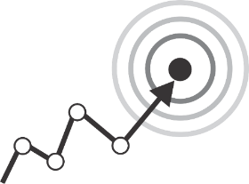
Aims

Slide 19
Aims
Further explore the impact of ADT-induced appearance and functionality changes on patients’ body image.

Slide 20
Aims
Further explore the impact of ADT-induced appearance and functionality changes on patients’ body image.
Investigate patients’ attitudes towards exercise and potential exercise barriers.

Slide 21
Methods

Slide 22
Methods
Participants
22 men diagnosed with PCa
ADT at least once in their life
Mage = 67.9 yo, SD = 9.99
Recruited through charities, social media, UWE press release

Slide 23
Methods
Participants
22 men diagnosed with PCa
ADT at least once in their life
Mage = 67.9 yo, SD = 9.99
Recruited through charities, social media, UWE press release
22 Semi structured interviews
30 - 50 min.
13 phone
9 face to face
audio recorded
transcribed verbatim

Slide 24
Methods
Topics
ADT-induced bodily changes
Body image issues
Masculinity
Exercise

Slide 25
Methods
Topics
ADT-induced bodily changes
Body image issues
Masculinity
Exercise
Analyses
Thematic analysis
NVivo

Slide 26
Results: main themes

Slide 27
Results: main themes
Body feminization
I was somehow convinced that I was turning into a woman.
Enrico

Slide 28
Breast enlargement
Results: main themes
It’s embarrassing. I remember having the grankid saying shouting to his sister “my grandad got boobies!” you know… which is not nice you know…”
Carlo
Body feminization
I was somehow convinced that I was turning into a woman.
Enrico

Slide 29
Breast enlargement
Results: main themes
It’s embarrassing. I remember having the grankid saying shouting to his sister “my grandad got boobies!” you know… which is not nice you know…”
Carlo
Weight gain
Body feminization
I feel I am looking fatter as well as feeling fatter… emh… I don’t want to be carrying all this extra weight around with me when I do that…”
Edoardo
I was somehow convinced that I was turning into a woman.
Enrico

Slide 30
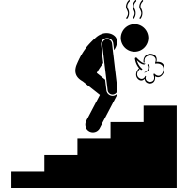
Breast enlargement
Results: main themes
It’s embarrassing. I remember having the grankid saying shouting to his sister “my grandad got boobies!” you know… which is not nice you know…”
Carlo
Weight gain
Body feminization
I feel I am looking fatter as well as feeling fatter… emh… I don’t want to be carrying all this extra weight around with me when I do that…”
Edoardo
I was somehow convinced that I was turning into a woman.
Enrico
Functionality loss
Now my energy levels aren’t as great as they used to be. Before I was able to walk 15 to 20 miles a day. But those days have gone now and I found that very sad.
Giovanni

Slide 31
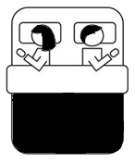
Breast enlargement
Results: main themes
It’s embarrassing. I remember having the grankid saying shouting to his sister “my grandad got boobies!” you know… which is not nice you know…”
Carlo
Weight gain
Body feminization
I feel I am looking fatter as well as feeling fatter… emh… I don’t want to be carrying all this extra weight around with me when I do that…”
Edoardo
I was somehow convinced that I was turning into a woman.
Enrico
Functionality loss
Now my energy levels aren’t as great as they used to be. Before I was able to walk 15 to 20 miles a day. But those days have gone now and I found that very sad.
Giovanni
Sexual issues
It’s upset… is uncomfortable, it’s upset. (…) Obviously the physical side of our relationship is not totally fulfilled
Giovanni

Slide 32
Results: main themes
Exercise

Slide 33
Counterbalance ADT
Regular exercise does help to keep your weight down…
Ludovico
Results: main themes
Exercise

Slide 34
Counterbalance ADT
Regular exercise does help to keep your weight down…
Ludovico
Results: main themes
Achievement and control
You are under still a little bit of control (..) I don’t know how long I have got but it’s just gratifying and reassuring that I can still do things…
Michele
Exercise

Slide 35
Counterbalance ADT
Regular exercise does help to keep your weight down…
Ludovico
Results: main themes
Achievement and control
You are under still a little bit of control (..) I don’t know how long I have got but it’s just gratifying and reassuring that I can still do things…
Michele
Exercise
Time and energy levels
I am working full time, and you are tired after work. It is difficult to fit exercise in your day
Mario

Slide 36
Counterbalance ADT
Regular exercise does help to keep your weight down…
Ludovico
Results: main themes
Achievement and control
You are under still a little bit of control (..) I don’t know how long I have got but it’s just gratifying and reassuring that I can still do things…
Michele
Exercise
Time and energy levels
I am working full time, and you are tired after work. It is difficult to fit exercise in your day
Mario
Fear of negative evaluation
You got somebody else in front of you or next to you and you still think “Oh they are quicker!”
Paolo

Slide 37
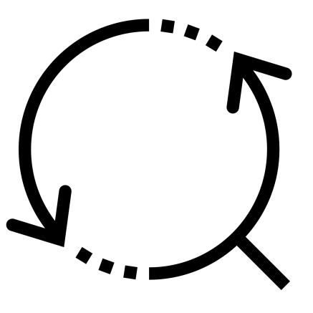
Conclusions

Slide 38
Conclusions
ADT side effects can have an impact on patients body image and masculine identity

Slide 39
Conclusions
ADT side effects can have an impact on patients body image and masculine identity
Body image issues are mostly dependent on body feminization

Slide 40
Conclusions
ADT side effects can have an impact on patients body image and masculine identity
Body image issues are mostly dependent on body feminization
Physically active patients find an effective coping strategy in exercise

Slide 41
Conclusions
ADT side effects can have an impact on patients body image and masculine identity
Body image issues are mostly dependent on body feminization
Physically active patients find an effective coping strategy in exercise
Future directions
I will further explore the topic quantitatively
Some patients might benefit from information and support for body image concerns
Patients who are not physically active might benefit from an exercise intervention

Slide 42
References
Alleva, J. M., Martijn, C., Jansen, A., & Nederkoorn, C. (2014). Body language: Affecting body satisfaction by describing the body in functionality terms. Psychology of Women Quarterly, 38(2), 181-196.
Appleton, L., Wyatt, D., Perkins, E., Parker, C., Crane, J., Jones, A., . . . Pagett, M. (2015). The impact of prostate cancer on men's everyday life. European journal of cancer care, 24(1), 71-84.
Beauchamp, M. R., Carron, A. V., McCutcheon, S., & Harper, O. (2007). Older adults' preferences for exercising alone versus in groups: Considering contextual congruence. Annals of Behavioral Medicine, 33(2), 200-206.
Braun, V., & Clarke, V. (2006). Using thematic analysis in psychology. Qualitative research in psychology, 3(2), 77-101.
Chapple, A., & Ziebland, S. (2002). Prostate cancer: embodied experience and perceptions of masculinity. Sociology of Health & Illness, 24(6), 820-841.
Chen, R. C., Hamstra, D. A., Sandler, H. M., & Zietman, A. L. (2014). Complications of prostate cancer treatment. The Lancet Oncology, 15(4), e150.
Craike, M. J., Livingston, P. M., & Botti, M. (2009). How much do we know about the determinants of physical activity among prostate cancer survivors? Directions for future research to inform interventions. Australian and New Zealand journal of public health, 33(2), 193-194.
Craike, M. J., Livingston, P. M., & Botti, M. (2011). An exploratory study of the factors that influence physical activity for prostate cancer survivors. Supportive Care in Cancer, 19(7), 1019-1028.
Dall’Era, M. A., Albertsen, P. C., Bangma, C., Carroll, P. R., Carter, H. B., Cooperberg, M. R., . . . Soloway, M. S. (2012). Active surveillance for prostate cancer: a systematic review of the literature. European urology, 62(6), 976-983.
Ervik, B., & Asplund, K. (2012). Dealing with a troublesome body: A qualitative interview study of men’s experiences living with prostate cancer treated with endocrine therapy. European Journal of Oncology Nursing, 16(2), 103-108.
Ferlay, J., Colombet, M., Soerjomataram, I., Dyba, T., Randi, G., Bettio, M., . . . Bray, F. (2018). Cancer incidence and mortality patterns in Europe: Estimates for 40 countries and 25 major cancers in 2018. European Journal of Cancer.
Forbes, C. C., Blanchard, C. M., Mummery, W. K., & Courneya, K. S. (2015). Prevalence and correlates of strength exercise among breast, prostate, and colorectal cancer survivors. Paper presented at the Oncol Nurs Forum.
Fowler, F. J., McNaughton Collins, M., Walker Corkery, E., Elliott, D. B., & Barry, M. J. (2002). The impact of androgen deprivation on quality of life after radical prostatectomy for prostate carcinoma. Cancer, 95(2), 287-295.
Galdas, P. M., Cheater, F., & Marshall, P. (2005). Men and health help‐seeking behaviour: literature review. Journal of advanced nursing, 49(6), 616-623.
Glode, L. M., Tangen, C. M., Hussain, M., Swanson, G. P., Wood, D. P., Sakr, W., . . . Dorff, T. B. (2017). Adjuvant androgen deprivation (ADT) versus mitoxantrone plus prednisone (MP) plus ADT in high-risk prostate cancer (PCa) patients following radical prostatectomy: A phase III intergroup trial (SWOG S9921) NCT00004124. In: American Society of Clinical Oncology.
Graham, J., Kirkbride, P., Cann, K., Hasler, E., & Prettyjohns, M. (2014). Prostate cancer: summary of updated NICE guidance. BMJ: British Medical Journal (Online), 348.
Harrington, J. M., & Badger, T. A. (2009). Body image and quality of life in men with prostate cancer. Cancer nursing, 32(2), E1-E7.
Harrington, J. M., Jones, E. G., & Badger, T. (2009). Body image perceptions in men with prostate cancer. Paper presented at the Oncology nursing forum.
Hyde, M., Newton, R., Galvao, D. A., Gardiner, R., Occhipinti, S., Lowe, A., . . . Chambers, S. K. (2017). Men's help‐seeking in the first year after diagnosis of localised prostate cancer. European journal of cancer care, 26(2).

Slide 43
Hyde, M. K., Zajdlewicz, L., Wootten, A. C., Nelson, C. J., Lowe, A., Dunn, J., & Chambers, S. K. (2016). Medical help-seeking for sexual concerns in prostate cancer survivors. Sexual medicine, 4(1), e7-e17.
Kelly, D. (2009). Changed men: The embodied impact of prostate cancer. Qualitative Health Research, 19(2), 151-163.
Keogh, J. W., Patel, A., MacLeod, R. D., & Masters, J. (2013). Perceptions of physically active men with prostate cancer on the role of physical activity in maintaining their quality of life: possible influence of androgen deprivation therapy. Psycho‐Oncology, 22(12), 2869-2875.
Keogh, J. W., Patel, A., MacLeod, R. D., & Masters, J. (2014). Perceived barriers and facilitators to physical activity in men with prostate cancer: possible influence of androgen deprivation therapy. European journal of cancer care, 23(2), 263-273.
Keogh, J. W., Shepherd, D., Krägeloh, C. U., Ryan, C., Masters, J., Shepherd, G., & MacLeod, R. (2010). Predictors of physical activity and quality of life in New Zealand prostate cancer survivors undergoing androgen-deprivation therapy. The New Zealand Medical Journal (Online), 123(1325).
Kunkel, E. J., Bakker, J. R., Myers, R. E., Oyesanmi, O., & Gomella, L. G. (2000). Biopsychosocial aspects of prostate cancer. Psychosomatics, 41(2), 85-94.
Langelier, D. M., Cormie, P., Bridel, W., Grant, C., Albinati, N., Shank, J., . . . Culos-Reed, S. N. (2018). Perceptions of masculinity and body image in men with prostate cancer: the role of exercise. Supportive Care in Cancer, 1-10.
Makarov, D. V., Humphreys, E. B., Mangold, L. A., Carducci, M. A., Partin, A. W., Eisenberger, M. A., . . . Trock, B. J. (2008). The natural history of men treated with deferred androgen deprivation therapy in whom metastatic prostate cancer developed following radical prostatectomy. The Journal of urology, 179(1), 156-162.
Meng, M. V., Grossfeld, G. D., Sadetsky, N., Mehta, S. S., Lubeck, D. P., & Carroll, P. R. (2002). Contemporary patterns of androgen deprivation therapy use for newly diagnosed prostate cancer. Urology, 60(3), 7-11.
Menzel, J. E., Krawczyk, R., & Thompson, J. K. (2011). Attitudinal assessment of body image for adolescents and adults. Body image: a handbook of science, practice, and prevention, 2, 154-169.
Navon, L., & Morag, A. (2003). Advanced prostate cancer patients’ ways of coping with the hormonal therapy’s effect on body, sexuality, and spousal ties. Qualitative Health Research, 13(10), 1378-1392.
Palinkas, L. A., Horwitz, S. M., Green, C. A., Wisdom, J. P., Duan, N., & Hoagwood, K. (2015). Purposeful sampling for qualitative data collection and analysis in mixed method implementation research. Administration and Policy in Mental Health and Mental Health Services Research, 42(5), 533-544.
Rock, C. L., Doyle, C., Demark‐Wahnefried, W., Meyerhardt, J., Courneya, K. S., Schwartz, A. L., . . . McCullough, M. (2012). Nutrition and physical activity guidelines for cancer survivors. CA: a cancer journal for clinicians, 62(4), 242-274.
Smith, J. A. (2007). Beyond masculine stereotypes: Moving men's health promotion forward in Australia. Health promotion journal of Australia, 18(1), 20-25.
Smith, M. R., Finkelstein, J. S., McGovern, F. J., Zietman, A. L., Fallon, M. A., Schoenfeld, D. A., & Kantoff, P. W. (2002). Changes in body composition during androgen deprivation therapy for prostate cancer. The Journal of Clinical Endocrinology & Metabolism, 87(2), 599-603.
Tewari, A., Sooriakumaran, P., Bloch, D. A., Seshadri-Kreaden, U., Hebert, A. E., & Wiklund, P. (2012). Positive surgical margin and perioperative complication rates of primary surgical treatments for prostate cancer: a systematic review and meta-analysis comparing retropubic, laparoscopic, and robotic prostatectomy. European urology, 62(1), 1-15.

Slide 44
Thompson, I. M., Tangen, C. M., Paradelo, J., Lucia, M. S., Miller, G., Troyer, D., . . . Swanson, G. (2009). Adjuvant radiotherapy for pathological T3N0M0 prostate cancer significantly reduces risk of metastases and improves survival: long-term followup of a randomized clinical trial. The Journal of urology, 181(3), 956-962.
Thorsen, L., Courneya, K. S., Stevinson, C., & Fosså, S. D. (2008). A systematic review of physical activity in prostate cancer survivors: outcomes, prevalence, and determinants. Supportive Care in Cancer, 16(9), 987-997.
Torre, L. A., Siegel, R. L., Ward, E. M., & Jemal, A. (2016). Global cancer incidence and mortality rates and trends—an update. Cancer Epidemiology and Prevention Biomarkers, 25(1), 16-27.
Tylka, T. L., & Wood-Barcalow, N. L. (2015). What is and what is not positive body image? Conceptual foundations and construct definition. Body image, 14, 118-129.
Vogel, D. L., Heimerdinger-Edwards, S. R., Hammer, J. H., & Hubbard, A. (2011). “Boys don't cry”: Examination of the links between endorsement of masculine norms, self-stigma, and help-seeking attitudes for men from diverse backgrounds. Journal of Counseling Psychology, 58(3), 368.
Walker, L. M., Tran, S., & Robinson, J. W. (2013). Luteinizing hormone–releasing hormone agonists: a quick reference for prevalence rates of potential adverse effects. Clinical genitourinary cancer, 11(4), 375-384.

