Slide 1
Somerset Wiltshire Avon and Gloucestershire Cancer Alliance National Cancer Patient Experience Survey Results - 2019 Ruth Hendy, Lead Cancer Nurse, UHBW

Slide 2
NCPES 2019 SWAG sample
Adults, with a confirmed diagnosis of cancer
3 month cohort, April - June 2019
Attended /discharged from a day case or inpatient episode related to a primary cancer diagnosis
A ‘snap shot’ of experience of the whole cancer pathway (from visiting the GP pre-diagnosis, referral to secondary care, diagnostics and treatments and any related follow-up / support care received)

Slide 3
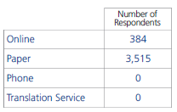
SWAG - NCPES 2019 responses

Slide 4
NCPES presentation of results
Results expressed in relation to ‘expected range’ for each Trust - with positive & negative outliers
(from ‘expected range’)
overall SWAG report: 9 positive outliers (above) and no negative outliers (below)
Only Questions with 21+ responses/ per question will have individual site results
Trusts with smaller patient numbers (despite good return rates) are unable to perform robust site specific analysis for service improvement

Slide 5
Highest SWAG scores
 |  | SWAG %
27 | Beforehand, patient had all information needed about operation | 97
44 | Cancer Dr had the right document at patient’s last Outpatient appointment | 96
54 | GP given enough information about patient’s condition and treatment | 96
5 | Received all the information needed about the test | 95
41 | Hospital staff told patient who to contact if worried about condition or treatment after leaving hospital | 95
19 | Patient given the name of the clinical nurse specialist who would support them through their treatment | 94
22 | Hospital staff gave information about support groups or self-help groups for people with cancer | 92
58 | Overall administration was good or very good | 90
6 | Length of time waiting for a test was about right | 90

Slide 6
Lowest SWAG scores
 |  | SWAG % | National average %
60 | Someone discussed with patient whether they would like to take part in cancer research | 34 | 30
57 | Patient given a care plan | 39 | 38
53 | Patient definitely given enough support from health or social services after treatment | 49 | 45
52 | Patient definitely given enough support from health or social services during treatment | 54 | 52
37 | Patient definitely found hospital staff to discuss worries or fears during inpatient visit | 55 | 52
17 | Patient definitely told about side effects that could affect them in the future | 59 | 57

Slide 7
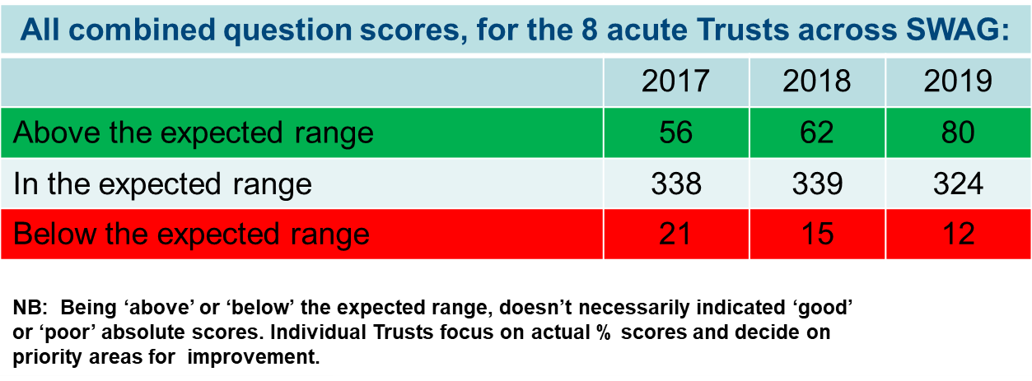
Overall SWAG picture
Sustained, improving patient experience landscape across the Cancer Alliance

Slide 8
SWAG scores: above / below expected range

Slide 9
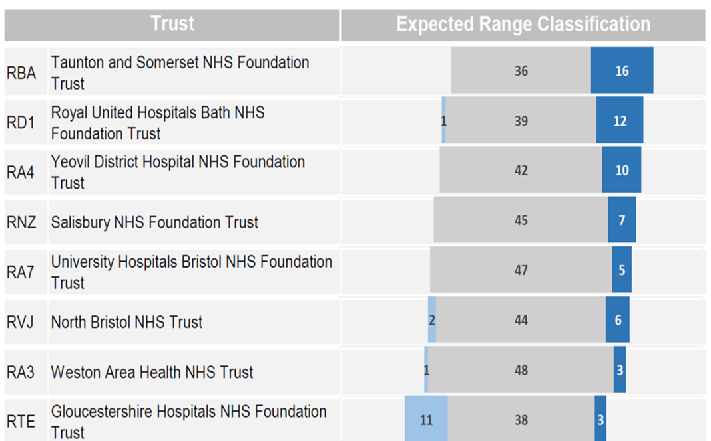
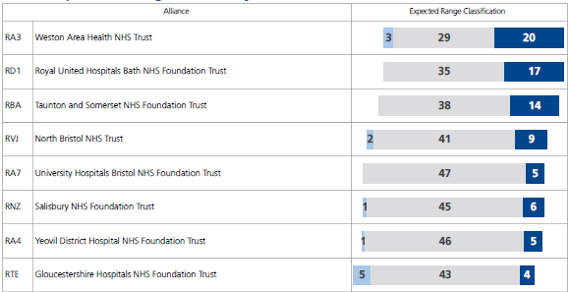
SWAG Trusts 2018 & 2019
Significant improvement in patient experience at Weston
2018 2019

Slide 10
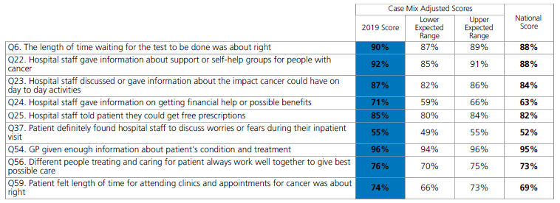
SWAG outliers - above expected range
SWAG had 9 positive outliers (and no negative outliers)
Most of these positive outliers (7/9), are specifically linked to the Personalised Care and Support programme.

Slide 11
Impact of ‘Personalised Care and Support’ programme
Cancer Support Workers
Allied Health Professionals – eg. cancer specialist dietitians, physiotherapists, psychologists
Holistic Need Assessments (HNAs)
Health and Wellbeing Events (H&WEs)
Treatment Summaries / Cancer Care Reviews
Stratified follow-up pathways
Remote monitoring
Pre-habilitation / Rehabilitation

Slide 12
Example of impact of Personalised Care and Support 2019: Weston

Slide 13
SWAG – PHE / NHS E Dashboard
The following questions are included in the phase 1 cancer dashboard, developed by Public Health England and NHS England.

Slide 14
SWAG challenges
Sustainability funding for Personalised Care and Support, rehabilitation and prehabilitation services
(Cancer Support Workers, specialist Allied Health Professionals, HNAs, H&WE, Treatment Summaries, stratified pathways, remote monitoring)
Capacity, workforce & environmental constraints
Performance impacting patient experience
Ability to impact provision of primary care support

Slide 15
Suggested priorities
Sustainability funding for Personalised Care and Support
Share good practice (between Trusts / teams)
Clinical Trials / cancer research (language / access)
Capturing holistic conversations / HNAs and care plans / COSD reporting
Inpatient support for worries and fears
Improve links with Health & Social Services / Primary care for support, during and after treatment

Slide 16
Future of NCPES
No comparable 2020 NCPES – currently developing NCPES ‘COVID’ cancer patient experience survey / qualitative feedback process
Whole survey (methodology / sampling / design / reporting) being reviewed ahead of 2021 iteration. Please feed in suggestions (via Lead Cancer Nurses).

