Slide 1
Clinical Nurse Specialist Update
Julie Burton,
Colorectal SSG, 27th June 2018

Slide 2
shared care patient information
Patient focus groups held in UH Bristol showed that care shared between centres can have a detrimental effect on the patient experience
Information on shared care arrangements may help to address this. If agreed, in what format?
Has such information been developed that can be shared?
Are there other ways to address this (short videos can be made by the communications team in UH Bristol)?

Slide 3
Gynae Patient Initiated Follow Up (PIFU) Card (Wallet Sized)

Slide 4
Alert Symptoms on reverse

Slide 5
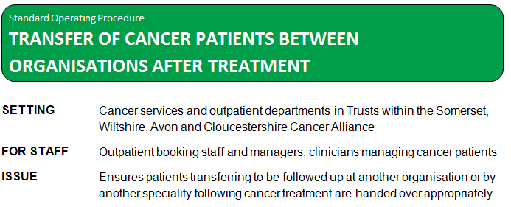

Slide 8
Colorectal SSG, 10th January 2018
A standard operation procedure for ensuring the handover of patients to their referring centres post-treatment, was circulated for agreement. This was deemed suitable for the majority of patients; as previously discussed, a different system will be optimised for the handover of anal cancer patients.
Generic email addresses for SWAG CNS team:
colorectalnurses@nbt.nhs.uk
ruh-tr.ColorectalNurses@nhs.net
colorectalnurses@uhb.nhs.uk
wnt-tr.colorectalstomacns@nhs.net
colorectalnurses@ydh.nhs.uk

Slide 9
South West Cancer Clinical Nurse Forum Update

