Slide 1
St Peters Hospice Services
Liz Attwood
Hospice CNS Manager
25 April 2018

Slide 2
Our Mission
To provide care and support for adult patients, families and carers in our community living with life-limiting illnesses in order to improve the quality of their living and dying. We do this working closely with other health and social care providers.
Our Vision
St Peter’s Hospice will play a leading role in the development and delivery of the best possible care and support services for adult patients, families, and carers living with life-limiting illnesses in our community.

Slide 3
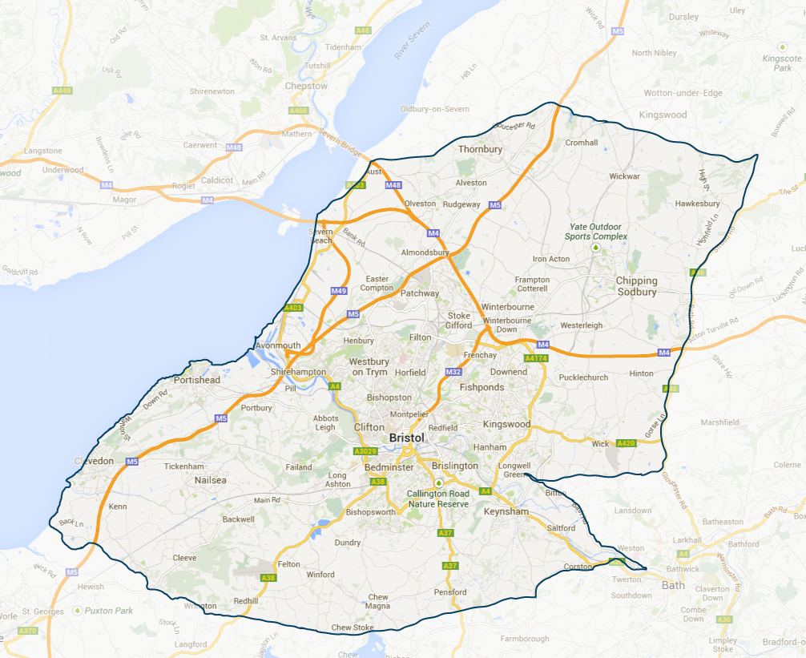

Slide 4
Access Team
Triage
Clinical advice line

Slide 5
Community Nurse Specialists
Assessment, support & advice at home
Partnership and MDT working

Slide 6
Medical Team
Complex assessment &
clinical management

Slide 7
Hospice at Home
Respite and end of life care at home

Slide 8
In Patient Unit
Short term assessment
&
complex management of holistic needs

Slide 9
Day Services
12 week programme
Fatigue and Breathlessness course

Slide 10
Patient and Family Support
Psychological therapies
&
Bereavement support
&
Social work

Slide 11
Complementary Therapies

Slide 12
Therapists
Occupational therapy
&
Physiotherapy

Slide 13
Hospice Volunteers
Hospice Neighbours
Support clinical teams

Slide 14
Hospice CNS Pathway
REFERRAL
Primary / secondary care professionals
TRIAGE
Meets referral criteria
Referral urgency
CNS VISIT
Advice and support to patient and family
Partnership working internal and external MDT
ONGOING CARE
OUTCOME
Internal referral to Hospice Services
Hospice discharge / Deceased
Bereavement follow up
On-going care from CNS and Hospice MDT

Slide 15
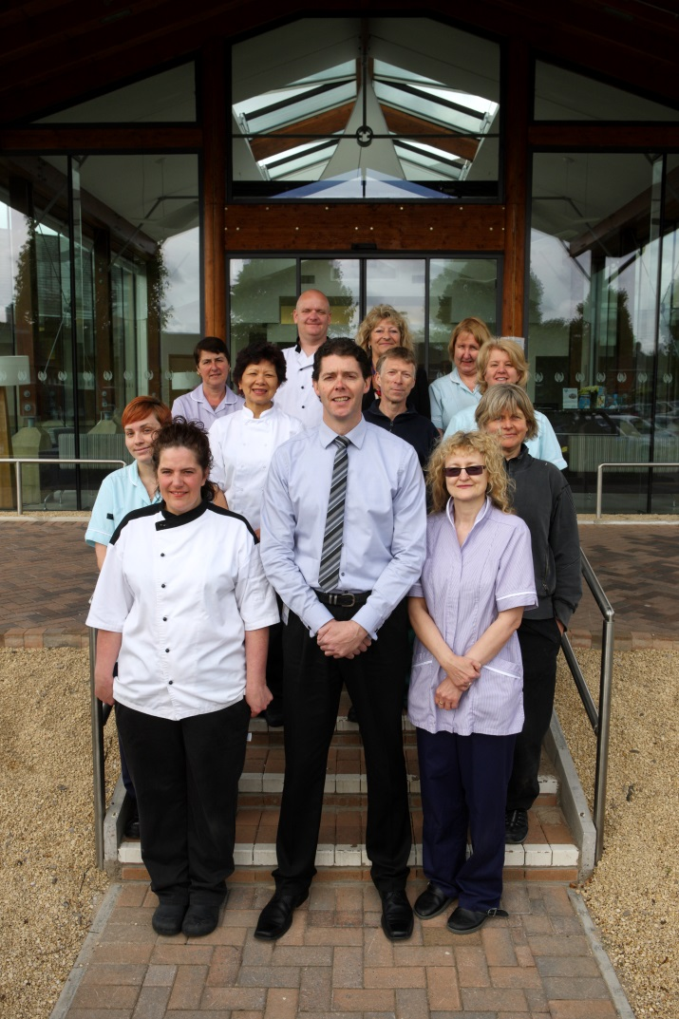
Some Key Statistics 2016/17
2150 referrals
8240 Community Nurse visits
2331 Day Hospice visits
Hospice at Home
16,247 care hours
362 patients
5173 In-patient bed days
2989 Advice line calls
360 paid staff
51 shops

Slide 16
https://youtu.be/PrZSfBoqdxk

Slide 17
Questions?

