Slide 1
Somerset, Wiltshire, Avon & Gloucestershire Cancer Alliance
Pathway Activity Funding Proposals
16.1.19

Slide 2
National Support Funding 2018/19
NHS England allocated National Support Funding (NSF) to the Somerset, Wiltshire, Avon & Gloucestershire (SWAG) Cancer Alliance
The criteria for the use of this money is:
Meeting the 62 day standard and sustaining it;
100% implementation of the rapid prostate, colorectal and lung pathways in 100% trusts across the Alliance geography by March 2019;
100% implementation of clinical protocols and a system for remote monitoring to support stratification of breast cancer patients across the Alliance geography by March 2019.
Total 2018/19 | £1700k

Slide 3
National Timed Rapid Diagnostic Pathway Colorectal
The pathway has been shaped by the NHS England Clinical Expert Group (CEG) for Colorectal Cancer.
CEG is chaired by Mr Michael Machesney, Consultant Colorectal Surgeon and co-chaired by Mr John Griffith, Consultant Colorectal Surgeon. The group also includes representation from the full range of professions involved in delivering bowel cancer services, as well as patient groups and commissioners.

Slide 4
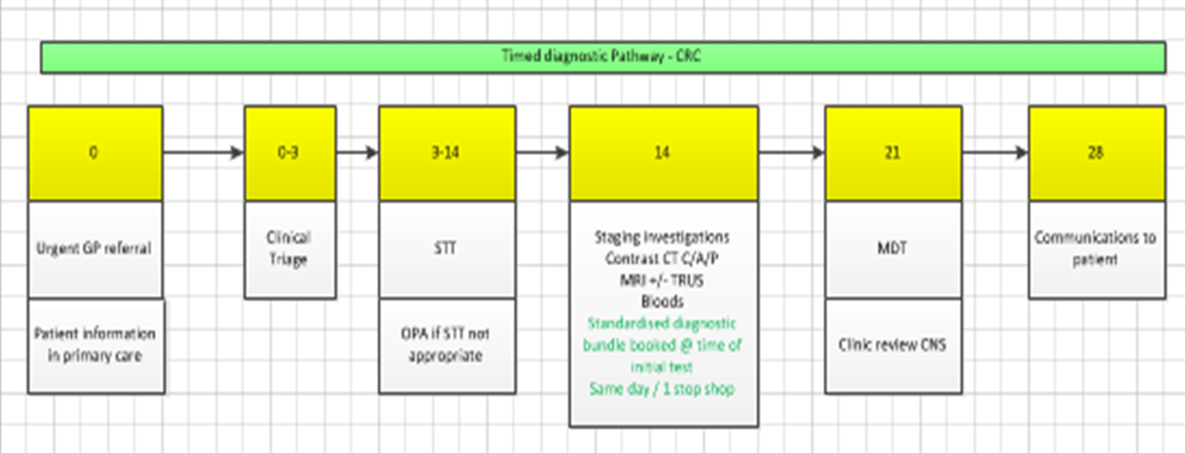
National Timed Rapid Diagnostic Pathway Colorectal

Slide 5
Indicative Pathway Activity Fund Q3/4
Indicative allocations weighted 75% to number of breaches and 25% to size of population
STP Indicative Allocation | Colorectal
BNSSG | 53K
BSW | 31K
Glos | 47K
Som | 37K
Total | 170K

Slide 6
Proposals
UHB: £17,000 backfill staff to introduce the Rapid Pathway
Gloucestershire: Reduce CT reporting delays*
RUH: £26,021 towards telephone triage and nurse endoscopist (partial funding 0.9 WTE Band 7)*
SDH: 0.1 Telephone triage – improve bowel preparation*
Somerset: Primary care across all pathways – Facilitator in primary care and QI GP £33,000*
YDH: Prehabilitation Pilot £10,000*
TST: Telephone triage move to PCAC £5,000*
*further detail required

Slide 7
Commissioning Guidance
Cancer Alliances: should work with commissioners and providers to ensure the whole pathway for colorectal cancer is provided within their geographical footprint
Support providers and CCG with actions to deliver where challenges
Priorities:
Quality data submissions
Earlier diagnosis (screening uptake and lower threshold of referral and improved diagnostic capacity)
Reduce variation in quality and outcomes through compliance with clinical advice in the commissioning guidance
Defined access to CNS support for improved patient experience

Slide 8
Clinical Senate Recommendation
SWAG and Peninsula Cancer Alliances support a peer review of the delivery of colorectal pathways with the aim of disseminating good practice across the region and highlighting issues that require a regional or national steer.
In particular the approaches to;
Four key decision points on the clinical pathway for patients at risk of or with colorectal cancer are identified:
i. This person may have colorectal cancer - what investigations are required?
ii. Colorectal cancer has been confirmed – what next?
iii. When cancer is fully staged, what treatment should be given?
iv. Is the proposed treatment appropriate for this particular patient?

Slide 9
CTF Early Diagnosis Transformation Project - FIT
Low risk not no risk
NG12 – adapted (not under 50 group)
650 GP practices in July 2018
To December 18 (South West)
4278 samples received
14.6% positive tests
18 cancers diagnosed (2.8%)
10 stage 1&2 , 7 stage 3&4
Make up very small proportion of 2 ww referrals therefore no hike in endoscopy demand
Modelling tool supported this finding opportunity to reproduce locally if experience differs
Preliminary evaluation led by Willie Hamilton results available from February

Slide 10
Prevention and early diagnosis SWAG CA Ambition to improve bowel screening uptake to 75% by 2020
BNSSG / CRUK targeted screening uptake improvement project - Standard per practice: £500 + variable uplift + postage (based on no. of non-responders) £21,916.60
Poor performing practices <52% uptake
Targeted to Deprivation / high BME proportion practices
Evidence based interventions
Non-responder flag
Process non-responders follow up
Practice specific ‘hard to reach’ approach
Staff training

