Slide 1
Clinical Research Network
West of England
SWAG SSG Gynaecology Cancer
Meeting
Friday 15th June
Research Report

Slide 2
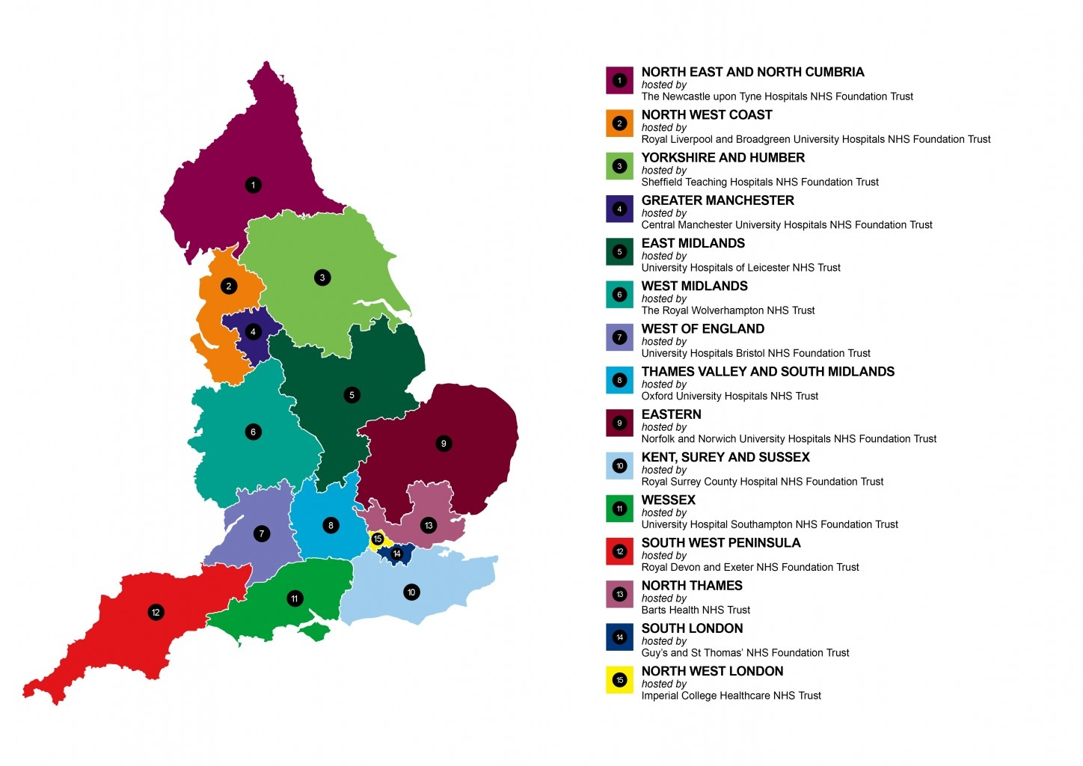
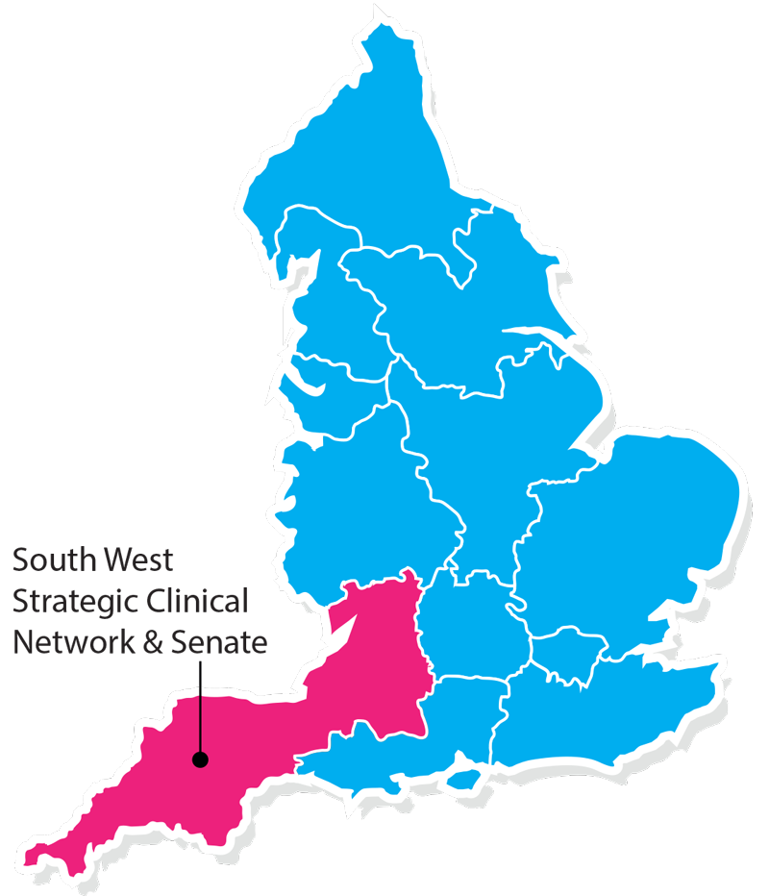
Clinical Research Network & Cancer Services
West ofEngland
SWAG - Somerset Wiltshire Avon & Gloucestershire
South West Children’s Cancer & Leukaemia
Research Network

Slide 3
NIHR CRN High Level Objectives 2017-18
Increase number of participants into NIHR CRN portfolio studies
  650,000 in England
  21,905 in West of England
Increase the number of studies that deliver to time and target
  Target 80%
Increase number of commercial studies delivered through network
Reduce NHS study set up times
Reduce time taken to recruit first participant

Slide 4
Cancer specialty objective for 2018-19
Increase patient access to Cancer research studies across the breadth of the Cancer subspecialties Number of LCRNs achieving on-target recruitment into at least 8 of the 13 Cancer subspecialties, where "on-target" means either improving recruitment by 10% from 2017/18 or meeting the following recruitment targets per 100,000 population served:
a) Brain: 0.2; b) Breast: 10 c); Colorectal: 3 d); Children and Young People: 3; e) Gynae: 3; f) Head & Neck: 1.5; g) Haematology: 7; h) Lung: 4; i) Sarcoma: 0.1; j) Skin: 0.5; k) Supportive & Palliative Care and Psychosocial Oncology: 4; l) Upper GI: 3; m) Urology: 12.

Slide 5
Performance regarding 2018/19 Cancer specialty target

Slide 10
Open studies – Gynaecology
CPMS ID | Title | Trust | Recruited (total) | Target | Edge recruitment end date | CPMS recruitment end date | Principle investigator | Link to study details
9812 | ICON8 and ICON8B - ICON8 Trial Programme | Gloucestershire Hospitals NHS Foundation Trust | 35 | 6 | 07/01/2019 | 01/07/2019 | Cook, Dr Audrey | http://public-odp.nihr.ac.uk/9812
 |  | Royal United Hospitals Bath NHS Foundation Trust | 26 | 6 | 01/01/2020 | 01/07/2019 | Bowen, Dr Rebecca
 |  | University Hospitals Bristol NHS Foundation Trust | 44 | 45 | 31/05/2019 | 01/07/2019 | Walther, Dr Axel
 |  | Weston Area Health NHS Trust | 6 | 8 | 30/09/2018 | 01/07/2019 | Owadally, Dr Waheeda
32967 | OCTOVA | Royal United Hospitals Bath NHS Foundation Trust | 2 | 7 | 30/09/2019 | 30/11/2021 | Bowen, Dr Rebecca | http://public-odp.nihr.ac.uk/32967
31860 | STATEC | University Hospitals Bristol NHS Foundation Trust | 1 | 36 | 30/04/2021 | 01/11/2026 | Newton, Dr Claire | -
30257 | C31004 | University Hospitals Bristol NHS Foundation Trust | 2 | 1 | 30/06/2018 | 30/06/2018 | Walther, Dr Axel | -
12591 | TRIOC | University Hospitals Bristol NHS Foundation Trust | 15 | 10 | 01/05/2017 | 02/12/2017 | Walther, Dr Axel | http://public-odp.nihr.ac.uk/12591

Slide 11
Open studies – Gynaecology
CPMS ID | Title | Trust | Recruited (total) | Target | Edge recruitment end date | CPMS recruitment end date | Principle investigator | Link to study details
20440 | OCTOPUS | Royal United Hospitals Bath NHS Foundation Trust | 4 | 5 | 15/08/2018 | 16/08/2018 | Bowen, Dr Rebecca | http://public-odp.nihr.ac.uk/20440
 |  | University Hospitals Bristol NHS Foundation Trust | 3 | 3 | 30/04/2018 | 16/08/2018 | Walther, Dr Axel
20204 | MROC: MR in Ovarian Cancer | Gloucestershire Hospitals NHS Foundation Trust | 2 | 12 | 29/11/2019 | 29/11/2019 | Hillaby, Ms Kathryn | http://public-odp.nihr.ac.uk/20204
17481 | CX.5 (SHAPE):Early Stage 1A2 and 1B1 | University Hospitals Bristol NHS Foundation Trust | 6 | 4 | 31/01/2019 | 27/01/2019 | Bailey, Dr Jo | http://public-odp.nihr.ac.uk/17481
15782 | NCRN - 2352 PiSARRO | University Hospitals Bristol NHS Foundation Trust | 6 | 4 | 31/12/2018 | 31/10/2018 | Walther, Dr Axel | -
15374 | NiCCC Trial (BIBF1120) | University Hospitals Bristol NHS Foundation Trust | 4 | 12 | 30/01/2019 | 15/06/2019 | Walther, Dr Axel | http://public-odp.nihr.ac.uk/15374
11775 | INTERLACE | Gloucestershire Hospitals NHS Foundation Trust | 2 | 4 | 31/12/2019 | 01/09/2018 | Cook, Dr Audrey | http://public-odp.nihr.ac.uk/11775

Slide 12
Studies in set-up - Gynaecology
CPMS ID | Short title | Partner organisation | Link to study details
16494 | PAZOFOS | University Hospitals Bristol NHS Foundation Trust | http://public-odp.nihr.ac.uk/16494
20204 | MROC: MR in Ovarian Cancer | University Hospitals Bristol NHS Foundation Trust | http://public-odp.nihr.ac.uk/20204
32895 | EDMONd-Elemental Diet in bowel obstruction | Royal United Hospitals Bath NHS Foundation Trust | http://public-odp.nihr.ac.uk/32895

Slide 13
Gynaecology cancer studies open to new sites
CPMS ID | Short title | LCRN | Study status | Planned closure date | Link to study details | Contact
9812 | ICON8 Trials Programme | Greater Manchester | Open, With Recruitment | 01/07/2019 | http://public-odp.nihr.ac.uk/9812 | Jessica.bartlett@nihr.ac.uk
11775 | INTERLACE | North Thames | Open, With Recruitment | 01/09/2018 | http://public-odp.nihr.ac.uk/11775 | Jessica.bartlett@nihr.ac.uk
14292 | ENGOT-EN2-DGCG-EORTC-55102 | Kent, Surrey and Sussex | Open, With Recruitment | 13/04/2018 | http://public-odp.nihr.ac.uk/14292 | Jessica.bartlett@nihr.ac.uk
15374 | NiCCC Trial (BIBF1120) | Kent, Surrey and Sussex | Open, With Recruitment | 15/06/2019 | http://public-odp.nihr.ac.uk/15374 | Jessica.bartlett@nihr.ac.uk
17481 | SHAPE - Simple Hysterectomy And Pelvic node dissection in Early cervix cancer | Yorkshire and Humber | Open, With Recruitment | 27/01/2019 | http://public-odp.nihr.ac.uk/17481 | Jessica.bartlett@nihr.ac.uk
20204 | MROC: MR in Ovarian Cancer | North West London | Open, With Recruitment | 29/11/2019 | http://public-odp.nihr.ac.uk/20204 | Jessica.bartlett@nihr.ac.uk
20440 | OCTOPUS | South London | Open, With Recruitment | 16/08/2018 | http://public-odp.nihr.ac.uk/20440 | Jessica.bartlett@nihr.ac.uk
31860 | STATEC | North Thames | Open, With Recruitment | 01/11/2026 | - | Jessica.bartlett@nihr.ac.uk
36724 | Developing new tests for ovarian cancer | West Midlands | Open, With Recruitment | 31/07/2020 | http://public-odp.nihr.ac.uk/36724 | Jessica.bartlett@nihr.ac.uk

Slide 14
Gynaecology cancer studies open to new sites
CPMS ID | Short title | LCRN | Study status | Planned closure date | Link to study details | Contact
32358 | COPELIA | Greater Manchester | Open to Recruitment | 15/06/2020 | http://public-odp.nihr.ac.uk/32358 | Jessica.bartlett@nihr.ac.uk
32895 | EDMONd-Elemental Diet in bowel obstruction | Kent, Surrey and Sussex | Open, With Recruitment | 31/01/2020 | http://public-odp.nihr.ac.uk/32895 | Jessica.bartlett@nihr.ac.uk
32967 | OCTOVA | Thames Valley and South Midlands | Open, With Recruitment | 30/11/2021 | http://public-odp.nihr.ac.uk/32967 | Jessica.bartlett@nihr.ac.uk
33260 | COMICE | North West Coast | In Setup, HRA Approval Received | 01/03/2019 | http://public-odp.nihr.ac.uk/33260 | Jessica.bartlett@nihr.ac.uk
33400 | RaNGO | Eastern | In Setup, HRA Approval Received | 01/10/2020 | http://public-odp.nihr.ac.uk33260 | Jessica.bartlett@nihr.ac.uk
33624 | Robotic QOL Study | North East and North Cumbria | Open, With Recruitment | 28/02/2019 | http://public-odp.nihr.ac.uk/33624 | Jessica.bartlett@nihr.ac.uk
34369 | Image guided radiotherapy and adaptive brachytherapy for cervix cancer | Eastern | Open, With Recruitment | 30/11/2019 | http://public-odp.nihr.ac.uk/34369 | Jessica.bartlett@nihr.ac.uk
36280 | ICON9 | Thames Valley and South Midlands | In Setup, HRA Approval Received | 01/04/2021 | http://public-odp.nihr.ac.uk/36280 | Jessica.bartlett@nihr.ac.uk
38041 | The role of pelvic examination in diagnosing gynaecological cancer | - | Open to Recruitment | 30/01/2019 | http://public-odp.nihr.ac.uk/38041 | Jessica.bartlett@nihr.ac.uk

Slide 15
Useful links
https://www.crn.nihr.ac.uk/
  National and local network information including training programmes templates, tools, contacts, videos etc
https://odp.nihr.ac.uk/
  Open data platform. Look at performance across whole CRN including all specialty areas
http://csg.ncri.org.uk/portfolio/portfolio-maps/
  View current national portfolio of open, closed and ‘in set up’ cancer studies
https://www.ukctg.nihr.ac.uk/
  See where a study is open across the country
http://public-odp.nihr.ac.uk/
  Search for a study to fit criteria. Good for horizon scanning, eligibility criteria

Slide 16
Contacts
Research Delivery Manager – David.Rea@nihr.ac.uk
Research portfolio facilitator – jessica.bartlett@nihr.ac.uk
Gynaecology cancer research lead – rebecca.bowen3@nhs.net

