Slide 1

Surgical Management of the parotid and neck in metastatic cutaneous skin cancer

Slide 2
Why offer treatment of the neck?
The overall regional metastatic rate of cSCC in a UK population has been reported at around 5 per cent.
These rates can be higher in the presence of adverse histological features; for instance, 33 and 47 per cent for poor differentiation or peri-neural infiltration.
Significant reduction in 5 year survival associated with metastatic nodal disease
In the clinically N0 neck, radiological imaging is not beneficial, and a policy of watchful waiting and patient education can be adopted
Appropriate imaging to determine the extent of primary NMSC is indicated when perineural involvement or bony invasion is suspected (R)

Slide 3
Important
The parotid is the site for up to 70 per cent of metastasing cSCC
Where the parotid is involved (P+), there is an increased chance of the neck containing occult and overt metastases (10–35 per cent).
In the P+N+ scenario, the incidence of metastases in level V approaches 30 per cent.
The posterior scalp is the site for 5 per cent of cSCC, and tumours here will metastasise initially commonly to post-auricular, occipital or level V nodes.

Slide 4
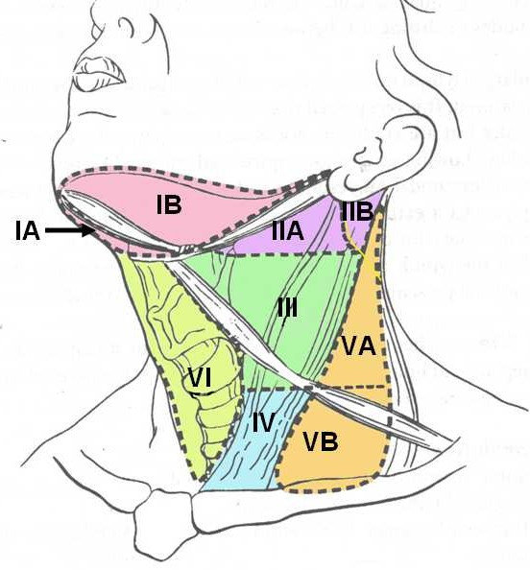

Slide 5
Non-melanoma skin cancer: United Kingdom National Multidisciplinary Guidelines
C NEWLANDS et al The Journal of Laryngology & Otology (2016), 130 (Suppl. S2), S125–S132.
P+ N0 disease: Resection should include involved parotid tissue, combined with levels I–III neck dissection, to include the external jugular node. (R)
P+ N+ disease: Resection should include level V if that level is clinically or radiologically involved. (R)
Adjuvant RT should include level V if not dissected. (R)
P0 N+ disease: Anterior neck disease should be managed with levels I–IV neck dissection to include the external jugular node. (R)
P0 N+ posterior echelon nodal disease (i.e. occipital or post-auricular) should undergo dissection of levels II–V, with sparing of level I. (R)
Consider treatment of the ipsilateral parotid if the primary site is the anterior scalp, temple or forehead. (R)
P+ Parotid positive for mets N+ Neck positive for mets
P0 Parotid negative for mets N0 Neck negative for mets

Slide 6
High clinical suspicion
Repeat FNAC or consider open biopsy
Clinical follow up or other appropriate treatment
If level V not resected then give radiotherapy
Parotidectomy + ND levels I-IV incl external jugular LNs +/- level V
P0
Cross sectional imaging including neck. CT +/-MRI
N+
Suspicion of metastases to parotid
US FNAC
P+
N0
Parotidectomy + ND levels I-III incl external jugular LNs
Repeat FNAC or consider open biopsy
inconclusive

Slide 7
High clinical suspicion
Repeat FNAC or consider open biopsy
If level V not resected then offer radiotherapy
Parotidectomy + ND levels I-IV incl external jugular LNs +/- level V
Clinical follow up or other appropriate treatment
N0
Cross sectional imaging including parotid. CT +/-MRI
P+
Suspicion of metastases to neck
US FNAC
N+
ND levels I-IV incl external jugular LNs
P0
Repeat FNAC or consider open biopsy
Post. echelon disease
ND levels II-V incl external jugular LNs
inconclusive

Slide 8
Role of Sentinel Node Biopsy
Sagar Kansaraa et al Surgical management of non melanoma skin cancer of the head and neck Oral Oncology Volume 100, January 2020, 104485
Sentinel lymph node biopsy (SLNB) has gained traction in the context of a clinically negative neck.
Studies show rates of occult metastases in high risk SCC is 5-11.3%
Factors found to be associated with occult metastasis included lymphovascular invasion, perineural invasion, and size of tumour.
SLNB may increase survival in high risk cutaneous SCC, suggesting that SLNB possesses significant clinical utility
Might be of use to distinguish between anterior echelon and posterior echelon disease

Slide 9
Questions
How much parotid – total vs superficial?
Adjuvant radiotherapy? Therapeutic vs prophylactic dose to parotid bed.

