Slide 1
Interventions for intractable cancer pain
Dr Nilesh Chauhan
Consultant In Anaesthesia & Pain management UHB

Slide 2
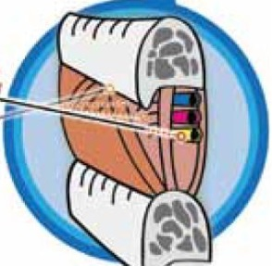
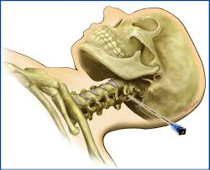
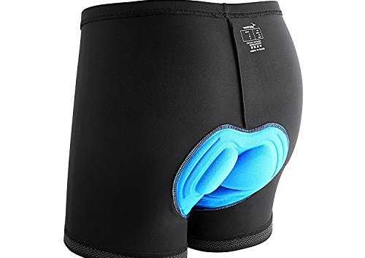
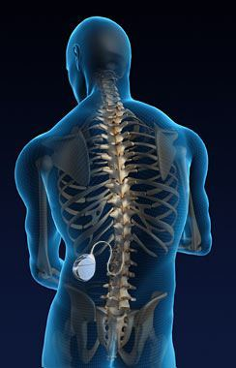
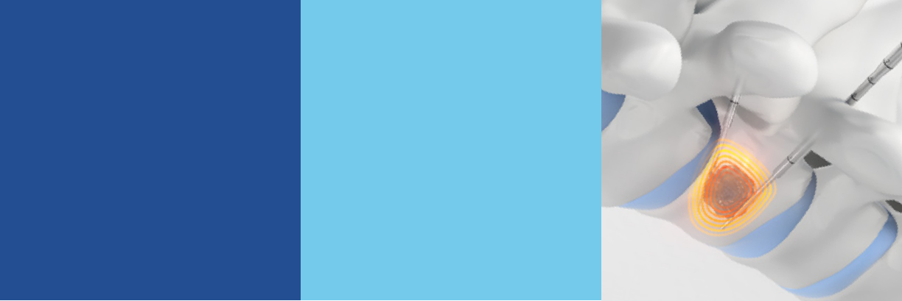
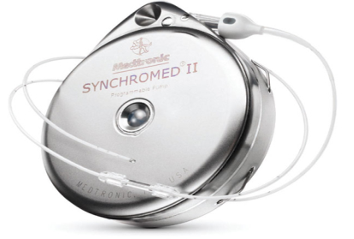


Slide 3

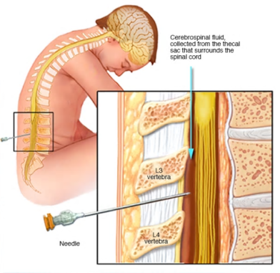
Neurolytic Saddle block
For intractable perineal /saddle area pain – difficulty sitting
Spinal injection with phenol whilst sitting (can start in lying position if unable to sit)
Catheter/Stoma/loss of function preferable
Limited life expectancy
Maybe easier to do whilst patient still an inpatient at BRI otherwise need to be able to travel to SBCH
Check anticoagulants/platelet meds

Slide 4
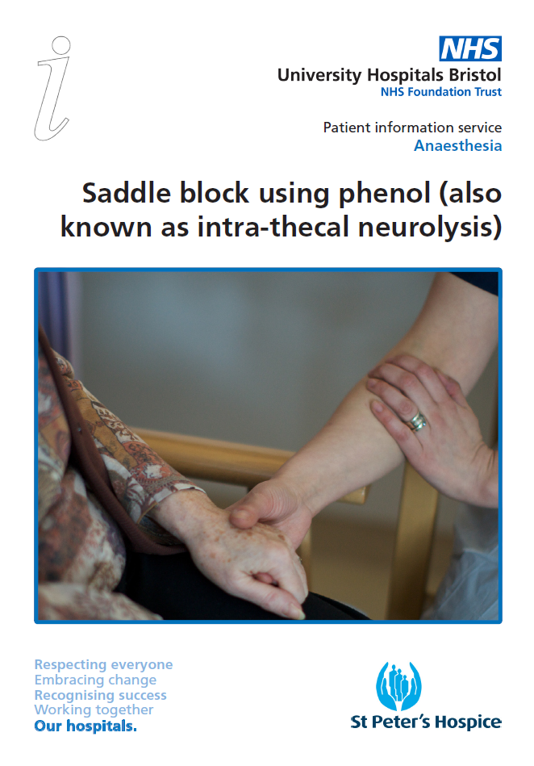
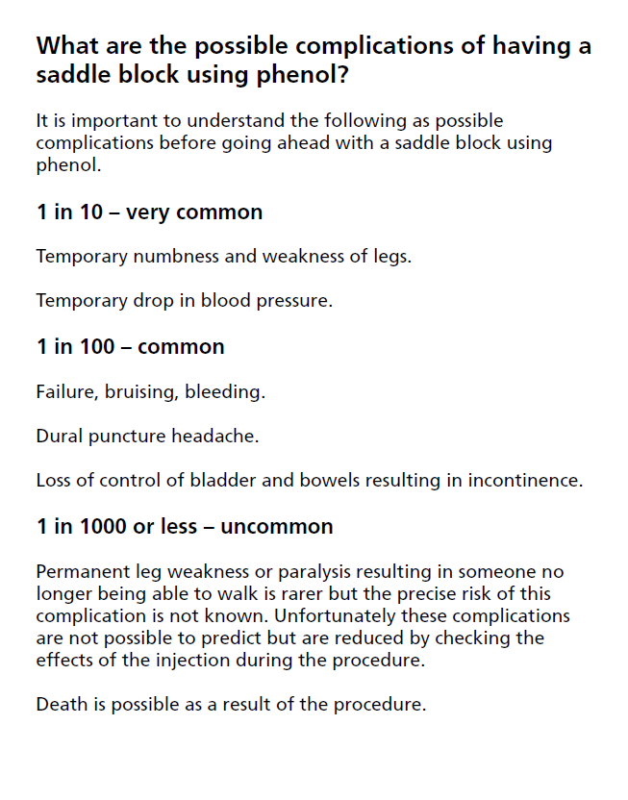
Neurolytic Saddle block

Slide 5
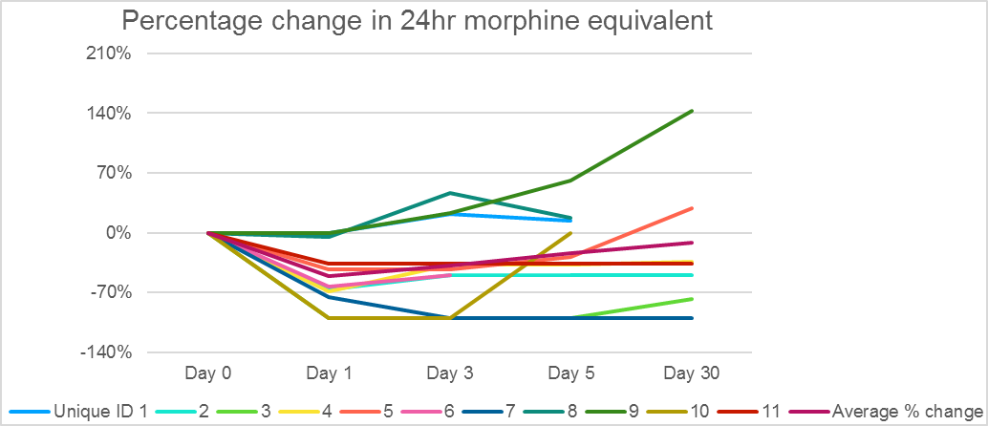
Neurolytic Saddle block

Slide 6
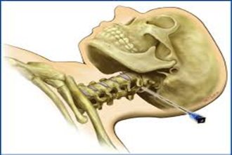
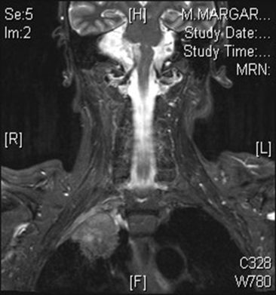

Cordotomy
Unilateral pain below C4
Uncontrolled, or likely to become so
Limited life expectancy (< 2 yrs)
Must be able to lie flat for an hour for procedure
Able to travel to Portsmouth
Best results -
  Chest wall (mesothelioma), arm (brachial plexus)
https://www.mesothelioma.uk.com/information-support/information/symptoms-and-controlling-them/#pain

Slide 7

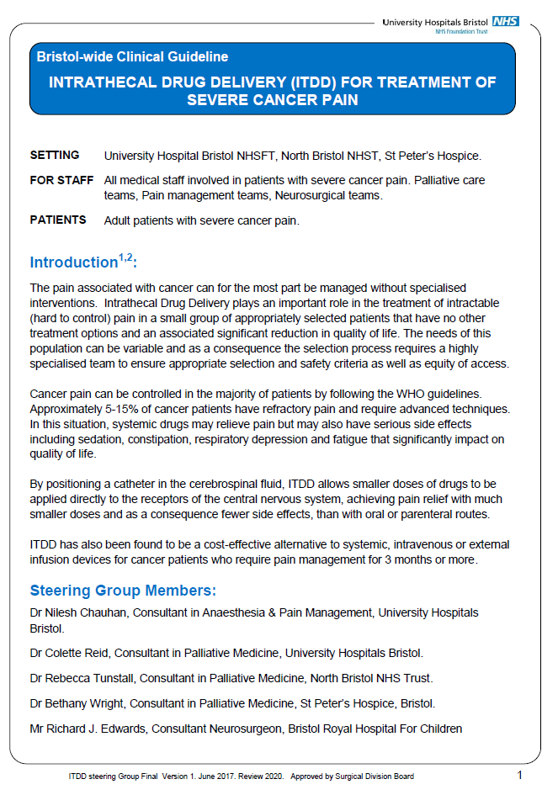
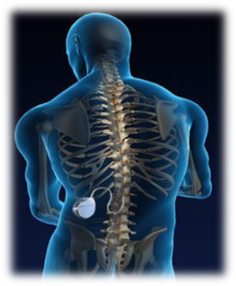
Intrathecal Drug Delivery (ITDD)

Slide 8

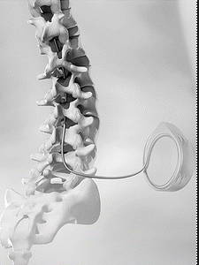
ITDD
Clinical Commissioning Policy: Intrathecal Pumps for Treatment of Severe Cancer Pain
5-15% of cancer patients have refractory pain
systemic drugs may relieve pain but may also have serious side effects
Placing a catheter in the cerebrospinal fluid, ITDD allows smaller doses of drugs to be applied directly to the receptors of the CNS
Cost-effective alternative to systemic, IV or external infusion devices for cancer patients who require pain management for 3 months or more

Slide 9
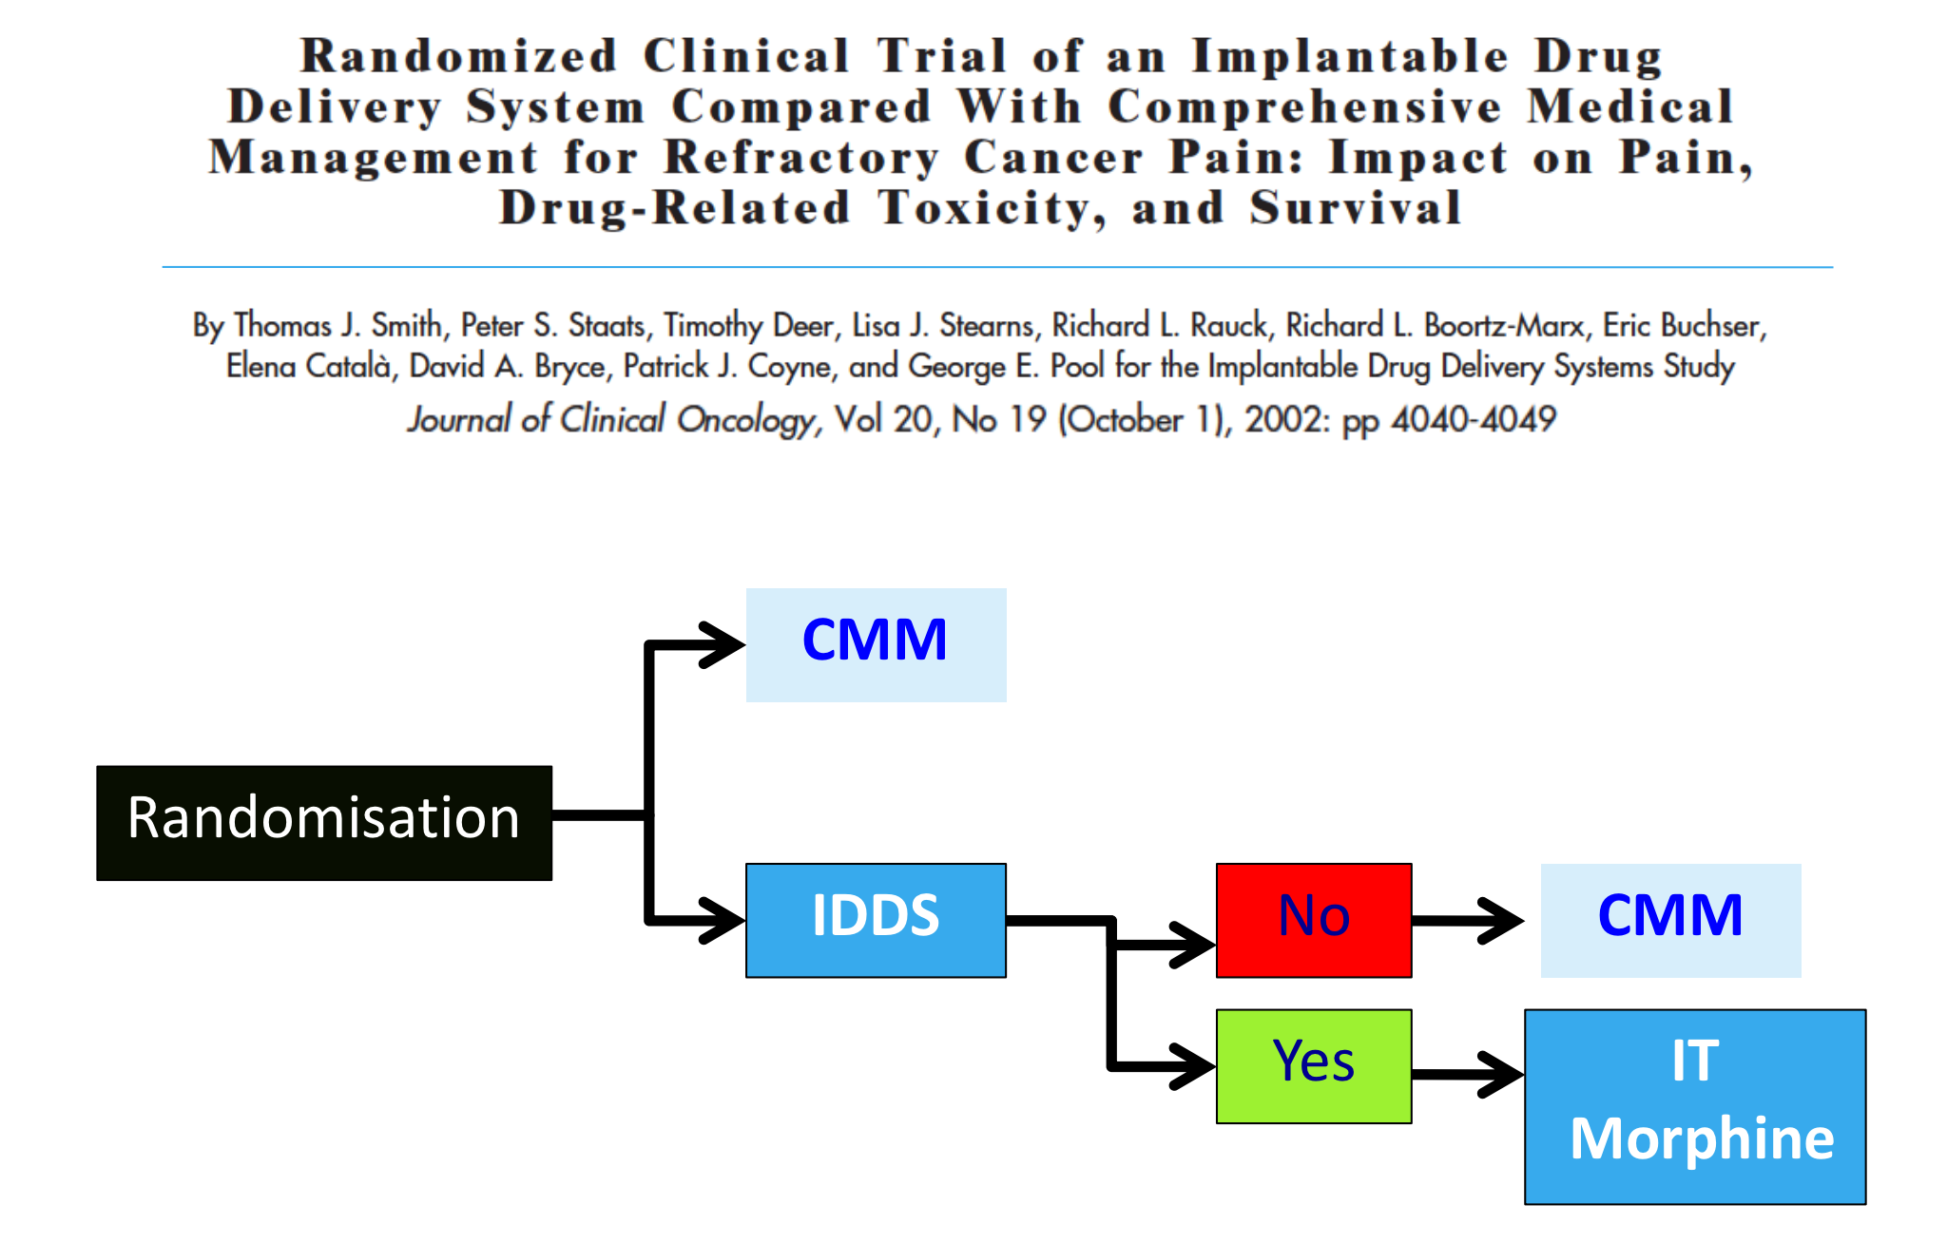
Notes:
Study presented at Rome conference
Primary outcome > 20% VAS and >20 % toxicity reduction. 200 pts powered to detect the >20% reduction
Showed reduction in VAS and toxicity

Slide 10
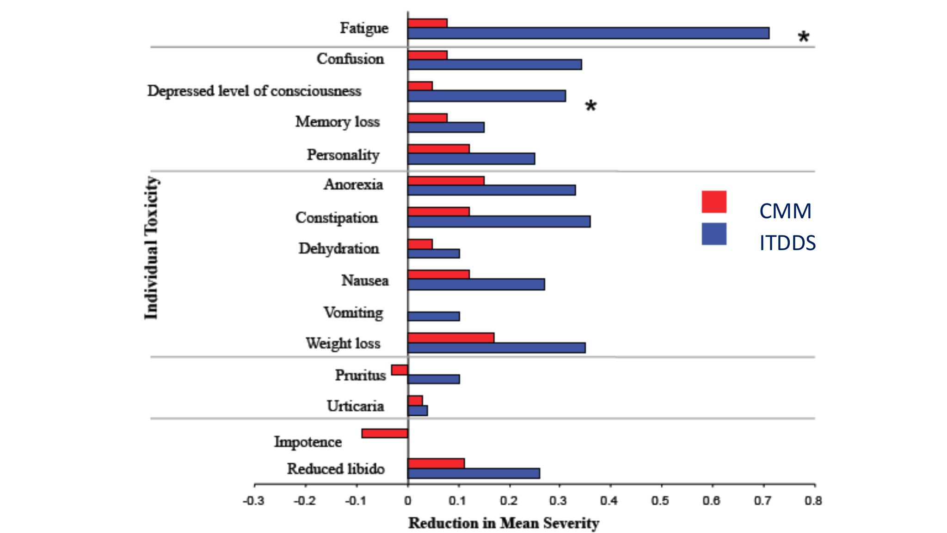
Side effects

Slide 11
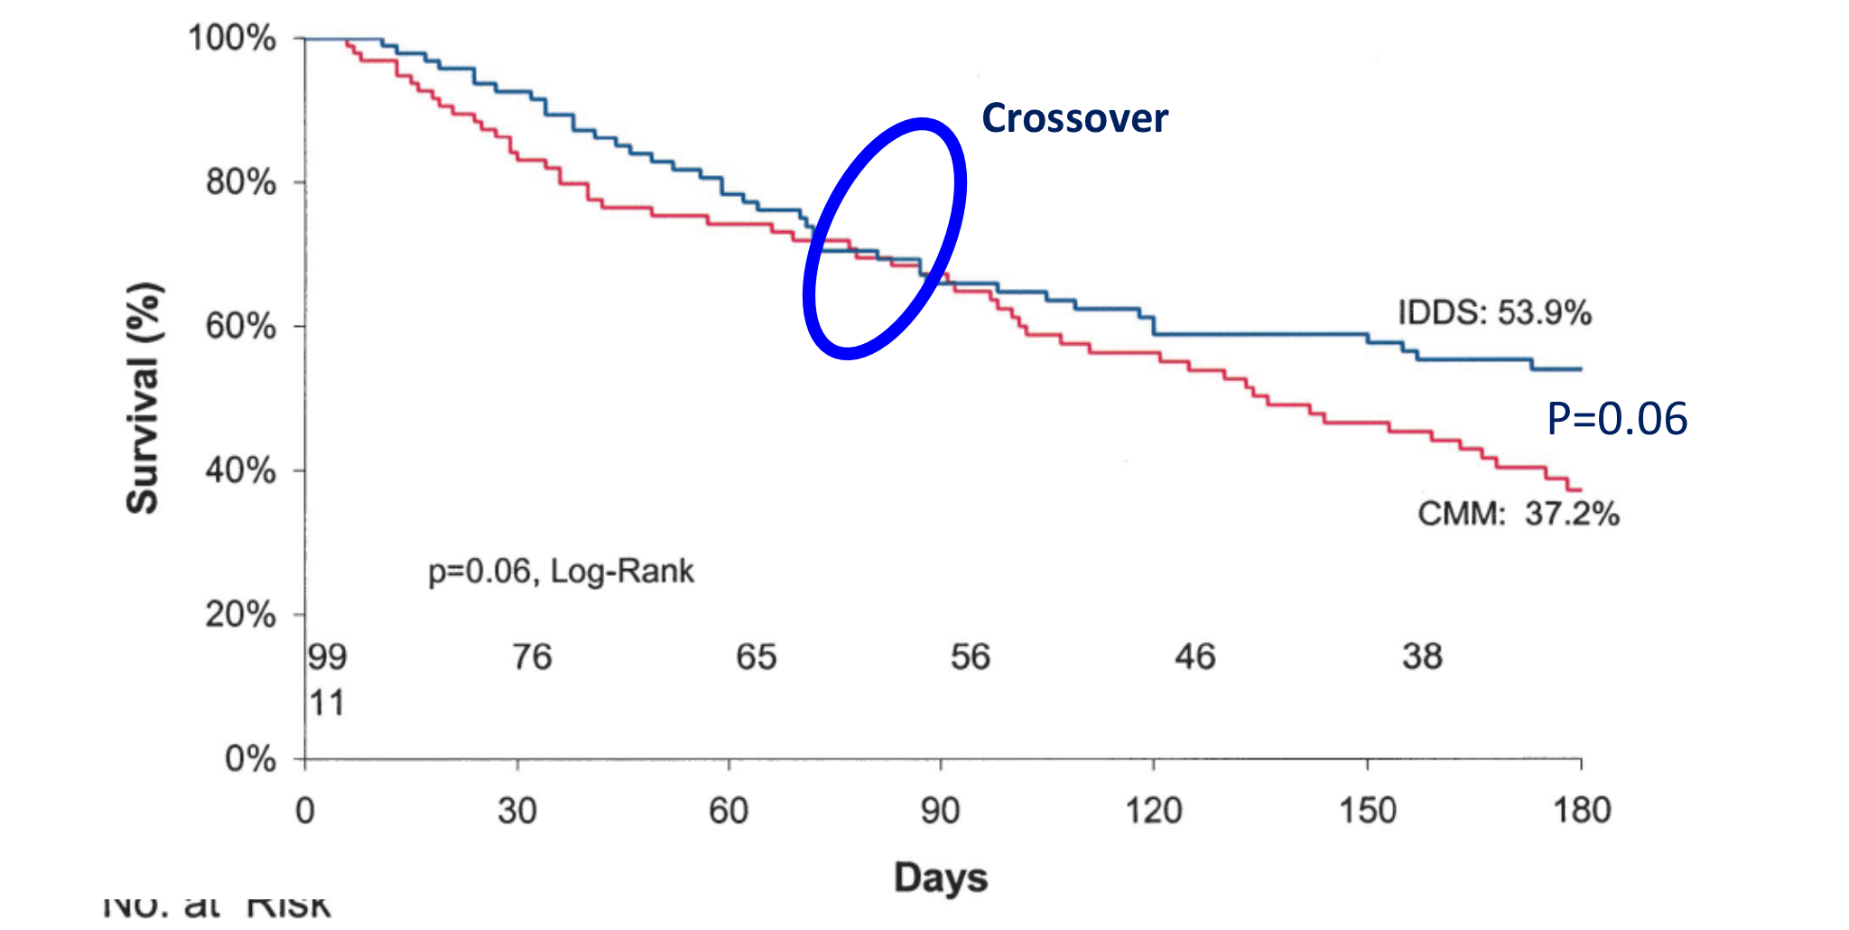
Survival

Slide 12
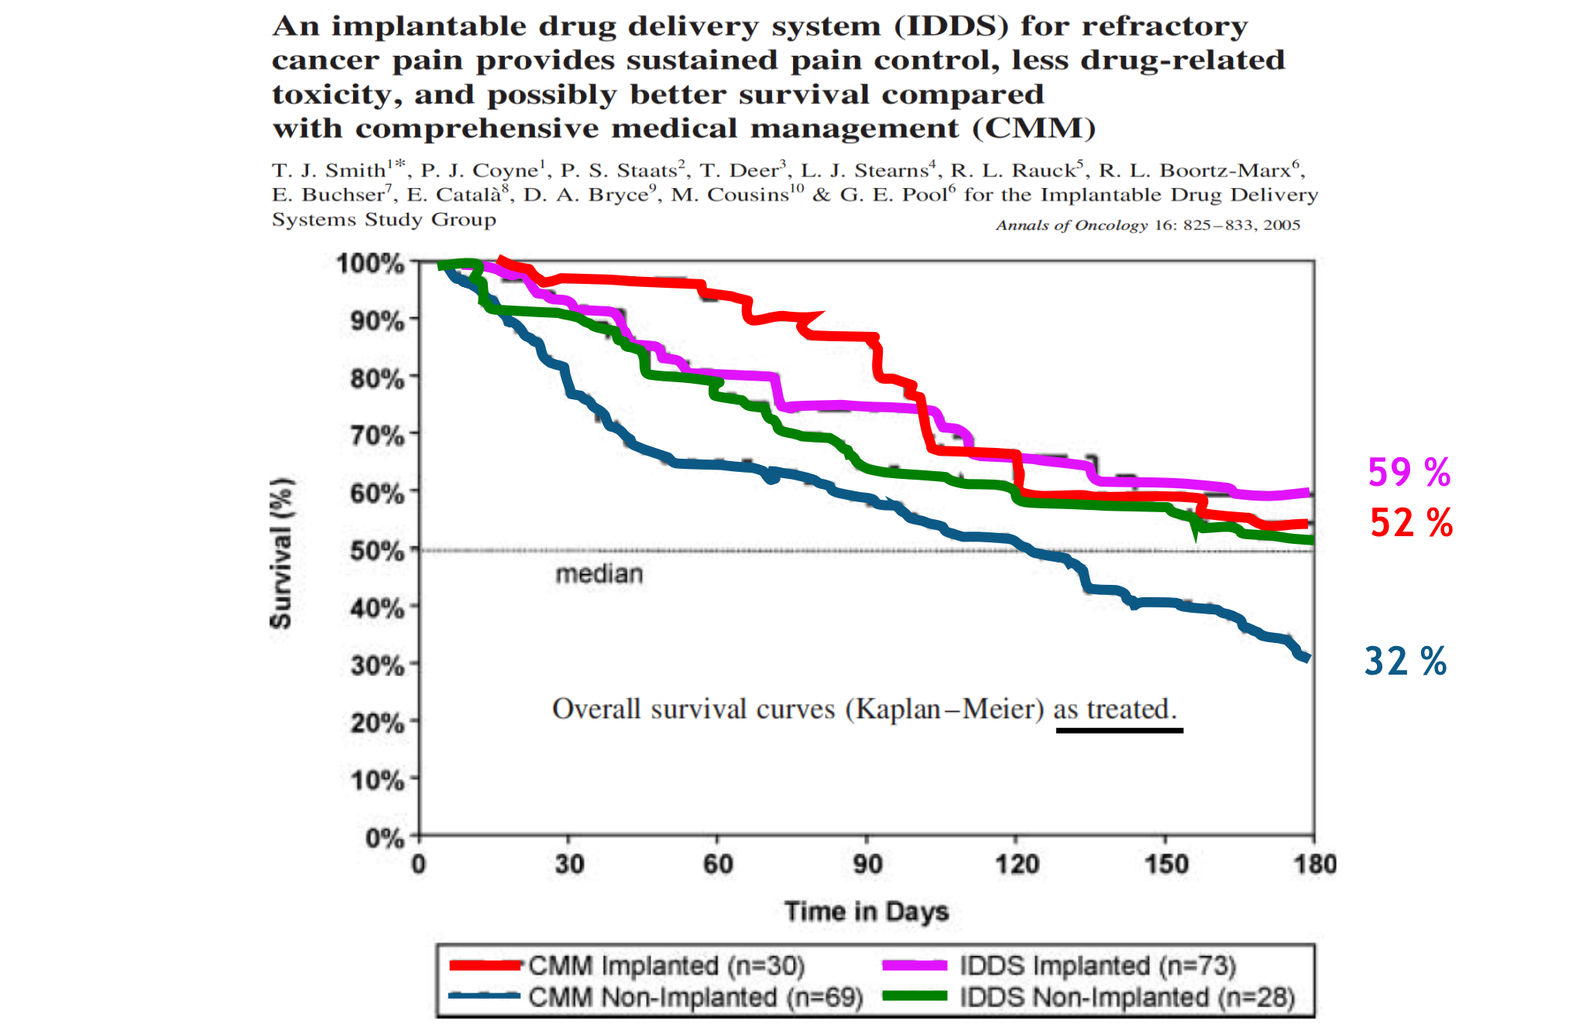

Slide 13
ITDD – eligible criteria
Severe pain of known origin that has failed to be satisfactorily managed despite conventional and specialised pain management or where that pain control is partially achieved but with unacceptable side effects.
Pain usually perceived below the diaphragm (e.g. spinal, pelvic or lower limb tumour).
A trial of properly managed oral/transdermal opioids has achieved some pain reduction however continued use is limited by high opioid toxicity.

Slide 14
ITDD – other criteria
Consideration of social and medical support systems
Within reasonable distance of UHB and St Peter’s hospice to attend appointments,
Prognosis and life expectancy (>3-6 months),
Fitness to undergo surgery and anaesthesia.

Slide 15
ITDD – eligible criteria
Intractable cancer pain
VAS > 4 despite 200mg/day oral morphine equivalent
Prognosis > 3 months

Slide 16
ITDD – contraindications
Pregnancy or nursing mother or planning to get pregnant,
Any concomitant treatment or medical condition that would render ITDD administration hazardous,
Infection,
Un-correctable bleeding disorder,
Logistical difficulties with after care including pump refills, funding of ongoing ITDD.

Slide 17
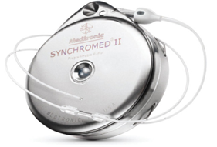
Eligible patients to be discussed by the MDT palliative care team – work up to include bloods, MRI head and whole spine
Referral for Pain Clinic assessment
Admission to BRI for trial
Admission to BRI for implantation by neurosurgeons
Outpatient refills at Pain Clinic (Central Health Clinic)

Slide 18
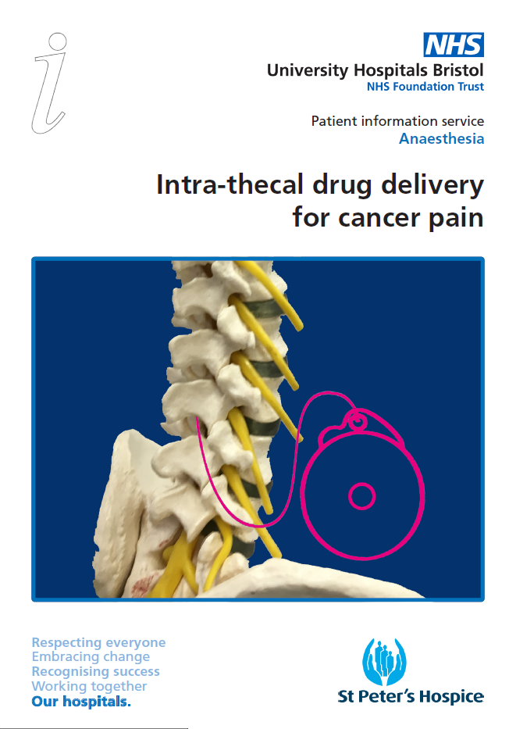
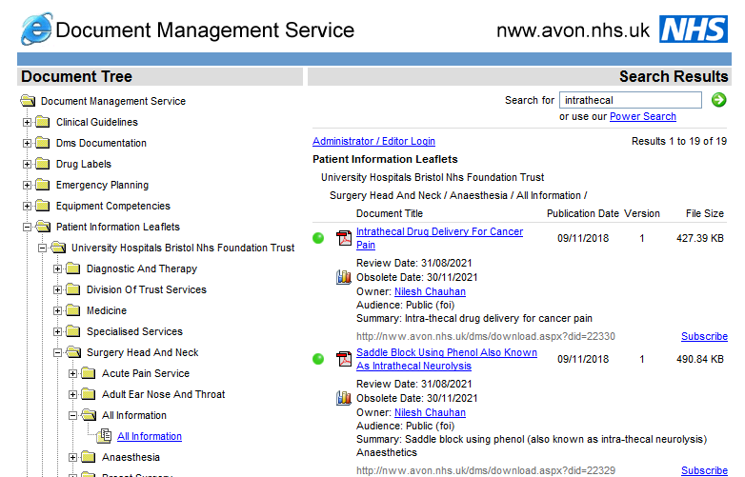

Slide 19
Complications
Overall 3% for lifetime of implant:
  Drug infusion related
  Neurological – requiring urgent investigation
  Infection
  CSF leak
  Catheter displacement

Slide 20
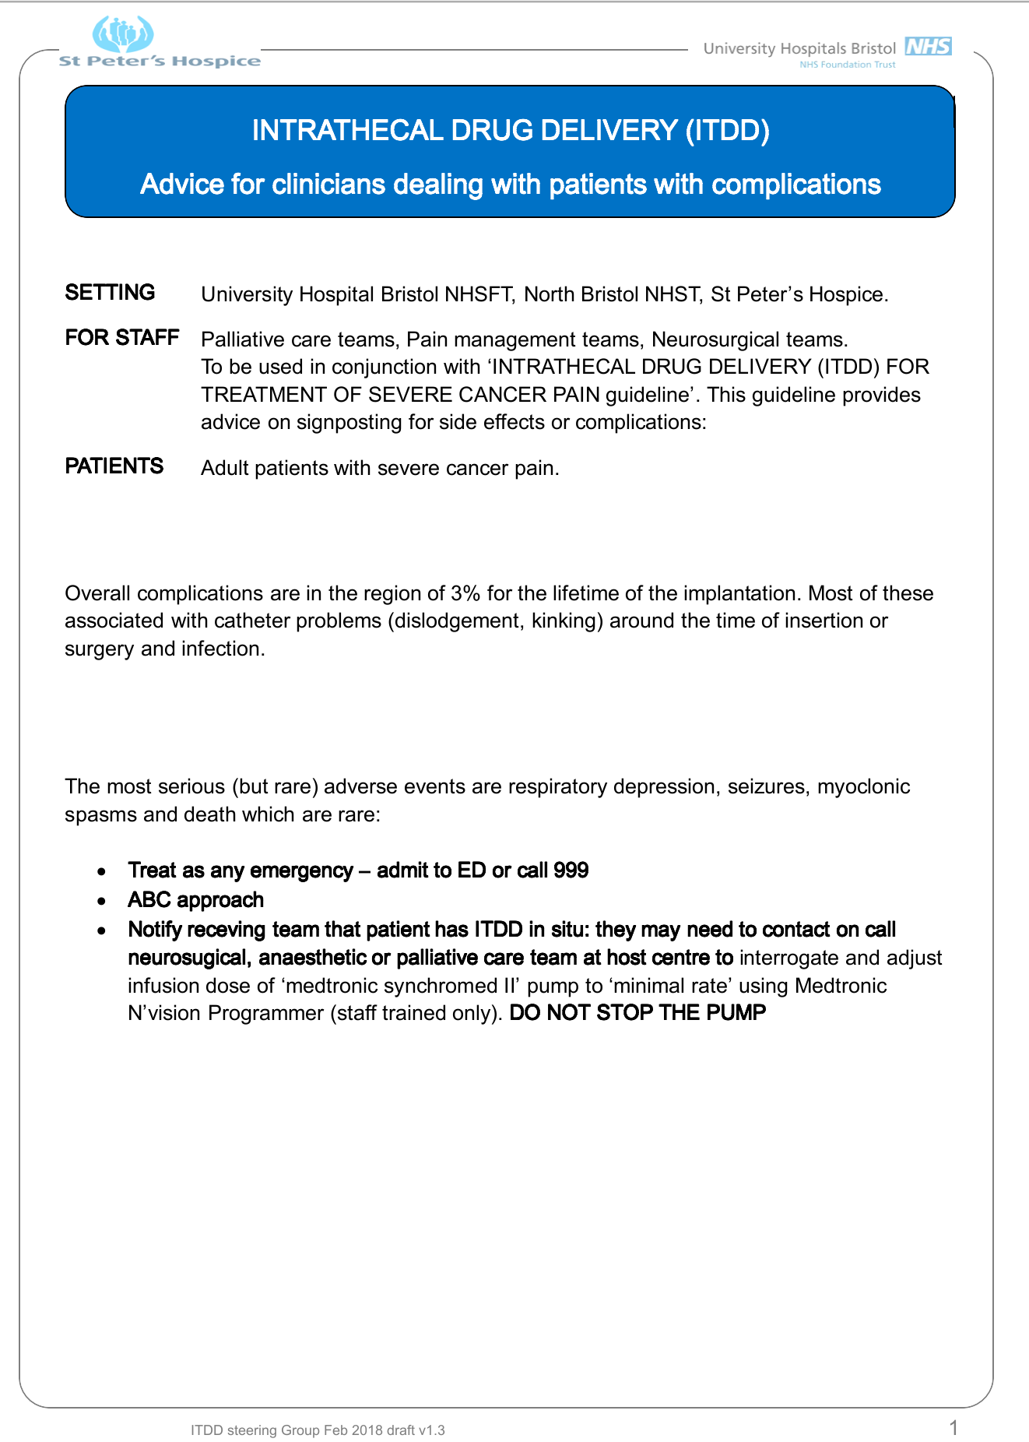

Slide 21
ITDD – eligible criteria
Intractable cancer pain
VAS > 4 despite 200mg/day oral morphine equivalent
Prognosis > 3 months

Slide 22
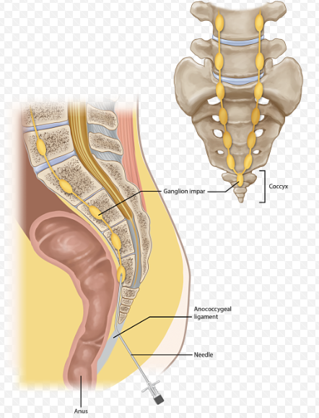
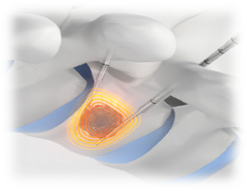
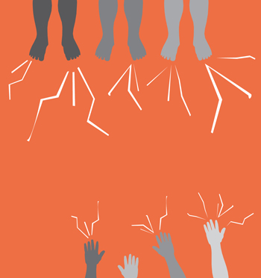


Slide 23
CHRONIC PAIN MANAGEMENT CLINIC
Central Health Clinic, Tower Hill,
Bristol BS2 0JD
Tel: 0117 342 7575

Slide 24






1st Wednesdays of the month 8.30 - 9.30am
Rotates between St peter’s Hospice & UHB next meeting St Peter’s Hospice: 6th Nov
Complex cancer pain – MDT
Forum to discuss any difficult to manage cancer pain patients
Consideration of interventional procedures
Palliative care, interventional radiologist and pain specialist presence
All welcome
If you would like discuss a patient at the meeting, please email
Bethany.wright1@nhs.net
Regular meetings take place 1st Wednesday of every month (venues will rotate)

Slide 25


