Slide 1
Mainstreaming Genomic Medicine post 100,000 Genomes Project
Update – Haem SSG
Nov 2018

Slide 2
Contents
Genetics and genomics
Background to 100,000 Genomes Project
Project progress
What next? Mainstreaming Genomic Medicine

Slide 3
Genetics vs Genomics
Genetic testing = single genes or panels (Sanger sequencing)
Exome sequencing = all coding DNA (Next-Gen Sequencing)
Genomic sequencing = all coding and non-coding DNA (NGS)
Single gene
Small panel (5-10)
Larger panel (50-100)
Clinical exome
Whole exome
Whole genome
Courtesy of HEE E&T Group

Slide 4
Contents
Genetics and genomics
Background to 100,000 Genomes Project
Project progress
What next? Mainstreaming Genomic Medicine

Slide 5
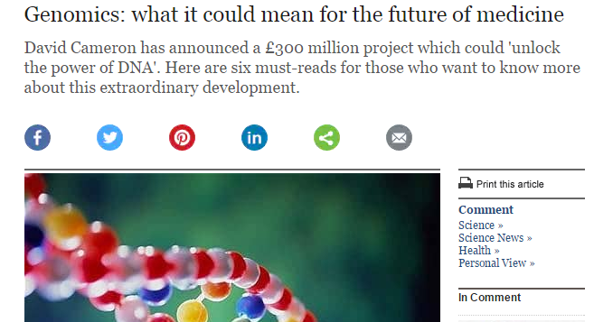
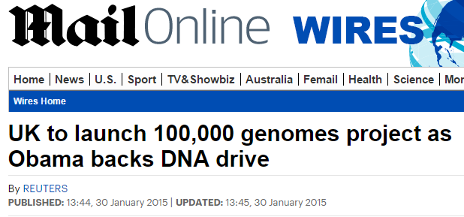
100,000 Genomes Project: Setting up
December 2012: David Cameron announces plans for the 100,000 Genomes Project as part of the Olympic legacy
July 2013: Jeremy Hunt launches Genomics England, a company established to deliver the 100,000 Genomes Project
December 2014: 11 NHS Genomic Medicine Centres are announced
December 2015: WE GMC announced as one of 2 final NHS Genomic Medicine Centres
Courtesy of HEE E&T Group

Slide 6
NHS Genomic Medicine Centres
NHS Genomic Medicine Centres (NHS GMCs) : mapped against AHSN boundaries
NHS GMCs work in partnership with academia, patients and industry through the AHSNs
Notes:
Emphasis national coverage – not all providers contributing but aim was national coverage

Slide 7
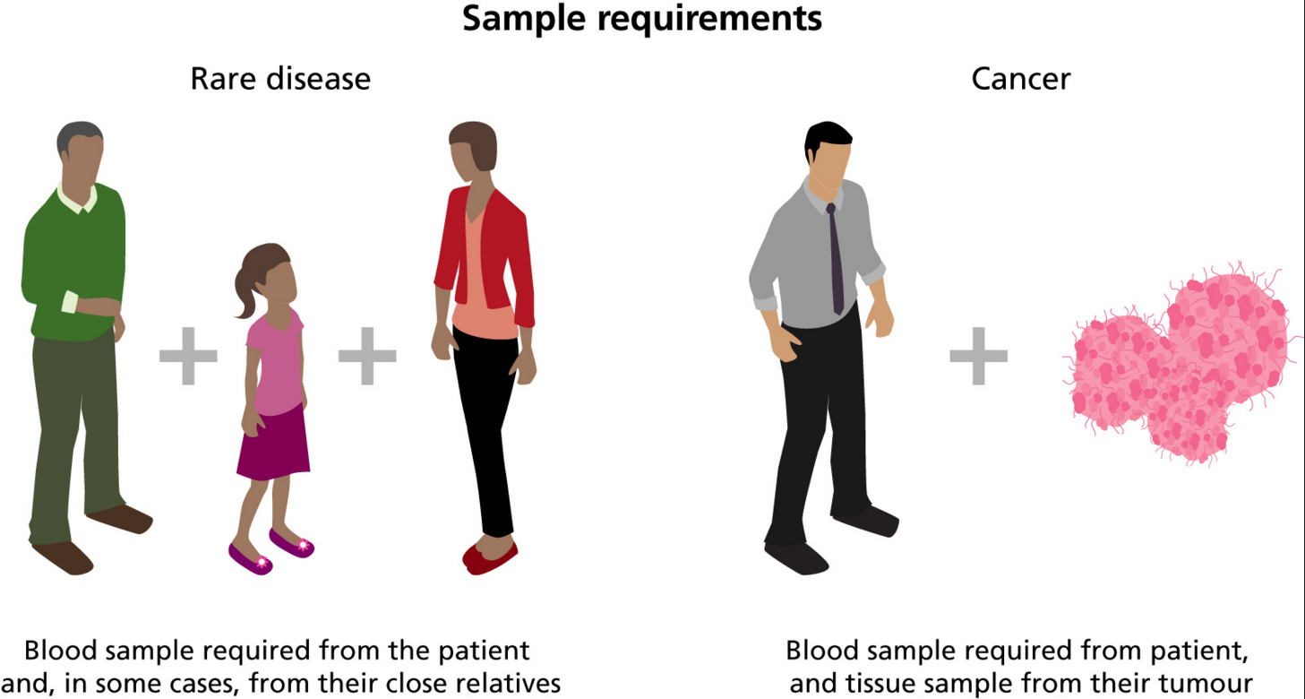
What samples were taken?

Slide 8
Types of cancer eligible for inclusion
Brain
Head & Neck
Breast
Upper GI
Lung
Prostate
Renal
Endometrium
Testicular
Bladder
Ovarian
Colorectal
Haematological
Melanoma
Paediatric
Sarcoma
Carcinoma Unknown Primary

Slide 9
Contents
Genetics and genomics
Background to 100,000 Genomes Project
Project progress
What next? Mainstreaming Genomic Medicine

Slide 10
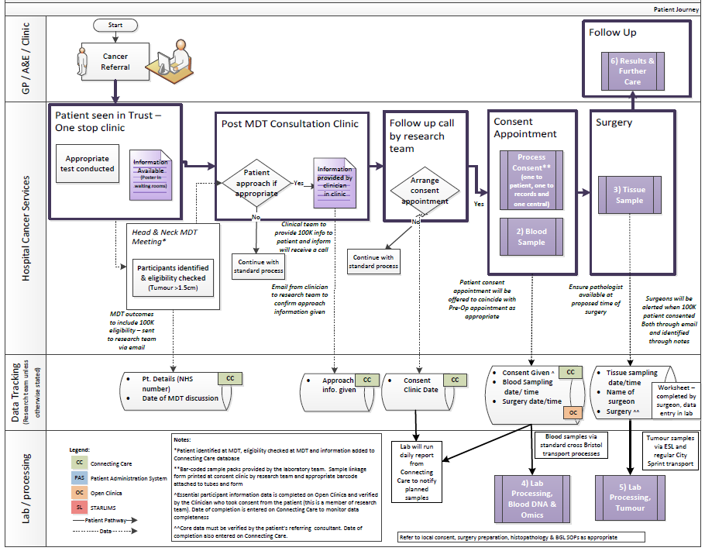
What did it mean for staff to support the 100,000 Genomes Project?
Patient
GPs
Pathology
Imaging
Surgeons
Consultants
Nursing staff
Specialists
Breast Care Nurses
Research team
Clinic management
Theatre team
MDT co-ordinators
Specimen transport team
IT experts
How do you develop a pathway? – the key is engagement at every step of the pathway…..
Blood laboratory
Tumour laboratory
Managers
Introduction to the 100,000 Genomes Project
10
Reception
Processing
Notes:
Stress importance of all individuals involved in the pathway being involved

Slide 11
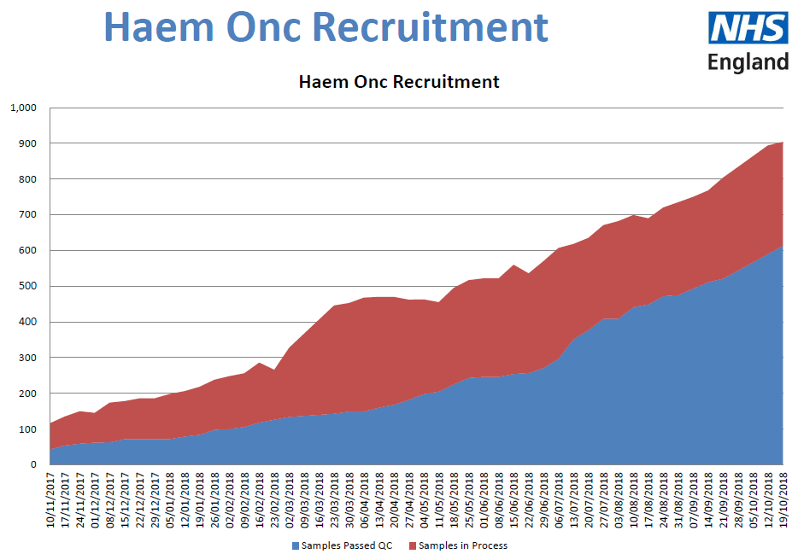
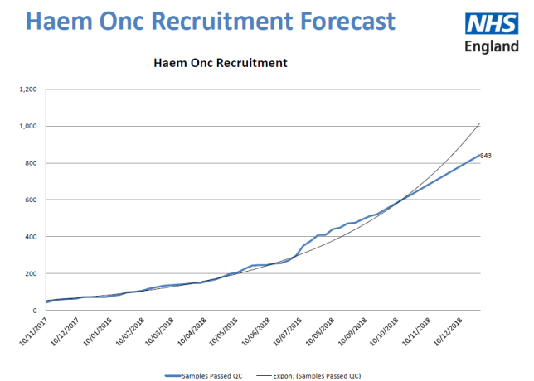
Recruitment

Slide 12
Contents
Genetics and genomics
Background to 100,000 Genomes Project
Project progress
What next? Mainstreaming Genomic Medicine

Slide 13
The national infrastructure for genomic medicine
Political oversight: Dept. of Health & Ministerial Board
Slide reproduced from NHS England SRO team
NHS Genomic Medicine Service
Strategic Oversight
Genomic Medicine Centres & Genomic Clinical Services
National Network of Genomic Laboratories
National Testing Directory
Informatics systems & data store
Whole Genome Sequencing Provision
Genomics Data Interpretation
with Genomics England
Workforce development
upskilling of existing staff & ongoing professional engagement in conjunction with Health Education England
Industry/ academic/ international partnerships
supporting ongoing research & development through clinical care
Advances in genomic & informatics technologies & other next generation diagnostics informing policy, strategy & regulation

Slide 14
Mainstreaming genomic medicine - Beyond 1st October 2018
Genomic Medicine Service
Genetics Laboratory Hubs:
7 nationally commissioned laboratory hubs
National Directory for all genetic & genomic testing
Genomic Laboratory Hubs
Clinical Genetics Services
Genomic Medicine Centres
Cancer Services
Genomic Medicine Centres:
Support transition from project to clinical practice
Clinical Genetics Services:
- Review of services to ensure support and equity
Cancer Services:
- Supporting 100,000 Genomes patients and future genomics pathways
Notes:
As of 1st October there are:
7 Genomic Laboratory Hubs
A national directory of tests dictating which tests will be funded nationally
GMCs will exist with a transformation, governance and potential project based remit
To support this there is a review of clinical genetics services as potential impact on their work will be critical

Slide 15
National Genomic Laboratory Hubs
Genomic Laboratory Hubs commissioned to deliver a national genomic test directory
Whole genome sequencing in place for a limited number of tumours
Sarcoma, paediatric and acute leukaemia (from Jan 19)
Nationally standardised panels for somatic (tumour) variants
Nationally standardised commissioning for germline variants to test cancer susceptibility
Annual review of test directory to update at national level test provision across country

Slide 16
National Genomic Test Directory
What is it?
Directory of tests and technology platform
How to access and how funded
How requested?
In cancer, as part of tissue diagnostic work up
What will be different?
Initially not much initially for most tests (current draft directory, update due in early 2019) or funding streams until Apr 2020 when move to central funding

Slide 17
National Genomic Test Directory
Access to WGS?
Initially for AML & ALL
Consent process not clear yet, due early 2019
Gene panels for myeloid disorders (others will develop)
In time anticipated other modalities such as RNA based tests, cfDNA & proteomics
How will it work?
Nearer to go live date site by site training for consenting, sampling, results

Slide 18
National Genomic Test Directory
How will I see results?
Standardised process of calling variants and assigning significance from WGS testing – evolved from 100k genome project
Probably after Genomic Tumour Advisory Board review
Preferably integrated into a pathology report
In this region via HiLIS for those that have access or for others an IT feed out to local LIMS

Slide 19
Thanks and any questions
Catherine Carpenter-Clawson
Programme Manager, WE GMC
07732 561067
Catherine.Carpenter-Clawson@nbt.nhs.uk
or
Ubh-tr.wegmc@nhs.net

