Slide 1
Clinical Advice for the Commissioning of the Whole Bowel Cancer Pathway
Mr Michael Thomas, Colorectal Cancer SSG, 27th June 2018

Slide 2
Audience:
Cancer Alliances: should work with commissioners and providers to ensure the whole pathway for colorectal cancer is provided within their geographical footprint
Commissioners: should ensure services for colorectal cancer are commissioned in alignment to this commissioning advice
Acute Trusts: should ensure services provided to colorectal cancer patients are in line with this commissioning advice
Patients and patient groups: to improve understanding of what best practice in treatment and care should be look like and therefore what they should experience.

Slide 3
Groups consulted:
Association of Coloproctology of Great Britain and Ireland (ACPGBI)
Beating Bowel Cancer
Bowel Cancer UK
Chemotherapy Clinical Reference Group (CRG)
Hepatobiliary CRG
Radiotherapy CRG
Specialist Colorectal CRG
Thoracic Surgery CRG.

Slide 4
Purpose:
The commissioning advice outlines best clinical practice for the provision of colorectal cancer services in England. It applies to the whole patient pathway, from first contact with the NHS, to discharge from follow up or palliative care
The commissioning advice should inform discussions between commissioners and providers on quality priorities. Where commissioners and providers feel unable to deliver the standards set out in this document, they should clearly set out the reasons for this, as well as what actions will be taken to address the issues identified.

Slide 5
Emergency Presentation
Patients presenting as an emergency should have surgery under the care of a consultant colorectal surgeon who is a member of a colorectal MDT.
This applies within and out of normal working hours. This may require innovations such as collaboration between Trusts to provide on-call rotas or reconfiguration of services.

Slide 6
Secondary to tertiary referrals
Referrals from outside the Cancer Alliance and secondary to tertiary referrals should be routed using appropriate referral standard operating procedures from the referring MDT to the colorectal MDT
There should be clear pathways for neo adjuvant treatment, early rectal cancer, liver, lung and multi-visceral resections and Hyperthermic Intraperitoneal Chemotherapy (HIPEC).

Slide 7
Diagnostic service (Straight to test)
Referral received to a designated referral centre ideally using a standardised pro-forma (designed in conjunction with Local Clinical Commissioning Groups (CCGs)
Referrals sent to dedicated fax or NHS.net email address or to a Choose and Book telephone consultation clinic (for triage)
Once received, referrals have clinically supervised triage, for example by a trained specialist nurse. Patients may be consulted by telephone to check clinical fitness and the indication according to local policy (building on existing local experience) agreed with local CCGs to one of the following:
Colonoscopy (+ OGD if the patient presents with Iron-deficiency anaemia)
Flexible Sigmoidoscopy (for investigation of rectal bleeding without anaemia)
CT Colonography
Out-patient consultation.

Slide 8
Patients with investigations that do not reveal cancer, but have a symptomatic condition manageable in primary care should be sent back to the referring GP with a full report of the investigation results including histopathology, and with advice on self-care and primary care medical management. If symptoms persist, patients should be referred via ‘18 week’ pathway to an appropriate outpatient clinic
Patients diagnosed with adenomatous polyps should be entered into surveillance managed at the acute trust level in accordance with the BSG guidelines
Patients diagnosed with cancer should go straight to staging, be seen by a CNS and referred to the Colorectal MDT
Patients diagnosed with Inflammatory bowel disease (IBD) should be referred to the IBD MDT for further management.

Slide 9
Multidisciplinary Team (MDT)
Workload
The core surgical members of the MDT should, as a group, discuss a minimum of 60 new colorectal cancer cases per year (average for two years)
Core surgical members of the MDT should undertake at least 30 colorectal resections per year. Procedures counted should include elective, emergency, and palliative cases, joint procedures and surgery for benign conditions (average over two years).

Slide 10
Multidisciplinary Team
Clinical nurse specialists
The workload of the CNSs should be reviewed by the Trust and shared with the Cancer Alliance annually to ensure the needs of patients can be met
• The importance of CNSs with patient care and patient experience should be recognised by Trusts by providing designated administrative support for CNSs
• There should be an adequate establishment of CNSs to allow for cover arrangements for annual leave and study leave
• There should be sufficient CNS staffing to support seamless transition of the patient along the different steps of the pathway: diagnosis, peri-operative, adjuvant therapy, living with and beyond, and palliative care.

Slide 11
Information
GPs will be notified of new patients diagnosed with cancer the next working day after the patient has been informed
The GP will be informed within 24 hours of the MDT decision, following discussion with the patient in the presence of a CNS and core member of the MDT. This will require an establishment of colorectal CNSs to cover a 52 week service.

Slide 12
Investigation protocol for primary colorectal cancer
The preferred method for making the initial diagnosis of a large bowel primary cancer is by colonoscopy
Complete examination of the large bowel by either total colonoscopy or CT pneumocolon should be performed before treatment
All endoscopy units recognised for colorectal cancer diagnosis should be Joint Advisory Group on GI endoscopy (JAG) accredited
All patients with a colorectal primary should have a contrast-enhanced CT of chest, abdomen and pelvis to stage the disease
In addition, when not contra-indicated, rectal cancers require local staging by MRI. Transrectal ultrasound may also be used as an additional modality in early rectal cancer
Radiology reporting standards must comply with the recommendations from the British Society of Gastrointestinal and Abdominal Radiology and the Royal College of Radiologists. A proforma report of the radiology with CT and MRI should be provided
Blood investigations should include haemoglobin, electrolytes, creatinine, liver function test and pre-operative carcinoembryonic antigen (CEA) level
Biopsy providing histological proof of malignancy is required in most cases of colorectal cancers treated electively.

Slide 13
Staging and reporting
In line with NICE guidance (DG27), all colorectal cancer patients should be tested for molecular features of Lynch syndrome, at diagnosis of colorectal cancer. Adherence to this guidance should be regularly audited and patients should be informed of the result and possible implications
Patients identified with suspected Lynch syndrome and Familial Adenomatous Polyposis (FAP) should be discussed at the MDT meeting and referred to appropriate genetic counselling services.

Slide 14
Surveillance
Patients who contact any member of the colorectal specialist team with worrying symptoms will be seen by the appropriate team within two weeks and if necessary, the case will be discussed at the MDT meeting
All patients following initial treatment for colorectal cancer, will be given information about self-care and surveillance. A list of symptoms that could be a cause for concern and a contact number for the Colorectal CNS will be given as part of the information pack developed by Trusts
GPs and patients should also be given information on symptoms which may indicate recurrence.

Slide 15
Systemic chemotherapy for potentially operable disease
Prior to chemotherapy the pathological sample should be used to determine the genetic status of the tumour (RAS/BRAF). This will be used to guide the oncologist as to whether a patient may benefit from an EGFR inhibitor such as cetuximab or panitumumab
Each patient receiving chemotherapy should be given a contact number for a chemotherapy CNS
All Trusts admitting emergency patients, should have established and specialist acute oncology team and an electronic flagging system for chemotherapy patients within A&E.

Slide 16
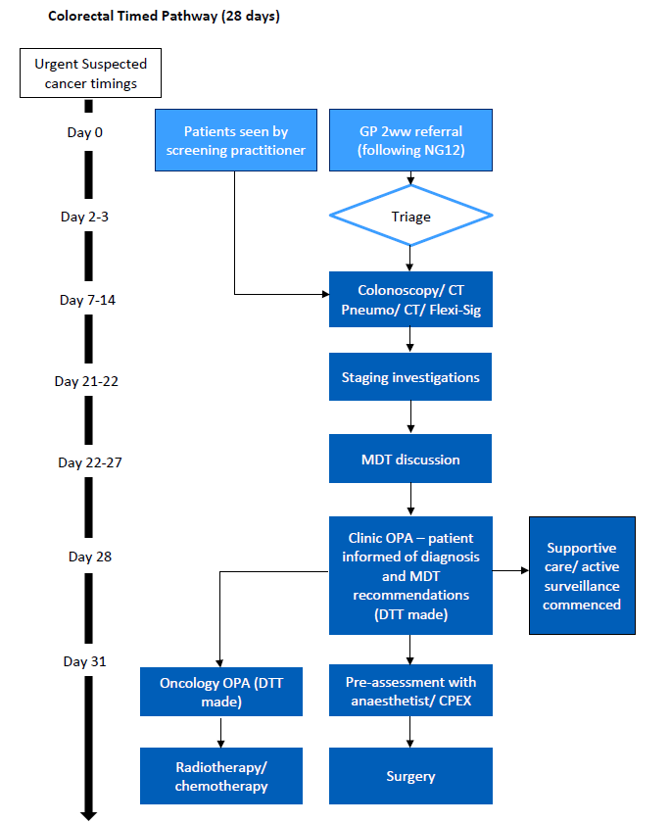
Notes:
Pan vanguard best practice colorectal times pathway

Slide 17
