Slide 1
Patient experience Moving on days
Samantha Boland – Breast Cancer Support Worker

Slide 2
The Recovery Package
The Recovery Package – to improve outcomes for people affected by cancer
Health and Wellbeing events are a key component
Education and information
Signpost to local resources and services
Facilitate interaction with other people affected by cancer
Notes:
The recovery package is a series of interventions, which, when delivered together can greatly improve outcomes for people affected by cancer.
Health and wellbeing events are a key component of the recovery package and are vital in enabling health or social care providers to deliver outcomes for people affected by cancer.
Health and wellbeing events are all about education and information
They support people living and beyond cancer, their carers and their families to take control and participate in their short and longterm recovery, giving them necessary information and promoting positive lifestyle change.

Slide 3
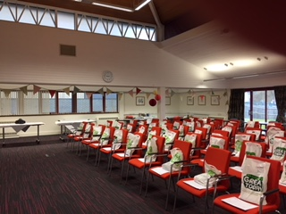
Moving on Days
Three times a year
60 patients
All day event
Lunch
‘Off site’
Series of talks by HCPs
Moving on day June ’18!
Notes:
Facilitated and organised by BCN and assistants, this event provides a series of talks by health care professionals which focuses on many of the on-going issues faced by patients who have had breast cancer.

Slide 4
Being breast aware
Bra advice
Counselling
Reducing your risk of lymphoedema
Dietary advice
Q&A managing the effects of treatment
Exercise and fitness
Managing treatment related fatigue
Psychological impact cancer

Slide 6
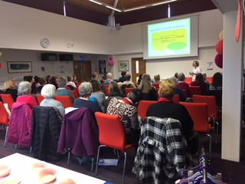
What our patients say…
“Learned a lot and gleaned useful information from every session”
“Really useful information – loved chatting to everyone. Brilliant day, thank you!”
“Very informative and useful meeting others who have been through the same treatment”
“Practical advice and lively lectures”
“The psychology session was fantastic – now I know I am not going mad and everything I’m feeling is completely normal, thank you!”
Moving on day June ’18!

Slide 7
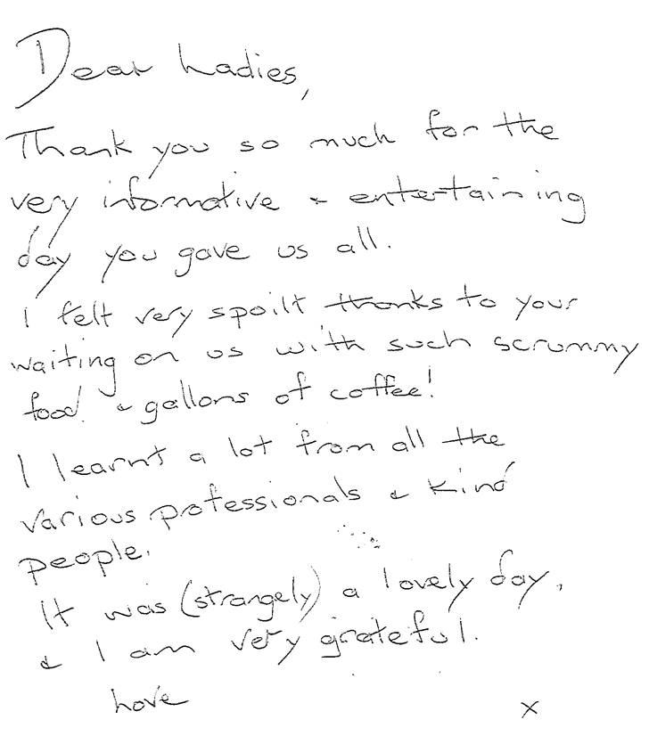
What our patients say…

Slide 8
With over 691,000 people living with and beyond breast cancer in the UK and numbers set to rise, it is vital that care post-treatment is put at the top of the agenda. (July, 2018).

