Slide 1
Dynamic Risk Stratification
Dr Matthew Beasley, Consultant Clinical Oncologist

Slide 2
Setting the scene…
An era of individualised, risk stratified approach to management of differentiated thyroid cancer
Current BTA Dynamic Risk Stratification post treatment mandates stimulated Tg and neck ultrasound at 9-12 months
Applies to those who have had surgery and radio-iodine ablation
Determines the TSH target for follow-up
Notes:
£583 for thyrogen

Slide 3
Dynamic Risk Stratification
Excellent Response | Indeterminate Response | Incomplete Response
All of the following Suppressed and stimulated Tg < 1ug/l* Neck US without evidence of disease Cross sectional imaging and/or nuclear medicine imaging negative (if performed) | Any of the following Suppressed Tg < 1ug/l and stimulated Tg ≥ 1 and < 10ug/l* Neck US with non specific changes or stable sub centimetre nodes Cross sectional imaging and/or nuclear medicine imaging with non-specific changes, although not completely normal | Any of the following Suppressed Tg ≥ 1ug/l or stimulated Tg ≥ 10ug/l* Rising Tg Persistent or newly identified disease on cross-sectional and/or nuclear medicine imaging
Low risk | Intermediate risk | High risk
British Thyroid Association Guidelines 3rd Edition Clinical Endocrinology Volume 81. Issue s1. Pages 1-122 July 2014

Slide 4
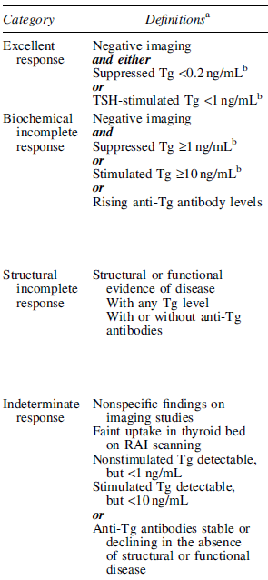
ATA Dynamic Risk Stratification
ATA Guidelines Haugen BR et al (2016) Thyroid 26 (1)
Suppressed Tg target <0.2 ng/L
Rising anti-Tg Abs implies multiple readings?

Slide 5
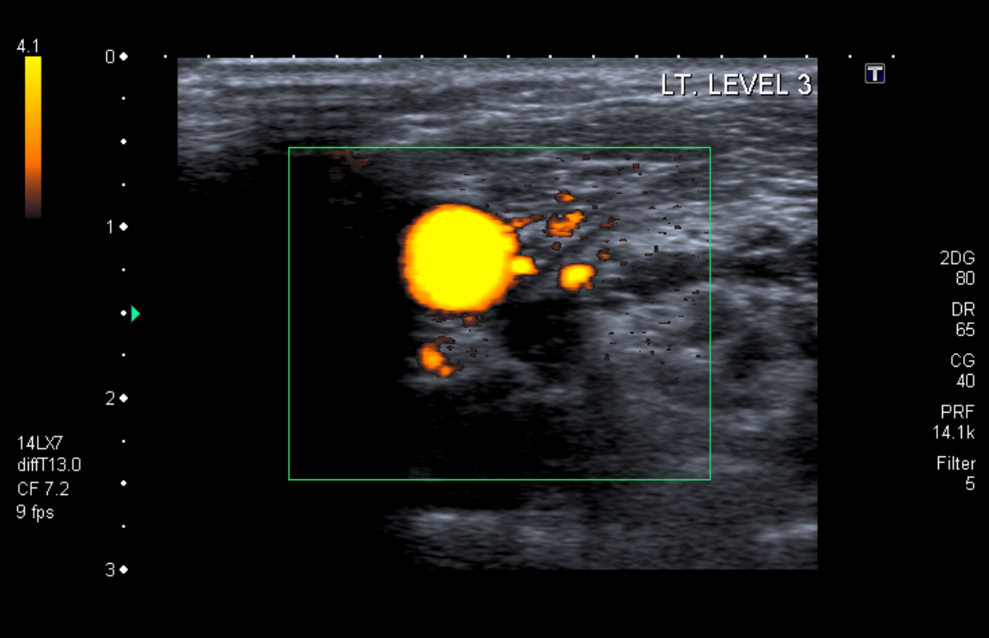
Neck ultrasound
Asking our radiology colleagues to make a response assessment on ultrasound
Operator dependent

Slide 6
Thyroglobulin (thyroid cancer blood tumour marker)
Thyroid Follicle
Colloid
TG
+ iodine + tyrosine
90% T4
10% T3

Slide 7
Thyroglobulin measurement
3 main methods
Radio-immuno assays first used in the 1980s
Novel highly sensitive 2 antibody “sandwich” immunometric assays introduced widely over the last decade
Liquid chromatography-tandem mass spectroscopy
Immunometric assay
Capture Ab
Signal Ab
Y
Y
TG

Slide 8
Thyroglobulin assays
Assay | RIA | Immunometric | LCMS
Functional sensitivity (ug/L) | 1.0 | 0.1 | 1.0
Antibody interference | Resistant | Problematic | Absent
Between method concordance | Problematic | Problematic | Problematic
Cost | ++ | + | +++
Clinical evidence of utility | ++ | ++ | ?
Radio-activity | + | - | -

Slide 9
TSH target
Excellent response | Indeterminate response | Incomplete response
Low normal range (within normal range but</=2.0) | 0.1-0.5 | <0.1

Slide 10
Excellent response
achieved in 86%–91% of ATA low-risk patients
risk of recurrence over 5–10 years of follow-up ranged from 1% to 4% (median 1.8%) in patients who had an excellent response to therapy by 6–18 months after total thyroidectomy and RAI remnant ablation (20 retrospective studies)
intermediate-risk patients who achieve an excellent response, risk of recurrent/persistent disease decreased from 36%–43%(predicted by initial ATA risk stratification) to 1%–2% (predicted by response-to-therapy reclassification)
The few high-risk patients that achieve an excellent response to therapy also have subsequent recurrence rates in the 1%–2% range
ATA Guidelines Haugen BR et al (2016) Thyroid 26 (1)
Notes:
Exception is the few high risk patients in MSK series where it was 14%

Slide 11
Indeterminate response
12%–29%of low-risk, 8%–23%of int-risk and 0%–4% of high-risk
15%–20% will have structural disease identified during follow-up
ATA Guidelines Haugen BR et al (2016) Thyroid 26 (1)

Slide 12
Incomplete response
Biochemical incomplete response
Biochemical incomplete response in 15-20% of patients
At least 30% spontaneously resolve to no evidence of disease
20% achieve no evidence of disease after additional therapy
Up to 20% develop structural disease (<1% disease specific death)
Structural incomplete response
2%–6% low risk, 19%–28% int risk, 67%–75% high risk
50%–85% continue to have persistent disease despite additional therapy
Disease specific death rates as high as 11%
ATA Guidelines Haugen BR et al (2016) Thyroid 26 (1)
Notes:
11-22% relatively independent of ATA risk group. Biochemical incomplete response defined as Negative imaging and Suppressed Tg ‡1 ng/mLb or Stimulated Tg ‡10 ng/mLb or Rising anti-Tg antibody levels

Slide 13
Non-stimulated sensitive Tg assays to define an excellent response
Author/Year | Patient No. | Time of assessment post ablation | Tg cut-off (ng/mL) | Recurrence rate
Malandrino (2011) | 425 | 8-18 months | <0.15 | 0% low risk, 1% int risk and 2.7% high risk
Brassard M (2011) | 589 | 3 months | <0.27 | 1.5%
Smallridge (2012) | 163 | 1.8 years | <0.1 | 4.3% low/int risk
Gionvanella (2009) | 185 | 6 months | <0.2 (and normal US) | 1.6% low risk
Good negative predictive value

Slide 14
Position statement from international consensus panel 2012/2013
…an undetectable Tg value using a highly sensitive assay is associated with an adequate sensitivity and negative predictive value to obviate the need for measuring TSH-stimulated Tg concentrations.
…but detectable basal highly sensitive Tg level (i.e. between 0.1 and 1ug/L) can only be considered disease free after a negative TSH-stimulated measurement.
As most patients… low-risk DTC data on patients with intermediate and high risk tumours are less robust
Giovanella et al (2014) Eur J of Endocrinol 171:33-46

Slide 15
Current algorithm
Neck US and usTg at 9-12 months
Neck US no evidence of disease
Neck US shows
residual disease
usTg < 0.1 ug/L
usTg ≥0.1 but <1.0 ug/L
Neck US equivocal or anti-Tg Abs
usTg≥ 1.0ug/L
sTg
sTg <1.0ug/L
sTg≥1.0ug/L
Excellent response
Indeterminate response
Incomplete response

Slide 16
Current algorithm
Neck US and usTg at 9-12 months
Neck US no evidence of disease
Neck US shows
residual disease
usTg < 0.1 ug/L
usTg ≥0.1 but <1.0 ug/L
Neck US equivocal or anti-Tg Abs
usTg≥ 1.0ug/L
sTg
?
sTg <1.0ug/L
sTg≥1.0ug/L
Excellent response
Indeterminate response
Incomplete response

