Slide 1
Clinical Research Network
West of England
SWAG SSG Brain and CNS Cancer Meeting
Wednesday 25th April
Research Report

Slide 2
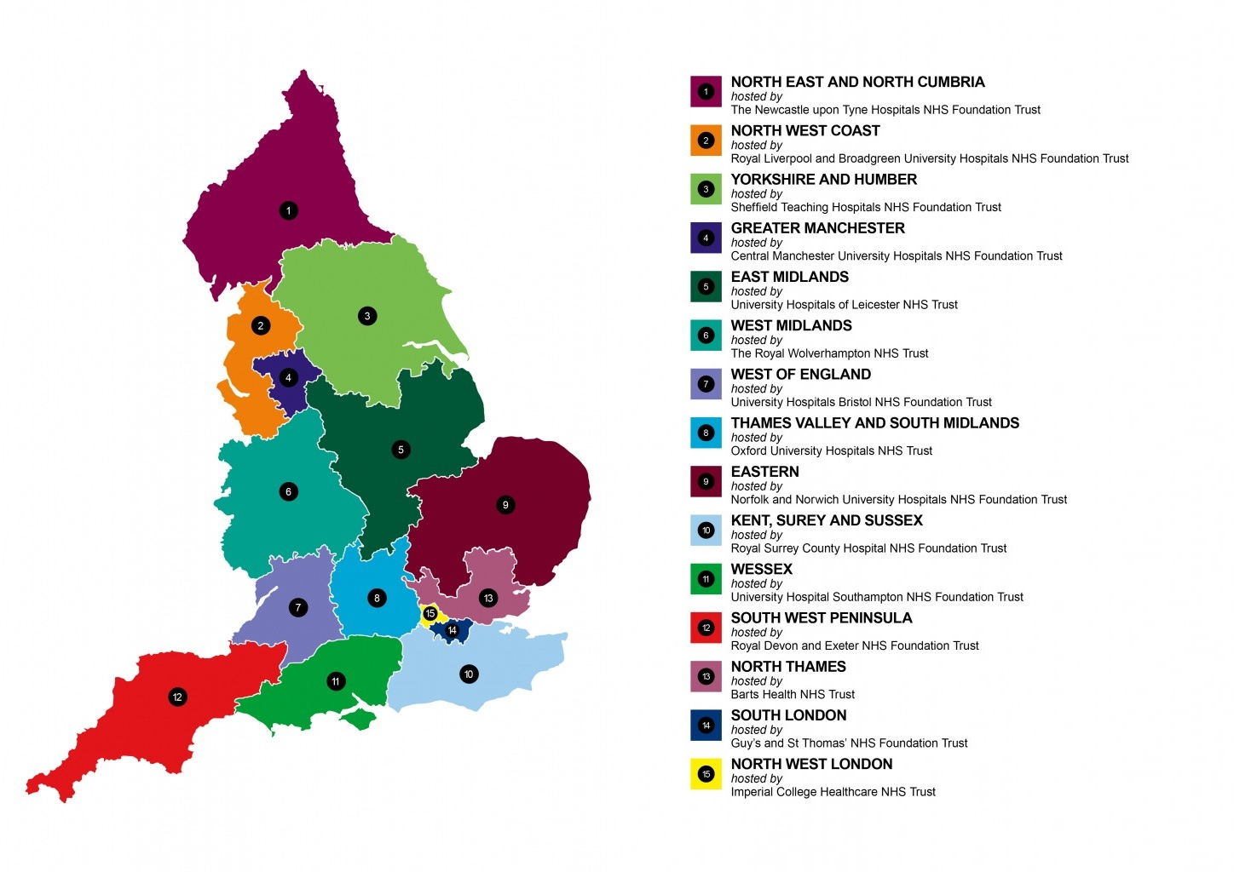
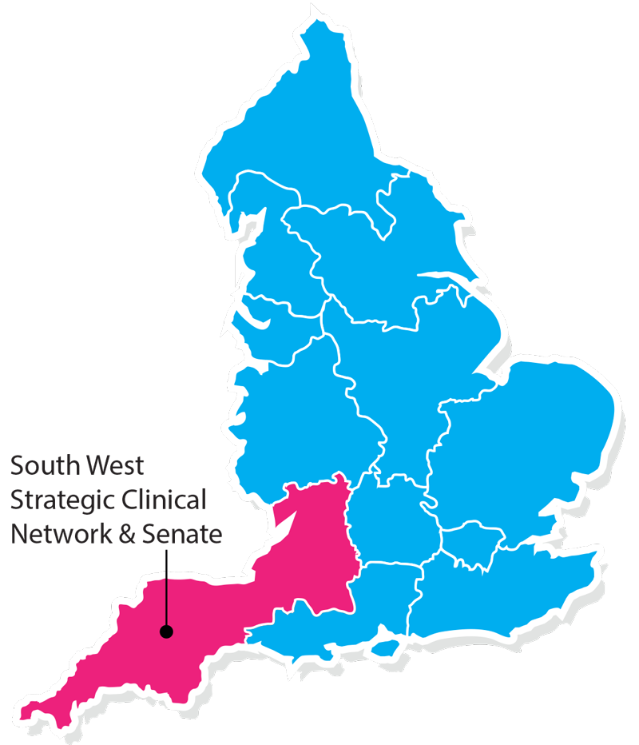
Clinical Research Network & Cancer Services
West ofEngland
SWAG - Somerset Wiltshire Avon & Gloucestershire
South West Children’s Cancer & Leukaemia
Research Network

Slide 3
NIHR CRN High Level Objectives 2017-18
Increase number of participants into NIHR CRN portfolio studies
650,000 in England
21,905 in West of England
Increase the number of studies that deliver to time and target
Target 80%
Increase number of commercial studies delivered through network
Reduce NHS study set up times
Reduce time taken to recruit first participant

Slide 4
Cancer specialty objective for 2017-18
Number of LCRNs achieving on-target recruitment into at least 8 of the 13 Cancer subspecialties, where "on-target" means either improving recruitment by 10% from 2016/17 or meeting the following recruitment targets per 100,000 population served:
a) Brain & CNS: 0.2; b) Breast: 8; c) Colorectal: 3; d) Paediatrics: 3; e) Gynae: 3; f) Head & Neck: 1; g) Haematology: 7; h) Lung: 4; i) Sarcoma: 0.1; j) Skin: 0.2; k) Supportive & Palliative Care and Psychosocial Oncology & Survivorship: 3; l) Upper GI: 3; m) Urology: 8.

Slide 5
Performance regarding 2017/18 Cancer specialty target

Slide 10
Open studies – Brain
Portfolio ID | Project Title | Site | PI | PI email
16948 | MOT | North Bristol NHS Trust | Love, Prof Seth | seth.love@bris.ac.uk
18137 | PARADIGM OlaPArib And RADiotherapy In newly-diagnosed GlioblastoMa: | University Hospitals Bristol NHS Foundation Trust | Herbert, Dr Chris | christopher.herbert@uhbristol.nhs.uk
18503 | SIOP Ependymoma II | University Hospitals Bristol NHS Foundation Trust | Cox, Dr Rachel | rachel.cox@ubht.nhs.uk
30967 | ROAM | University Hospitals Bristol NHS Foundation Trust | Cameron, Dr Alison | alison.cameron@uhbristol.nhs.uk
31760 | CMS Study | University Hospitals Bristol NHS Foundation Trust | Fellows, Dr Greg | gregfellows@nhs.net
31853 | VINILO | University Hospitals Bristol NHS Foundation Trust | Cox, Dr Rachel | rachel.cox@ubht.nhs.uk
33023 | Biomede | University Hospitals Bristol NHS Foundation Trust | Lowis, Dr Stephen | s.p.lowis@bristol.ac.uk
33552 | PARADIGM-2 | University Hospitals Bristol NHS Foundation Trust | Herbert, Dr Chris | christopher.herbert@uhbristol.nhs.uk

Slide 11
No studies in set-up – Brain

Slide 12
Cancer specialty objective for 2018-19
The following Objectives are extracted from the Draft Performance and Operating Framework 2018/19 (v0.9), which is yet to be approved by the Department of Health, and therefore, may be subject to change:
Increase patient access to Cancer research studies across the breadth of the Cancer subspecialties Number of LCRNs achieving on-target recruitment into at least 8 of the 13 Cancer subspecialties, where "on-target" means either improving recruitment by 10% from 2017/18 or meeting the following recruitment targets per 100,000 population served:
a) Brain: 0.2; b) Breast: 10 c); Colorectal: 3 d); Children and Young People: 3; e) Gynae: 3; f) Head & Neck: 1.5; g) Haematology: 7; h) Lung: 4; i) Sarcoma: 0.1; j) Skin: 0.5; k) Supportive & Palliative Care and Psychosocial Oncology: 4; l) Upper GI: 3; m) Urology: 12.

Slide 13
Useful links
https://www.crn.nihr.ac.uk/
National and local network information including training programmes templates, tools, contacts, videos etc
https://odp.nihr.ac.uk/
Open data platform. Look at performance across whole CRN including all specialty areas
http://csg.ncri.org.uk/portfolio/portfolio-maps/
View current national portfolio of open, closed and ‘in set up’ cancer studies
https://www.ukctg.nihr.ac.uk/
See where a study is open across the country
http://public-odp.nihr.ac.uk/
Search for a study to fit criteria. Good for horizon scanning, eligibility criteria

Slide 14
Contacts
Research Delivery Manager – David.Rea@nihr.ac.uk
Research portfolio facilitator – jessica.bartlett@nihr.ac.uk
Brain and CNS research lead – christopher.herbert@uhbristol.nhs.uk

