Slide 1
New developments in oncological treatment for Stage 3 NSCLC
Lung SSG 22nd May 2018
Gareth Ayre

Slide 2
Rationale:
5-year OS in all stage 3 NSCLC treated with CRT only 15%
Both chemo and RT shown to upregulate PDL1
Possible synergistic action when IO given with DNA-damaging treatments

Slide 3
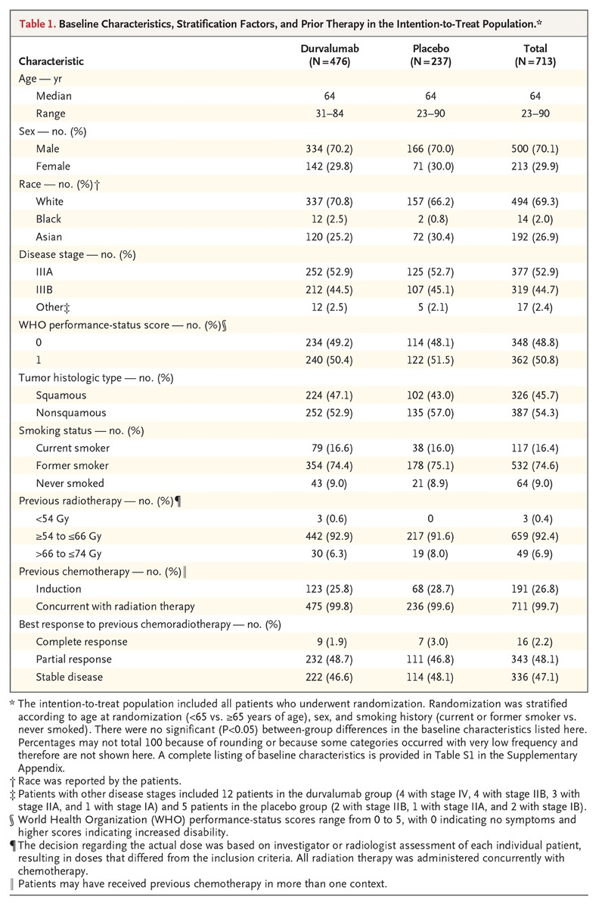

Slide 4
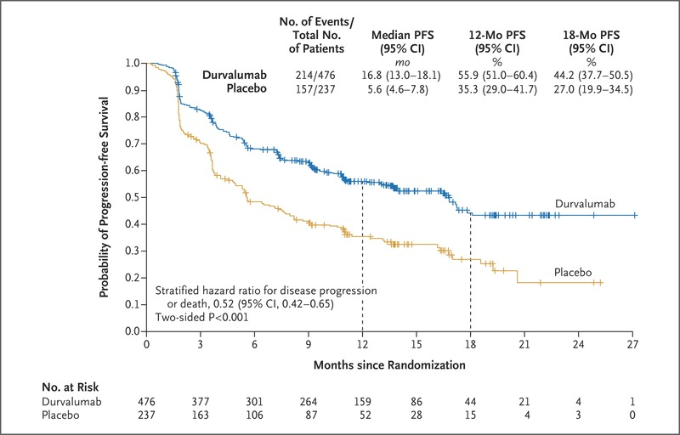
Median PFS – 16.8 vs 5.6 months!
Median time to death or mets – 23.2 vs 14.6 months p<0.001

Slide 5
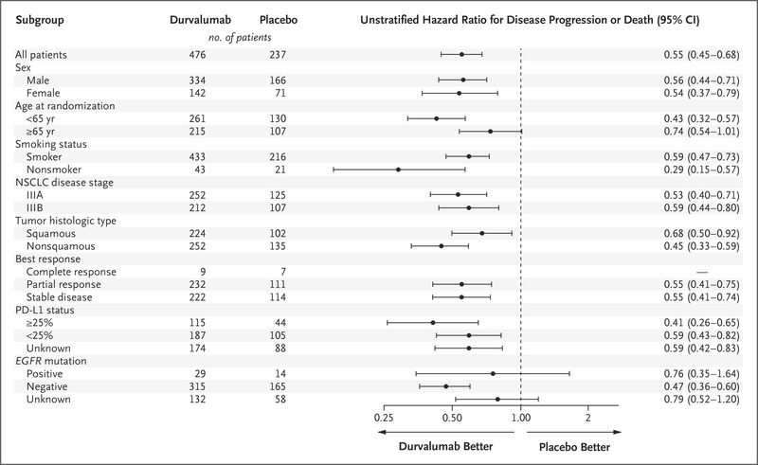

Slide 6
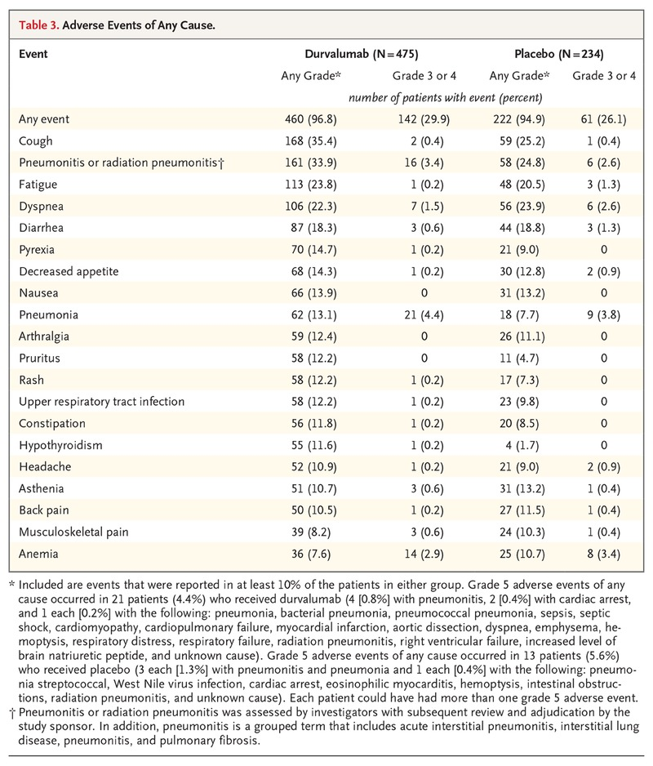

Slide 7
Take home points
Early indications are of a very effective treatment
Safe – no increase in pneumonitis or G3/4 toxicity
May exploit RT-induced tumour antigen presentation which can them prime and activate T cells
Expanded access scheme available
OS data in September – NICE decision to follow
Unclear whether this will change paradigm for all stage 3 lung cancer – comparative trials needed

Slide 8
AdScan (BHOC, RUH)
Randomised phase II ‘pick the winner’ format to inform which RT schedule should be compared to 55 / 20 in a phase 3 trial
For patients suitable for radical chemo-radiotherapy but not fit enough for concurrent treatment
Rationale:
Improving local control can improve survival
(e.g. CHART vs standard RT trials – 29 vs 20% survival at 3 years)
Only a minority of patients are fit for concurrent treatment
Giving dose-escalated treatment after chemo may improve outcomes
BUT adding extra treatments is not the answer (RTOG 0617)

Slide 9
Trial layout
2 cycles of standard chemo then CT
Consent and randomise provided no progression
Complete 2 – 4 cycles of chemo
RT to start 21 - 28 days after last chemo

Slide 10
RT options
Standard 55Gy in 20# od 4 weeks
CHART-ED 54Gy tds over 12 days then 3 days bd
64.8Gy over 17 days in total
IDEAL 63 – 71Gy in 30# od 5 weeks (bd Fri)
I-START 55 – 65Gy in 20# od 4 weeks
Isotoxic IMRT 61.2 – 79.2Gy bd 4 – 5 weeks

Slide 11
Adjuvant Canakinumab study (BHOC, CGH)
Background:
25-30% of NSCLC is resectable - ½ of these are disease-free at 5 years
Chronic inflammation is a known aetiological factor
IL-1b is a mediator of lung inflammation - linked to carcinogenesis
CANTOS:
10,000 patients with previous MI and CRP > 2 randomised to placebo or 3 dose levels of canakinumab (anti-IL-1b MAb)
14% reduction in further cardiovascular event
Dose-dependent reduction in lung cancer risk also seen

Slide 13
Eligibility
Tumour >4cm or node-positive
Must receive ≥ 2 cycles of platinum chemo
Pre-op chemo / RT or previous TB are contra-indications
Treatment
1 year or 3-weekly MAb infusion vs placebo
Small increase in risk of infection

