Slide 1
Clinical Research Network
West of England
SWAG SSG Skin Cancer
Meeting
Tuesday 22nd May
Research Report

Slide 2
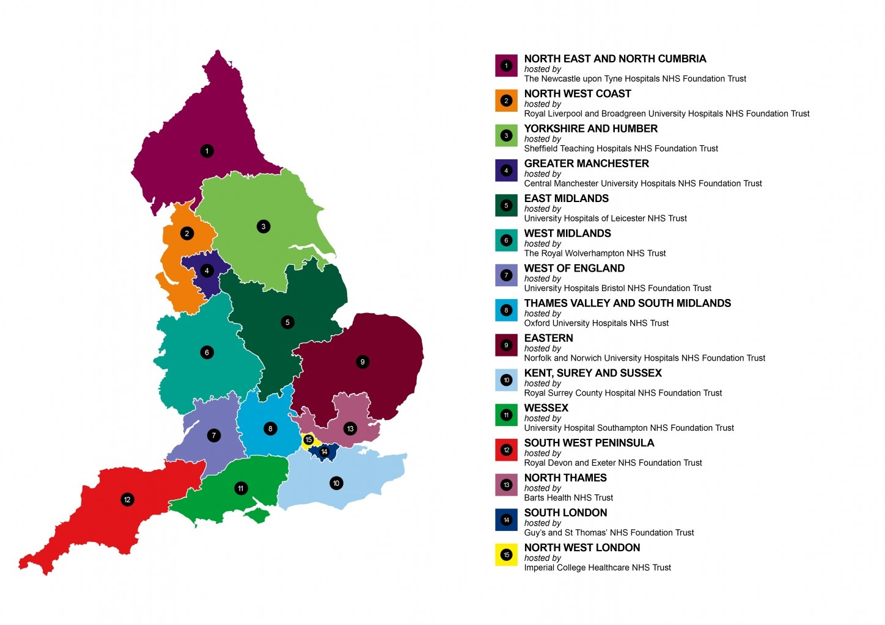
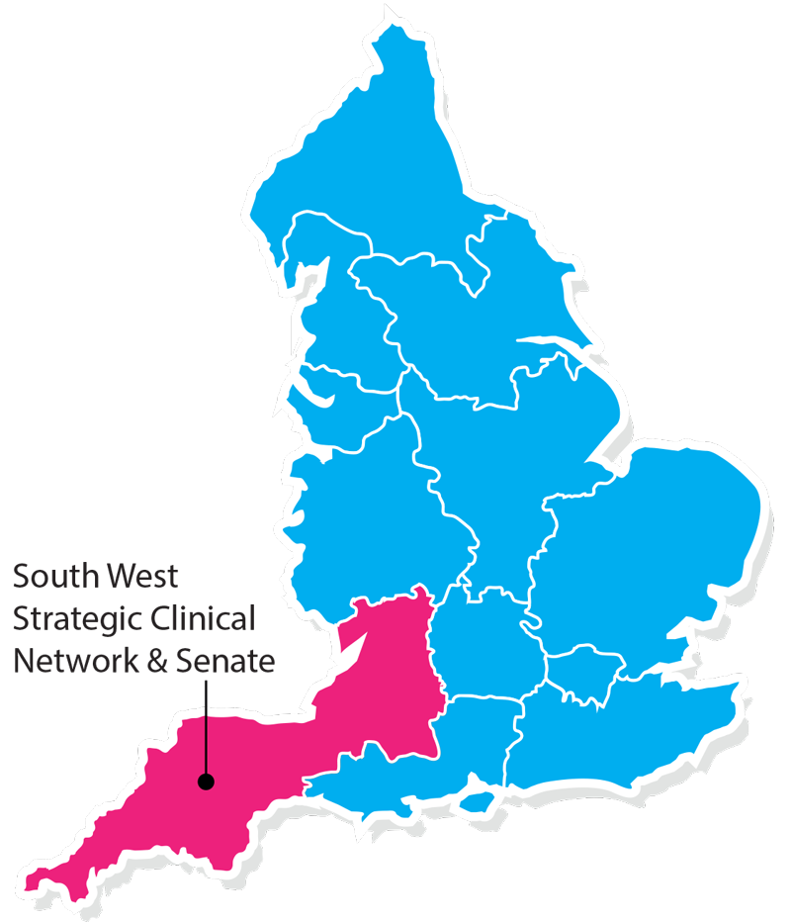
Clinical Research Network & Cancer Services
West ofEngland
SWAG - Somerset Wiltshire Avon & Gloucestershire
South West Children’s Cancer & Leukaemia
Research Network

Slide 3
NIHR CRN High Level Objectives 2017-18
Increase number of participants into NIHR CRN portfolio studies
  650,000 in England
  21,905 in West of England
Increase the number of studies that deliver to time and target
  Target 80%
Increase number of commercial studies delivered through network
Reduce NHS study set up times
Reduce time taken to recruit first participant

Slide 4
Cancer specialty objective for 2017-18
Number of LCRNs achieving on-target recruitment into at least 8 of the 13 Cancer subspecialties, where "on-target" means either improving recruitment by 10% from 2016/17 or meeting the following recruitment targets per 100,000 population served:
a) Brain & CNS: 0.2; b) Breast: 8; c) Colorectal: 3; d) Paediatrics: 3; e) Gynae: 3; f) Head & Neck: 1; g) Haematology: 7; h) Lung: 4; i) Sarcoma: 0.1; j) Skin: 0.2; k) Supportive & Palliative Care and Psychosocial Oncology & Survivorship: 3; l) Upper GI: 3; m) Urology: 8.

Slide 5
Performance regarding 2017/18 Cancer specialty target

Slide 10
Open studies - Lung
CPMS ID | Title | Edge end date | Recruited (total) | Target | Edge recruitment end date | CPMS recruitment end date | Principle investigator | Link to study details
9851 | LungCAST - Does smoking status after a diagnosis of lung cancer affect outcomes? | Gloucestershire Hospitals NHS Foundation Trust | 50 | 24 | 31/03/2019 | 30/06/2021 | Raghuran, Dr Ananthakrishnan | http://public-odp.nihr.ac.uk/9851
9851 | LungCAST - Does smoking status after a diagnosis of lung cancer affect outcomes? | Great Western Hospitals NHS Foundation Trust | 1 | 25 | 31/03/2019 | 30/06/2021 | Khan, Dr Omar | http://public-odp.nihr.ac.uk/9851
9851 | LungCAST - Does smoking status after a diagnosis of lung cancer affect outcomes? | North Bristol NHS Trust | 12 | 20 | 21/03/2019 | 30/06/2021 | Comins, Dr Charles | http://public-odp.nihr.ac.uk/9851
15909 | MARS 2 | North Bristol NHS Trust | 1 | 2 | 30/09/2020 | 31/07/2020 | Maskell, Dr Nick | http://public-odp.nihr.ac.uk/15909
30083 | CANC 5371 | North Bristol NHS Trust | 3 | 3 | 31/01/2019 | 31/03/2020 | Comins, Dr Charles | -

Slide 11
Open studies - Lung
CPMS ID | Title | Partner organisation | Target | Recruited (total) | Edge recruitment end date | CPMS recruitment end date | Principle investigator | Link to study details
31643 | MesoTRAP feasibility study | North Bristol NHS Trust | 1 | 2 | 30/09/2019 | 30/06/2019 | Maskell, Dr Nick | http://public-odp.nihr.ac.uk/31643
5686 | Lung ART | University Hospitals Bristol NHS Foundation Trust | 0 | 15 | 01/05/2018 | 25/10/2018 | Comins, Dr Charles | http://public-odp.nihr.ac.uk/5686
18341 | The VIOLET study | University Hospitals Bristol NHS Foundation Trust | 174 | 67 | 31/03/2019 | 30/04/2019 | Batchelor, Tim | http://public-odp.nihr.ac.uk/18341
20184 | SARON | University Hospitals Bristol NHS Foundation Trust | 0 | 6 | 30/06/2019 | 01/03/2019 | Comins, Dr Charles | http://public-odp.nihr.ac.uk/20184
31018 | ATLANTIS Trial | University Hospitals Bristol NHS Foundation Trust | 0 | 3 | 31/03/2018 | 31/07/2018 | Dangoor, Dr Adam | -

Slide 12
Studies open - Lung
CPMS ID | Title | Partner organisation | Target | Recruited (total) | Edge recruitment end date | CPMS recruitment end date | Principle investigator | Link to study details
36310 | Adjuvant canakinumab vs placebo in stages IB, II-IIIA resected NSCLC | University Hospitals Bristol NHS Foundation Trust | 0 | 8 | 31/08/2020 | 31/05/2020 | Ayre, Dr Gareth | -

Slide 13
Studies in set-up – Lung
CPMS ID | Title | Partner organisation | Link to study details
15909 | MARS 2 | University Hospitals Bristol NHS Foundation Trust | http://public-odp.nihr.ac.uk/15909
17746 | National Lung Matrix: Multi-Drug Phase II trial in NSC Lung Cancer | University Hospitals Bristol NHS Foundation Trust | http://public-odp.nihr.ac.uk/17746
32033 | ROVA-T Maintenance in SCLC (MERU) | Gloucestershire Hospitals NHS Foundation Trust | -
32290 | CONFIRM | University Hospitals Bristol NHS Foundation Trust | http://public-odp.nihr.ac.uk/32290
36310 | Adjuvant canakinumab vs placebo in stages IB, II-IIIA resected NSCLC | Gloucestershire Hospitals NHS Foundation Trust | -

Slide 14
Studies open to new sites - Lung
CPMS ID | Title | Lead LCRN | Link to study summary | Contact
19914 | LuCID: Lung Cancer Indicator Detection | North Thames | http://public-odp.nihr.ac.uk/19914 | Jessica.bartlett@nihr.ac.uk
31183 | Investigation of biological changes in urine in patients with advanced lung cancer: a pilot study | North West Coast | http://public-odp.nihr.ac.uk/31183 | Jessica.bartlett@nihr.ac.uk
31692 | Study 15 | North Thames | http://public-odp.nihr.ac.uk/31692 | Jessica.bartlett@nihr.ac.uk
31920 | Deciphering Antitumour Response and Resistance With INtratumour Heterogeneity A phase II, multi-centre, non-randomised, molecularly stratified trial for NSCLC patients to study tumour heterogeneity using genomic analysis | North Thames | http://public-odp.nihr.ac.uk/31920 | Jessica.bartlett@nihr.ac.uk
32185 | A randomised controlled phase II trial of oral vinorelbine as second line therapy for patients with malignant pleural mesothelioma | East Midlands | http://public-odp.nihr.ac.uk/32185 | Jessica.bartlett@nihr.ac.uk
32290 | CheckpOiNt blockade For Inhibition of Relapsed Mesothelioma (CONFIRM): A Phase III Trial to Evaluate the Efficacy of Nivolumab in Relapsed Mesothelioma | East Midlands | http://public-odp.nihr.ac.uk/32290 | Jessica.bartlett@nihr.ac.uk
33998 | A PHASE I/II TRIAL OF COMBINATION NAB-PACLITAXEL AND NINTEDANIB OR NAB-PACLITAXEL AND PLACEBO IN RELAPSED NSCLC ADENOCARCINOMA | South London | http://public-odp.nihr.ac.uk/33998 | Jessica.bartlett@nihr.ac.uk
34870 | Targeted therapy with or without dose intensified radiotherapy for oligo-progressive disease in oncogene-addicted lung tumours | South London | http://public-odp.nihr.ac.uk/34870 | Jessica.bartlett@nihr.ac.uk

Slide 15
Cancer specialty objective for 2018-19
The following Objectives are extracted from the Draft Performance and Operating Framework 2018/19 (v0.9), which is yet to be approved by the Department of Health, and therefore, may be subject to change:
Increase patient access to Cancer research studies across the breadth of the Cancer subspecialties Number of LCRNs achieving on-target recruitment into at least 8 of the 13 Cancer subspecialties, where "on-target" means either improving recruitment by 10% from 2017/18 or meeting the following recruitment targets per 100,000 population served:
a) Brain: 0.2; b) Breast: 10 c); Colorectal: 3 d); Children and Young People: 3; e) Gynae: 3; f) Head & Neck: 1.5; g) Haematology: 7; h) Lung: 4; i) Sarcoma: 0.1; j) Skin: 0.5; k) Supportive & Palliative Care and Psychosocial Oncology: 4; l) Upper GI: 3; m) Urology: 12.

Slide 16
Useful links
https://www.crn.nihr.ac.uk/
  National and local network information including training programmes templates, tools, contacts, videos etc
https://odp.nihr.ac.uk/
  Open data platform. Look at performance across whole CRN including all specialty areas
http://csg.ncri.org.uk/portfolio/portfolio-maps/
  View current national portfolio of open, closed and ‘in set up’ cancer studies
https://www.ukctg.nihr.ac.uk/
  See where a study is open across the country
http://public-odp.nihr.ac.uk/
  Search for a study to fit criteria. Good for horizon scanning, eligibility criteria

Slide 17
Contacts
Research Delivery Manager – David.Rea@nihr.ac.uk
Research portfolio facilitator – jessica.bartlett@nihr.ac.uk
Lung research lead – ashley.cox@nhs.net

