Slide 1
An update on clinical trials in mesothelioma
For the SWAG Network Lung SSG Meeting, 22/05/18
Dr Anna Bibby
Post CCT NIHR Research Fellow
University of Bristol & North Bristol NHS Trust

Slide 2
Overview
Summary of trials currently recruiting at NBT
  TARGET
  ASSESS-meso
  TILT
  MARS2
  Meso-TRAP
Eligibility
Trial processes
How to get your patient involved

Slide 3

Randomised controlled trial to compare the diagnostic yield of Positron Emission Tomography Computed Tomography (PET-CT) TARGETed pleural biopsy versus CT-guided pleural biopsy in suspected pleural malignancy.

Slide 4
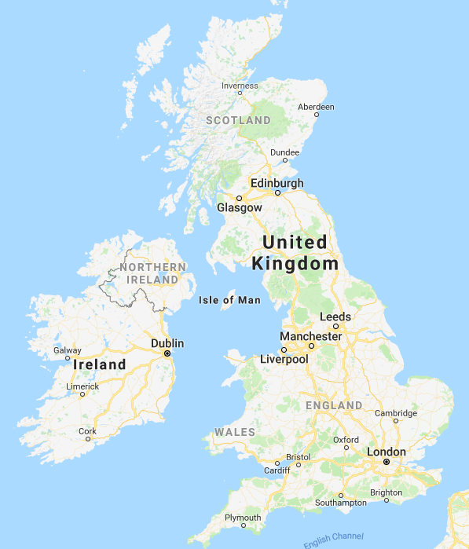
Multicentre randomised trial
PET vs CT-guided biopsy
NIHR RfPB funded
1 o/c - diagnostic accuracy
2 o/c - Time to diagnosis
    - Number of procedures
    - Healthcare costs
N = 45/78
Closes 30/9/18
Notes:
Blackpool, Bristol, Glasgow, Gloucester, Newport, Norwich, Oxford, Portsmouth, Sheffield, Stoke-on-Trent
In suspected pleural malignancy, following previous negative biopsy

Slide 5
INCLUSION CRITERIA
Pleural thickening on CT, suspicious for pleural malignancy
Previous non-diagnostic pleural biopsy in the past 12 months
MDT decision to perform further CT-guided biopsy to pursue a diagnosis
EXCLUSION CRITERIA
Unsuitable for a CT guided biopsy
  Inability to co-operate/lie still
  Uncorrectable coagulopathy
  Inability to tolerate PTx
  Severe underlying lung disease (FEV1 < 35%)
Pleural thickening not amenable to a radiologically guided biopsy
Talc pleurodesis in past 6 mo
Notes:
Other exclusions inc:
Unable to give consent
Pregnancy or lactation
Age <18 years

Slide 6
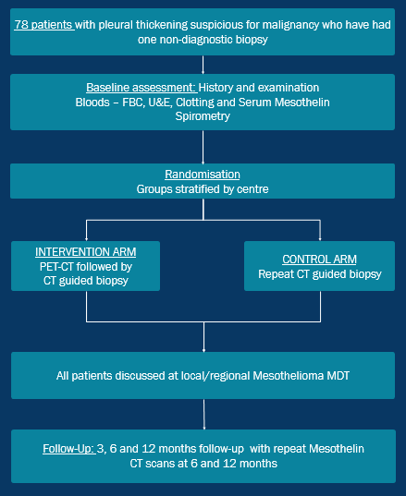

Slide 7
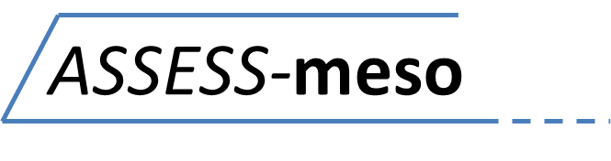
A prospective obServational cohort Study collecting data on dEmographics, Symptoms and biomarkerS in people with mesothelioma that will provide a resource for future trials

Slide 8
Multicentre pragmatic observational study
Funding: Avon Mesothelioma Foundation
All-comers with mesothelioma
Followed up from diagnosis to death
Aims:
  To explore natural history of disease
  To describe symptoms & symptom evolution
  To investigate factors affecting outcomes
  To provide a resource for biomarker testing
N = 23/700
Notes:
Bristol & Oxford open, Taunton, Leicester & Hywell Dda in set up.
Factors affecting outcomes including response to chemotherapy
Running until 2027 so we’ve got some time

Slide 9
INCLUSION CRITERIA
Histological, cytological or clinico-pathological diagnosis of MPM, confirmed at MDT
Willing & able to comply with study follow up assessments (including at least 1 appointment at a study centre)
Able to provide written informed consent
EXCLUSION CRITERIA
Age <18 years old
Unable to give written informed consent
Declines ongoing hospital follow up

Slide 10
Clinical assessment, imaging, blood tests, fluid assessment, PROMS
Clinical history inc drainage vols, PROMS, recent bloods/ imaging if appropriate
Study assessments alongside clinic appts
Able/
willing to continue clinic
F/U?
NO
Option to switch to telephone/ postal F/U
Meets eligibility criteria
Death or withdrawal from study
YES
Minimum every 3 months

Slide 11
A Trial of Intra-pleuraL bacterial immuno-Therapy in mesothelioma: A feasibility study using the ‘trial within a cohort’ methodology

Slide 12
Randomised 3-arm feasibility trial
Based on “trials within cohorts” design
Intra-pleural OK432 vs BCG vs usual care
Funded by NIHR DRF
Primary outcome – feasibility
Secondary outcomes – response rates,
survival, PROMS
N=1/24
Further 12 months recruitment
Notes:
Talk a bit about immunotherapy

Slide 13
INCLUSION CRITERIA
Pathological diagnosis of MPM & enrolled in ASSESS-meso
Functioning IPC in situ or willing (& able) to have one inserted
No chemotherapy planned for 4 weeks either side of trial
Performance status ≤3
Predicted survival ≥12 weeks
EXCLUSION CRITERIA
Contra-indication to IPC
Trapped lung or heavily loculated effusion
Known immunodeficiency or immuno-suppressive medication
Intercurrent infection
Known allergy to OK432, BCG or penicillin
Previous immunotherapy
Brain metastases or CNS involvement

Slide 14
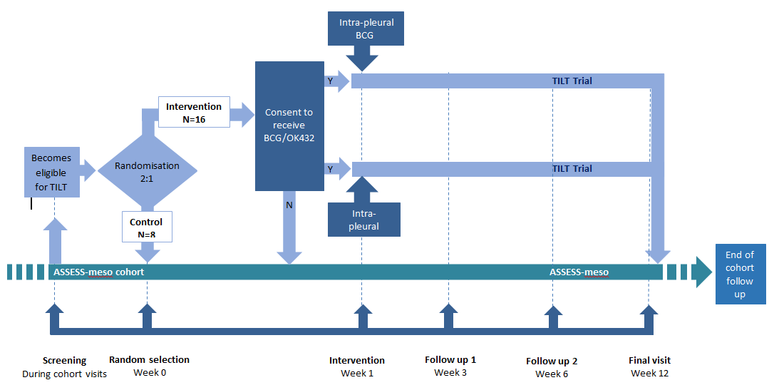
Intra-pleural OK432

Slide 15
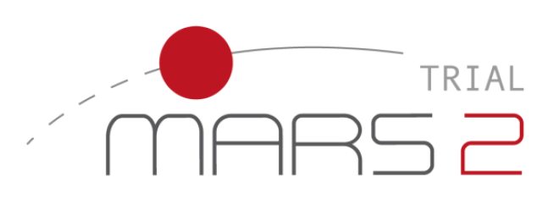
Mesothelioma and Radical Surgery 2: a multicentre randomised trial comparing (extended) pleurectomy decortication versus no (extended) pleurectomy decortication for patients with malignant pleural mesothelioma
Notes:
Mention MARS1

Slide 16
Potentially eligible patient
Bristol
Eligibility confirmed by surgical team
London, in absentia
Consent
Bristol
2 cycles of chemotherapy, then CT
Locally
Randomisation
Bristol
No surgery
(Extended) pleurectomy decortication
London
Up to 4 cycles of chemotherapy
Locally
Follow up at 6 weeks, 6 months, 12 months, 18 months & 24 months
Bristol

Slide 17
INCLUSION CRITERIA
≥16 years old
Tissue confirmed mesothelioma
Disease confined to one hemi-thorax on CT
Disease deemed surgically resectable
Fit for surgery
Able to provide written informed consent
EXCLUSION CRITERIA
Severe shortness of breath
  PS ≥ 2
  Pre-operative FEV1 or TLco <20%
Serious concomitant disorder that would preclude surgery
Severe heart failure (EF <30%)
End stage kidney failure on dialysis
Liver failure
Prisoner
Lacks capacity to consent
Enrolled in another interventional trial
Notes:
Nb no staging

Slide 18
Meso-TRAP
A study comparing video-assisted thoracoscopic partial pleurectomy/decortication (VATS-PP) with indwelling pleural catheter (IPC) in patients with trapped lung due to malignant pleural mesothelioma
Randomised feasibility study
Patients have to have “clinically significant trapped lung requiring intervention”
Must be fit enough & willing to undergo VATS-PP
N=4/38
Notes:
Aiming to address recruitment and randomisation uncertainties and sample size requirements for a phase III trial
in the opinion of the clinical team

Slide 19
How do I get my patient into a trial?
All patients discussed at NBT Mesothelioma MDT are screened for eligibility
All patients seen in NBT pleural/meso clinic are screened
We are happy to receive referrals asking re trial eligibility
Also happy to discuss any potentially eligible patients over the phone

Slide 20
Conclusion
Meso trials are available at (almost) every step of the patient pathway
  TARGET
  ASSESS-meso
  TILT
  MARS2
  Meso-TRAP
All require the patient to travel to Bristol at least once
But some treatments can be given locally to reduce travel burden
Prof Maskell & I are always happy to discuss potential patients prior to referral
Diagnostic
Observational
Immunotherapy
Surgery

Slide 21
Thank you very much
Any questions?
Anna.Bibby@nbt.nhs.uk Nick.Maskell@bristol.ac.uk
Tel: 0117 414 8049
Mob: 07724912367

