Slide 1
Somerset Cancer Register (SCR)
Living With & Beyond Cancer Update

Slide 2
SCR - LWBC Update
CNS Enhancements
PSA Tracker
Remote Monitoring
Notes:
We currently are making some improvements to the CNS screens and dashboard to support the LWBC agenda. In particular to support the metrics and the recording of Support Workers activity.
We are developing PSA, Breast and Colorectal Trackers, available in the next release. You will be able to add your patient to the tracker, which will produce a worklist of all patients latest tumour marker dates within SCR and highlight those patients that have exceed their set alert level.
We are working on a remote monitoring solution which will be a standalone system, but will link to SCR and your hospital clinical systems and will provide a more comprehensive database of patients who have been placed onto remote monitoring. It will include features like alerts, reporting, overdue tests and reviews

Slide 3
CNS Enhancements
Notes:
We currently are making some improvements to the CNS screens and dashboard to support the LWBC agenda. In particular to support the metrics and the recording of Support Workers activity.

Slide 4
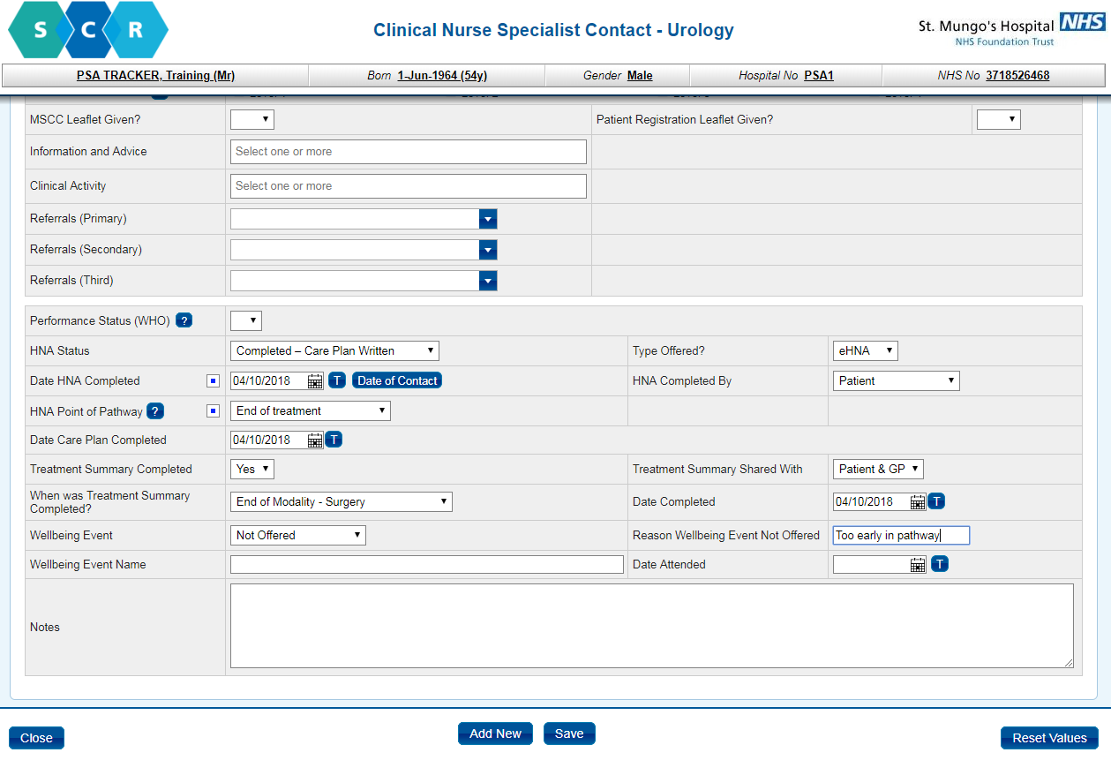
Notes:
CNS Enhancements
HNA Status (Not Offered, Offered, Completed)
Date Care Plan Completed
Treatment Summary Completed (Yes, No)
Treatment Summary Shared With (GP, Patient, Patient & GP)
When was Treatment Summary Completed (After all treatments, After Surgery Treatment, After Anti-Cancer Drugs Treatment, After Teletherapy Treatment, After Brachytherapy Treatment)
Reason Wellbeing Event Not Offered (free text)

Slide 5
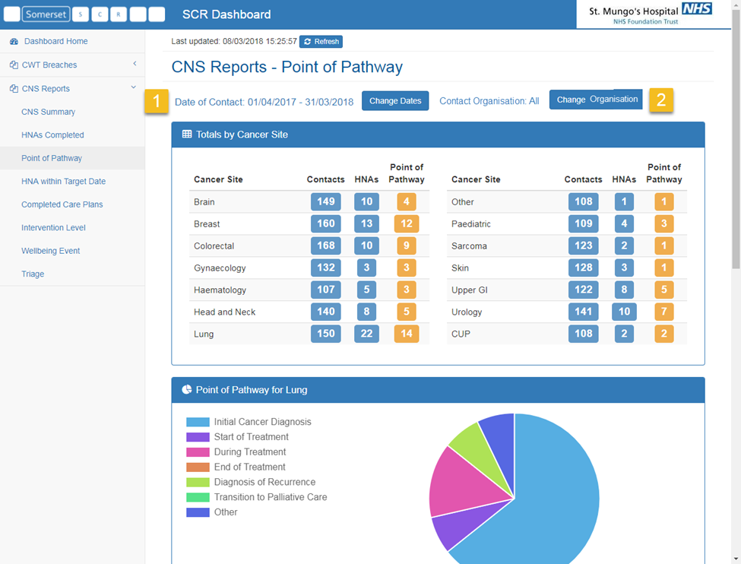
Notes:
Current Dashboards available listed on left:
HNAs within target, Completed Care Plans etc

Slide 6
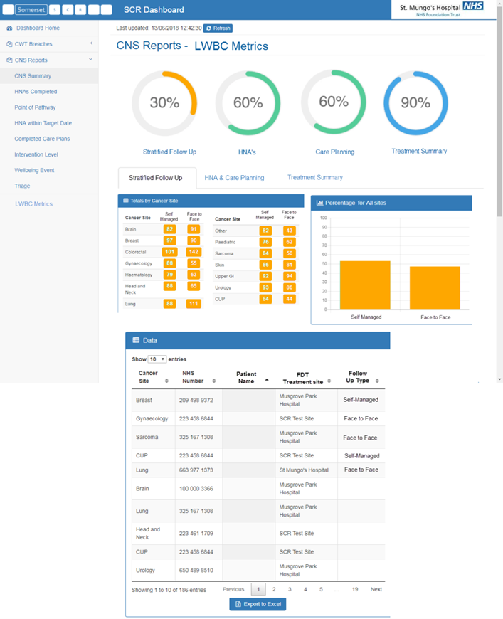
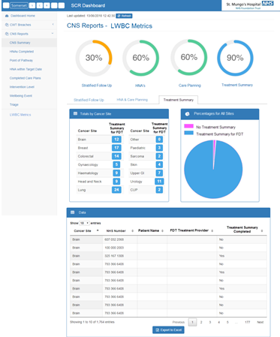
Notes:
Mock up of LWBC metrics once confirmed in August.

Slide 7
PSA Tracker
Notes:
We are developing PSA, Breast and Colorectal Trackers, available in the next release. You will be able to add your patient to the tracker, which will produce a worklist of all patients latest tumour marker dates within SCR and highlight those patients that have exceed their set alert level.

Slide 8
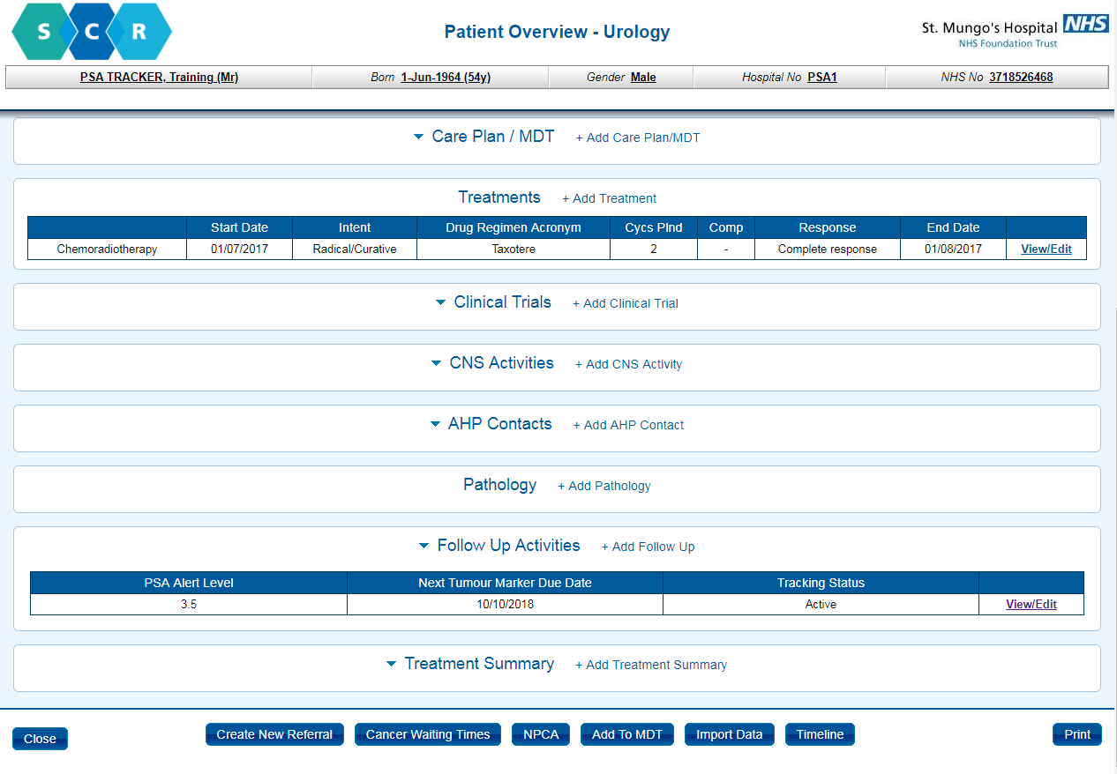
Notes:
PSA Tracker
Add patient to tracker in follow up section

Slide 9
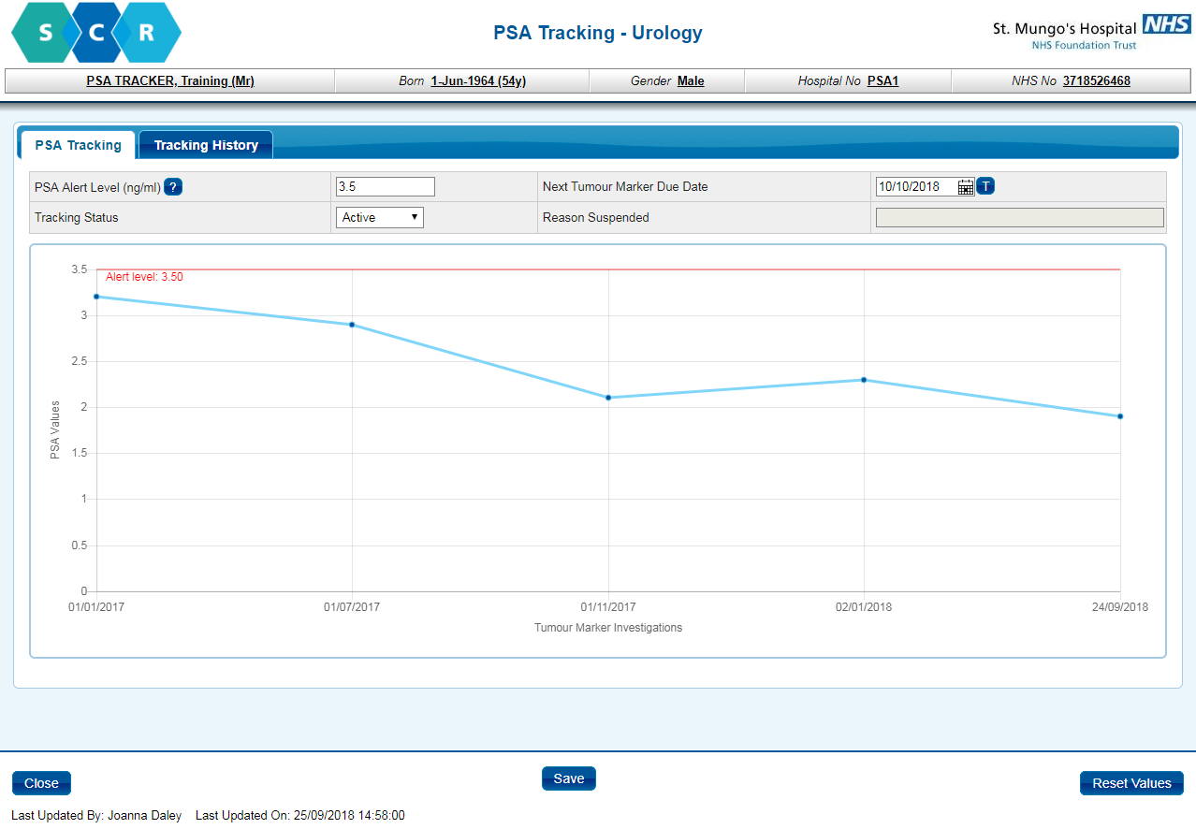
Notes:
PSA Tracker
Add patient to tracker in follow up section – add PSA alert level and next tumour marker date
Tracking status defaulted to Active

Slide 10
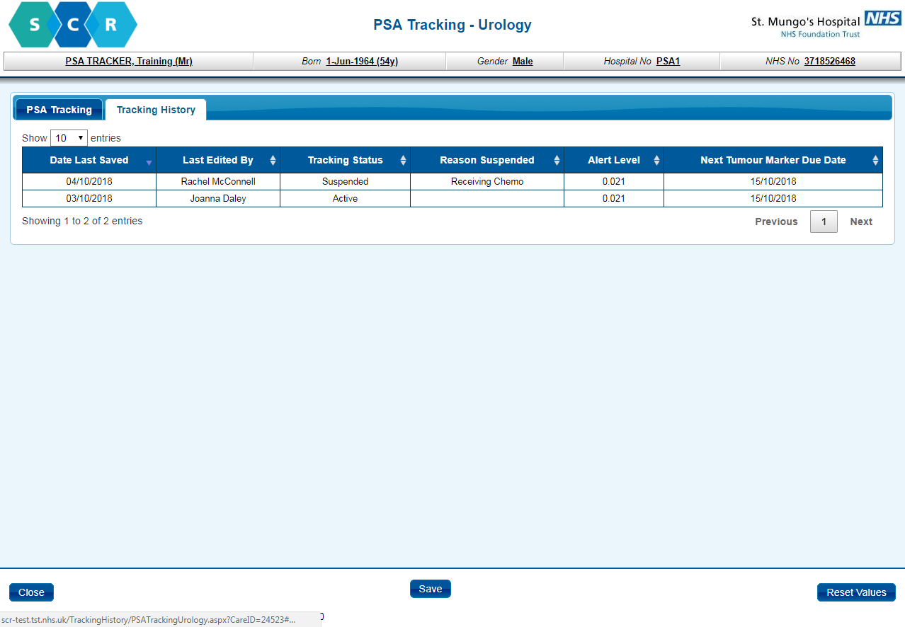
Notes:
BPSA Tracker – View / Edit
Two tabs: - Tracking History – on / off tracking via admin menus

Slide 11
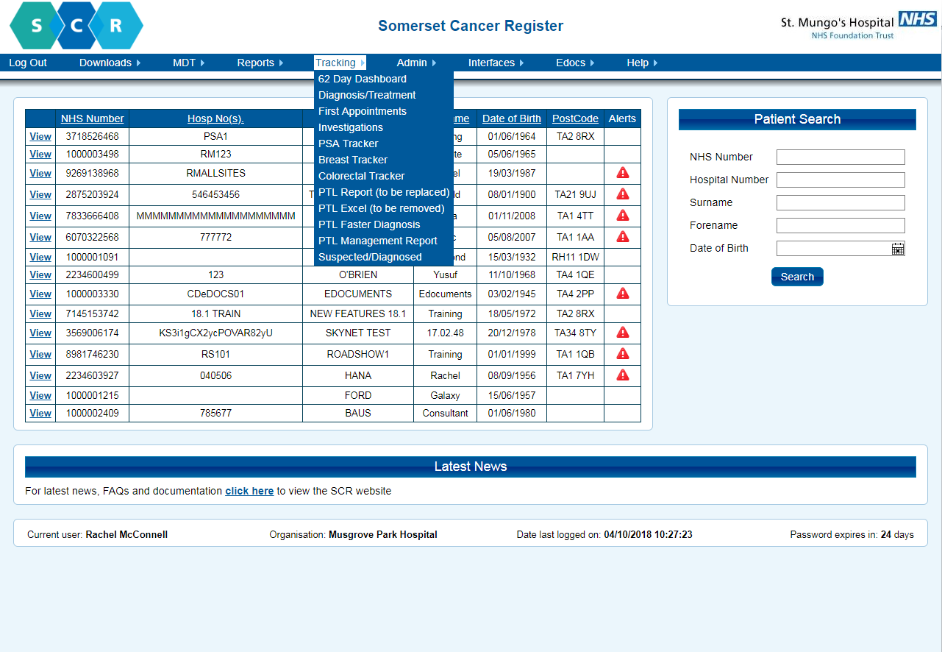
Notes:
PSA Tracker
Report / Worklist available from tracking menu

Slide 12
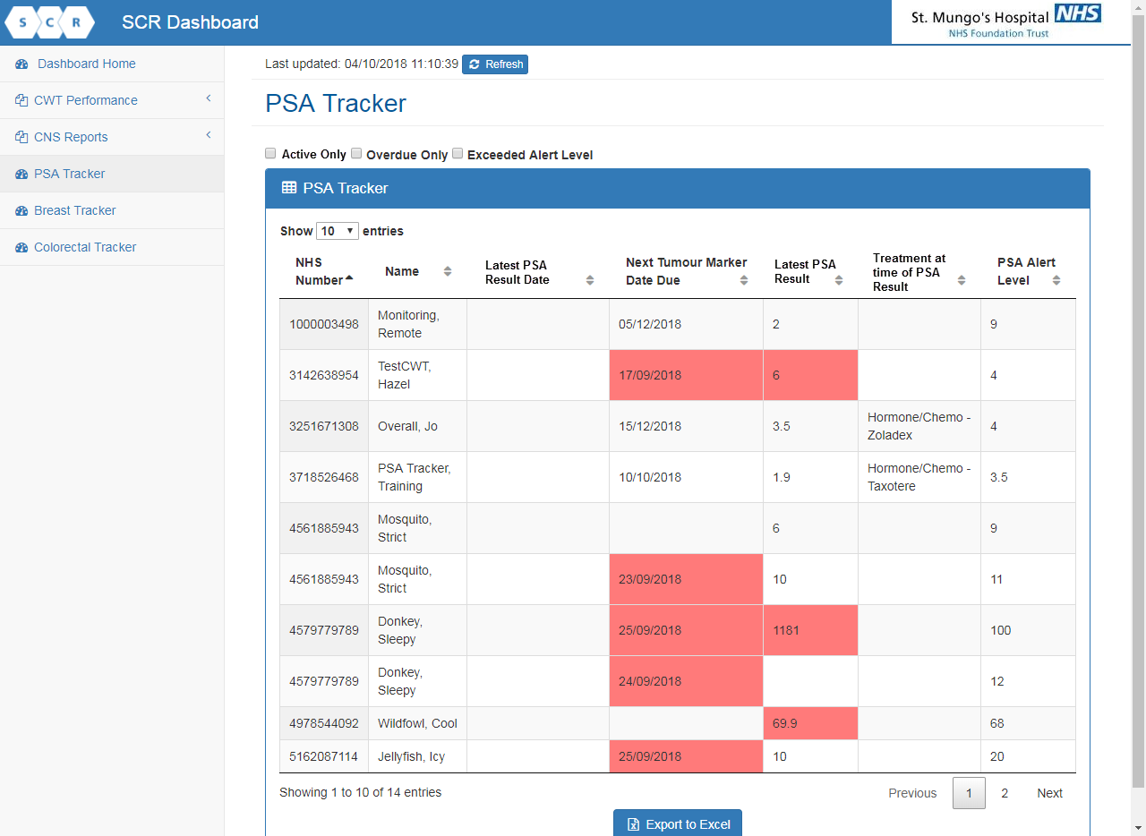
Notes:
PSA Tracker - Worklist
Can exclude suspended patients or just filter on those with high PSA Levels above alert
If overdue date or exceed alert level will be red

Slide 13
Remote Monitoring System
Notes:
We are working on a remote monitoring solution which will be a standalone system, but will link to SCR and your hospital clinical systems and will provide a more comprehensive database of patients who have been placed onto remote monitoring. It will include features like:
Alerts, reporting, overdue tests and reviews

Slide 14
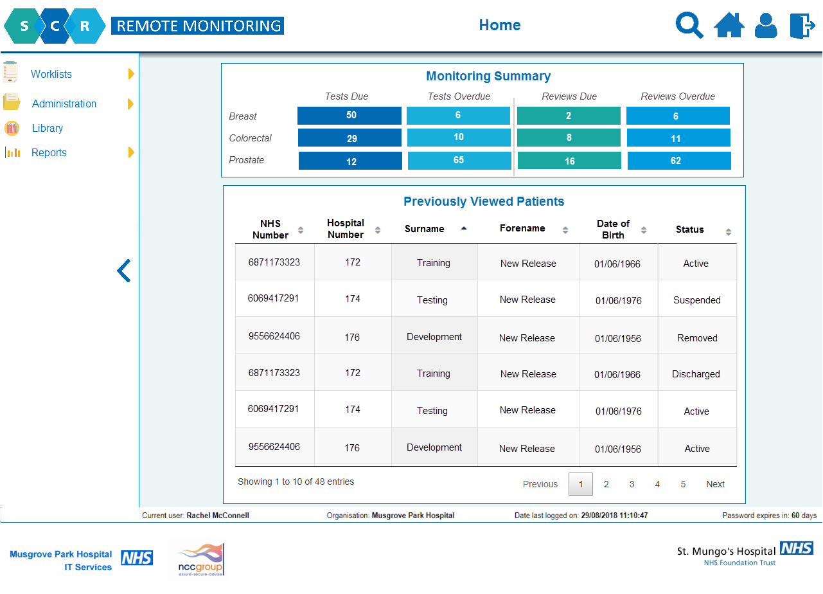
D R A F T

Slide 15
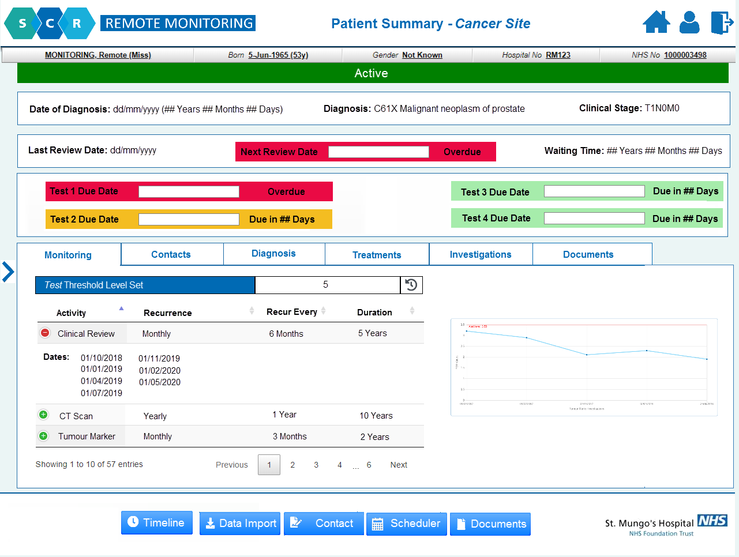
D R A F T

Slide 16
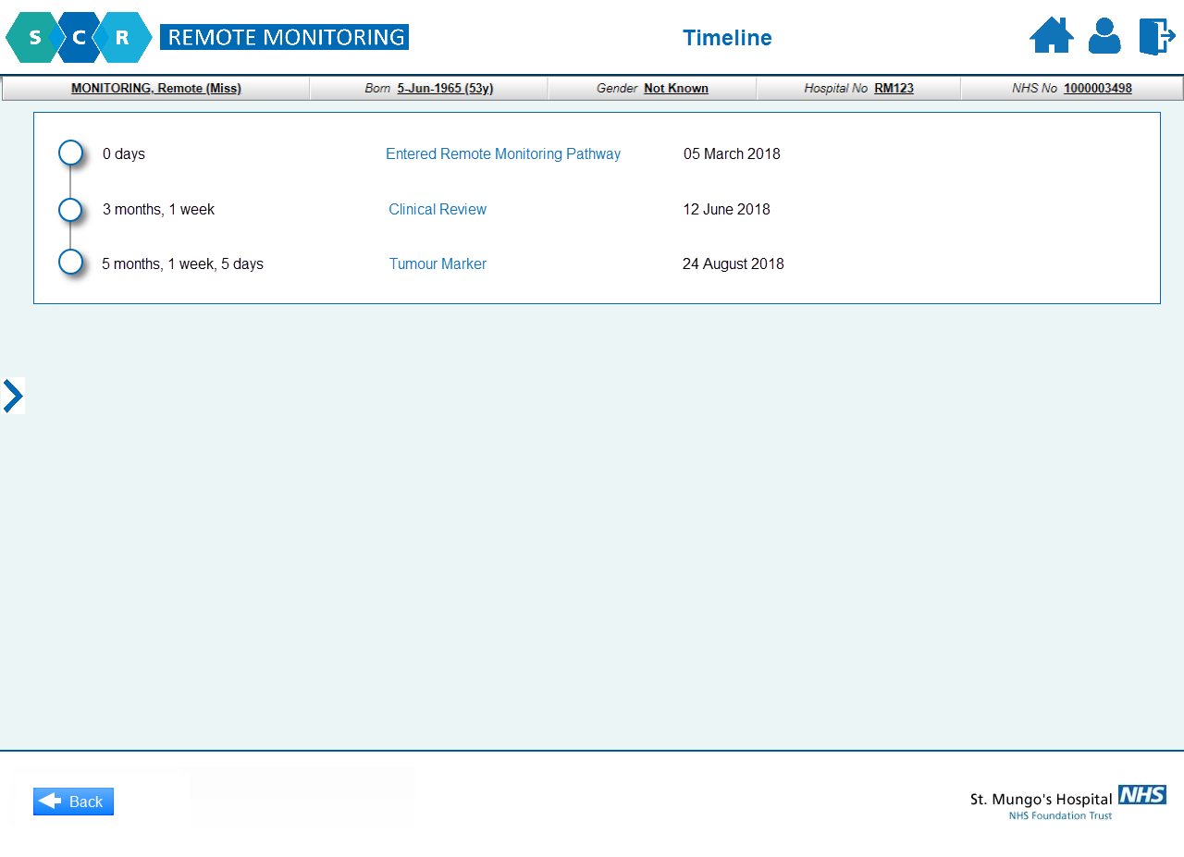
D R A F T

Slide 17
Proposed Phases of Remote Monitoring Development for Breast, Colorectal and Prostate
Phase 1 | Clinical summary (read only data from SCR) Pull test results from local systems (pathology, radiology, oscopies) Record any relevant treatment history during monitoring period including a log of patient contacts Support user-defined patient range/tolerances for tests Schedule tests based on user defined follow up schedules Provide a summary history and treatment page with test results shown numerically and graphically to record the outcome of any event or test Timelines of events Various worklists (due / overdue tests; above threshold results) which can be exported to Excel for further analysis IG and HL7 compliant
Phase 2 | Clinical summary via interface with other hospital systems (non-SCR) Hold a range of template letters to enable communication of results / scheduled test to patients / health care professionals Include an alert system that identifies test results for review, due dates exceeded or test results that exceed tolerance Additional worklists / reports as requested
Phase 3 | Provide a patient portal for patients to view test results GP view Additional worklists / reports as requested
Phase 4 | Allow patients to complete an eHNA and update their care plan actions. Additional worklists / reports as requested
Notes:
Current SCR Position Statement

Slide 18
Thank You
Email: cancerreg@tst.nhs.uk
Website: http://nww.cancerreg.somersethis.nhs.uk/

