Slide 1
The BAHNO Head & Neck Cancer Surveillance Audit 2018
MTReC

Slide 2
OVERVIEW
Background
Aims
Standard
Methods
Data shared
Further information

Slide 3
BACKGROUND
Head and neck cancer is the sixth most common malignancy worldwide
Post treatment surveillance is an essential element of patient care
Limited evidence base to support surveillance strategies but guidelines published
Traditionally follow-up has focused on the detection of recurrence potentially at the detriment of holistic patient care
New imaging technology has improved tumour detection and may have an increasing role in post-treatment surveillance
Recent upsurge in trainee collaborative research has made large scale national audit and research both feasible and affordable

Slide 4
AIMS
To assess adherence to ‘Follow-up after treatment for head and neck cancer: United Kingdom National Multidisciplinary Guidelines’ 2016
To help us understand current practices, and the gaps and areas of need.
To examine follow-up practices for head and neck cancer patients in the UK, with the aim of establishing a research programme to improve current practice
To develop trainee collaborative links in a cross specialty setting

Slide 5
STANDARDS
Patients should be followed up to a minimum of five years with a prolonged follow-up for selected patients. (G)
Patients should be followed up at least two monthly in the first two years and three to six monthly in the subsequent years. (G)
Patients should be seen in dedicated multidisciplinary head and neck oncology clinics. (G)
Patients should be followed up by dedicated multidisciplinary clinical teams. (G)
The multidisciplinary follow-up team should include CNS, SLT, dietitians and other allied health professionals in the role of key workers. (G)
Clinical assessment should include adequate clinical examination including rigid or flexible nasopharyngolaryngoscopy. (R)
MRI and PET CT should be used when recurrence is suspected. (R)
Narrow band imaging can be used in the follow-up in selected sites. (R)
Second primary tumours should be part of rationale of follow-up and therefore adequate screening strategies should be used to detect them. (G)
Patients should be educated with regard to the appearance and detection of recurrences. (G)
Patients with persistent pain should be investigated to exclude recurrent disease. (R)
Patients should be offered support with tobacco and alcohol cessation services. (R)

Slide 6
METHODS
2 week retrospective → 1st to 14th November 2017
4 week prospective → 16th April to 11th May 2018
Coordinated by a specialty-specific ‘Site Leads’ at each centre
Includes ALL consultations for the surveillance of treatment-complete head and neck cancer. (Excluding primary thyroid malignancy)
Audit clinic proforma used to replace written notes entry in prospective arm
Anonymous data shared via secure on line data transfer strategy for analysis

Slide 7
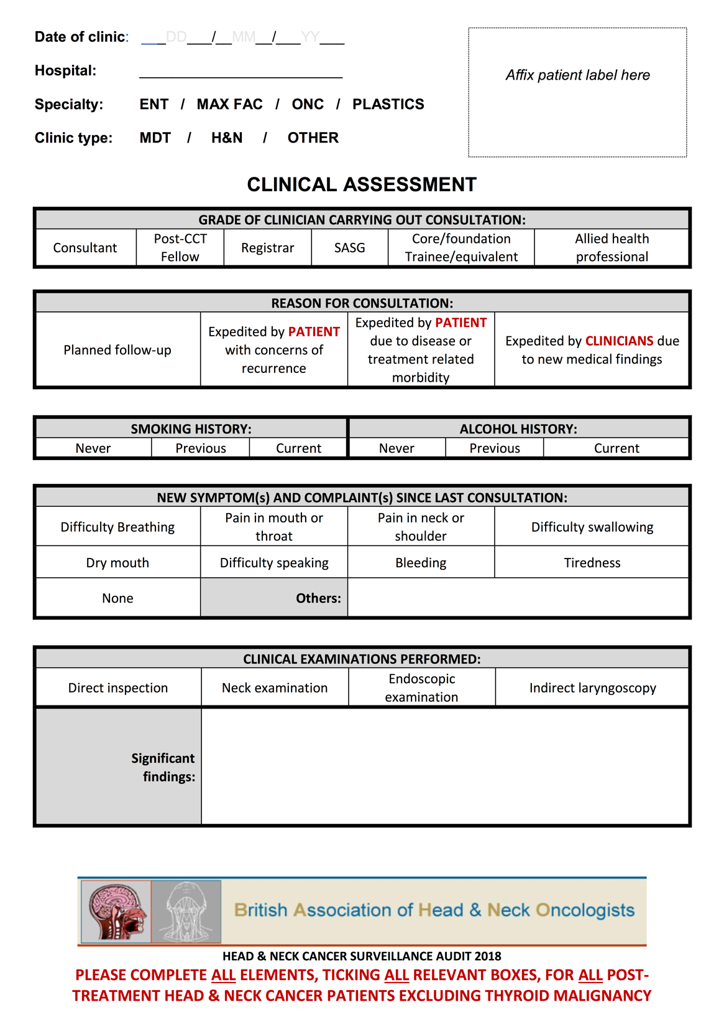
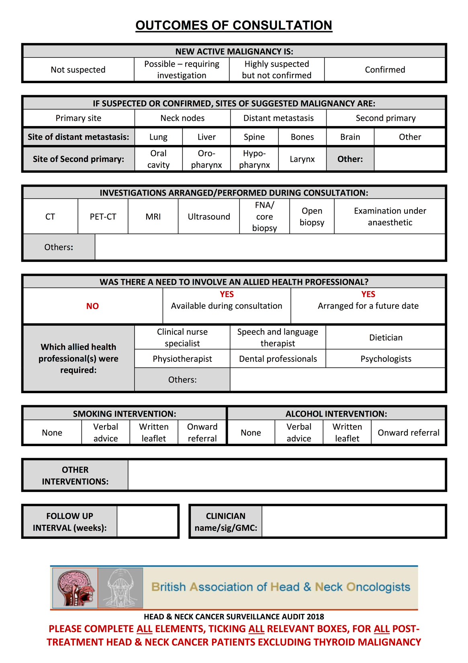
PROFORMA

Slide 8
Data Shared
Date of clinic
Age
Gender
Smoking status
Alcohol intake
Type of cancer
HPV status
Date of diagnosis
Date of completion of treatment
Type of treatment received
Grade of clinician
Type of clinic appointment
Symptoms identified during consultation
Methods of clinical examination
Details of patient education
Advice regarding smoking
Other allied health professionals seen
Suspicion of recurrence/metastasis/2nd primary
What investigations are initiated
The follow up interval
Outcome of investigations

Slide 9
CONTACT
Supporting information and documents at:
www.entINTEGRATE.org
Contact the steering committee at:
info@entintegrate.org

