Slide 1
Living With and Beyond Cancer
Hannah Manton
Project Manager (Somerset Wide)
27th JUNE 2018

Slide 2

Introduction
NHS since March 2017
Previously Project Manager at Clarks shoes for 8 years.
Living With and Beyond Cancer Project Manager - 2nd week in May 18
Work for the Somerset CCG – based at YDH, MPH and CCG at Wynford House Yeovil.
Email: hannah.manton1@nhs.net
Phone: 07551 136800

Slide 3
Living with and Beyond Cancer – Why?
There are over 2.5 million people in England living with a diagnosis of Cancer. This number is likely to double to 4 million by 2030.
There is evidence to suggest that many living with and beyond cancer have unmet needs particularly at the end of treatment. Others are struggling with the consequences of treatment.
    • Survivors are 37% more likely to be unemployed
    • 22% suffer from loneliness
    • 30% of people reported 5 unmet needs a year after diagnosis
Changes to the way that we support those living with and beyond cancer is a priority that we need to address in order to improve the patient journey and quality of life.

Slide 4
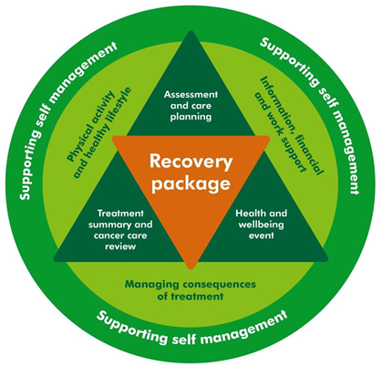
Living with and Beyond Cancer – How?
By implementing a number of key initiatives (Recovery Package) we can start to make a difference:

Slide 5

Living With and Beyond Cancer – What?:
3 cancer sites = Breast, Colorectal & Prostate
2 x Structured Holistic needs assessments
  31 days post diagnosis.
  Within 6 weeks of end of treatment
Introduction of Cancer Support Workers
Treatment Summaries
Patient Education and Support Events (Health and
  Well-Being Clinics)
Advise & support regarding exercise schemes
that support people to undertake activities and exercise.
  SPRING in YDH

Slide 6
Living With and Beyond Cancer – What?:
GP Cancer Care Review (CCR)
  Conversation carried out within 6 months of the cancer diagnosis
  Part of the Recovery Package.
  There is thought to be a lack of clarity and guidance about what should be covered in the CCR
    Looking to assist GP’s in conducting high quality CCR’s
    Ensure CCRs include a care plan that is given to the patient
Implementation of Risk Stratified Pathways
    By end of Year 1 – Breast
    By end of Year 2 – Colorectal & Prostate

Slide 7
Living With and Beyond Cancer – Who?:
I will be looking to engage and work with a large number of people including
  CNS from each cancer site
  Lead cancer nurses
  Consultants and Surgeons
  GP’s
  Cancer Support Workers
  Community
  Somerset CCG
  Macmillan
  Other Organisations
  I am ultimately here to ensure we are able to achieve an
  equitable, sustainable and consistent service for people
  living with and beyond cancer across Somerset

Slide 8
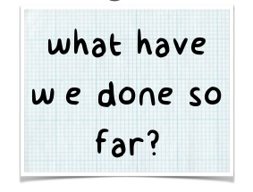
So Far in Somerset:
  Induction to the LWBC project (including
  attendance at workshops, SWAG meetings etc)
  Key stakeholder meetings started (MPH & YDH)
    including attendance at MDTs
  Project documentation devised (and completed
    where already in place) including amalgamating data into Somerset wide tracker
  Process Mapping (As Is) in process for Urology at YDH
  Commissioning workshop attended and time for shadowing in place in order to understand commissioning models

Slide 9
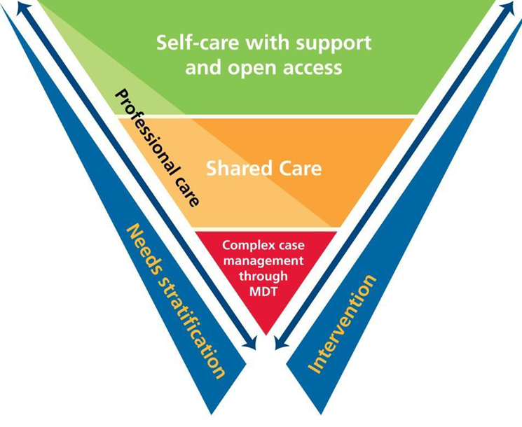
So Far (Colorectal Specific)
Draft SWAG Colorectal Risk Pathway
Based on Yeovil CRC pathway
Treatment Summary templates
Post-surgery
Post-chemotherapy
Post-radiotherapy
Metastatic disease

Slide 11

Snap shot of what is planned:
  Colorectal Process Mapping Session (both YDH and MPH)
  Devise a strategy for generic and site specific Health & Wellbeing Events and provision of a well-being programme in Taunton
  (Similar to SPRING in YDH)
  Current trajectories to be looked at for both YDH & MPH
  Sustainable commissioning model for Somerset
  Patient Focus Groups for Somerset
  Somerset Wide B5 Project Support Role
  Treatment Summaries
  GP Roadshow Event (July 12th Taunton)

Slide 12


hannah.manton1@nhs.net
07551 136800

