Slide 1
Upper GI Cancer Clinical Advisory Group
Research Report
29/11/2019
Dave Rea

Slide 2
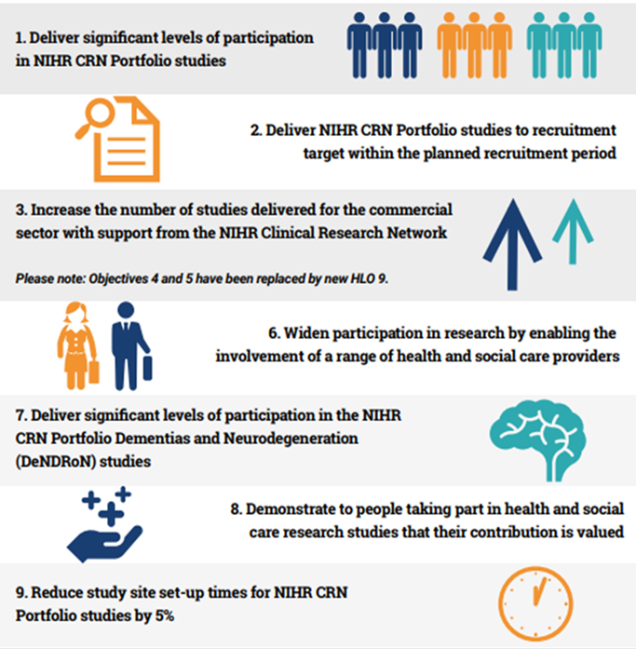
NIHR CRN High Level Objectives 2019-20
HLO 1
Target - 28,883 recruits
HLO 2 Commercial – 80%
Non Commercial – 80%
HLO 9
Commercial – 80 days
Non-commercial – 62 days

Slide 3
Harmonised speciality objectives 2019-20
Harmonised speciality objectives have been introduced
30 individual speciality objectives replaced by 5 harmonised objectives
    Increasing early career researchers involvement in NIHR portfolio research.
    Specific areas within cancer, currently under represented.
      Cancer Surgery
      Radiotherapy
      Rare Cancers
      Teenage and Young Adults

Slide 4
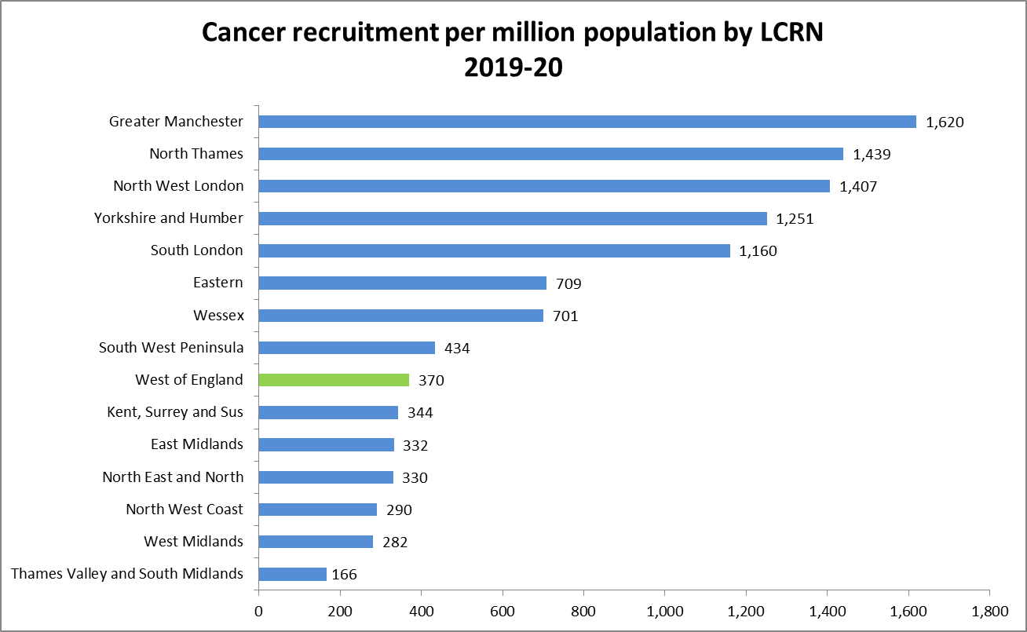
Cancer recruitment per million population 2019-20

Slide 5
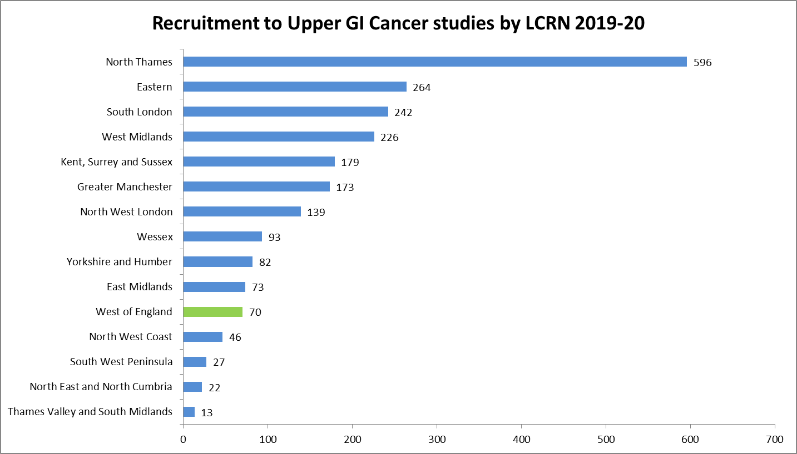
Upper GI cancer recruitment by LCRN 2019-20

Slide 6
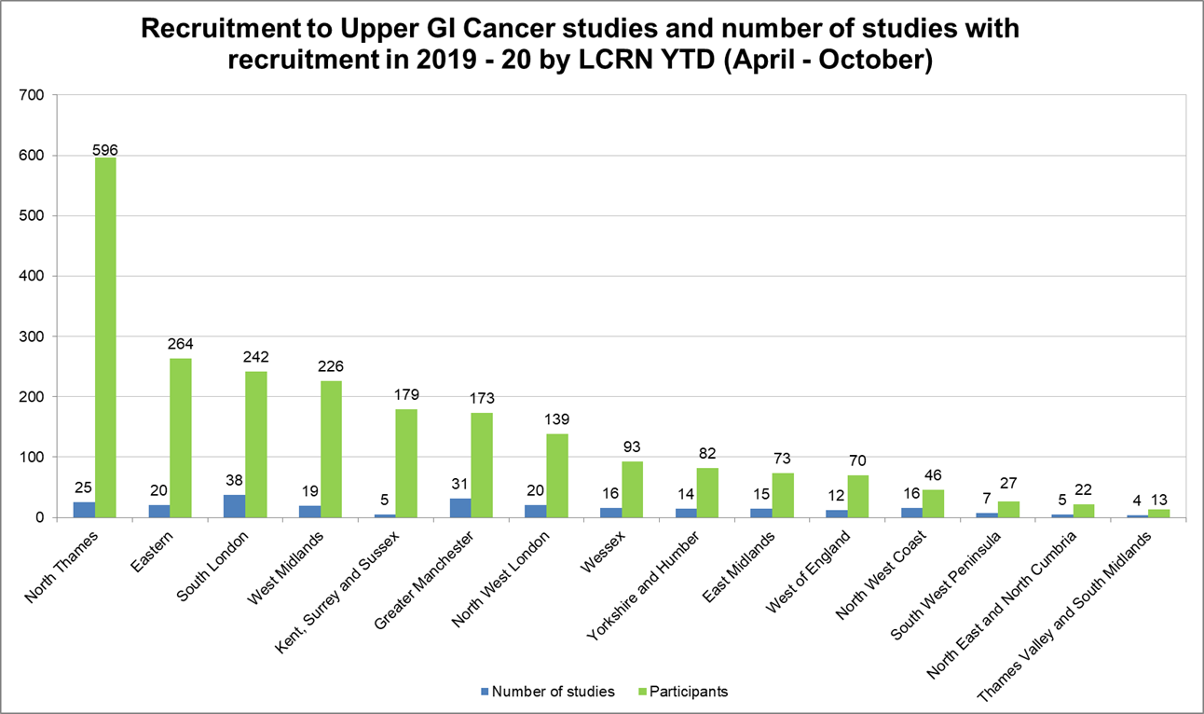
Recruitment and number of Upper GI Cancer studies 2019-20

Slide 7
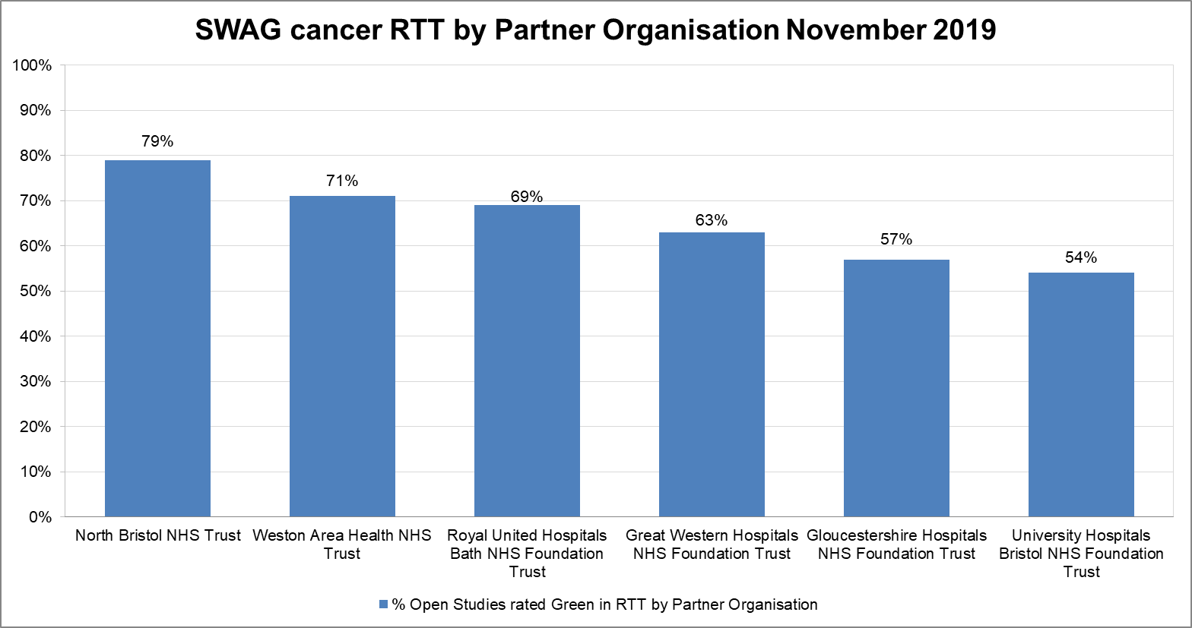
Cancer recruitment to time and target

Slide 8
Open Upper GI cancer recruitment to time and target across CRN West of England Partner Organisations

Slide 9
Useful links
https://www.crn.nihr.ac.uk/
  National and local network information including training programmes templates, tools, contacts, videos etc.
https://odp.nihr.ac.uk/
  Open data platform. Look at performance across whole CRN including all specialty areas
http://csg.ncri.org.uk/portfolio/portfolio-maps/
  View current national portfolio of open, closed and ‘in set up’ cancer studies
https://www.ukctg.nihr.ac.uk/
  See which studies are open across the country (will soon be Be Part of Research)
http://public-odp.nihr.ac.uk/
  Search for a study to fit criteria. Good for horizon scanning, eligibility criteria

Slide 10
Contacts
Research Delivery Manager – David.Rea@nihr.ac.uk
Research Portfolio Facilitator – Jessica.Bartlett@nihr.ac.uk
Upper GI Sub-specialty Lead - Sharath.Gangadhara@nhs.net

