Slide 1
FIT <10 Pathway Webinar with
Amelia Randle, SWAG Clinical Director, and
Louise Hunt, Consultant Colorectal Surgeon,
Somerset Foundation Trust
17.09.2020

Slide 2
Agenda
Agenda Item
Welcome and Introduction Dr Amelia Randle, Clinical Director, SWAG Cancer Alliance
The FIT <10 Pathway for Suspected Colorectal Cancer Dr Amelia Randle, Clinical Director, SWAG Cancer Alliance
2ww Colorectal cancer and qFIT Louise Hunt, Somerset NHS Foundation Trust
Discussion and Q&A Opportunity
AOB

Slide 3
Glossary
FIT – Faecal Immunochemical Test
Negative FIT – FIT result <10
Positive FIT – FIT result >10
2ww – Suspected cancer referral under two-week-wait rule

Slide 4
Rationale
The availability of colonoscopy has been significantly reduced by the Coronavirus Pandemic.
The maximum possible capacity for inpatient and critical care has been freed up, and preparations made to respond to large numbers of inpatients requiring respiratory support.
To reduce the risk of coronavirus transmission during endoscopy special procedures are necessary. These reduce the number of tests than can be done in a single session.
The current advice from the British Society of Gastroenterology (BSG) for endoscopy services, is to investigate only urgent cases.
Colorectal teams are using Faecal Immunohistochemical Testing (FIT) to help prioritise referrals.
There has been a reduction in the number of referrals for suspected colorectal cancer:
Patients practicing social distancing in accordance with government guidance have not been engaging with health services for fear of burdening the NHS, or of contracting the virus.
Overlap of symptoms of coronavirus in patients with symptoms of suspected cancer may delay diagnosis.
Trusts in SWAG are preparing to manage the backlog of patients whose investigations have been delayed, alongside an additional increase in primary referrals as services return to normal.

Slide 5
The Problem
There is widespread agreement in the use of FIT as a tool to triage colorectal 2 week-wait referrals.
The national guidance is that patients with negative FIT should be held on a waiting list and offered a colonoscopy at a later date.
Increasing clinical opinion is that these patients can be safely reassured and given ‘safety-netting’ advice
A small number of patients with negative FIT will later be diagnosed with colorectal cancer (From evidence range of figures from 1:200 to1:1000)
Reassuring patients with a negative FIT without referral, will allow patients with higher risk symptoms to be assessed and treated more quickly as more colorectal team time will be available.

Slide 6
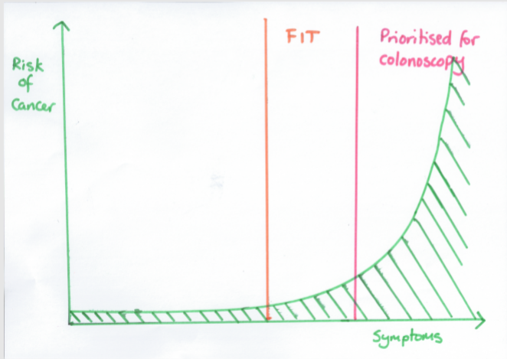

Slide 7
Before COVID-19, all patients represented by a red box were offered a colonoscopy
Age | Abdominal mass | Rectal mass | Rectal Bleeding and 1 other symptom¹ | Abdominal pain and weight loss | FIT >10 | Rectal bleeding | Change in bowel habit | Iron deficiency anaemia
<40
40-50
50-60
60+

Slide 8
National COVID-19 Pathway
Patients in the orange box below will be offered a FIT, and if negative, held on a list awaiting further tests.
Patients in the red boxes are treated as before.
Age | Abdominal mass | Rectal mass | Rectal Bleeding and 1 other symptom¹ | Abdominal pain and weight loss | FIT >10 | Rectal bleeding | Change in bowel habit | Iron deficiency anaemia
<40
40-50
50-60
60+
Patients with FIT <10 are ‘safety-netted’ on a patient tracking list until investigations can be completed
Low risk patients are those with NG12-specified symptoms and a FIT <10µg/g.
All patients placed on tracking lists should have a virtual consultation to provide information and reassurance. They should be given advice on what to do if their symptoms progress.
While many patients with a FIT <10 will not require endoscopy, patients should not be discharged from the 2WW pathway on the basis of a FIT test alone, except in existing FIT pioneer service evaluation sites that were piloting the use of FIT before the COVID-19 outbreak.

Slide 9
1,000 FIT Tests
1,000 FIT tests
925 appropriately reassured without colonoscopy
52 prioritised for investigation and cancer ruled out
18 prioritised for investigation and diagnosed with cancer
1-5 potential delayed cancer diagnosis
 | Cancer | No Cancer | total
FIT >10 | 18 | 52 | 70
FIT <10 | 1-5 | 925 | 930

Slide 10
SWAG Cancer Alliance proposed colorectal cancer pathway, during COVID recovery phase

Slide 11
Primary Care Clinical Assessment
Remote assessment with face to face for physical exam, rectal examination (PR) abdominal examination
Bloods: Full Blood Count , Ferritin, Urea and Electrolytes, Liver Function Tests, C-reactive Protein
If reassessing after negative FIT and ongoing NG12 symptoms, repeat FIT after 6 weeks
If ongoing symptoms and negative FIT x 2 advice and guidance
60+ change in bowel habit
50+ unexplained rectal bleeding
60+ IDA rectal mass
40+ unexplained weight loss and abdominal pain
Abdominal mass
<50 rectal bleeding and abdominal pain
Weight loss or iron deficiency anaemia
Symptoms not meeting 2WW or NSS RDS criteria
Symptoms resolved
GP reassess
Reassurance and safety netting
GP diagnosis and management with Advice and Guidance or routine referral
negative
FIT
positive
Suspected cancer (2WW) referral
positive
FIT
Key:
Purple: existing pathway
Red: existing 2WW referral
Green: proposed new pathway
negative
NSS RDS available?
No
Yes
2 x FIT negative and ongoing symptoms
Colorectal Advice and Guidance
NSS RDS

Slide 12
Discussion Summary
Proposals seem ‘doable’ with the reassurance of they’re in the system
It’s correct and proper that GPs address the emerging problem of a limited resource versus high demand
Conversations with GPs to establish they are happy to take on ‘extra’ workload
Also shared conversations GPs/Clinicians/Patients – aim is to limit the anxiety of those ‘on hold.’ Don’t mind waiting but open-ended waiting not acceptable. Importance of clarity on what the next step is and when it will take place.
Trying to establish a moral/clinical pathway

Slide 13
Clinicians want to be pragmatic and move away from current NICE guidance
Exploring this with CA allows People/Patient view which is overall support for why clinicians have taken this course
Request for feedback ‘after the event’
Noted that from the SWCS Council meeting 29/09/18 that the various scale sensitivity of FIT Tests is always improving as a diagnostic so already a very good indicator of patient point on a pathway.
Recording of session: (From 4.30 min to 46.30 min)
https://web.microsoftstream.com/video/082e19b1-ebf0-444b-9160-9425d0a650e0

Slide 14



Slide 15
Colorectal cancer
Colorectal cancer (CRC) is the fourth most common cancer diagnosis in the UK and the second most common cause of cancer‐related death
In 2016, over 260,000 patients with lower abdominal symptoms were investigated following an urgent GP referral for suspected cancer.

Slide 16
The majority of these patients were referred to colonoscopy or CT colonoscopy but only about 3-4% of them will have cancer.
The introduction of the 2‐week‐wait (2WW) pathway in 2000 has had limited beneficial impact on clinical outcomes for CRC

Slide 17
The CRC 2WW pathway consumes huge diagnostic capacity at great cost, and pressure continues to grow
FIT has been shown to outperform traditional referral criteria
Combining FIT with referral criteria and anaemia could potentially minimize the risk of missed diagnosis but also identify high‐risk groups most likely to benefit from rapid investigation

Slide 18
What is FIT?
Quantitative Faecal Immunochemical Test is a test to detect hidden or ‘occult’ blood in stool samples.
Unlike older FOB tests, FIT uses antibodies that specifically recognise human haemoglobin and so there is no need for patients to undergo dietary restriction prior to using the test.
As it is antibody based, FIT is a more sensitive and specific test than the guaiac test.
This reduces the chances of false positives.

Slide 19
Studies from the UK
Godber et al Clin Chem Lab Med 2016; 54(4): 595–602
  Scottish study using FIT at a 10µg/g threshold
  Sensitivity for colorectal cancer -> 100% and specificity -> 80.2%
  PPV -> 26.3% and NPV -> 100%
Widlak et al Aliment Pharmacol Ther 2017; 45: 354–363
  English study
  Sensitivity -> 84% and specificity -> 93%
  NPV -> 99%

Slide 20
Early clinical outcomes of a rapid colorectal cancer diagnosis pathway using faecal immunochemical testing in Nottingham
  C. Chapman, C. Thomas, J. Morling, A. Tangri, S. Oliver, J. A. Simpson,D. J. Humes and A. Banerjea
  Colorectal Disease Dec 2019 22, 679–688
The CRC detection rate in 531 patients investigated after a FIT result of < 4.0 lg Hb/g faeces was 0.2%.
In 899 investigated patients, a FIT result with a threshold of 4.0 lg Hb/g faeces had sensitivity 97.2% (85.5–99.9% CI), speciﬁcity 61.4% (58.1 –64.7% CI), negative predictive value 99.8% (98.7–100.0% CI) and positive predictive value 9.5% (8.7–10.4% CI)

Slide 21
The quantitative threshold for the Bowel Cancer Screening Programme qFIT is much higher than that used in our ‘Symptomatic qFIT’ testing, so a recent ‘normal’ or ‘negative’ from the screening programme should not be relied on by GPs for reassurance.
i.e. >120 for BCSP vs >10 for the 2WW pathway

Slide 22
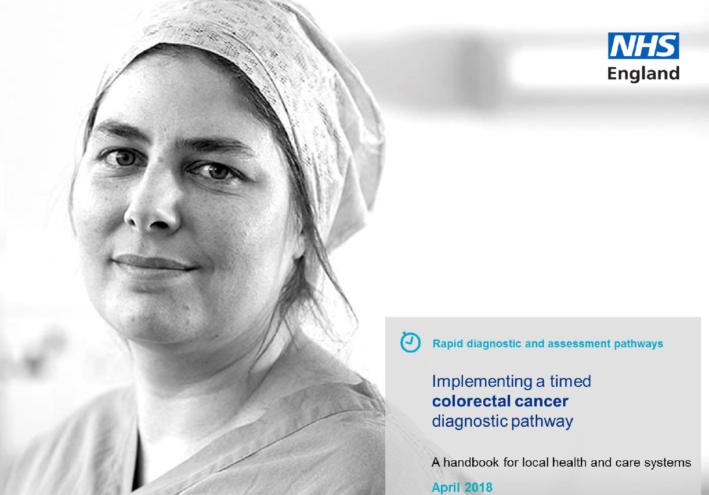

Slide 23
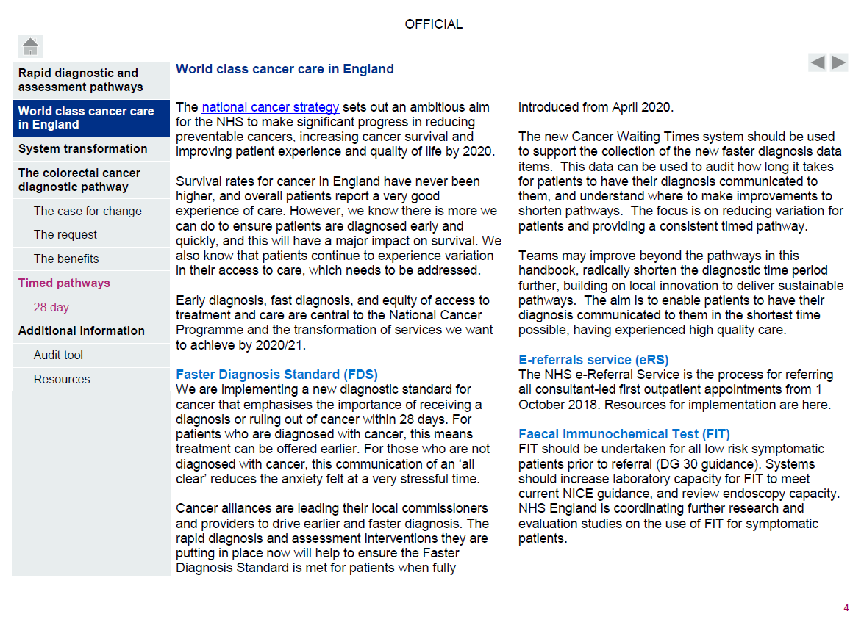

Slide 25
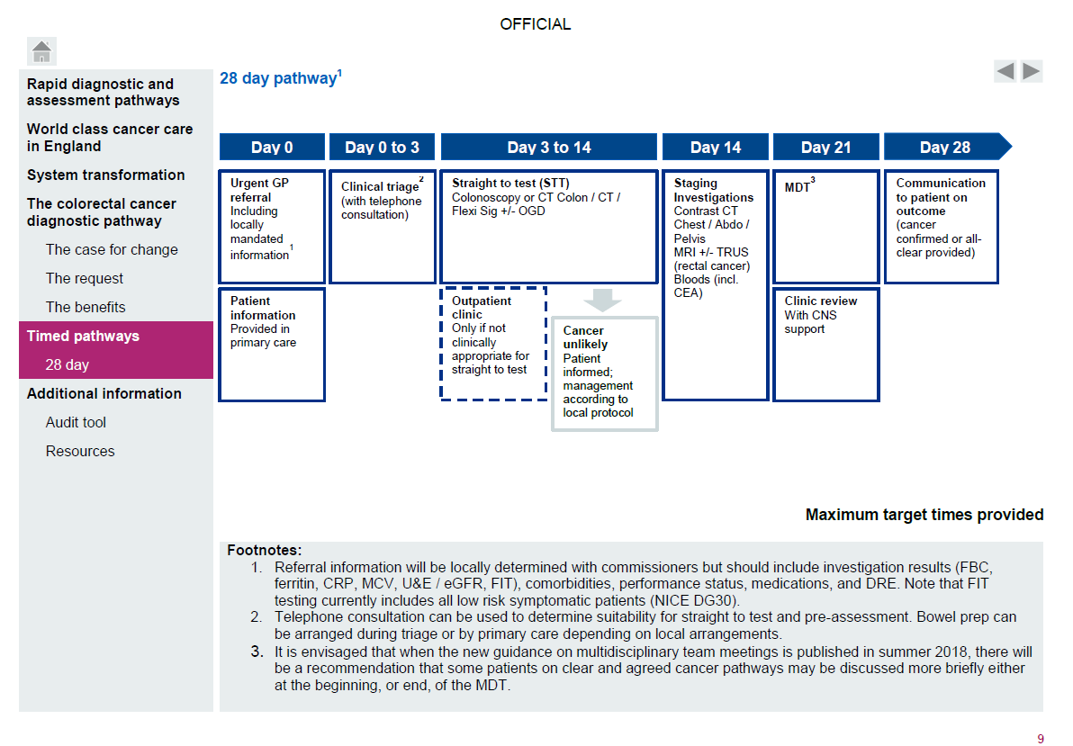

Slide 26
Taunton Experience during COVID

Slide 27
Lockdown 23 March 2020
Some restrictions lifted 1 June 2020
Normally 40-50 referrals per week
Dropped to about 17-20 per week
Unable to investigate ALL but most urgent (usually inpatients)- only plain CT, no scopes

Slide 29
COVID 2WW Referrals
Database 16/03/20 – 01/06/20
282 referrals
  11 cancers (4%)(8 had FIT , All >50; range 55->400)
  223 investigated and discharged
  10 other cancers (prostate, pancreas, CLL, ovary)
  7 colitis
  31 declined investigation/ deferred until AFTER

Slide 30
COVID 2WW Referrals

Slide 31
Endoscopy & Radiology Waiting List
Around 600 FIT tests sent out
Stratified patients for investigation in order of priority
>400
100-400
>100
>10
<10

Slide 32
Pathway Issues
Reduced capacity for investigation
97% do NOT have CRC
Endoscopy working at 75% capacity (from ZERO in April)
Radiology working at about 60% (from 10% in April)
Reduced Outpatient capacity (F2F)
Significant backlog

Slide 33
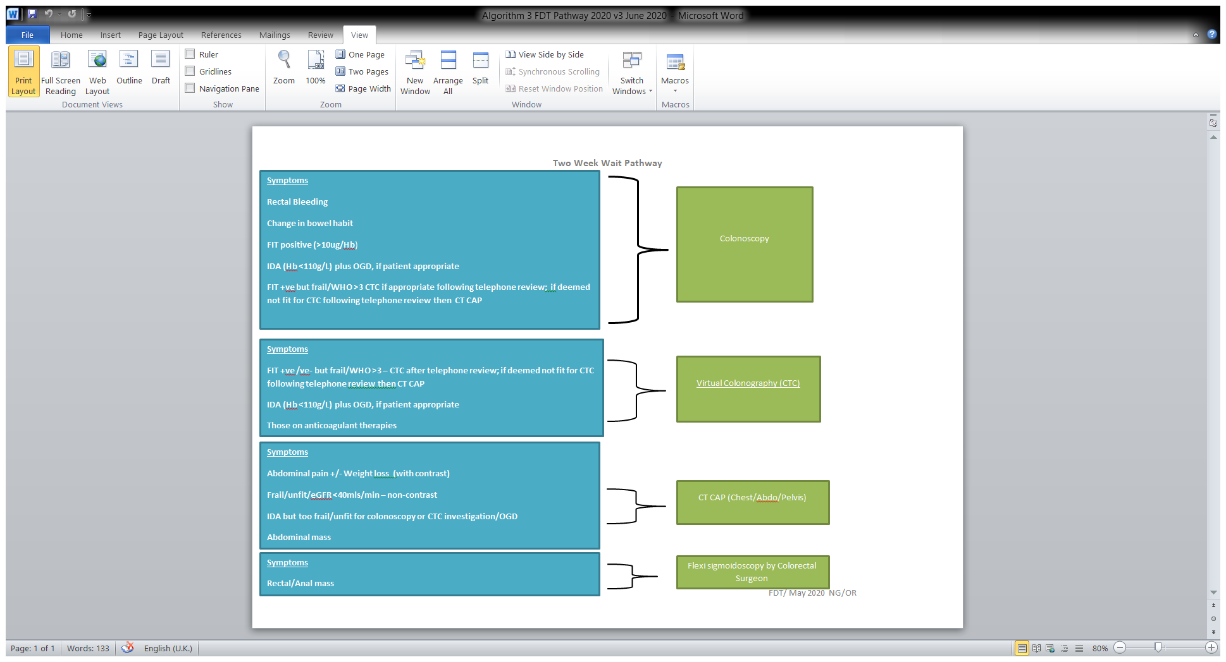

Slide 34
Questions?

