Slide 1
Clinical Research Network
West of England
SWAG SSG Skin Cancer
Meeting
Wednesday 23rd May
Research Report

Slide 2
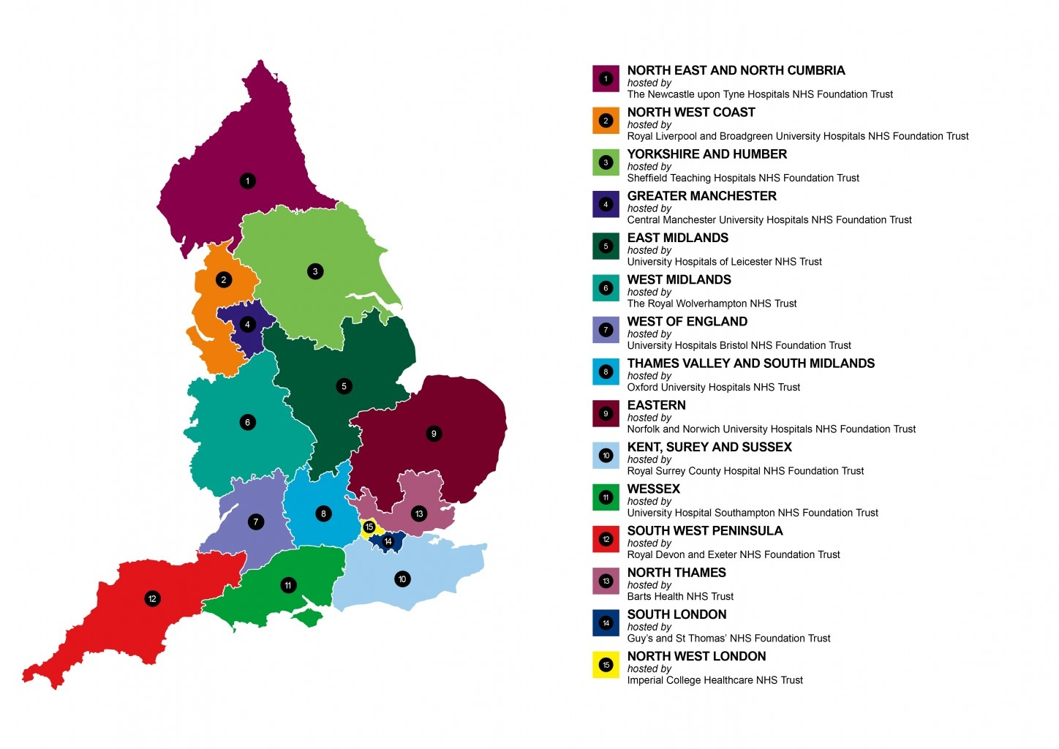
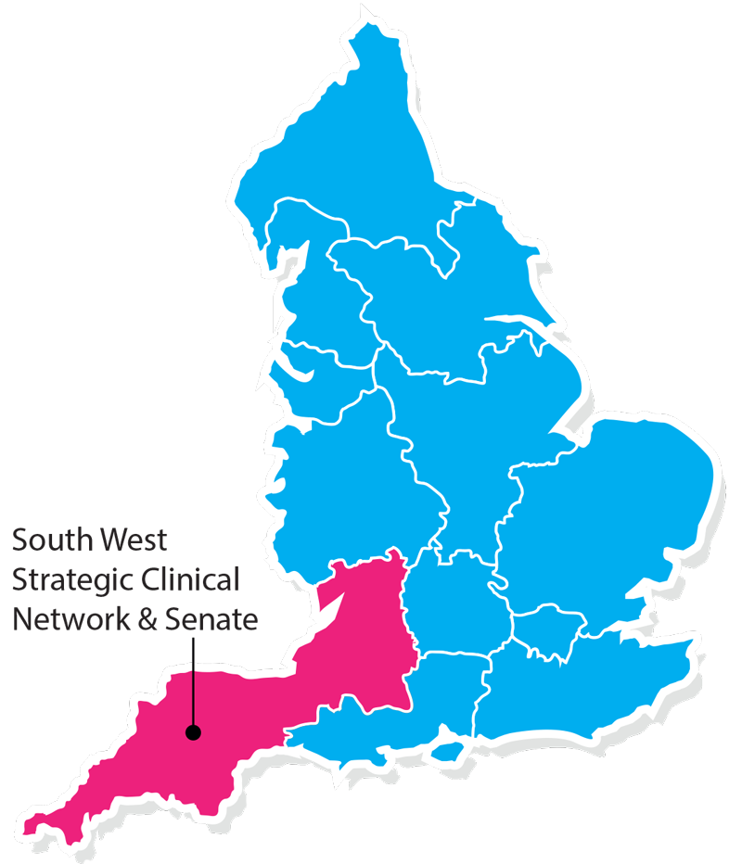
Clinical Research Network & Cancer Services
West ofEngland
SWAG - Somerset Wiltshire Avon & Gloucestershire
South West Children’s Cancer & Leukaemia
Research Network

Slide 3
NIHR CRN High Level Objectives 2017-18
Increase number of participants into NIHR CRN portfolio studies
  650,000 in England
  21,905 in West of England
Increase the number of studies that deliver to time and target
  Target 80%
Increase number of commercial studies delivered through network
Reduce NHS study set up times
Reduce time taken to recruit first participant

Slide 4
Cancer specialty objective for 2017-18
Number of LCRNs achieving on-target recruitment into at least 8 of the 13 Cancer subspecialties, where "on-target" means either improving recruitment by 10% from 2016/17 or meeting the following recruitment targets per 100,000 population served:
a) Brain & CNS: 0.2; b) Breast: 8; c) Colorectal: 3; d) Paediatrics: 3; e) Gynae: 3; f) Head & Neck: 1; g) Haematology: 7; h) Lung: 4; i) Sarcoma: 0.1; j) Skin: 0.2; k) Supportive & Palliative Care and Psychosocial Oncology & Survivorship: 3; l) Upper GI: 3; m) Urology: 8.

Slide 5
Performance regarding 2017/18 Cancer specialty target

Slide 10
Open studies – Skin
CPMS ID | Short title | Partner organisation | Edge recruitment end date | CPMS recruitment end date | Recruited (total) | Target | Link to study details
20444 | Rational MCC | North Bristol NHS Trust | 30/05/2021 | 30/03/2021 | 1 | 3 | http://public-odp.nihr.ac.uk/20444

Slide 11
Studies in set-up in West of England – Skin
CPMS ID | Short title | Partner organisation | Link to study details
20444 | Rational MCC | University Hospitals Bristol NHS Foundation Trust | http://public-odp.nihr.ac.uk/20444
20841 | EAGLE FM | North Bristol NHS Trust | http://public-odp.nihr.ac.uk/20841
35180 | DANTE (Duration of Anti-PD1 therapy for melanoma) | University Hospitals Bristol NHS Foundation Trust | http://public-odp.nihr.ac.uk/35180

Slide 12
Skin cancer studies open to new sites
CPMS ID | Short title | LCRN | Status | Recruitment end date | Link to study details
19639 | The PERM Study | South London | Open, With Recruitment | 01/09/2019 | http://public-odp.nihr.ac.uk/19639
20444 | Rational MCC | West Midlands | Open, With Recruitment | 30/03/2021 | http://public-odp.nihr.ac.uk/20444
20841 | EAGLE FM | Eastern | Open, With Recruitment | 01/01/2026 | http://public-odp.nihr.ac.uk/20841
35180 | DANTE (Duration of Anti-PD1 therapy for melanoma) | Yorkshire and Humber | In Setup, HRA Approval Received | 28/02/2023 | http://public-odp.nihr.ac.uk/35180

Slide 13
Cancer specialty objective for 2018-19
The following Objectives are extracted from the Draft Performance and Operating Framework 2018/19 (v0.9), which is yet to be approved by the Department of Health, and therefore, may be subject to change:
Increase patient access to Cancer research studies across the breadth of the Cancer subspecialties Number of LCRNs achieving on-target recruitment into at least 8 of the 13 Cancer subspecialties, where "on-target" means either improving recruitment by 10% from 2017/18 or meeting the following recruitment targets per 100,000 population served:
a) Brain: 0.2; b) Breast: 10 c); Colorectal: 3 d); Children and Young People: 3; e) Gynae: 3; f) Head & Neck: 1.5; g) Haematology: 7; h) Lung: 4; i) Sarcoma: 0.1; j) Skin: 0.5; k) Supportive & Palliative Care and Psychosocial Oncology: 4; l) Upper GI: 3; m) Urology: 12.

Slide 14
Useful links
https://www.crn.nihr.ac.uk/
  National and local network information including training programmes templates, tools, contacts, videos etc
https://odp.nihr.ac.uk/
  Open data platform. Look at performance across whole CRN including all specialty areas
http://csg.ncri.org.uk/portfolio/portfolio-maps/
  View current national portfolio of open, closed and ‘in set up’ cancer studies
https://www.ukctg.nihr.ac.uk/
  See where a study is open across the country
http://public-odp.nihr.ac.uk/
  Search for a study to fit criteria. Good for horizon scanning, eligibility criteria

Slide 15
Contacts
Research Delivery Manager – David.Rea@nihr.ac.uk
Research portfolio facilitator – jessica.bartlett@nihr.ac.uk
Skin cancer research lead – christopher.herbert@uhbristol.nhs.uk

