Slide 1
100,000 Genomes Project & Mainstreaming Genomic Medicine
Update Session
Provided by Catherine Carpenter-Clawson Programme Manager, WE GMC with Tracie Miles Genomics Champion RUH, Bath.

Slide 3
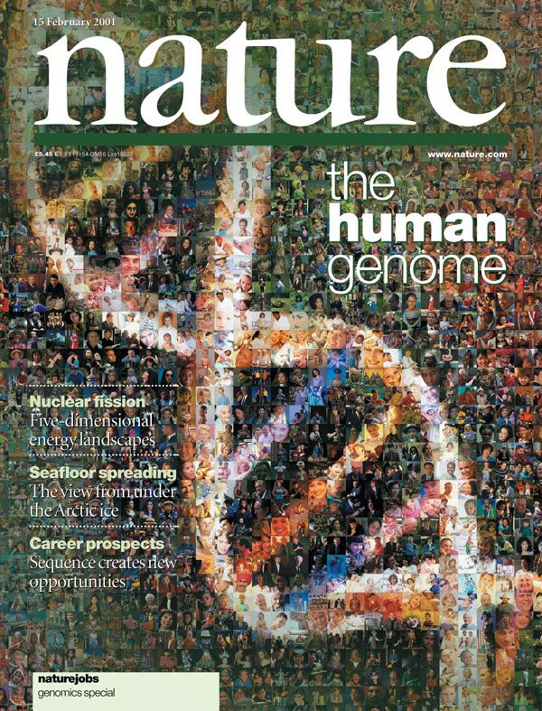
The Human Genome Project
Commenced in 1990 - completed in April 2001/2003
First genome costs $2.7 billion in total
First time the human genetic blueprint had been completely read
Enabled the discovery of genes which cause disease
Allowed genetic diagnostics to progress
Paved the way for large-scale diagnostic sequencing programmes
Courtesy of HEE E&T Group
Notes:
Reference genome created…..version 38 now causing issues!

Slide 4
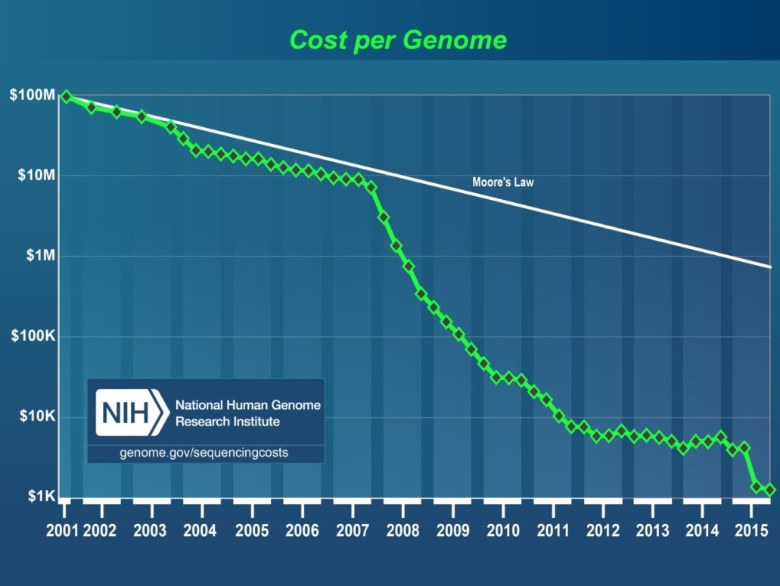
100,000 Genomes Project: How did we get here?
Human Genome Project generates reference sequence at an estimated cost of $2.7 billion
Development of new technologies drives down the cost of Whole Genome Sequencing – the $1000 genome is now a reality
Graph from NHGRI
Now potential to bring real benefits to patients, drive research and drug development, and develop personalised medicine for the NHS, in the NHS, by the NHS
Courtesy of HEE E&T Group
Notes:
The $1000 genome was talked about as the holy grail of genomics – the point at which it became possible to offer WGS at a parallel cost to standard diagnostics.
These two things made it possible, but the biggest drive for the 100K programme was the potential to bring benefits to current and future patients in the form of personalised medicine – a one size does not fit all model. Recognising that we are not identical, that tumours are not identical, some drugs work better in some than others (especially so in cancer) and that targeting therapies to individuals is a possibility – that no one alive is youer that you.

Slide 5
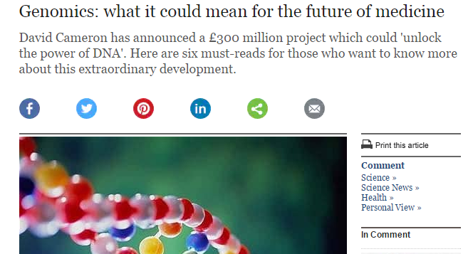
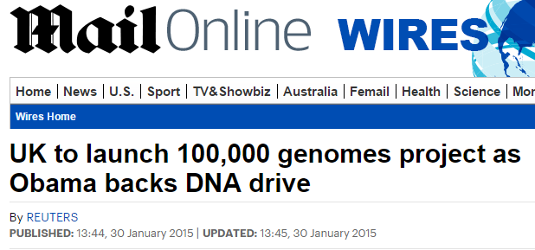
100,000 Genomes Project: Setting up
December 2012: David Cameron announces plans for the 100,000 Genomes Project as part of the Olympic legacy
July 2013: Jeremy Hunt launches Genomics England, a company established to deliver the 100,000 Genomes Project
December 2014: 11 NHS Genomic Medicine Centres are announced
December 2015: WE GMC announced as one of 2 final NHS Genomic Medicine Centres
Courtesy of HEE E&T Group

Slide 6
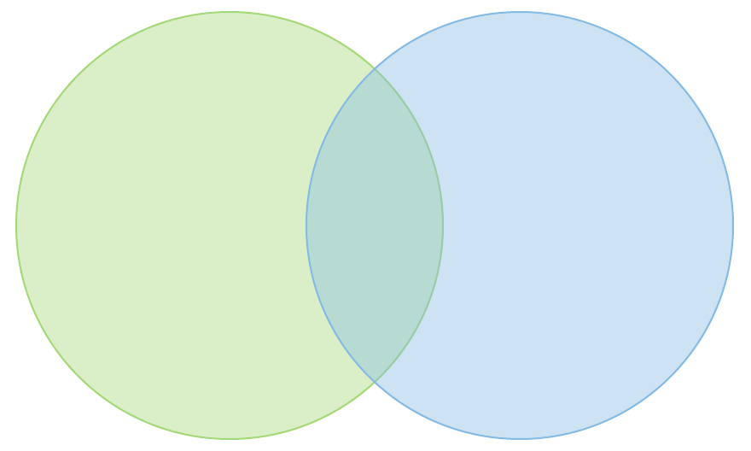
100,000 Genome Project: Objectives
NHS
Transformation
Research
Clinical
100,000 Whole Genome Sequences with linked data set by end 2018
Increased discovery of pathogenic variants leading to new treatments, devices and diagnostics
Accelerate uptake with advanced genomic medicine practice integrated into the NHS
*Mainstreaming*
Increase public understanding and support for genomic medicine
Stimulate and advance UK life sciences industry and commercial activity in genomics
Courtesy of HEE E&T Group
Notes:
Programme legacy will see:
Improving outcomes for patients and reducing variation in clinical care
High quality sample preparation and use of high throughput and novel genomic technologies
Reduction in variation of quality in laboratory processes and access to genomic testing
Richer phenotypic data linked to genetic abnormalities and markers
A robust informatics infrastructure and interoperability
Stronger link between clinical practice and applied genomics
New genomic multidisciplinary teams – bringing together many more clinical scientists and clinicians Improved clinical leadership and delivery of the clinical change model

Slide 7
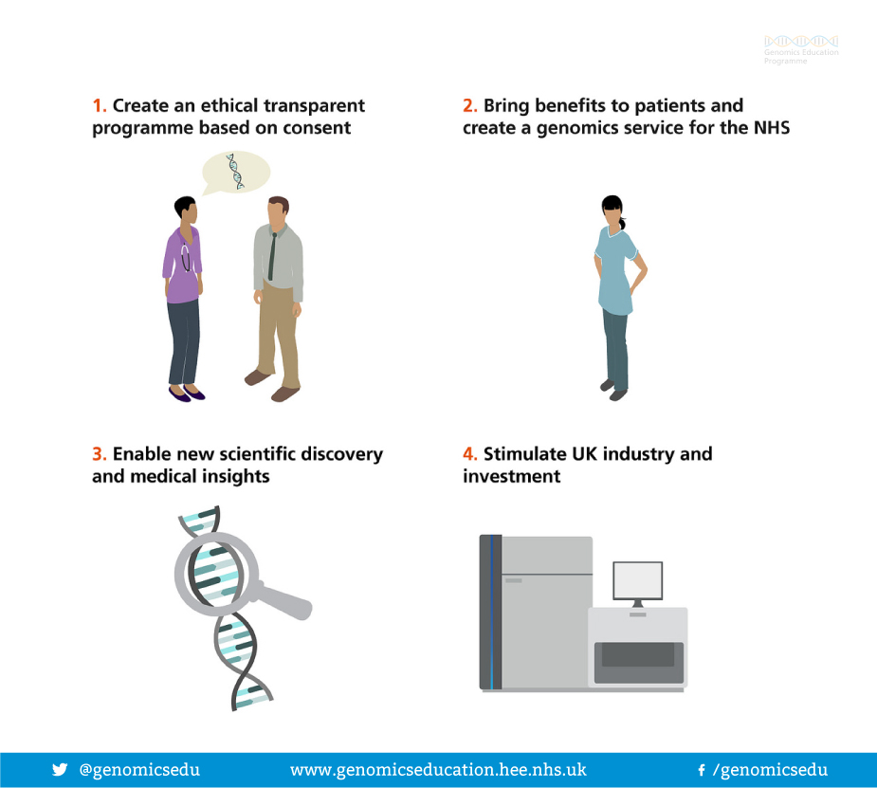
100,000 Genomes Project: Aims
Courtesy of Genomics Education Programme

Slide 8
NHS Genomic Medicine Centres
NHS Genomic Medicine Centres (NHS GMCs) : mapped against AHSN boundaries
NHS GMCs work in partnership with academia, patients and industry through the AHSNs
Notes:
Emphasis national coverage – not all providers contributing but aim was national coverage

Slide 9
What is a Genomic Medicine Centre (GMC)?
A group of NHS providers (and other key local organisations) who have come together to support delivery of the 100,000 Genomes Project
We are ordinary NHS staff seconded to work on the project and set it up alongside existing clinical practice
We are not building a big new centre or working outside of existing NHS structures

Slide 10
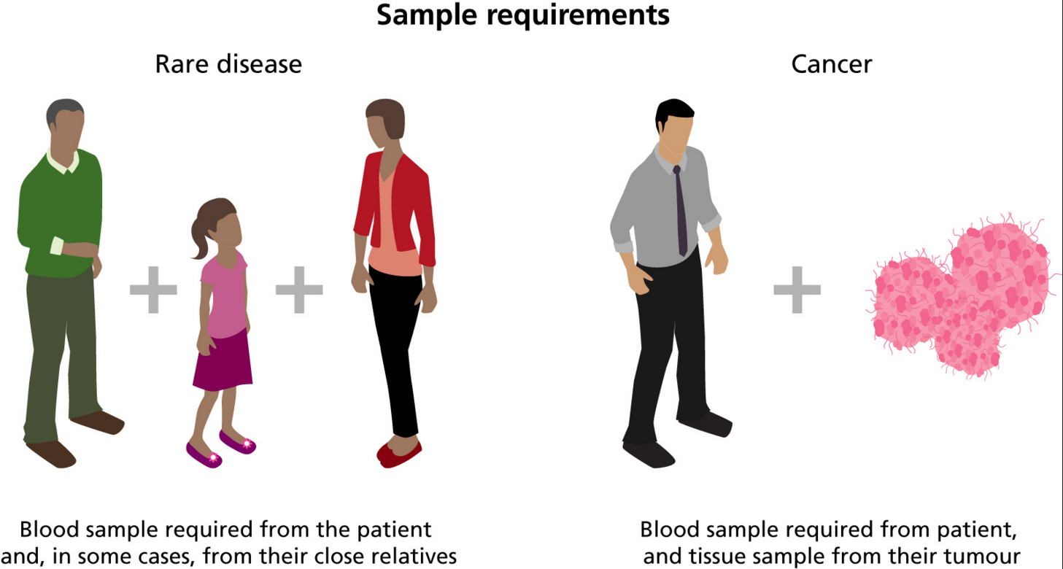
What samples are taken?

Slide 11
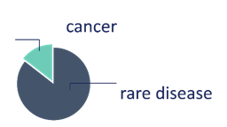
100,000 Genomes Project: National Update – March 2018
Samples
Genomes
Analysis and Reports
79,742
52,881
Reports for
8,918
families sent to GMCs
Samples collected from NHS GMCs
genomes
Equivalent to
17,083
18,346
genomes
8,705
62,659
20-25% actionable findings
48,870
Over 1000 cancers
Fast Turnaround Time
Research
Clinical data on 53,150 People
33,025 Genomes
Scaling up
759
12.9
+12,151 genomes
since meeting
847
As of 09/03/2018
Courtesy of Genomics England & NHS England

Slide 12
Phase 1. Contracting & pathway mapping
Phase 2. Informatics & piloting
Phase 3. Engagement & Expansion
Phase 4. Transition & mainstreaming
First
RD consent GHNFT
28th Mar
First
RD consent
RUH 22nd June
First RD consent UHB
10th Jun
1,000 individuals enrolled 19th July
All providers operational – 4 RD & 16 cancer pathways live
First cancer consent GHNFT
11th Jan
“Go-live” of cancer & RD pathways
27th May
First cancer consent NBT
27th Jun
First
cancer consent
RUH
19th May
First cancer consent UHB
8th Nov
Designation as GMC
23rd Dec
2,000 individuals enrolled March 18
Jan 16
Jan 17
Jan 18
Launch event
26th Sep
Conference
1st Sep

Slide 13
100,000 Genomes Project: WE GMC Summary
Samples
Genomes
Analysis and Reports
2,983
Reports received for patients
2,090
Samples collected across WE GMC
~135
Samples sent to national biorepository
First reports being issued to families across the region
Samples collected from all provider organisations in both rare disease and cancer
17 cancer pathways actively consenting patients
445
1,645
Identifying actionable findings
Scaling up
Human Phenotypic Ontology Data completed in of cases
Developing processes to speed up consent to sample dispatch
~71%
175 samples
sent last 4 weeks
Cancer diagnosis data being submitted
S
Notes:
11,000 cancer samples processed and further 5,000 collected

Slide 14
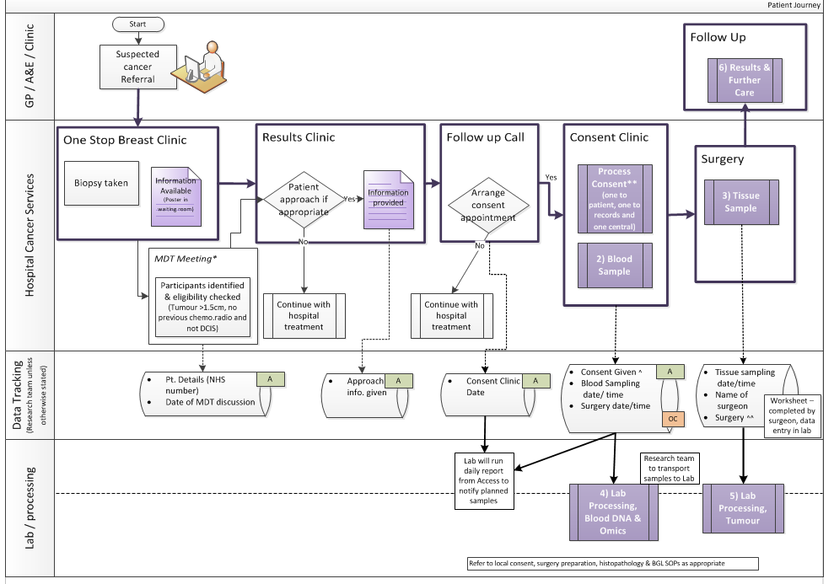
How do you develop a pathway?
Patient
Pathology
GPs
Imaging
Consultants
Surgeons
Nursing staff
Specialists
Breast Care Nurses
Research team
Theatre team
Clinic management
MDT co-ordinators
Specimen transport team
IT experts
How do you develop a pathway? – the key is engagement at every step of the pathway…..
Blood laboratory
Tumour laboratory
Managers
Reception
Processing
Notes:
Emphasis on how everyone needs to be on-board in order to get just one pathway going

Slide 15
How do you develop a pathway?
Patient
Pathology
GPs
Imaging
Consultants
Surgeons
Nursing staff
Specialists
Breast Care Nurses
Research team
Theatre team
Clinic management
MDT co-ordinators
Specimen transport team
IT experts
How do you develop a pathway? – the key is engagement at every step of the pathway…..
Blood laboratory
Tumour laboratory
Managers
Reception
Processing
Notes:
Now turning our attention to return of results

Slide 16
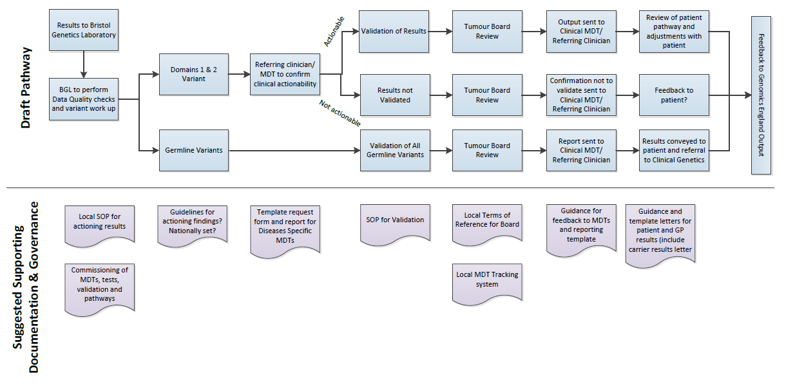
Developing the return of results pathway
WE GMC Cancer Clinical Oversight Group is starting to work through practical steps:
- Welcome comments/feedback/advice from anyone interested.
Draft for internal
discussion only
First meeting 16th February 2018 to discuss first result
Future meetings 3rd Friday of every month
Notes:
Emphasis we tried to map this at the start but this is a pilot/development project and until we get a real result it is very hypothetical.
Results come back centrally to the Bristol Genetics laboratory
Focus on defined gene panel actionable in cancer
Potential variants are highlighted
Patient clinical situation will be reviewed
Anyone who wants to be involved can be.

Slide 17
Providing actionable information for cancer patients
Courtesy of Genomics England
Early analysis found 65% of Project cancer cases have variants in actionable genes
Prognosis
Diagnosis
Clinical Trials opening up eligibility
Cancer Molecular Markers
WGS provides extra diagnostic reach (structural variants, copy no. variants etc)
Global patterns of mutation (‘signatures’) proving informative
Defining causal drivers from benign ‘passengers’ is critical
Therapy selection
Cancer susceptibility
Notes:
This is from an Genomics England presentation and will be of interest to see how our local experience compares to this:
Early analysis shows 65% of reports identify actionable genes
Tumour disposition genes also found in germline analysis
Findings have opened up eligibility for patients to enter further clinical trials

Slide 18
Genomics in Mainstream Healthcare
Diagnoses
Genomics
Personalised Medicine
Prognoses
Treatments
The NHS workforce needs to understand, discuss and convey this complex area to colleagues and patients
How do we support clinical teams to deliver genomic medicine in the future, training, support, piloting and education
Notes:
The introduction of genomics into mainstream healthcare is set to provide new diagnoses, prognoses and treatments, forming the foundations of personalised medicine.
The genomic revolution is critical to the personalisation of healthcare, to the prediction of disease, and the prevention of disease.

Slide 19
Mainstreaming genomic medicine - Beyond 1st October 2018
Genomic Medicine Service
Genetics Laboratory Hubs:
7 nationally commissioned laboratory hubs by October 2018
National Directory for all genetic & genomic testing
Genomic Laboratory Hubs
Clinical Genetics Services
Genomic Medicine Centres
Cancer Services
Genomic Medicine Centres:
Support transition from project to clinical practice
Clinical Genetics Services:
- Review of services to ensure support and equity
Notes:
What we know is from 1st October there will be:
Genomic Laboratory Hubs
A national directory of tests dictating which tests will be funded nationally
GMCs will exist with a transformation, governance and potential project based remit
To support this there is a review of clinical genetics services as potential impact on their work will be critical

Slide 20
How to Get Involved
Opportunities for supporting activity in the project
Get involved in recruitment– discuss possible patients with your clinical team or the GMC team
Opportunities to further your own education
Become a contact for your department / team for us to disseminate genomics information through
Tell us what you need/tell us how we can make this work together
Notes:
MENTION GeCIPS

Slide 21
Thanks and any questions
Catherine Carpenter-Clawson
Programme Manager, WE GMC
07732 561067
Catherine.Carpenter-Clawson@nbt.nhs.uk
or
Ubh-tr.wegmc@nhs.net
Or
Tracie.Miles@nhs.net

