Slide 1
Making MDTs better Steve Falk

Slide 2
A good MDT
Improving the effectiveness of multidisciplinary team meetings in cancer services CRUK review 2017
MDT working is considered the gold standard for cancer patient management bringing continuity of care and reducing variation in access to treatment – and ultimately improving outcomes for patients. However, the health service has changed significantly since their introduction in 1995.
The number of patients to be discussed in MDT meetings has grown significantly, as has the complexity of patients; due to an ageing population and the growing number of treatment options available.
However, the way that MDT meetings are organised has not adapted to cope with this increased demand. To reflect the changing nature of cancer care and the increased demand for services, there is a need to refresh the format of MDT meetings to make them work more effectively

Slide 3
2015 strategy recommendations
NHS England should encourage providers to streamline MDT processes such that specialist time is focused on those cancer cases that don’t follow well established clinical pathways, with other patients being discussed more briefly.
NHS England should require MDTs to review a monthly audit report of patients who have died within 30 days of active treatment, to determine whether lessons can be learned about patient safety or avoiding superfluous treatment.
The Trust Development Authority, Monitor and NHS England should strongly encourage the establishment of national or regional MDTs for rarer cancers where treatment options are low volume and/or high risk. Clinical Reference Groups will need to play a key role in supporting these.”

Slide 4
Peer review common problems
“There is a general trend of increasing workload for MDTs without increasing capacity resulting in not all cases being discussed and potentially compromising patient pathways of care”. Some MDTs scored very high levels of compliance, with 40 per cent achieving compliance with over 90 per cent of measures. However, 35 per cent of MDTs assessed were classed either as a ‘serious concern’ or ‘immediate risk’ to patients or staff.

Slide 5
Peer review common problems
Key issues :
- A lack of functional Cancer of Unknown Primary teams and robust pathways
- Lack of Clinical Nurse Specialist (CNS) resource and cover
- MDTs who do not meet minimum numbers requirements for surgical treatments (as defined in Improving Outcomes Guidance)
- A number of core team members not fulfilling the minimum 66 per cent attendance.

Slide 6
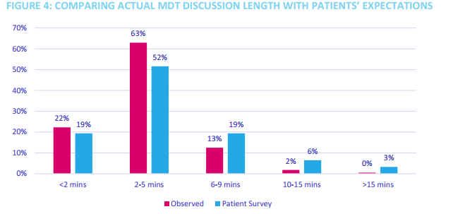
Time pressures

Slide 7
Time pressures

Slide 8
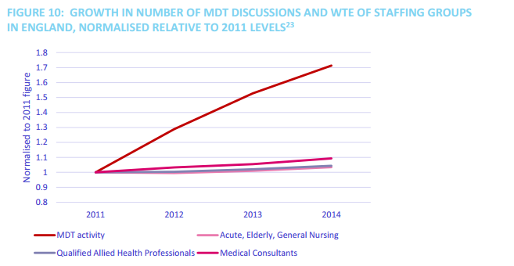
Time pressures

Slide 9
Quality
The quality of decision making has been shown to drop dramatically after discussion of 20 patient/after 1 hour
Introduction of a 10 minute break in the MDT has been shown to bring balance to the quality of decision making and reduce the overall time of the meeting.
Streamlining MDTs should work around the needs of radiology and pathology colleagues
The key to streamlining is teamwork
Teamwork in MDTs can be measured, assessed and improved, and there 3 validated tools that can be used for this purpose
Training is required to use the tools to assess MDT performance.

Slide 10
Recommendations
The UKs health services should work with NICE and SIGN to identify where a protocolised treatment pathway could be applied and develop a set of treatment recommendations for each of these, to be implemented across the UK. Every Cancer Alliance or devolved cancer network should develop their own approach based on these central recommendations. These treatment protocols should be reviewed regularly.
Recommendation 2: MDTs for tumour types for which a protocolised approach has been developed should agree and document their approach to administering protocols. This could include a ‘pre-MDT triage meeting’. The implementation and outcomes of these protocols should be audited and reviewed by the full MDT in an operational meeting.

Slide 11
Recommendations
Recommendation 3: National requirements for individual minimum attendance should be reviewed and amended where necessary, with an emphasis on ensuring all required specialties are present at a meeting.

Slide 12
Recommendations
Recommendation 4: The UK’s health services should lead the development of national proforma templates, to be refined by MDTs. MDTs should require incoming cases and referrals to have a completed proforma with all information ready before discussion at a meeting. • Patient demographics
• Diagnostic information
• Patient fitness and co-morbidities; history of previous malignancies
• Results from a Holistic Needs Assessment, if available
• The patient’s preferences (if known)
• The rationale for requiring MDT discussion
• Whether there were known treatment protocols for the specific tumour type
• Whether the patient is suitable for any current clinical trials

Slide 13
Recommendations
Recommendation 5: MDTs should use a database or proforma to enable documentation of recommendations in real time. Ideally this should be projected so that it is visible to team 11 members; if this is not possible there should be a named clinical individual responsible for ensuring the information is accurate. Hospital Trusts and boards should ensure that MDTs are given sufficient resource to do this.
Recommendation 6: each MDT should ensure that they have a mortality and morbidity process to ensure all adverse outcomes can be discussed by the whole MDT and learned from, rather than discussed in silos. The primary time for this to take place should be a quarterly or biannual operational meeting. Time for quarterly operational meetings should be included in attendees’ job plans. There should be oversight from national MDT assessment programmes.

