Slide 1
Complex Cancer Late Effects Rehabilitation Service.
Lucy Cooper Chronic Pain Nurse CCLERS

Slide 2
What is BRIRS?
Breast Radiation Injury Rehabilitation Service.
LC 01/18

Slide 3
BRIRS - Developing a service
1995 The Maher Committee guidelines:
Specialist MDT assessment, pain management, aids for daily living and psychological support.
2006 RAGE “Yesterdays Women” Report.
2009 Getting It Right: Piloting specialist care for people with radiation-related problems
2012 BRIRS established (RNHRD, Barts, Christie)
2017 BRIRS at the RNHRD funded by NHS England
LC 01/18

Slide 4
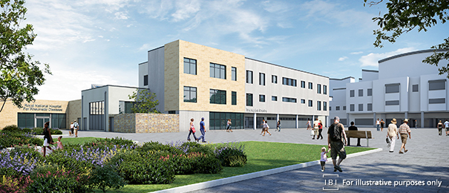
‘A national service funded by
NHS England for people
living with brachial plexus
injury following breast
cancer radiotherapy treatment’
LC 01/18

Slide 5
Clinical Presentation
What is the Brachial Plexus?
Network of nerves originate in the neck region branch off to form most of the other nerves that control movement and sensation in the upper limbs, including the shoulder, arm, forearm, and hand. The radial, median, and ulnar nerves originate in the brachial plexus.
LC 01/18

Slide 6
What is CCLERS ?
Complex Cancer Late effects Rehabilitation Service.
LC 01/18

Slide 7
Referral Criteria
CCLERS
12 month post cancer treatment
Chronic pain
Reduced limb function
Psychological distress
Considered to be complex by local / regional pain services.
BRIRS
12 month post cancer treatment
Brachial Plexus Injury following radiotherapy treatment for breast cancer
Chronic pain
Reduced upper limb function
Psychological distress
LC 01/18

Slide 8
LC 01/2018

Slide 9
Residential Programme
2 week Residential programme
Specialist, tailored rehabilitation
Positively impacts on: self-efficacy, functional performance and quality of life
The residential rehabilitation programme includes:
Occupational Therapy
Physiotherapy
Hydrotherapy
Psychology access
Pain Consultant access
LC 01/2018

Slide 10
Any Questions
Effective rehabilitation is vital in minimising consequences of treatment and improving quality of life for someone with cancer.
Achieving world-class cancer outcomes: A strategy for England 2015-2020
LC 01/18

Slide 11
All Referrals should be sent to:
Professor Candy McCabe
Royal National Hospital for Rheumatic Diseases
Upper Borough Walls
Bath
BA1 1 RL
Email: k.cuss@nhs.net
BRIRS Administrator- 01225 473481
LC 01/18

