Slide 1
Clinical Research Network
West of England
SWAG SSG Colorectal Cancer
Meeting
Friday 27th June
Research Report

Slide 2
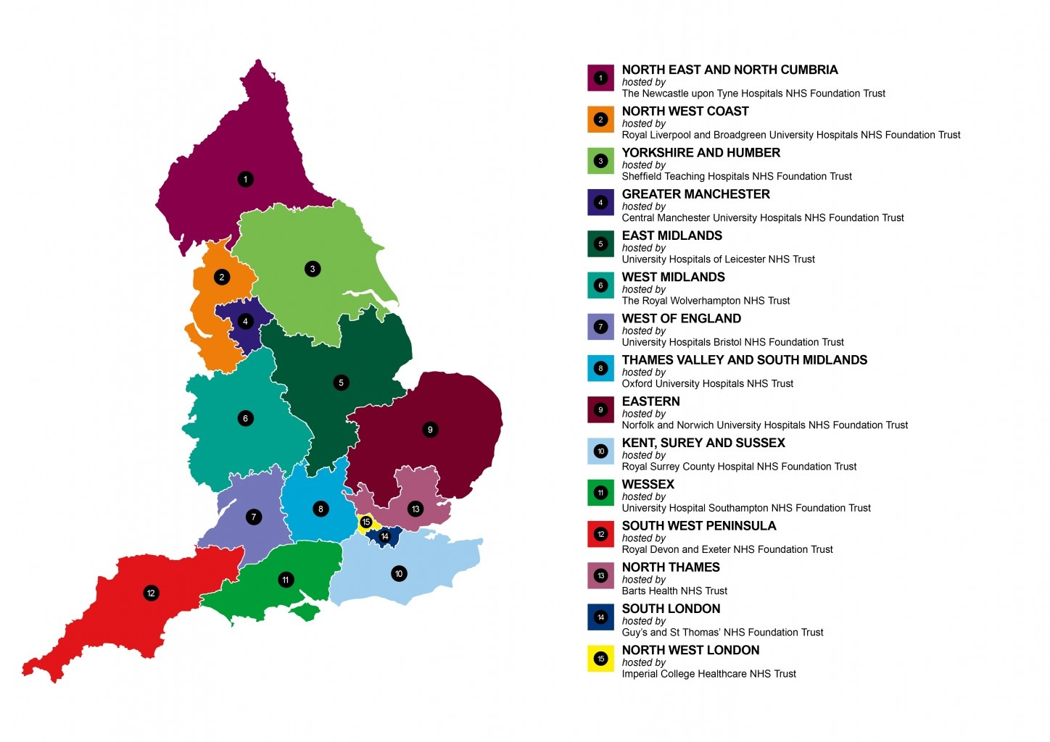
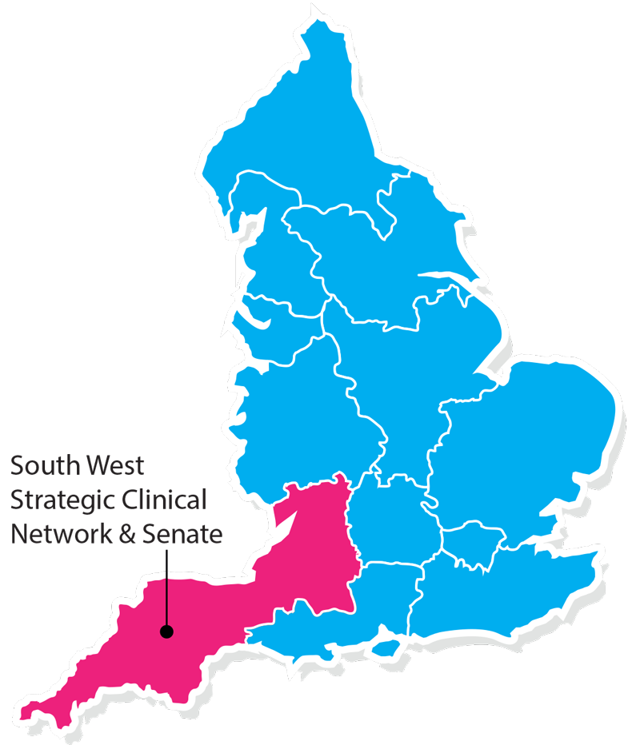
Clinical Research Network & Cancer Services
West ofEngland
SWAG - Somerset Wiltshire Avon & Gloucestershire
South West Children’s Cancer & Leukaemia
Research Network

Slide 3
NIHR CRN High Level Objectives 2018-19
Increase number of participants into NIHR CRN portfolio studies
  650,000 in England
  21,905 in West of England
Increase the number of studies that deliver to time and target
  Target 80%
Increase number of commercial studies delivered through network
Reduce NHS study set up times
Reduce time taken to recruit first participant

Slide 4
Cancer specialty objective for 2018-19
Increase patient access to Cancer research studies across the breadth of the Cancer subspecialties Number of LCRNs achieving on-target recruitment into at least 8 of the 13 Cancer subspecialties, where "on-target" means either improving recruitment by 10% from 2017/18 or meeting the following recruitment targets per 100,000 population served:
a) Brain: 0.2; b) Breast: 10 c); Colorectal: 3 d); Children and Young People: 3; e) Gynae: 3; f) Head & Neck: 1.5; g) Haematology: 7; h) Lung: 4; i) Sarcoma: 0.1; j) Skin: 0.5; k) Supportive & Palliative Care and Psychosocial Oncology: 4; l) Upper GI: 3; m) Urology: 12.

Slide 5
Performance regarding 2018/19 Cancer specialty target

Slide 11
Open studies – Colorectal
CPMS ID | Title | Trust | Recruited (total) | Target | Edge recruitment end date | CPMS recruitment end date | Principle investigator | Link to study details
31184 | PLATO - PersonaLising Anal cancer radioTherapy dOse | University Hospitals Bristol NHS Foundation Trust | 10 | 35 | 31/08/2021 | 31/05/2021 | Falk, Dr Stephen J | http://public-odp.nihr.ac.uk/31184
20576 | TRIGGER | University Hospitals Bristol NHS Foundation Trust | 2 | 8 | 31/10/2021 | 30/06/2018 | Falk, Dr Stephen J | http://public-odp.nihr.ac.uk/20576
16402 | NCRN - 3131: EPOCH TheraSphere in Metastatic Colorectal Carcinoma of the Liver (TS102) | Great Western Hospitals NHS Foundation Trust | 3 | 2 | 31/08/2018 | 01/10/2018 | Lowndes, Dr Sarah | -
 |  | Royal United Hospitals Bath NHS Foundation Trust | 1 | 2 | 01/10/2018 | 01/10/2018 | Cox, Dr Ashley
 |  | University Hospitals Bristol NHS Foundation Trust | 1 | 3 | 31/08/2018 | 01/10/2018 | Falk, Dr Stephen J
 |  | Weston Area Health NHS Trust | 0 | 2 | 01/10/2018 | 01/10/2018 | Di Nardo, Dr Poala
14893 | FOCUS 4 | Gloucestershire Hospitals NHS Foundation Trust | 15 | 8 | 20/12/2020 | 01/01/2019 | Benstead, Dr Kim | http://public-odp.nihr.ac.uk/14893
 |  | Royal United Hospitals Bath NHS Foundation Trust | 34 | 8 | 01/04/2020 | 01/01/2019 | De Winton, Dr Emma

Slide 12
Open studies – Colorectal
CPMS ID | Title | Trust | Recruited (total) | Target | Edge recruitment end date | CPMS recruitment end date | Principle investigator | Link to study details
14893 | FOCUS 4 | University Hospitals Bristol NHS Foundation Trust | 46 | 60 | 01/04/2018 | 01/01/2019 | Falk, Dr Stephen J | http://public-odp.nihr.ac.uk/14893
 |  | Weston Area Health NHS Trust | 9 | 10 | 30/10/2020 | 01/01/2019 | Hilman, Dr Serena
14777 | HART | Royal United Hospitals Bath NHS Foundation Trust | 33 | 50 | 30/03/2018 | 31/12/2017 | Williamson, Mr Mike | http://public-odp.nihr.ac.uk/14777
 |  | Weston Area Health NHS Trust | 4 | 10 | 31/03/2018 | 31/12/2017 | West, Mr Reuben
7890 | Aristotle | Great Western Hospitals NHS Foundation Trust | 3 | 3 | 29/06/2018 | 29/06/2018 | Lowndes, Dr Sarah | http://public-odp.nihr.ac.uk/7890
 |  | University Hospitals Bristol NHS Foundation Trust | 46 | 75 | 29/06/2018 | 29/06/2018 | Falk, Dr Stephen J
1269 | NSCCG | Gloucestershire Hospitals NHS Foundation Trust | 154 | 160 | 30/09/2018 | 30/09/2018 | Benstead, Dr Kim | http://public-odp.nihr.ac.uk/1269
 |  | Great Western Hospitals NHS Foundation Trust | 273 | 15 | 30/09/2018 | 30/09/2018 | Blesing, Dr Claire
 |  | North Bristol NHS Trust | 214 | 37 | 30/09/2018 | 30/09/2018 | Lyons, Ms Ann
 |  | Royal United Hospitals Bath NHS Foundation Trust | 227 | 100 | 30/09/2018 | 30/09/2018 | Milsom, Mrs Carey
 |  | University Hospitals Bristol NHS Foundation Trust | 398 | 258 | 30/09/2018 | 30/09/2018 | Falk, Dr Stephen J
 |  | Weston Area Health NHS Trust | 215 | 5 | 30/09/2018 | 30/09/2018 | Muldoon, Annie

Slide 13
Studies in set-up – Colorectal
CPMS ID | Short title | Partner organisation | Link to study details
31184 | PLATO - PersonaLising Anal cancer radioTherapy dOse | Gloucestershire Hospitals NHS Foundation Trust | http://public-odp.nihr.ac.uk/31184
33877 | CORGI 2 | University Hospitals Bristol NHS Foundation Trust | -

Slide 14
Colorectal cancer studies open to new sites
CPMS ID | Short title | Lead LCRN | Study status | Planned closure date | Link to study details | Contact
8413 | COGS2 | - | Open, With Recruitment | 31/12/2020 | http://public-odp.nihr.ac.uk/8413 | Jessica.bartlett@nihr.ac.uk
14777 | HART | - | Open, With Recruitment | 31/12/2017 | http://public-odp.nihr.ac.uk/14777 | Jessica.bartlett@nihr.ac.uk
14893 | FOCUS-4: Molecular selection of therapy in colorectal cancer | Thames Valley and South Midlands | Open, With Recruitment | 01/01/2019 | http://public-odp.nihr.ac.uk/14893 | Jessica.bartlett@nihr.ac.uk
15799 | CAPITAL | South London | Open, With Recruitment | 01/12/2018 | http://public-odp.nihr.ac.uk/15799 | Jessica.bartlett@nihr.ac.uk
17006 | IMPRESS Trial | South London | Open, With Recruitment | 31/08/2019 | http://public-odp.nihr.ac.uk/17006 | Jessica.bartlett@nihr.ac.uk
17065 | Beyond TME | South London | Open, With Recruitment | 01/09/2019 | http://public-odp.nihr.ac.uk/17065 | Jessica.bartlett@nihr.ac.uk
19625 | Risk factors for colorectal precursor lesions | North Thames | Open to Recruitment | 31/03/2018 | http://public-odp.nihr.ac.uk/19625 | Jessica.bartlett@nihr.ac.uk
20443 | TRACC - Predicting Relapse in eArly Colorectal Cancer | South London | Open, With Recruitment | 01/03/2019 | http://public-odp.nihr.ac.uk/20443 | Jessica.bartlett@nihr.ac.uk

Slide 15
Colorectal cancer studies open to new sites
CPMS ID | Short title | Lead LCRN | Study status | Planned closure date | Link to study details | Contact
30965 | Prepare-ABC | Eastern | Open, With Recruitment | 01/05/2020 | http://public-odp.nihr.ac.uk/30965 | Jessica.bartlett@nihr.ac.uk
31184 | PLATO - PersonaLising Anal cancer radioTherapy dOse | Yorkshire and Humber | Open, With Recruitment | 31/05/2021 | http://public-odp.nihr.ac.uk/31184 | Jessica.bartlett@nihr.ac.uk
31934 | The SCOTTY Study | - | Open, With Recruitment | 30/09/2021 | http://public-odp.nihr.ac.uk/31934 | Jessica.bartlett@nihr.ac.uk
32164 | Uterine Protection in Lynch Syndrome (UP study) | Greater Manchester | Open, With Recruitment | 01/11/2019 | http://public-odp.nihr.ac.uk/32164 | Jessica.bartlett@nihr.ac.uk
33580 | The qFIT Pilot | North Thames | Open, With Recruitment | 31/03/2019 | http://public-odp.nihr.ac.uk/33580 | Jessica.bartlett@nihr.ac.uk
34700 | EMT2: EPA for Metastasis Trial 2 | Yorkshire and Humber | Open, With Recruitment | 30/09/2019 | http://public-odp.nihr.ac.uk/34700 | Jessica.bartlett@nihr.ac.uk
35370 | Petal | North West London | Open, With Recruitment | 02/12/2019 | http://public-odp.nihr.ac.uk/35370 | Jessica.bartlett@nihr.ac.uk
35640 | The COMET Trial | South London | Open, With Recruitment | 02/11/2020 | http://public-odp.nihr.ac.uk/35640 | Jessica.bartlett@nihr.ac.uk
35915 | NICE FIT | South London | Open, With Recruitment | 01/09/2018 | http://public-odp.nihr.ac.uk/35915 | Jessica.bartlett@nihr.ac.uk
36542 | IDEAS - (Identification of DEterminants of Altered circadian rhythms) | West Midlands | In Setup, HRA Approval Received | 01/06/2018 | http://public-odp.nihr.ac.uk/36542 | Jessica.bartlett@nihr.ac.uk

Slide 16
Useful links
https://www.crn.nihr.ac.uk/
  National and local network information including training programmes templates, tools, contacts, videos etc
https://odp.nihr.ac.uk/
  Open data platform. Look at performance across whole CRN including all specialty areas
http://csg.ncri.org.uk/portfolio/portfolio-maps/
  View current national portfolio of open, closed and ‘in set up’ cancer studies
https://www.ukctg.nihr.ac.uk/
  See where a study is open across the country
http://public-odp.nihr.ac.uk/
  Search for a study to fit criteria. Good for horizon scanning, eligibility criteria

Slide 17
Contacts
Research Delivery Manager – David.Rea@nihr.ac.uk
Research portfolio facilitator – jessica.bartlett@nihr.ac.uk
Colorectal cancer research lead – stephen.falk@uhbristol.nhs.uk

