Slide 1
SWAG Cancer Alliance: Cancer Transformation Programme
Catherine Neck
Macmillan Cancer Rehabilitation/ Recovery Package Project Lead
Catherine.neck@nbt.nhs.uk

Slide 2
Cancer Transformation Funding
SWAG Alliance CT Funding:
Revenue £2.8m in 2017/18; £2.7m in 2018/19 Capital £0.4m in 2017/18 only
Principle cancer sites = Breast, colorectal & prostate *
* Gynae at UHB
* Lung at UHB & SFT
Increase roll out of the Recovery Package:
2 x Holistic Needs Assessment: by 31 days post diagnosis; within 6 weeks of end of treatment
Health & Wellbeing events
Treatment summaries
GP Cancer Care Review
Implement Risk Stratified Pathways:
By end of Yr 1 – Breast
By end of Yr 2 – Colorectal & Prostate

Slide 3
SWAG Cancer Alliance CT Project
Recruitment of Cancer Support Workers to enable increased delivery of HNA and H&WB activity
Development of SCR/ Infoflex to support data collection and support implementation
Psychological training programme
Quality improvements for primary care support
Cancer Rehabilitation services including prehabilitation

Slide 4
Alliance Programme Governance
Clinical Leadership is provided by Dr Dorothy Goddard as Alliance LWBC Clinical Lead and Chair of the Alliance LWBC group.
There will be a pan –Alliance programme management team made up of the Alliance Programme manager, Macmillan resourced senior project managers and cancer transformation funded (CTF) STP and provider project managers.
The CTF project managers will work in a consistent way and be professionally accountable to the Alliance programme manager and clinical lead in addition to their employing organisation. This will enable the team to work across the alliance and with system wide developments across each STP including primary care and the community to ensure delivery of the Alliance agreed ambitions.
This structure crucial to achieve change at pace both within Trusts but also achieve an equitable and sustainable service across SWAG.

Slide 5
Jon Miller South West Cancer Programme Lead
Peninsula Cancer Alliance
SWAG Cancer Alliance
Dr Alison Diamond Executive Lead
Mr John Renninson Clinical Lead
Lynne Kilner Programme Manager
Patricia Mclarnon Programme Manager
Dr Amelia Randle Clinical Lead
James Rimmer Executive Lead
Dr Joe Mays P&ED Clinical Lead
LWBC Clinical Lead
Pathways Clinical Lead – Prostate Mr Nick Burns-Cox
Dr Sadaf Haque P&ED Clinical Lead
Dr Dorothy Goddard LWBC Clinical Lead
Pathways Clinical Lead – Prostate Prof. Raj Persad
Lung – vacant
Nina Kamalarajan SSG Manager
Macmillan Patient and Public Involvement Lead
Sarah-Jane Davies P&ED Project Manager
Nicola Gowen
P&ED Project Manager
Katy Horton-Fawkes
Macmillan PPE Lead
Helen Dunderdale SSG Manager
Asha Sahni SSG Administrator
Emma Derrick Network Assistant
Admin Assistant – Harriet Munday

Slide 6
Treatment Summary Templates
Draft Gynae-oncology Treatment Summary templates have been produced for the 4 disease sites:
Chemo
Brachy & ext beam radiotherapy
Palliative radiotherapy
Need to develop post surgical templates
Input from clinical teams and Macmillan GPA
Aim to improve quality of TS

Slide 7
Next Steps:
Treatment Summary Templates:
Develop surgical templates for the 4 disease sites
Circulate draft TS templates to SSG for comments
Work with Somerset Cancer Register/ local IT systems to upload templates

Slide 8
Patient initiated follow up
Rationale for 5 year follow up
Cancer services under increasing pressure
Commissioners questioning the relevance of follow up
Some sites are already stratified

Slide 9
Planning
Long standing resistance
Clinic activity at ‘breaking point’
Engagement

Slide 11
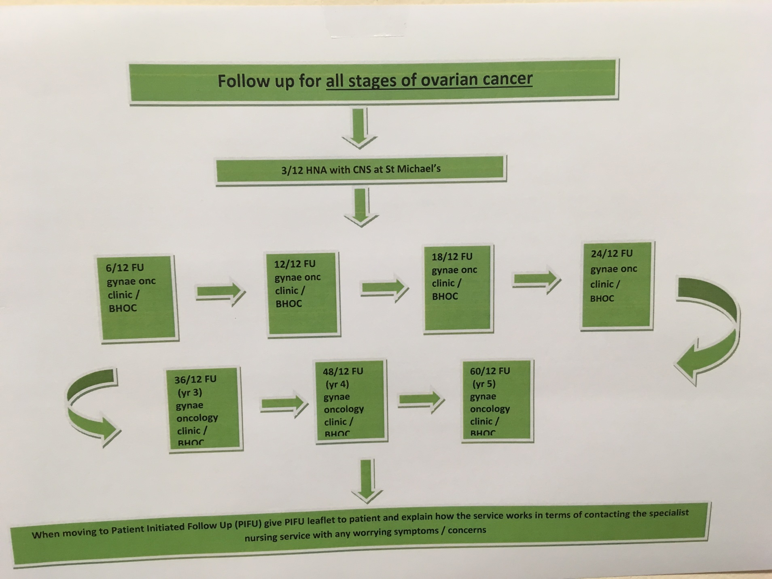

Slide 12
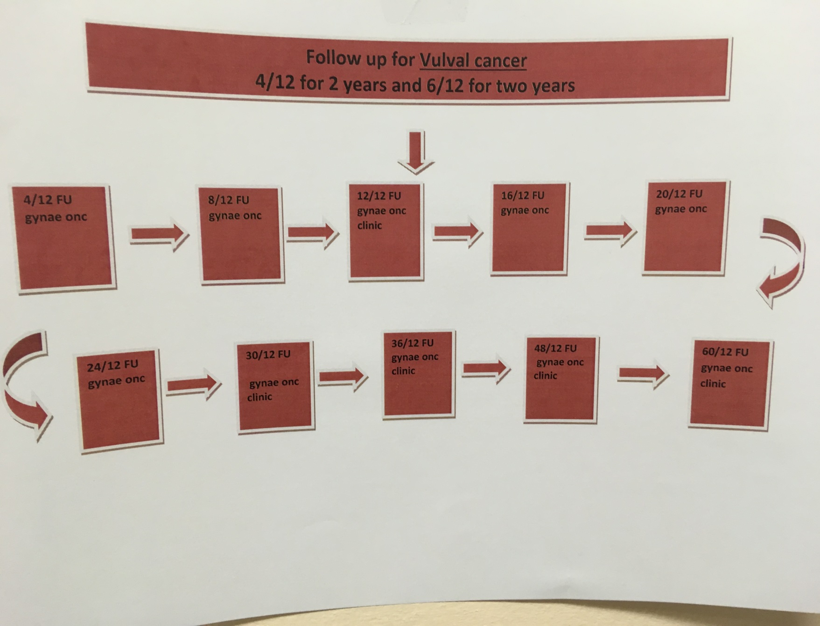

Slide 14
PIFU trigger card

Slide 15
PIFU trigger card

Slide 16
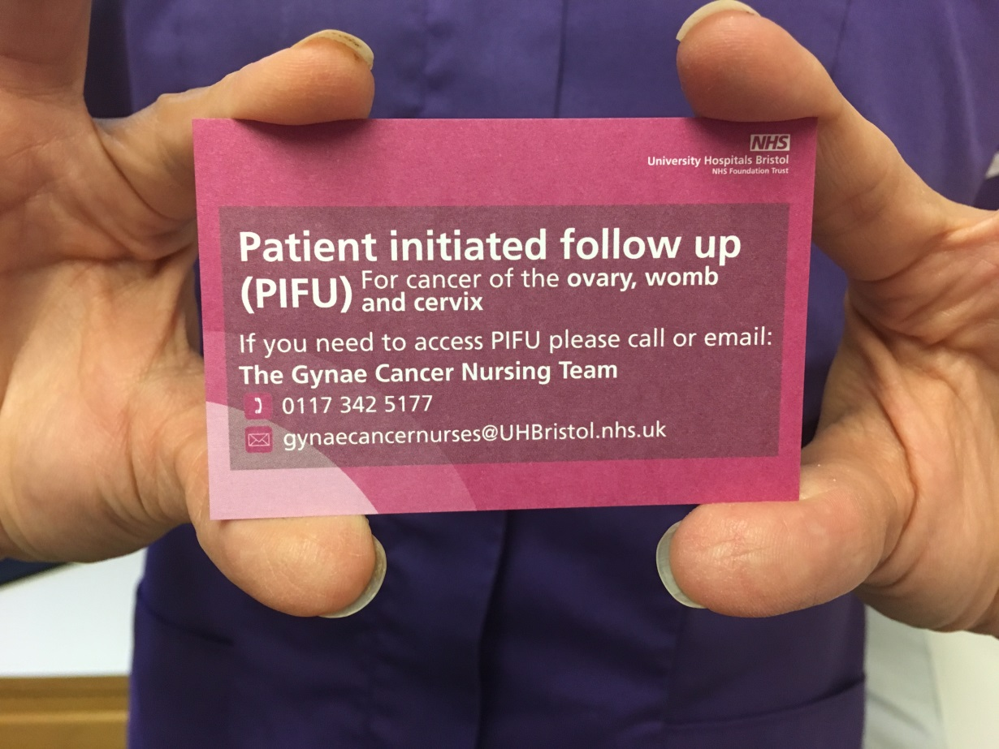
Gynae cancer trigger card

Slide 17
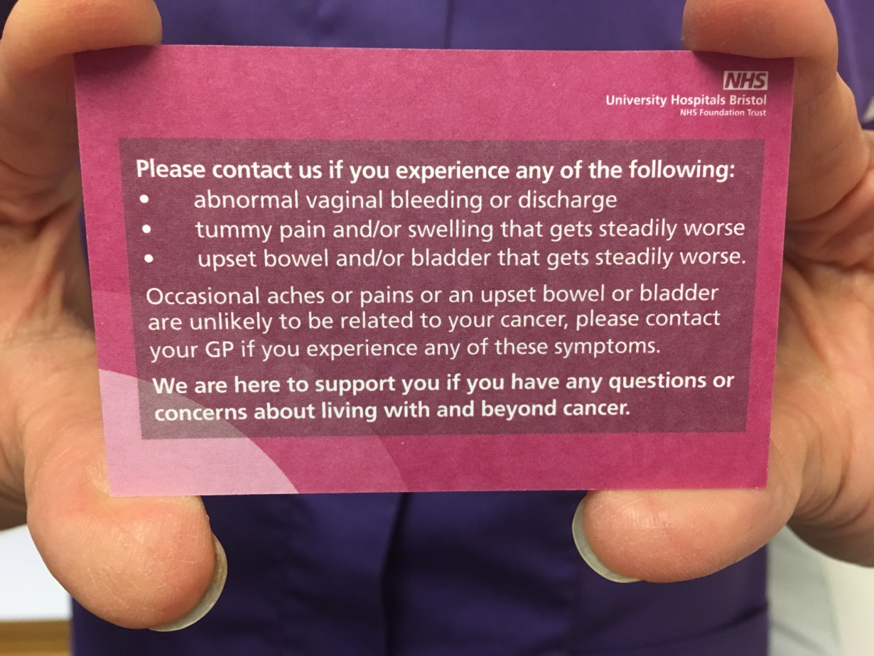
Gynae cancer trigger card

Slide 18
What is PIFU?

Slide 20
Future plans
Assess quality of life on PIFU.
Questionnaires (EORTC and others) completed in clinic, postal at 6/12 and 24/12
Multi-centered trial planned looking at the safety of 2 year PIFU for all gynae oncology services

